Slide 1
Pump Teardown Walkthrough
Slide 2 is a lone picture

Slide 2
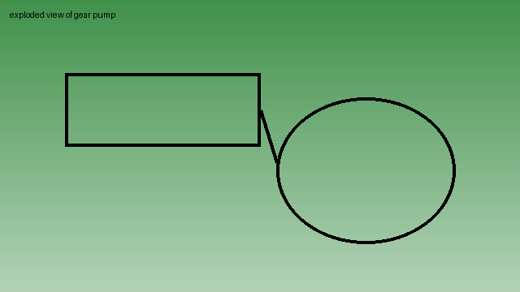

Slide 3
Inspection Points
Gear faces for scoring
Bushings for wear
Seals for hardening

Slide 4
Reassembly
Lubricate with system fluid
Torque in a cross pattern

Slide 5
Close
Leak test at working pressure

