Slide 1
Vinder
jan.schulz@devugees.org

Slide 2


Slide 3
+

Slide 4
+
Videos

Slide 5
Rule: If you like the video (and the profile
text) you swipe right.
Else, you swipe left.

Slide 6
Prototype
Vinder – Authenticate
Login
Create test profile:
NICKNAME
NICKNAME
Choose a movie File (MP4):
Login
CLICK HERE
Profile Text:
Profile Text
Sign Up

Slide 7
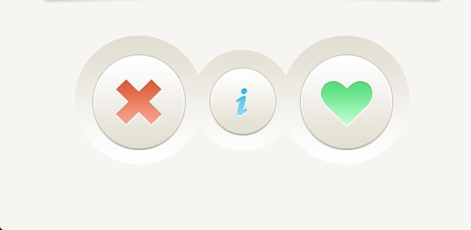
Prototype
Vinder - Discover
VIDEO

Slide 8

Prototype
Vinder - Discover
VIDEO

Slide 9
Prototype
WebApp HTML5
A signup form to enter a username and upload a video
A discover form to swipe left and right -> maybe with $().on(‘swipe‘) ? HTML5 video or
NodeJS Backend requests
/login POST
/signup POST
/match GET
/upload POST
Database
MySQL

