Slide 1

width
(0,0)
(width//2 – r_width//2,
height//2 – r_height//2)
r_width = width//3
r_height = height // 3
height

Slide 2
(x,y)
bounding box
height
width

Slide 3
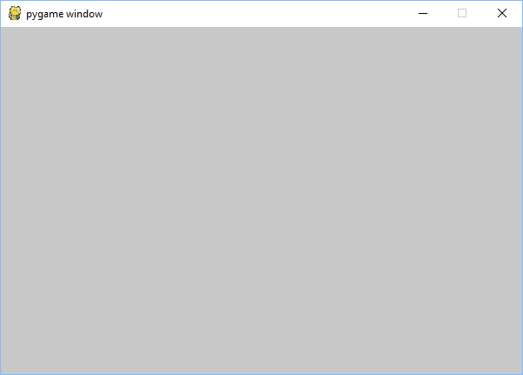
x
73
win

Slide 4
4
3
9
1.4142…
2
2
Domain
Range

Slide 5

None
“Hello World”
7
3.14159
Side effect
Domain
Range
Hello World
7
3.14159

Slide 6
f2c(f)

Slide 7
Pixel at (x,y)

Slide 8
x
move(x,y)
x
y
y

Slide 9







$$\left(\frac{w}{2},0\right)=(x_{0},y_{0})$$
Midpoint of a line between hiker and tower 0
$$\left(\frac{x+x_{0}}{2},\frac{y+y_{0}}{2}\right)$$
2
3
(x,y)
1
$$\left(0,h−1\right)=(x_{2},y_{2})$$
$$\left(w−1,h−1\right)=(x_{1},y_{1})$$

Slide 10


Slide 11
dy
(x,y)
dx

Slide 12
x
move(x,y,dx,dy)
x
y
y
dx
dx
dy
dy

Slide 13
dx
dy
-dx
dy

Slide 14
(ball2_x + ball_r, ball2_y + ball_r)
(ball1_x + ball_r, ball1_y + ball_r)
2*radius

Slide 15

(paddle_x, paddle_y)
paddle_y
(ball_x, ball_y)
ball_h
paddle_h
ball_w
(ball_dx, ball_dy)
paddle_y + paddle_h
paddle_w

Slide 16
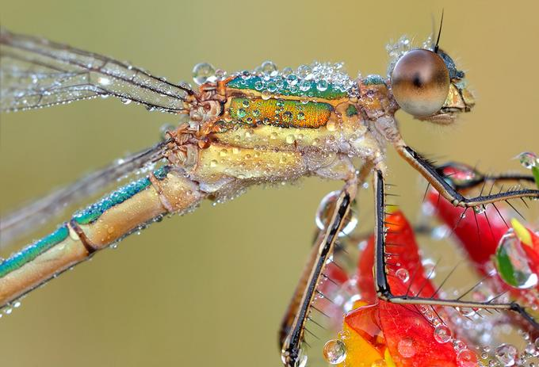
scaled_w
scaled_w
scale
scaled_h
scaled_h
scaled_image
original_image

Slide 17
original_image
scaled_image
(x,y)

Slide 18
44 39 46 | 40 16 16 | 46 2 3
62 37 41 | 111 56 49 | 109 33 19
82 32 21 | 119 46 31 | 106 21 1
 | 80 32 25
Red = (44+40+46+62+111+109+82+119+106)/9 = 80
Green = (39+16+2+37+56+33+32+46+31)/9 = 32
Blue = (46+16+3+41+49+19+21+31+1)/9 = 25
surface
neighbord_mean
x
(r,g,b)
y

Slide 19
mean_filter
surface
surface

Slide 20

Attack A Dawn

