Slide 1

width
(0,0)
(width//2 – r_width//2,
height//2 – r_height//2)
r_width = width//3
r_height = height // 3
height

Slide 2
(x,y)
bounding box
height
width

Slide 3
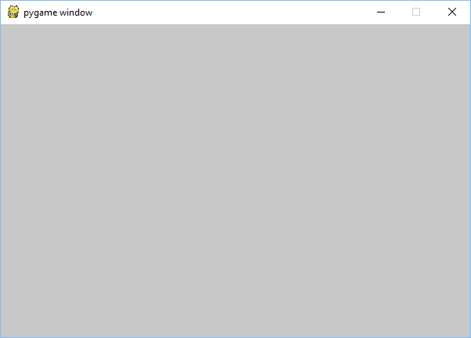
x
73
win

Slide 4
4
3
9
1.4142…
2
2
Domain
Range

Slide 5

None
“Hello World”
7
3.14159
Side effect
Domain
Range
Hello World
7
3.14159

Slide 6
f2c(f)

Slide 7
Pixel at (x,y)

Slide 8
x
move(x,y)
x
y
y

Slide 9







$$\left(\frac{w}{2},0\right)=(x_{0},y_{0})$$
Midpoint of a line between hiker and tower 0
$$\left(\frac{x+x_{0}}{2},\frac{y+y_{0}}{2}\right)$$
2
3
(x,y)
1
$$\left(0,h−1\right)=(x_{2},y_{2})$$
$$\left(w−1,h−1\right)=(x_{1},y_{1})$$

Slide 10


Slide 11

dy
(x,y)
dx

Slide 12
x
move(x,y,dx,dy)
x
y
y
dx
dx
dy
dy

Slide 13

dx
dy
-dx
dy

Slide 14
(ball2_x + ball_r, ball2_y + ball_r)
(ball1_x + ball_r, ball1_y + ball_r)
2*radius

Slide 15

(paddle_x, paddle_y)
paddle_y
(ball_x, ball_y)
ball_h
paddle_h
ball_w
(ball_dx, ball_dy)
paddle_y + paddle_h
paddle_w

Slide 16
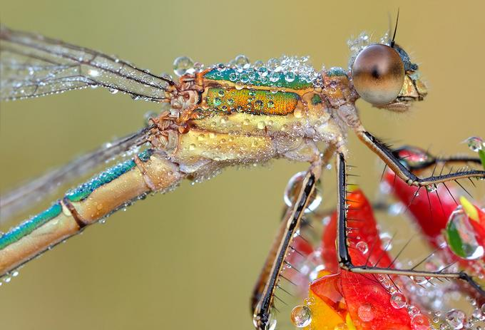
scaled_w
scaled_w
scale
scaled_h
scaled_h
scaled_image
original_image

Slide 17
original_image
scaled_image
(x,y)

Slide 18
44 39 46 | 40 16 16 | 46 2 3
62 37 41 | 111 56 49 | 109 33 19
82 32 21 | 119 46 31 | 106 21 1
 | 80 32 25
Red = (44+40+46+62+111+109+82+119+106)/9 = 80
Green = (39+16+2+37+56+33+32+46+31)/9 = 32
Blue = (46+16+3+41+49+19+21+31+1)/9 = 25
surface
neighbord_mean
x
(r,g,b)
y

Slide 19
mean_filter
surface
surface

Slide 20
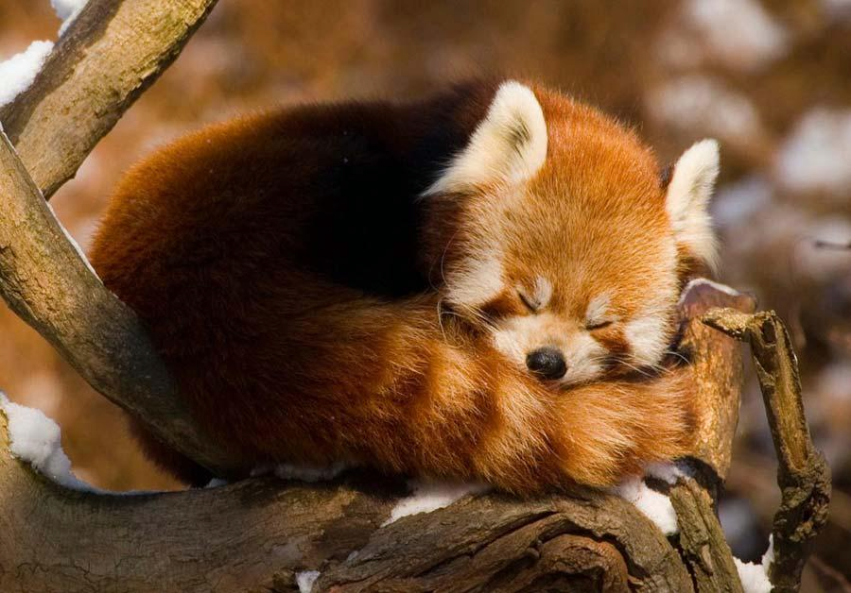
Image where all red values are even
Black-and-white image with secret message
Attack A Dawn
Attack A Dawn
Wherever there is a black pixel in the message then make the red component in the corresponding pixel in the image odd. Of course the objective is not to see the message in the new image

Slide 21
 | X
X
 |  | X

Slide 22




CPU
Main memory
(RAM)
USB
Graphics Card
Hard drive

Slide 23
#include <stdio.h>
int main() {
printf(“Hello World\n”);
}
C program
C Compiler
001000111110001010101000000001010111010000001110110010
Machine code

Slide 24
Python program
print("Hello World")
Python Interpreter

Slide 25
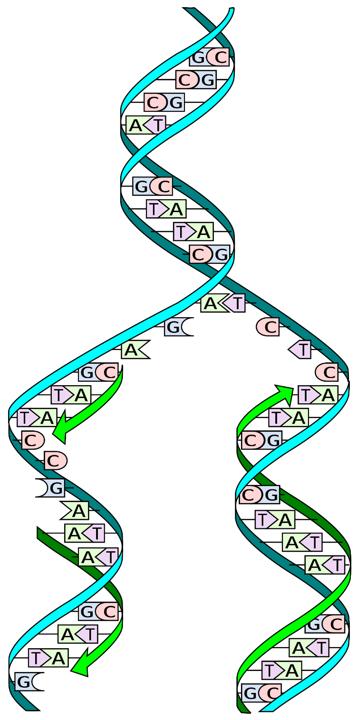

Slide 26
agcttttcattctgactgcaacgggcaatatgtctctgtgtggattaaaaaaagagtgtctgatagcagcttctgaactggttacctgccgtgagtaaat
start
start+3
end

Slide 27

Encrypt
“skfntuqwgrfbgx”
Decrypt
“attack at dawn”
“attack at dawn”
Key
Alice
Key
Bob
Eve

Slide 28
cleartext
encrypt
ciphertext
shift

Slide 29
 | a | p | p | l | e
 | l | z | k | s | j
+ | l | o | z | d | n
 | 0 | 15 | 15 | 11 | 4
 | 11 | 25 | 10 | 18 | 9
+ | 11 | 14 | 25 | 3 | 13
 | l | o | z | d | n
 | l | z | k | s | j
- | a | p | p | l | e
 | 11 | 14 | 25 | 3 | 13
 | 11 | 25 | 10 | 18 | 9
- | 0 | 15 | 15 | 11 | 4

Slide 30
-4
-3
-2
-1
0
1
2
3
4

Slide 31
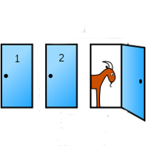

Slide 32
