Slide 1
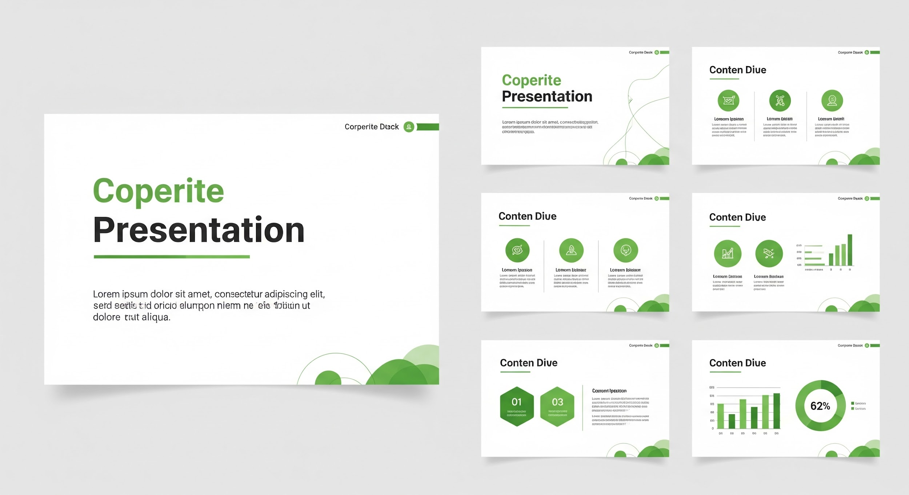


Selecting Your Professional Template
Optimizing for Ecopetrol & Polyrific Brand Guidelines
Corporate Standard
Based on the 2022-2023 Ecopetrol EA Template. Best for formal executive meetings and internal corporate reporting.
Innovation & Tech
Utilizing the Polyrific Basic Template. Ideal for AI pioneers, project backgrounders, and technical stack reviews.
Visual Impact
Focused on Assertion-Evidence principles. Recommended for high-stakes pitches where "less is more".

