Slide 1

SQL Analysis of Skin Lesion Data
for Early Detection Support
Key Findings and Recommendations
for DermAI Diagnostics
Presenter: Edidiong Ekanem
DermAI Diagnostics
Notes:
Good morning/afternoon, everyone. Thank you for joining today. On behalf of DermAI Diagnostics, I’ll be presenting an analysis of skin lesion data focused on identifying diagnosis patterns, highlighting features linked to more clinically concerning lesions, and showing how structured SQL analysis can support future early detection and predictive modeling efforts. [Sources] - Generated background image created with OpenAI image generation for this presentation.

Slide 2
Business Context and Problem
Business Context
Problem
DermAI Diagnostics uses data and AI to support skin lesion assessment.
The goal is to generate insights that strengthen early detection and decision support.
Early identification of clinically concerning lesions remains challenging.
Diagnosis may be influenced by patient history, exposures, and lesion presentation.
Structured analysis is needed to support better decision-making.
Stakeholder focus:
What patterns should inform screening, analytics, and future AI workflows?
Notes:
At DermAI Diagnostics, our broader goal is to strengthen skin lesion assessment through data-driven and AI-enabled approaches. One of the key challenges in this space is that early identification of clinically concerning lesions is not always straightforward. Diagnosis can be influenced by a combination of patient background, environmental exposures, medical history, and the physical characteristics of the lesion itself. Because of that, structured analysis is essential if we want to better understand these patterns and support more informed clinical and operational decision-making. [Sources] - Project overview PDF provided by the user (SQL Capstone.pdf). - Generated background image created with OpenAI image generation for this presentation.

Slide 3
Project Objectives
1
2
3
4
Combine patient and lesion data into one analytic view
Identify demographic and environmental risk patterns
Analyze lesion characteristics linked to more concerning diagnoses
Prepare an ML-ready dataset for future predictive work
Notes:
This analysis was designed around four main objectives. First, to combine patient-level and lesion-level data into one integrated analytic view. Second, to identify demographic and environmental patterns associated with diagnosis. Third, to examine lesion characteristics that may help distinguish more clinically concerning cases. And fourth, to prepare a structured, machine-learning-ready dataset that can support future predictive work at DermAI Diagnostics. [Sources] - Project overview PDF provided by the user (SQL Capstone.pdf). - Generated background image created with OpenAI image generation for this presentation.

Slide 4
Data and Method Overview
Patient Table
Lesion Table
SQL Workflow
Age
Gender
Smoking status
Pesticide exposure
Medical history
Body region
Lesion size
Symptoms
Biopsy status
Diagnosis
Validate structure
Check duplicates and missing values
Analyze diagnosis patterns
Create an ML-ready dataset
Joined on
patient_id
From database validation to analytics-ready output
Notes:
For this analysis, we worked with two linked datasets. One contained patient-level information, such as age, gender, smoking status, pesticide exposure, and relevant medical history. The second contained lesion-level information, including lesion location, lesion size, symptoms, biopsy status, and diagnosis. These datasets were joined using patient_id. From there, we used SQL to validate the data structure, check for duplicates and missing values, analyze diagnosis patterns, and create a final integrated dataset that can be used for future machine learning and decision-support applications. [Sources] - Project overview PDF provided by the user (SQL Capstone.pdf). - Generated background image created with OpenAI image generation for this presentation.

Slide 5
Baseline Diagnosis Distribution
Overall Diagnosis Distribution
ACK: 461
BCC: 273
NEV: 144
SEK: 137
SCC: 56
MEL: 17
Key takeaway
ACK was the most common diagnosis.
BCC was the second most common.
MEL was the least frequent, indicating a much smaller but clinically important subset.
Notes:
We began by reviewing the overall diagnosis distribution to establish a baseline understanding of the dataset. ACK was the most common diagnosis, followed by BCC. NEV and SEK appeared in the middle range, while SCC and especially MEL were much less frequent. This baseline is important because it provides context for the rest of the findings and helps us interpret how these diagnoses appear across different patient and lesion characteristics. [Sources] - User-provided SQL query outputs from the restored DermAI Diagnostics dataset. - Generated background image created with OpenAI image generation for this presentation.

Slide 6
Demographic and Environmental Findings
Age effect
Gender pattern
Exposure & history
Older age groups had the highest counts for ACK, BCC, SEK, and SCC.
50–69 showed the highest ACK (240) and BCC (141) counts.
Male patients had higher counts across most diagnoses.
Examples: ACK 326 vs 135, SEK 109 vs 28.
BCC stood out among pesticide-exposed patients and among patients with prior skin cancer history.
BCC counts: 127 (exposed) and 128 (history).
Key takeaway: age, gender, pesticide exposure, and prior skin cancer history were relevant to diagnosis patterns.
Notes:
When we looked at demographic and environmental factors, several patterns stood out. Older age groups, especially those aged 50 to 69 and 70 plus, showed higher counts for ACK, BCC, SEK, and SCC. Male patients also had higher counts across most diagnosis categories. In addition, BCC appeared especially prominent among patients with pesticide exposure and among those with a prior history of skin cancer. Overall, these findings suggest that age, gender, environmental exposure, and clinical history may all provide valuable context for risk review and lesion assessment. [Sources] - User-provided SQL query outputs from the restored DermAI Diagnostics dataset. - Generated background image created with OpenAI image generation for this presentation.

Slide 7
Lesion Characteristics Findings
MEL, SCC, and BCC had the largest average lesion sizes in the dataset.
Growth signal
Growth was especially common among MEL, BCC, and SCC.
Change signal
Visible change stood out most clearly for MEL.
Bleeding signal
Bleeding was especially notable for BCC.
Notes:
The lesion-level analysis revealed some of the strongest clinical signals in the dataset. MEL had the largest average lesion size, followed by SCC and BCC. Growth was especially common among MEL, BCC, and SCC. Visible change stood out most clearly for MEL, while bleeding was especially notable for BCC. Taken together, these findings suggest that lesion size and symptom progression may be especially useful in identifying lesions that warrant closer clinical attention. [Sources] - User-provided SQL query outputs from the restored DermAI Diagnostics dataset. - Generated background image created with OpenAI image generation for this presentation.

Slide 8
Biopsy and Clinical Signal
Key takeaway
BCC, SCC, and MEL appeared only in biopsied lesions.
ACK, NEV, and SEK were mostly not biopsied.
Biopsy status was the clearest indicator of diagnoses requiring closer clinical confirmation.
Notes:
One of the clearest findings came from biopsy status. BCC, SCC, and MEL appeared only among biopsied lesions, while ACK, NEV, and SEK were mostly found among lesions that were not biopsied. This suggests that biopsy was more strongly associated with diagnoses requiring closer clinical confirmation. From a decision-support perspective, biopsy status emerged as one of the strongest indicators of more clinically concerning diagnosis patterns in the dataset. [Sources] - User-provided SQL query outputs from the restored DermAI Diagnostics dataset. - Generated background image created with OpenAI image generation for this presentation.

Slide 9
ML-Ready Dataset and Business Value
Patient
Features
Integrated
SQL Dataset
Decision
Support Value
Age
Gender
Exposure history
Medical history
Classification
Risk prediction
Early detection workflows
Structured for downstream modeling
A strong foundation for AI-enabled early detection support
Notes:
A key output from this work was the creation of a final integrated dataset that combines the most relevant patient and lesion variables into one structured SQL output. This includes demographic information, environmental exposures, medical history, lesion measurements, lesion symptoms, biopsy status, and diagnosis. From a business and analytics perspective, this is valuable because it creates a strong foundation for future predictive modeling, risk scoring, and AI-enabled decision-support workflows at DermAI Diagnostics. [Sources] - User-provided SQL query definitions and selected feature set for the final integrated dataset. - Generated background image created with OpenAI image generation for this presentation.

Slide 10
Recommendations and Next Steps
Recommendations
Next Steps
Prioritize age, pesticide exposure, and skin cancer history in risk reviews.
Flag lesions with larger size, growth, change, or bleeding for closer evaluation.
Retain body region and biopsy-related variables in future analytic workflows.
Use the final structured dataset for predictive modeling and validation.
Validate findings using proportions and rates, not just raw counts.
Explore classification models for diagnosis prediction.
Use the integrated dataset to support future decision-support workflows.
DermAI Diagnostics can use these findings as a practical bridge from SQL analysis to AI-supported early detection workflows.
Notes:
Based on these findings, we recommend that DermAI Diagnostics continue to prioritize age, pesticide exposure, and prior skin cancer history as important contextual risk factors in future analytic and clinical review workflows. We also recommend closer evaluation of lesions that show larger size, growth, visible change, or bleeding, since these features were more strongly linked with clinically concerning patterns in the data. Body region and biopsy-related variables should also be retained in future analytic workflows because they add important clinical context. As a next step, these findings should be validated using proportions and rates, in addition to raw counts, and the final structured dataset should be used to support future predictive modeling for diagnosis classification. Overall, this analysis shows that combining patient background factors with lesion-level characteristics can generate useful clinical and operational insights and provides a practical foundation for future AI-supported early detection work at DermAI Diagnostics. [Sources] - User-provided SQL query outputs from the restored DermAI Diagnostics dataset. - Generated background image created with OpenAI image generation for this presentation.

Slide 11
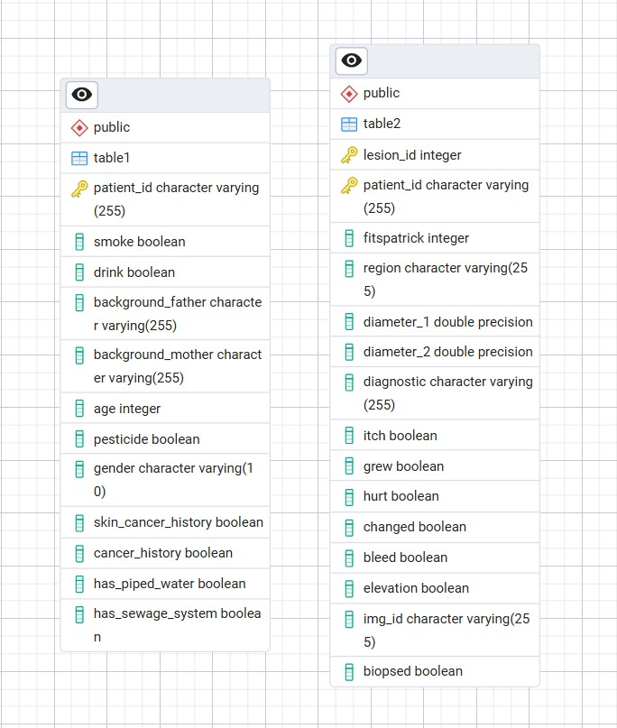
Appendix A1: ERD / Data Structure
table1 stores patient-level variables; table2 stores lesion-level variables; both are linked by patient_id.
Notes:
The appendix provides technical backup material. This ERD view summarizes the relationship between the patient table and the lesion table and confirms that they are linked through patient_id. [Sources] - User-provided ERD screenshot. - Generated background image created with OpenAI image generation for this presentation.

Slide 12
Appendix A2: Sample SQL Join Query
Used to create the combined analytic view for downstream analysis
1 select * 2 from table1 t1 3 join table2 t2 4 on t1.patient_id = t2.patient_id;
Notes:
This sample SQL statement shows the core join used to create the combined analytic view that supports downstream analysis throughout the presentation. [Sources] - User-provided SQL join query content. - Generated background image created with OpenAI image generation for this presentation.

Slide 13
Appendix A3: Data Validation Checks
Checks performed
Validation outcome
Record counts in both tables
Joined record count
Duplicate check for patient_id
Duplicate check for lesion_id
Composite uniqueness check for lesion_id + patient_id
Missing value checks in key analytical fields
Repeated lesion_id values were investigated and found not to be true duplicate records because the lesion_id–patient_id combination remained unique.
Conclusion: the dataset was structurally suitable for downstream analysis.
Notes:
These checks were used to validate data quality and structural integrity before deeper analysis. A key investigation confirmed that repeated lesion_id values were not true duplicate records because the lesion_id and patient_id combination remained unique. [Sources] - User-provided SQL validation outputs and query logic. - Generated background image created with OpenAI image generation for this presentation.

Slide 14
Appendix A4: Selected Output Highlights
Diagnosis counts
Average lesion size
Biopsy pattern
ACK: 461
BCC: 273
NEV: 144
SEK: 137
SCC: 56
MEL: 17
Highest average size ranking:
1. MEL
2. SCC
3. BCC
Biopsied only:
BCC, SCC, MEL
Mostly not biopsied:
ACK, NEV, SEK
Notes:
This appendix slide consolidates selected outputs that were especially important to the findings: overall diagnosis distribution, lesion-size ranking, and biopsy-pattern summary. [Sources] - User-provided SQL query outputs from the restored DermAI Diagnostics dataset. - Generated background image created with OpenAI image generation for this presentation.

Slide 15
Appendix A5: ML-Ready Dataset Structure
Patient features
Lesion features
age
gender
smoking_status
alcohol_use
pesticide_exposure
skin_cancer_history
cancer_history
has_piped_water
has_sewage_system
lesion_id
fitspatrick
region
diameter_1
diameter_2
itch
growth_present
pain_present
change_present
bleeding_present
elevation
biopsy_status
diagnostic
Notes:
This appendix slide summarizes the feature groups included in the final integrated dataset used to support future predictive modeling and analytics workflows. [Sources] - User-defined field selection for the final integrated SQL dataset. - Generated background image created with OpenAI image generation for this presentation.

