Slide 1
Analyzing Booking Trends
in the Hospitality Industry
A predictive model to determine hotel booking cancellation status
Edidiong Ekanem
Python Machine Learning
Hotel Haven
Notes:
This project focuses on Hotel Haven, a luxury hotel chain facing challenges with booking cancellations. The goal was to use historical booking data to understand cancellation patterns and build a machine learning model that can predict whether a booking is likely to be canceled or not canceled.

Slide 2
Business Introduction
Context
Hotel Haven
Business need
Luxury hotel chain with multiple locations
Better understand booking patterns
Predict customer cancellations earlier
Create strategies to improve retention
Support more effective resource planning
Room types
Meal plans
Parking options
Booking channels
The analysis connects customer booking behavior to operational decisions.
Notes:
Hotel Haven is framed as a luxury hotel chain with multiple locations and several booking options, including different room types, meal plans, and parking options. The business wants to better understand booking patterns and use that knowledge to reduce cancellations and improve customer retention.

Slide 3
Problem Statement
Why this matters
Core challenge
Business goal
High cancellation rates
Lost revenue from canceled bookings
Inefficient room and staffing plans
Limited insight into why customers cancel
Predict cancellations
Improve planning
Support retention
Can booking data help predict cancellation risk?
Notes:
The problem is that cancellations affect revenue, room availability, staffing, and resource planning. The existing data can be used to predict which bookings are more likely to be canceled, so the hotel can act earlier and make better operational decisions.

Slide 4
Project Rationale and Objective
Project focus
1
2
3
4
Understand cancellations
Identify key factors
Build prediction model
Support business action
Use booking patterns to uncover cancellation-related behavior.
Examine lead time, room type, market segment, price, and requests.
Train a supervised ML model to predict cancellation status.
Translate findings into retention and planning recommendations.
Notes:
The rationale for the project is to understand cancellations, identify key factors behind them, and turn those insights into a predictive model. The objective is not only to build a model, but to create insights that can help improve retention, resource allocation, and customer satisfaction.

Slide 5
Dataset Overview
Data
36,248
25
booking status
is_canceled
Cleaned booking records
Columns after feature engineering
Target variable
Model target
Key variables
Target encoding
lead time
average price
market segment type
room type
special requests
date of reservation
0 = Not canceled
1 = Canceled
The original target was converted into a numeric classification target for modeling.
Notes:
The dataset contains historical hotel booking records. After cleaning, there were 36,248 records available for analysis. The original target variable was booking status, which was converted to is_canceled for modeling, where 1 represents canceled bookings and 0 represents not canceled bookings.

Slide 6
Data Cleaning and Feature Engineering
Data preparation
Data quality checks
New features created
No missing values
No duplicate records
No duplicate Booking_ID values
Removed 37 invalid dates recorded as 2018-2-29
total_nights
total_guests
has_children
reservation_month
reservation_day_of_week
reservation_quarter
lead_time_group
Cleaned dataset ready for EDA and modeling
Notes:
The dataset was generally clean, with no missing values or duplicate records. The main issue was 37 invalid reservation dates recorded as February 29, 2018, which is not a valid date. These rows were removed. Additional features were created to support the analysis and modeling.

Slide 7
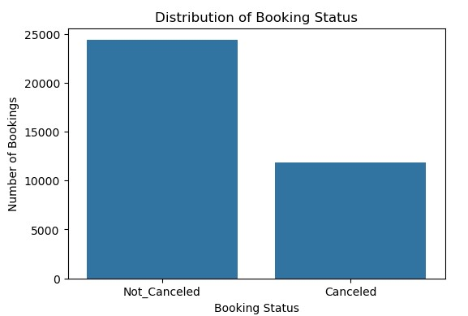
Booking Status Distribution
Target variable
Most bookings were not canceled
67.2%
Not canceled
32.8%
Canceled
Some imbalance, but not severe.
Notes:
The target variable showed that about two-thirds of bookings were not canceled, while about one-third were canceled. Because the dataset is somewhat imbalanced, accuracy alone is not enough. Precision, recall, F1-score, confusion matrix, and ROC-AUC are also important, especially for the canceled class.

Slide 8
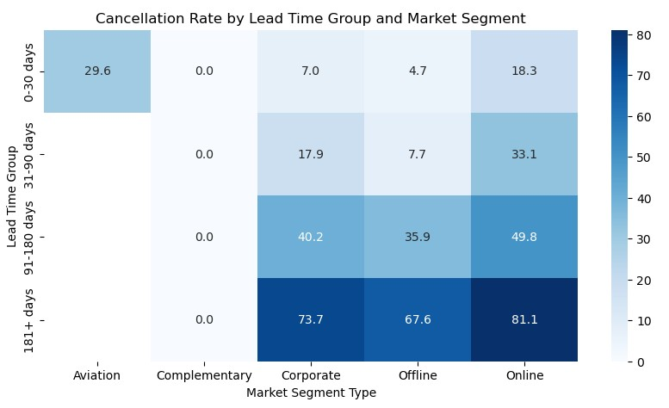
Lead Time Was a Major Driver of Cancellations
Key finding 1
Key pattern
Short lead-time bookings had lower cancellation rates
Long lead-time bookings had much higher cancellation rates
Bookings made 181+ days in advance had especially high cancellation risk
Risk increases as lead time increases
Notes:
One of the clearest patterns in the analysis was lead time. Customers who booked further in advance were much more likely to cancel. This pattern showed up in the EDA, the correlation analysis, and the final model feature importance. Lead time is therefore one of the strongest signals Hotel Haven can use to flag bookings that may need closer monitoring.

Slide 9
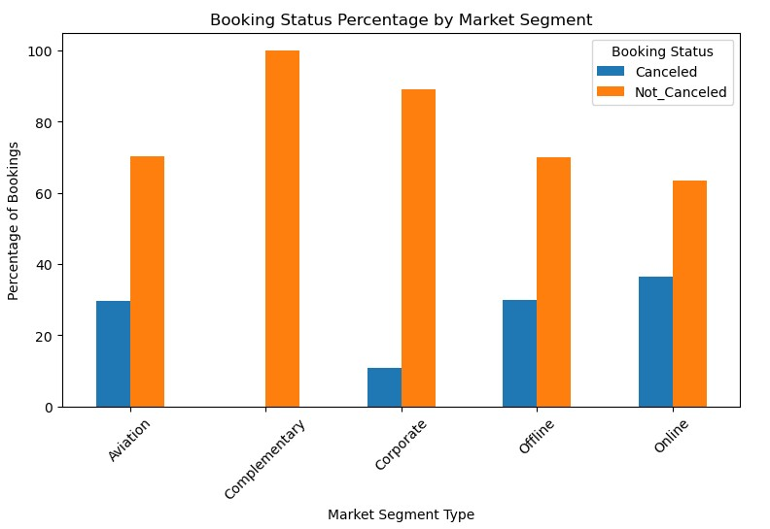
Online Bookings Had Higher Cancellation Risk
Key finding 2
Market segment mattered
Online bookings had the highest cancellation rate
Corporate bookings had much lower cancellation rates
Market segment remained important in the model results
This suggests online customers may need targeted follow-up and retention strategies.
Notes:
Market segment was another important factor. Online bookings had the highest cancellation rate, while corporate bookings were much more likely to be kept. This suggests that online customers may need more follow-up or retention strategies such as reminder emails, confirmation messages, or targeted incentives closer to the booking date.

Slide 10
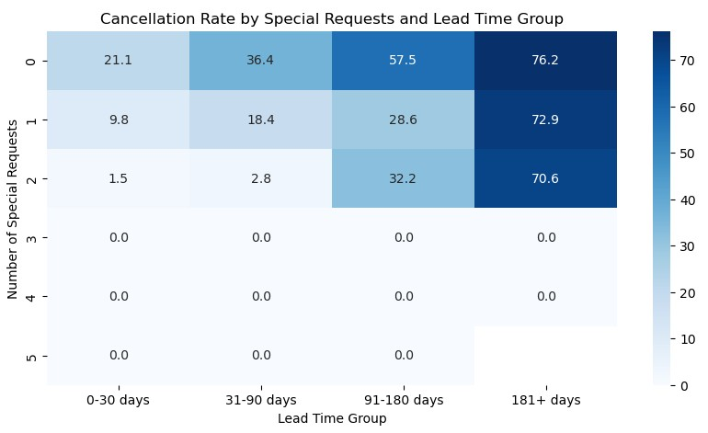
Special Requests Were Linked to Lower Cancellation Risk
Key finding 3
Customer engagement signal
Most bookings had no special requests
Not canceled bookings had more requests on average
Requests may signal stronger commitment to the stay
More requests = stronger booking commitment
Notes:
Special requests also stood out in the analysis. Customers who made special requests were generally less likely to cancel. One possible explanation is that these customers are more engaged with their booking because they have already thought about specific needs for their stay.

Slide 11
Model Development Approach
Modeling
Supervised classification problem
Logistic Regression
Decision Tree
Random Forest
Gradient Boosting
Evaluation metrics: Accuracy, Precision, Recall, F1-score, Confusion Matrix, ROC-AUC
Because the business goal is to catch likely cancellations, recall and F1-score for the canceled class were especially important.
Notes:
Since the goal was to predict whether a booking would be canceled or not canceled, this was treated as a supervised classification problem. Four models were tested. Because the business goal is to catch likely cancellations, recall and F1-score for the canceled class were especially important, not just overall accuracy.

Slide 12
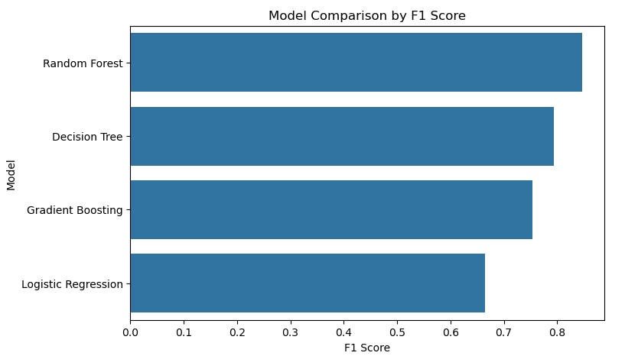
Random Forest Performed Best Overall
Model comparison
Model comparison
Random Forest achieved the strongest overall balance across accuracy, recall, and F1-score.
90.2%
84.7%
Accuracy
F1-score for canceled bookings
F1-score balances precision and recall for cancellation prediction.
Notes:
After comparing the models, Random Forest performed best overall. It had the highest accuracy and F1-score, and it also performed strongly on recall for canceled bookings. Decision Tree also performed well, but Random Forest gave a better balance between correctly identifying cancellations and avoiding too many false cancellation predictions.

Slide 13
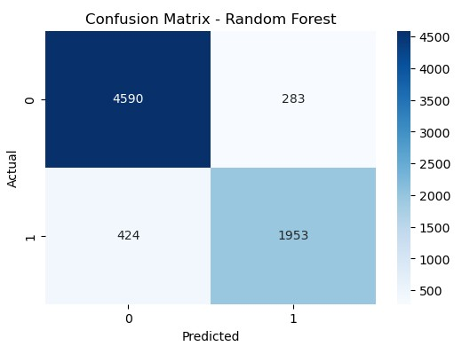
Final Model: Random Forest
Final model
Final performance
90.2%
87.3%
Accuracy
Precision for canceled bookings
82.2%
84.7%
Recall for canceled bookings
F1-score for canceled bookings
0.954
ROC-AUC
Notes:
The final selected model was Random Forest. It correctly predicted about 90 percent of bookings in the test set. For canceled bookings specifically, it had recall of about 82 percent, meaning it identified most actual cancellations. The ROC-AUC score of 0.954 also shows the model was very strong at separating canceled bookings from not canceled bookings.

Slide 14
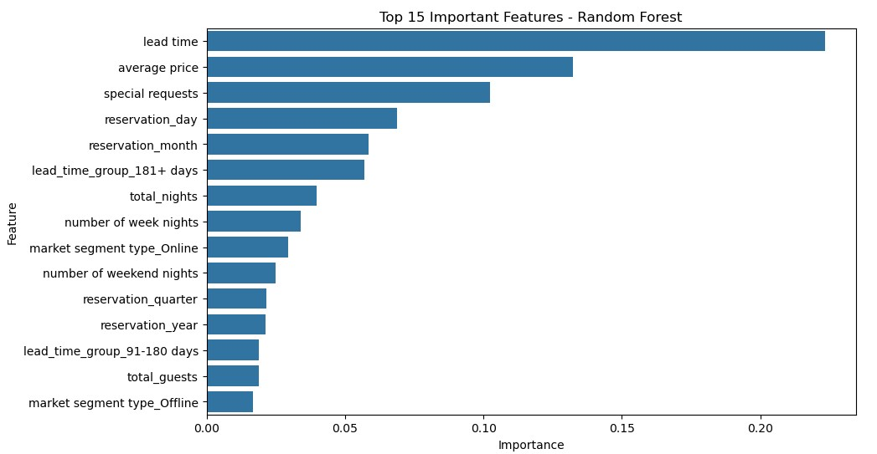
Top Predictors of Booking Cancellation
Feature importance
Most important predictors
Lead time
Average price
Special requests
Reservation timing
Online market segment
Notes:
The feature importance results helped explain what the Random Forest model relied on most. Lead time was the strongest predictor, which matches the EDA findings. Average price and special requests were also important, along with reservation timing and online market segment. This consistency gives more confidence in the final model.

Slide 15
Business Recommendations
Action
1
Monitor long lead-time bookings
Flag bookings made far in advance, especially 181+ days.
2
Prioritize online booking retention
Use reminder emails, confirmation messages, or targeted incentives.
3
Use special requests as an engagement signal
Customers with requests may be more committed to their booking.
4
Review pricing and cancellation patterns
Explore whether higher-priced bookings need different retention strategies.
5
Use the model as an early warning tool
Support proactive follow-up, room planning, and resource allocation.
Notes:
The recommendations focus on turning the analysis into action. Hotel Haven can monitor long lead-time bookings more closely, especially those made more than 180 days in advance. Since online bookings had higher cancellation rates, they may need targeted follow-up. Special requests can also be used as a sign of stronger booking commitment. Finally, the model can support early warning systems so the hotel can plan more proactively.

Slide 16
Business Impact, Limitations, and Next Steps
Closing
Business impact
Limitations
Next steps
Identify high-risk bookings earlier
Improve room and staffing plans
Support targeted customer retention
Historical data may not reflect future behavior
Cancellation reasons were not included
Test on newer booking data
Monitor performance over time
Use predictions with staff judgment
Final takeaway: booking data can support earlier cancellation risk detection and better business planning.
Notes:
The main value of this project is not only that the model predicts cancellations, but that the predictions can support better business decisions. If Hotel Haven can identify high-risk bookings earlier, the team can follow up with customers, plan rooms and staffing more effectively, and improve customer retention strategies. The model should be tested on newer data and, if available, strengthened with customer cancellation reason data.

