Slide 1
Citation grounded Retrieval system for interpreting academic University regulations.
Slide Deck
Eldar Dikhanbayev
https://git.cs.bham.ac.uk/projects-2025-26/exd462

Slide 2
System overview
Project Title: Citation grounded Retrieval system for interpreting academic University regulations.
Core Architecture: Started as a monolithic Model View Controller prototype, and then decoupled into a Service Oriented Architecture featuring a 3-Tier Hybrid Retrieval Augmented Generation engine.
Technology Stack: Built with Python, Flask 3.0, SQLAlchemy, PyMuPDF, ChromaDB, BM25Okapi, and Groq Cloud APIs (llama-3.3-70b-versatile for generation and llama-3.1-8b-instant for evaluation judging)
Primary Objective: Address AI failure modes in university administration by eliminating domain hallucinations, enforcing multi tenant security boundaries, and providing page level citations

Slide 3
Background and Motivation
Dense regulatory frameworks: Higher education institutions operate under thousands of pages of regulations, codes of practice, assessment policies, and extenuating circumstances procedures.
Structural complexity of policy text: Regulatory documents rely on hierarchical clause dependencies, exact alphanumeric codes (e.g., MSc Projects 18159,), and conditional logic exceptions
Operational and administrative challenges: Manual search is error-prone for students seeking time sensitive answers, while manual responses place a heavy burden on academic staff and risk academic appeals or legal liability.
Limitations of traditional tools: Traditional keyword search engines fail to understand natural language intent, while ungrounded LLMs suffer from hallucinations, lack verifiable citations, and cannot enforce document clearance boundaries.

Slide 4
Research problem and hypotheses
Domain Failure Modes of Standard LLMs:
  Hallucination: Probabilistic generation of fabricated institutional policies.
  Lack of auditability: Generates responses without verifiable page level source citations.
  Coarse access Control: Inability to enforce security clearance boundaries (e.g., student vs. internal faculty guidelines)
Hypotheses:
  Hypothesis 1 (Hybrid vs. Dense-Only): using dense vector search with sparse BM25 indexing via Reciprocal Rank Fusion yields higher precision, for exact terms, acronyms, and contact information than dense vector search alone.
  Hypothesis 2 (Hybrid vs. Sparse-Only): Fusing sparse BM25 search with dense vector embeddings via candidate rank fusion and stop-word suppression prevents context pollution and closes retrieval gaps caused by semantic paraphrasing to achieve higher Hit Rates than sparse search alone.

Slide 5
System architecture and Relational design
Transition to Service-Oriented Architecture :
  Routing Layer: Flask Blueprints (auth_routes, admin_routes, chat_routes) decouple web request management.
  Business Logic Layer: document_service.py encapsulates file validation, disk I/O, and asynchronous background worker execution.
  Core Engine Layer: models.py (RagEngine) manages vector storage, in-memory BM25 indexing, semantic query caching, and LLM API calls
Normalized relational Data schema:
    SQLite/SQLAlchemy relational schema tracking User, Conversation, ChatMessage, Document, and Citation entities.
Role-Based access control :
  Enforces strict document clearance boundaries (public, internal, restricted) by injecting metadata filter rules directly into vector search queries.

Slide 6
The 3-Tier Hybrid retrieval engine
Layer 1: Semantic query cache: Checks vectorized incoming queries against saved caches and returns cached answers and citations immediately while bypassing refusal outputs.
Layer 2: In Memory BM25 and dynamic promotion: Loads all document chunks into a RAM-buffered BM25Okapi index for instant lexical scoring. Tracks access counts and automatically promotes documents cited more than 5 times into vector hot storage.
Layer 3: Two tier vector storage routing: Directs vector operations across full document collection and promoted fast-access collection.
Conversational intent reservation: Pre-retrieval LLM condensation passconverts multi-turn follow-up prompts into standalone search queries before execution..

Slide 7
Empirical results: Retrieval ablation experiment
Experimental Setup: 35 QA pairs benchmarked at depth k = 4 (up to 4 resource files), requiring dual matching of both filename and exact target page number for a hit
Ablation performance metric comparison (N = 35, k = 4):
  Dense-Only: Hit Rate = 94.3% (33/35), MRR = 0.8524.
  Sparse-Only: Hit Rate = 97.1% (34/35), MRR = 0.8976.
  Hybrid: Hit Rate = 100.0% (35/35), MRR = 0.9214.
Key failure mode findings:
  Dense retrieval limitations: Failed on exact proper nouns and acronyms (e.g., "AFNOM" hacking club) due to embedding space distance drift.
  Sparse Retrieval Limitations: Failed on conceptual paraphrasing (e.g., Generative AI / ChatGPT policy query) due to vocabulary mismatch.
  Hybrid RRF Synergies: Recovered all single-mode failure cases and elevated split-rank candidates to Rank 1.

Slide 8
Quantitative RAGAS Benchmark and system performance
End-to-End RAGAS Evaluation Results (N = 16$Queries, 64 Judge Passes via llama-3.1-8b-instant):
  Context Recall: 97.9% - Confirms necessary context is consistently extracted.
  Context Precision: 94.3% - Validates effective noise chunk suppression.
  Faithfulness: 88.6% - Confirms response generation remains strictly grounded in retrieved text.
  Answer Relevancy: 87.5% - Confirms outputs directly address user prompts.
Runtime execution and Hot tier promotion logs:
  Successfully initialized and indexed 171 corpus chunks into RAM BM25 memory.
  Verified automated dynamic promotion: Chunks from Handbook files were promoted to Hot collection after reaching 5 access hits.
  Cache hit: When similar or same query is asked, the system hits Cache and provides answer without extensive search through all database.

Slide 9
Operational limitations and future roadmap
System Limitations:
  Standard equal-weight RRF (K=60) can allow keyword repetition to cause minor rank displacement (e.g., target page pushed to Rank 2).
  Potential middle-loss attention degradation in downstream LLMs when MRR drops to 0.5.
  PyMuPDF sequential parsing can fragment visual multi-column table layouts.
  Layer 2 RAM dependency requires shared infrastructure for multi-node scaling.
Future work and Research directions:
  Implement adaptive RRF scoring paired with a cross-encoder re-ranker
  Integrate GraphRAG to map complex structural cross-references between university regulations.
  Adopt multimodal layout parsers for tabular data extraction, allows to analyze both visual bounding boxes and text tokens simultaneously.
  Synchronize Layer 2 RAM indices across distributed nodes (for instance using Redis)

Slide 10
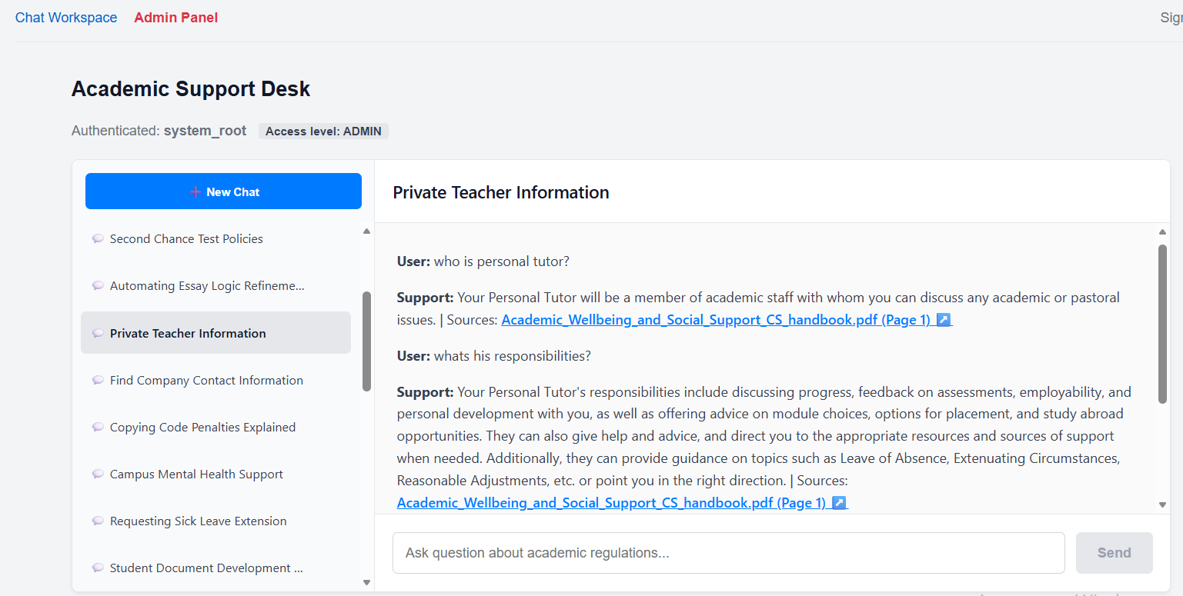
Screenshot of the System main page

Slide 11
