Slide 1
ODSP UX Hackathon

Slide 2
Agenda
Overview
Objective/Challenge
Approach
Analysis
Recommendations
Next Steps

Slide 3
Overview
The OSDP provides access to science, data, publications and information about development activities across the country that can be used to understand the cumulative effects of human activities to support better decisions in the future. It comprises of over 150,000 publicly available records from federal, provincial and territorial as well as regulatory systems.

Slide 4
Objective/Challenge
Identify a relevant environmental challenge in which an OSDP dataset can be used
Develop a solution to the identified challenge by using at least one of the OSDP’s datasets
How can the OSDP platform be improved?

Slide 5
Analysis

Slide 6
Recommendations

Slide 7
Next Steps

Slide 8
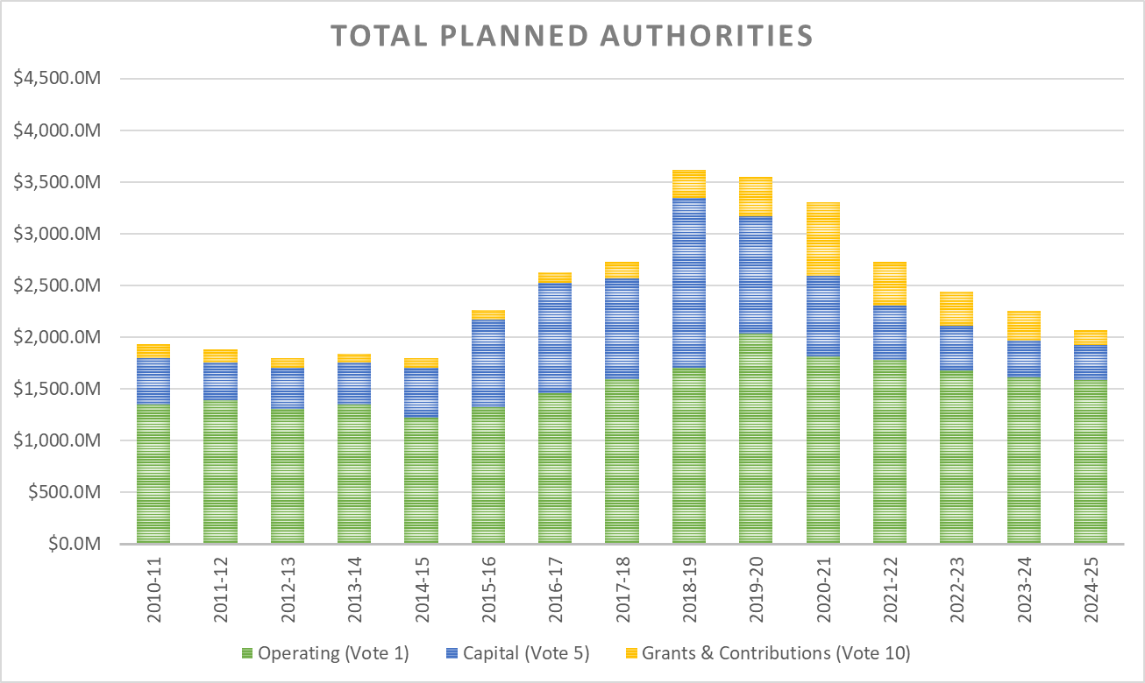
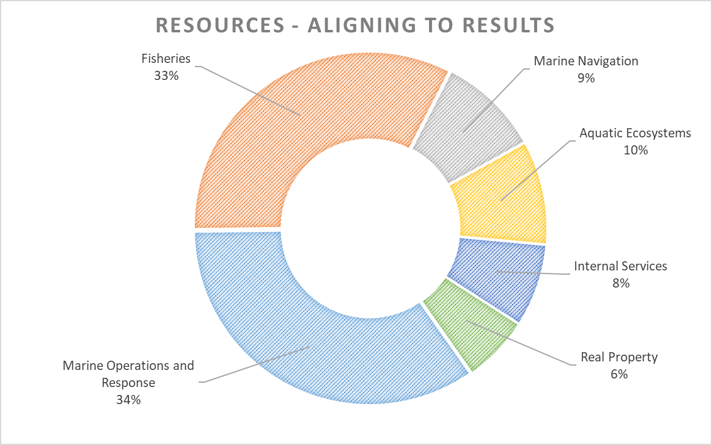
Total Planned Authorities
2010-11 to 2018-19 authorities represent year-end authorities, as per Public Accounts
Does not reflect renewal of some sunsetters
DFO is a highly decentralized department, managing a 2020-21 budget of ~$3.3B distributed across the country.
The Department has received important funding to Advance Reconciliation on Indigenous Rights Issues to implement reconciliation agreements as well as implement treaties and engage with Indigenous communities and stakeholders on fisheries policies (approximately $600M over the next 5 years, including $13M ongoing).
Key initiatives such as the Trans Mountain Expansion Project has also received funding to support project implementation and facilitate the implementation of accommodation measures for the benefit of Indigenous communities ($386M over the next 5 years, including $3M ongoing).
Some funding initiatives are time-limited (sun-setting) and subject to future funding decisions.

Slide 9
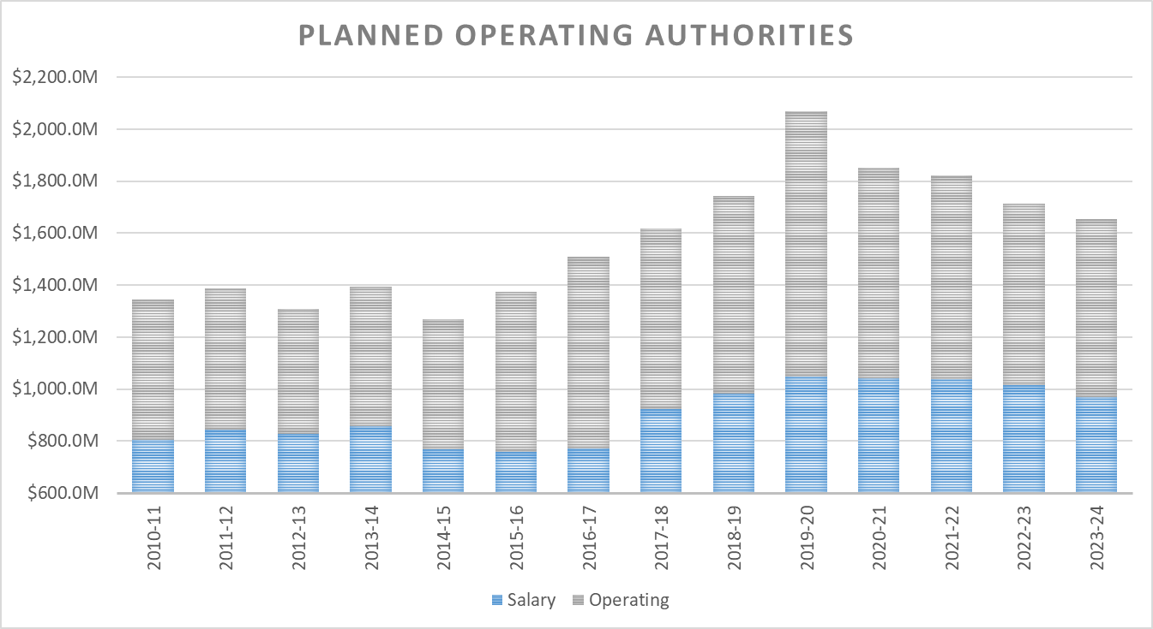
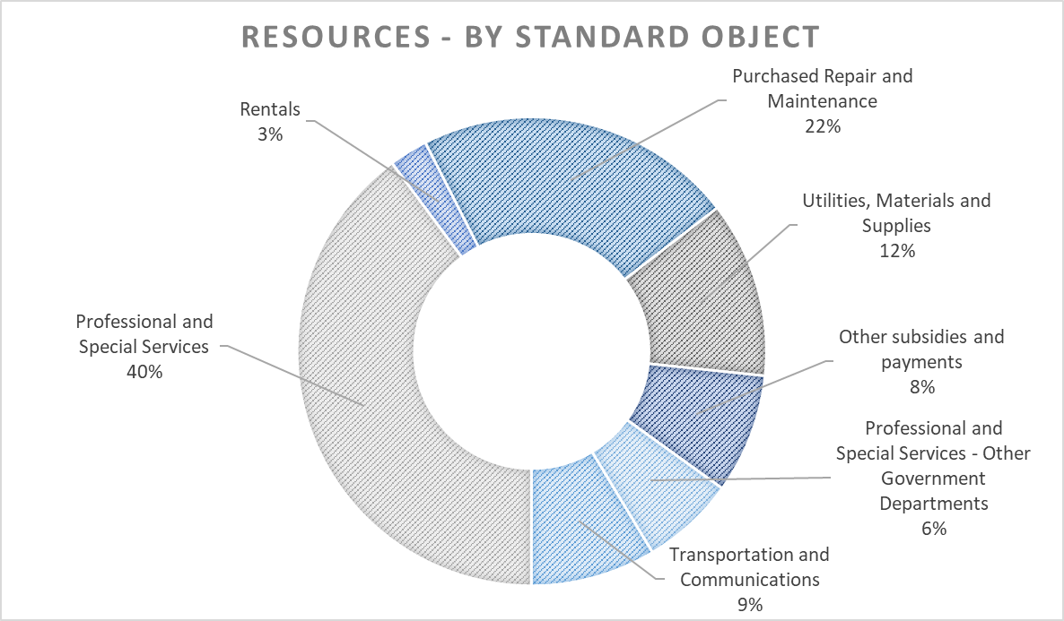
Vote 1 – Planned Operating
The spike in authorities for 2019-20 is due to one-time payments scheduled for Indigenous Reconciliation and for the Offshore Fisheries Science Vessel acquisition contract
Does not reflect renewal of some sunsetters
Salary makes up approximately 55 per cent of operating spending – approximately 12,600 FTEs are planned for 2020-21, across Canada.
With fluctuating funding profiles and sunsetting programs over the next two to four years, HR planning is critical to ensure there is no impact on the Department’s ability to deliver.
DFO has one of the largest asset base in the Government. In 2020-21, close to 46 per cent of non-salary spending will be on professional or special services and about 22 per cent on repairs and maintenance primarily to support the asset base. Most of this spending is non-discretionary.
DFO has absorbed the fiscal dividend for Shared Services Canada ($11M ongoing) and has provided existing funding to support the new programming for whales.

Slide 10
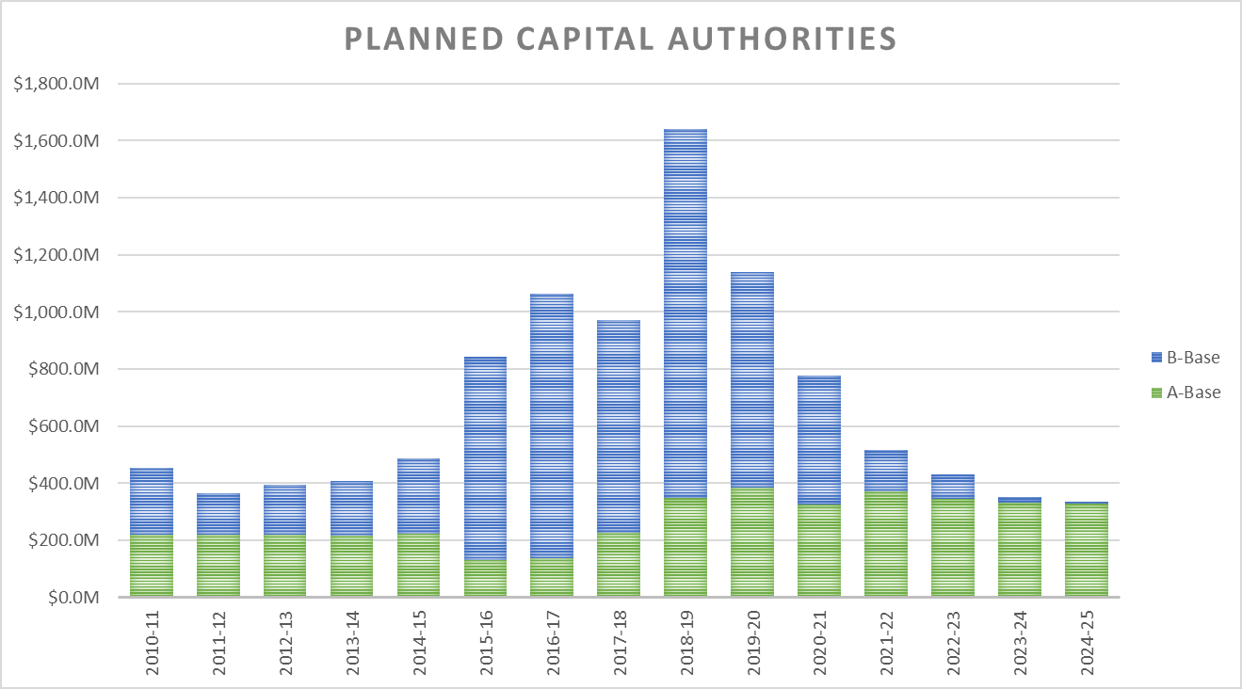
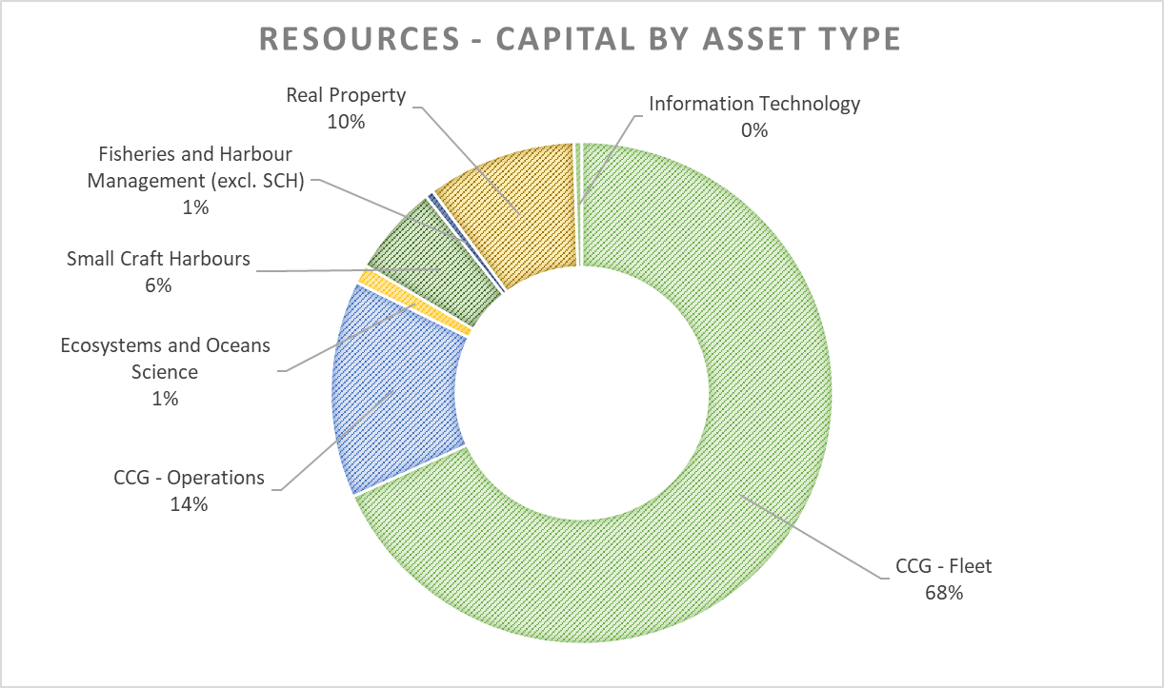
Vote 5 – Planned Capital
A-Base authorities refer to the department’s permanent/ongoing funding, while B-Base authorities reflect temporary funding sources.
Does not reflect renewal of some sunsetters
Total capital authorities of $776.8M are anticipated for 2020-21.
Over 84 per cent of DFO’s capital budget is for investments in the Coast Guard fleet, small craft harbours and real property portfolio.
DFO received a significant influx in funding to invest in key assets over the last three years (e.g., small craft harbours, Coast Guard fleet renewal, Comprehensive Review).
Coast Guard fleet renewal continues to be a high priority. Since 2005, approximately $24.0B in fleet investments have been committed in the fiscal framework.
Under Comprehensive Review, the department has undertaken work in several areas, including critical maintenance to real property assets and upgrades to information technology networks.

Slide 11
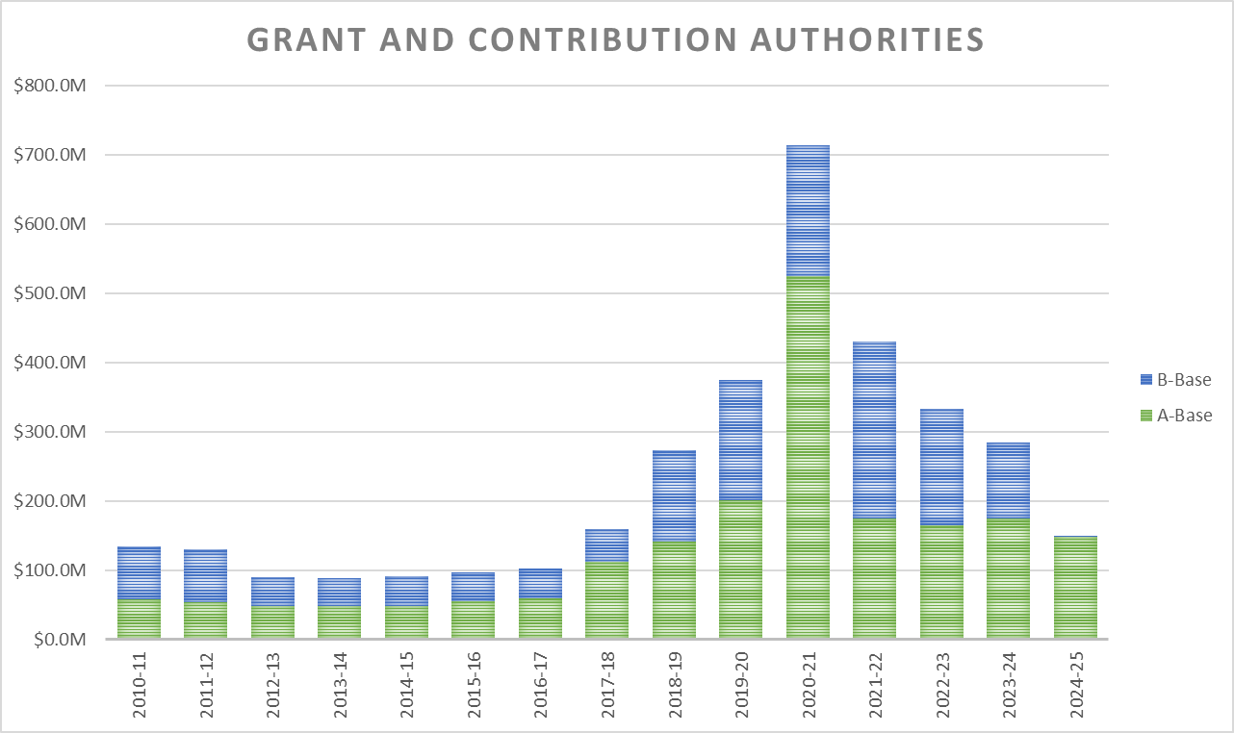
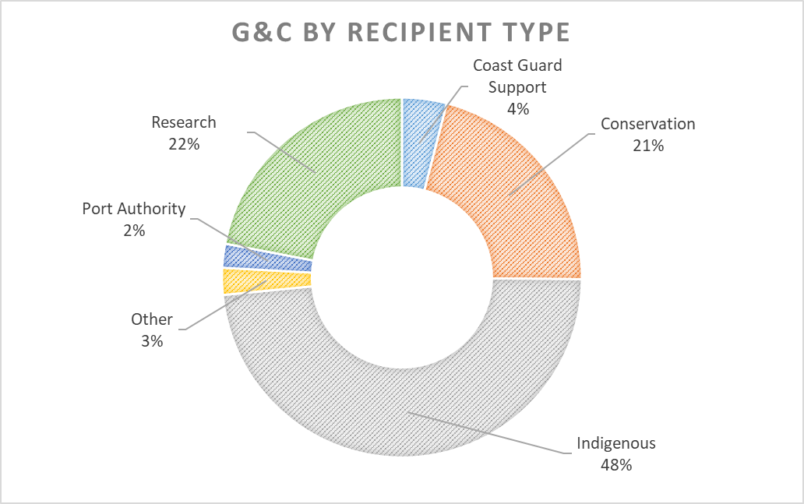
Vote 10 – Planned Grants and Contributions
A-Base authorities refer to the department’s permanent/ongoing funding, while B-Base authorities reflect temporary funding sources.
Does not reflect renewal of some sunsetters
Total Grants and Contributions anticipated authorities for the 2020-21 are $714.2M
Authorities have steadily increased over the last three years, with permanent/ongoing funding essentially tripling over that time.
Temporary funding sources make up a large portion of the new funding. Notable programs funded in this way include, Reconciliation Mandate funding; Trans-Mountain Pipeline; and, the three Fisheries Funds across the country.
Grants represent approximately 1 per cent of the total Vote 10 authorities.
The Department has over 30 contribution programs – with the largest recipients consisting of Indigenous organizations, associations focused on conservation, research organizations, and port authorities.

Slide 12
DFO – Financial Outlook

