Slide 1
OSDP UX Hackathon
Understand human-related toxic air emissions in Canada + UX Recommendations

Slide 2
Agenda
Overview
Challenge
Environmental Problem
Approach
Analysis
UX Issues
Recommendations

Slide 3
Overview
The OSDP provides access to science, data, publications and information about development activities across the country that can be used to understand the cumulative effects of human activities to support better decisions in the future.
It comprises of over 150,000 publicly available records from federal, provincial and territorial as well as regulatory systems.

Slide 4
Challenge
Identify a relevant environmental challenge in which an OSDP dataset can be used
Develop a solution to the identified challenge by using at least one of the OSDP’s datasets
How can the OSDP platform be improved?

Slide 5
Environmental Problem
Understand human-related toxic air emissions in Canada
The Canadian Environmental Sustainability Indicators (CESI) program provides data and information to track Canada's performance on key environmental sustainability issues.
These indicators track 3 human-related toxic air emissions
Lead
Mercury
Cadmium

Slide 6
Approach
Leverage information using OSDP + external sources
Data sources
Visualizations
Data sources
Emissions of harmful substances to air – Cadmium emissions to air by facility
Emissions of harmful substances to air – Lead emissions to air by facility
Emissions of harmful substances to air – Mercury emissions to air by facility
Canadian Environmental Sustainability Indicators

Slide 7
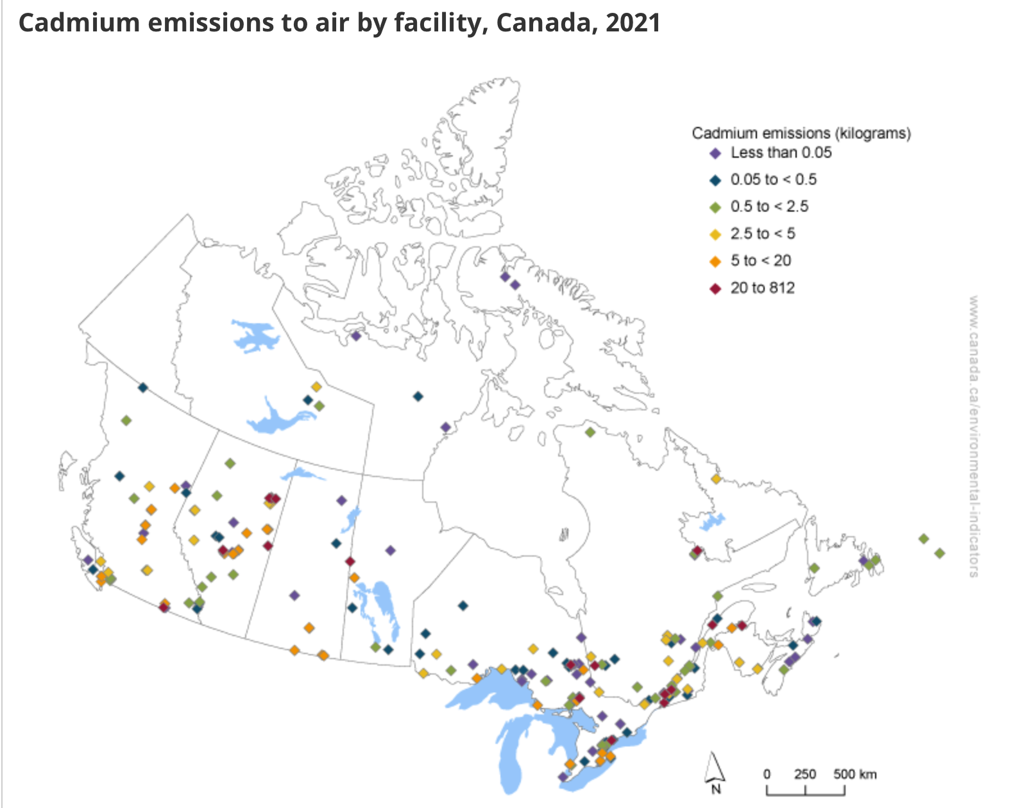
Analysis - Cadmium
In 2021, facility-reported cadmium emissions represent 74% of total national cadmium emissions.
115 facilities reported emissions under 0.5 kilogram (kg)
115 facilities reported emissions between 0.5 to 20 kg
18 facilities reported emissions over 20 kg, which were located in British Columbia (1), Manitoba (1), New Brunswick (1), Newfoundland and Labrador (1), Ontario (3), Alberta (5), and Quebec (6)

Slide 8
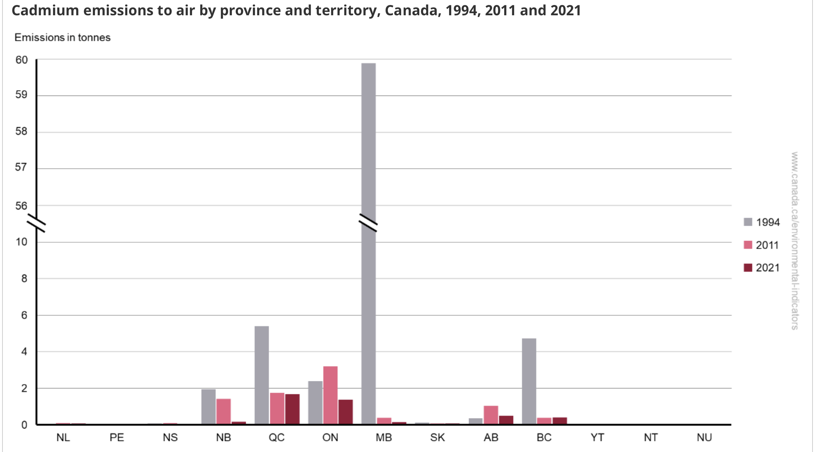
Analysis - Cadmium
In 2021, Ontario and Quebec accounted for 68% (3.1 tonnes) of national cadmium emissions
Between 1994 and 2021, Manitoba had the largest decline in emissions (59.6 tonnes)

Slide 9
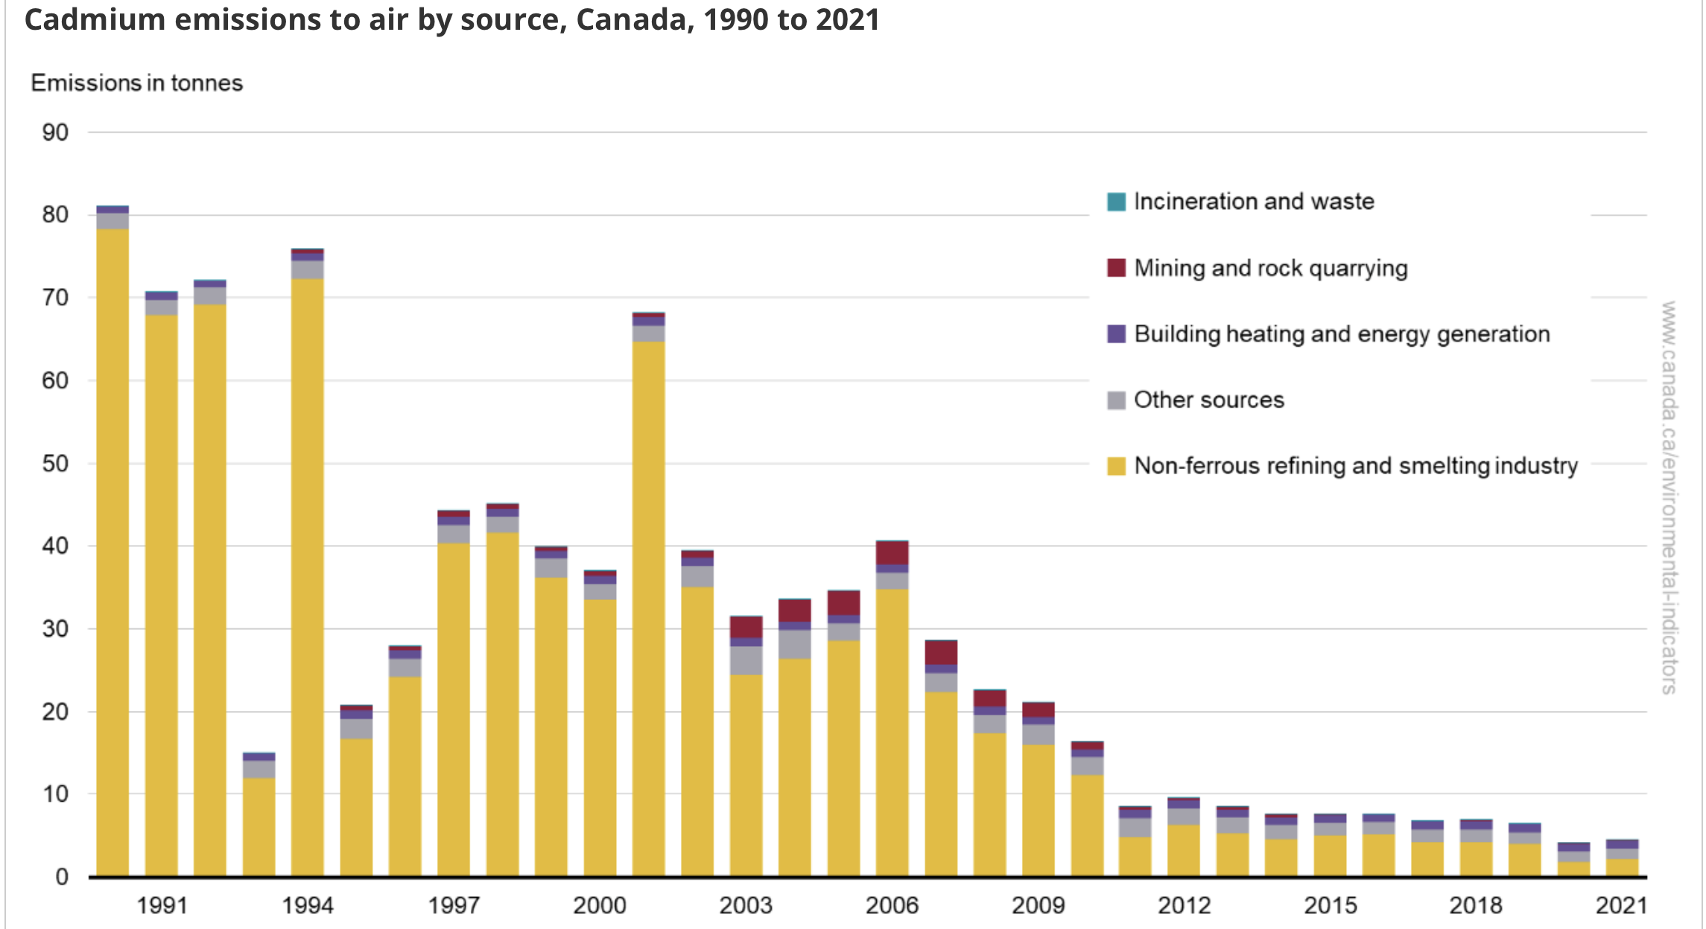
Analysis - Cadmium
In 2021, 4.5 tonnes of cadmium were emitted in Canada
Since 1990, the largest source of cadmium emissions has been the non-ferrous refining and smelting industry. It accounted for 49% (or 2.2 tonnes) of the national total in 2021
Between 1990 and 2021, cadmium emissions decreased by 94% (or 76.7 tonnes)
Cadmium emissions fluctuated between 1990 and 2006, but decreased steadily from 2007 onward. Fluctuations in cadmium emissions prior to 2010 are mostly driven by emissions from a non-ferrous refining and smelting facility in Manitoba.

Slide 10
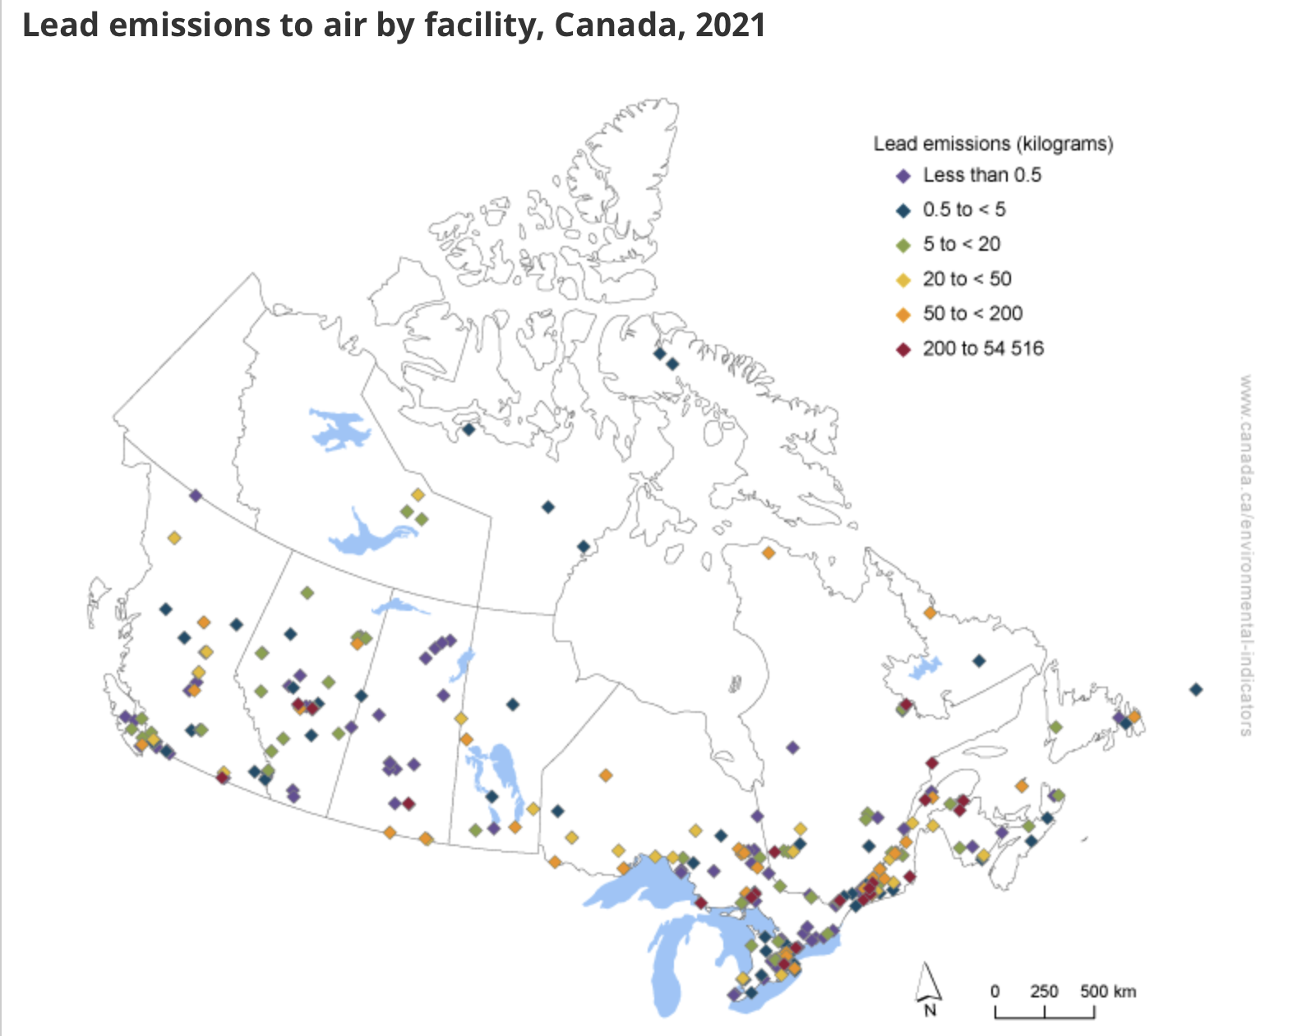
Analysis - Lead
In 2021, facility-reported lead emissions represent 82% of total national lead emissions
121 facilities reported emissions under 0.5 kilogram (kg)
200 facilities reported emissions between 0.5 to 120 kg
35 facilities reported emissions over 120 kg, which were located in British Columbia (1), Saskatchewan (2), Manitoba (2), New Brunswick (2), Newfoundland and Labrador (2), Alberta (3), Ontario (11) and Quebec (12)
One (1) non-ferrous smelting and refining facility in Quebec accounted for 70% (or 54 516 kg) of the total facility-reported lead emissions in 2021

Slide 11
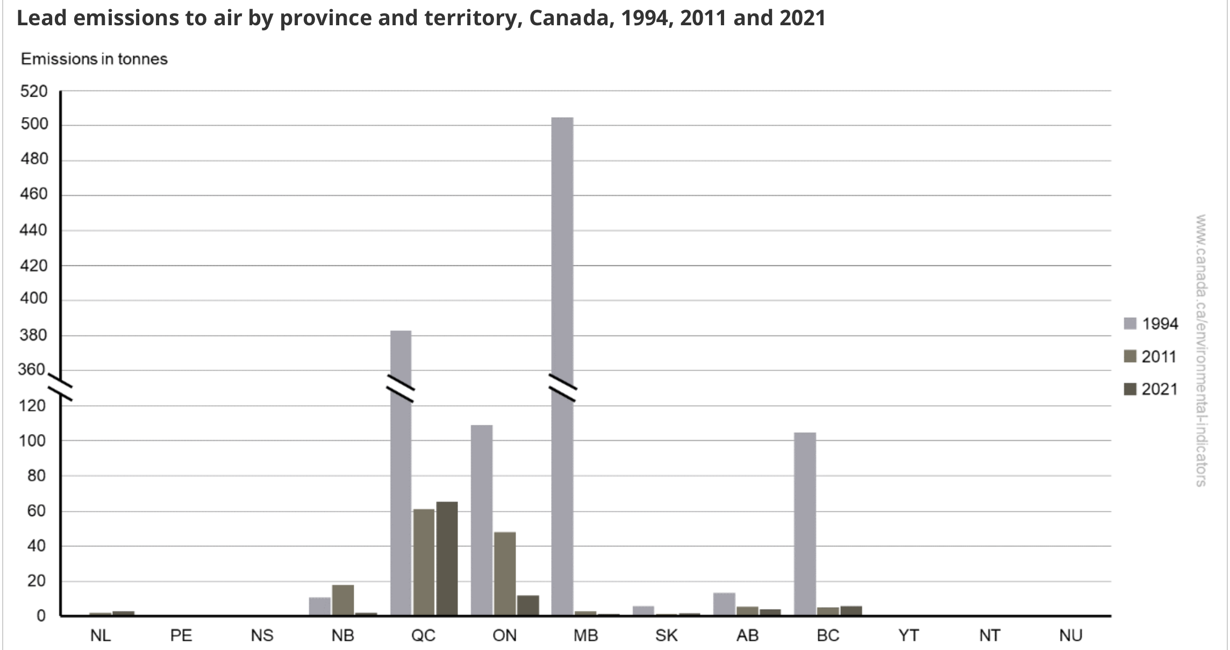
Analysis - Lead
In 2021, Quebec and Ontario accounted for 69% and 12% of national lead emissions, respectively
Between 1994 and 2021, Manitoba had the largest decrease in emissions of 503.5 tonnes

Slide 12
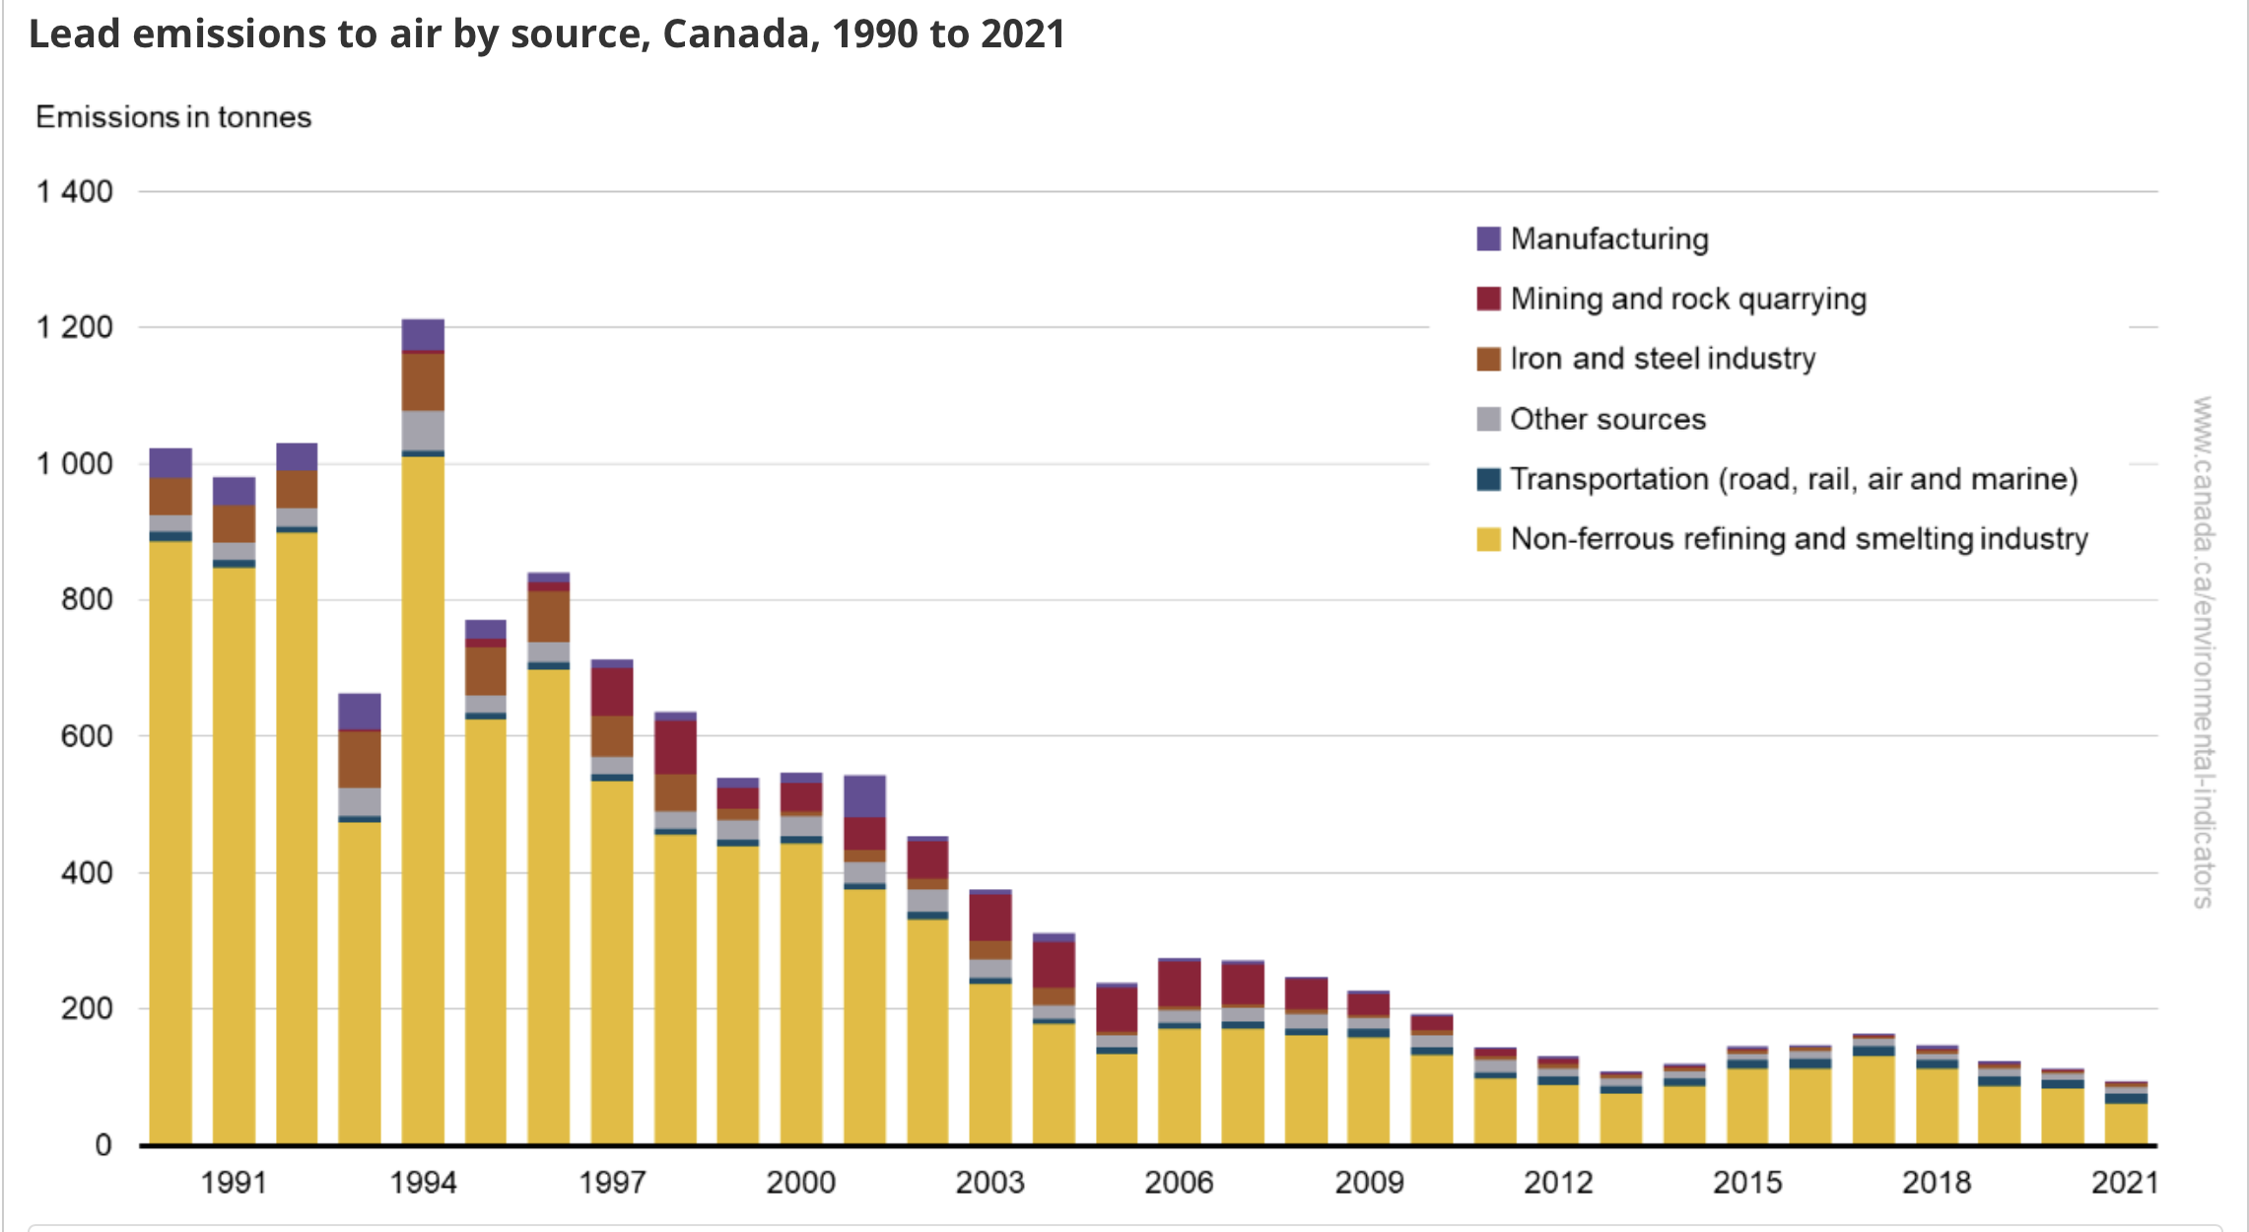
Analysis - Lead
In 2021, 94.7 tonnes of lead were emitted in Canada
The largest source of lead emissions has been the non-ferrous smelting and refining industry since 1990. It accounted for 65% (or 62.0 tonnes) of total emissions in 2021
Between 1990 and 2021, lead emissions decreased by 91% (or 928.2 tonnes)
Reductions were driven by changes in lead concentrations in smelter feed and changes in production levels at some facilities

Slide 13
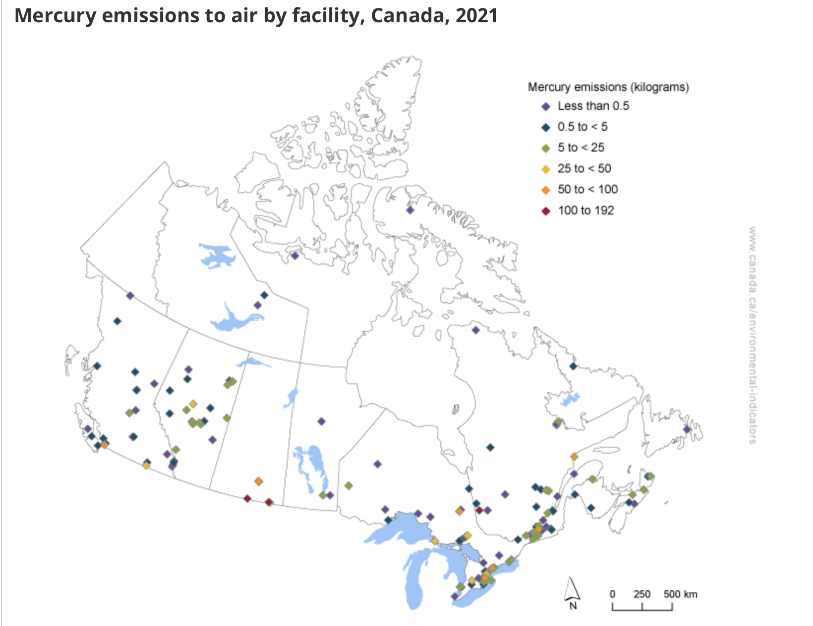
Analysis - Mercury
In 2021, facility-reported mercury emissions represent 60% of total national mercury emissions.
60 facilities reported emissions under 0.5 kilogram (kg)
109 facilities reported emissions between 0.5 to 100 kg
3 facilities reported emissions over 100 kg, which were located in Quebec (1) and Saskatchewan (2)

Slide 14
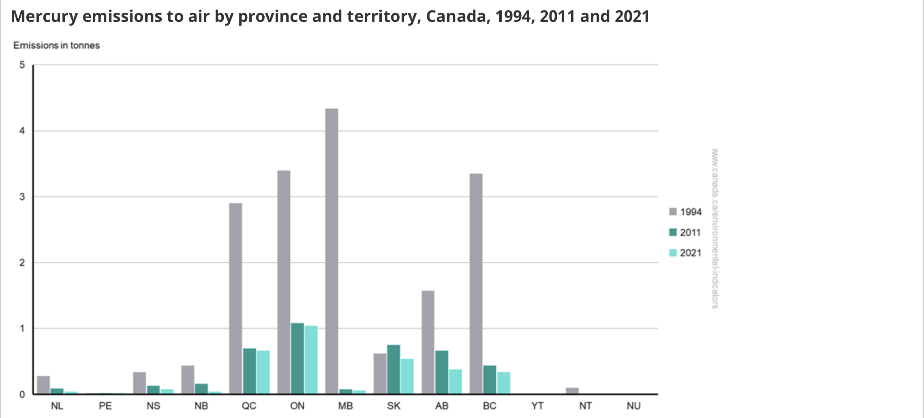
Analysis - Mercury
In 2021, Ontario, Saskatchewan and Quebec accounted for 70% of national mercury emissions
Between 1994 and 2021, Manitoba had the largest reduction in emissions with a decrease of 4.3 tonnes

Slide 15
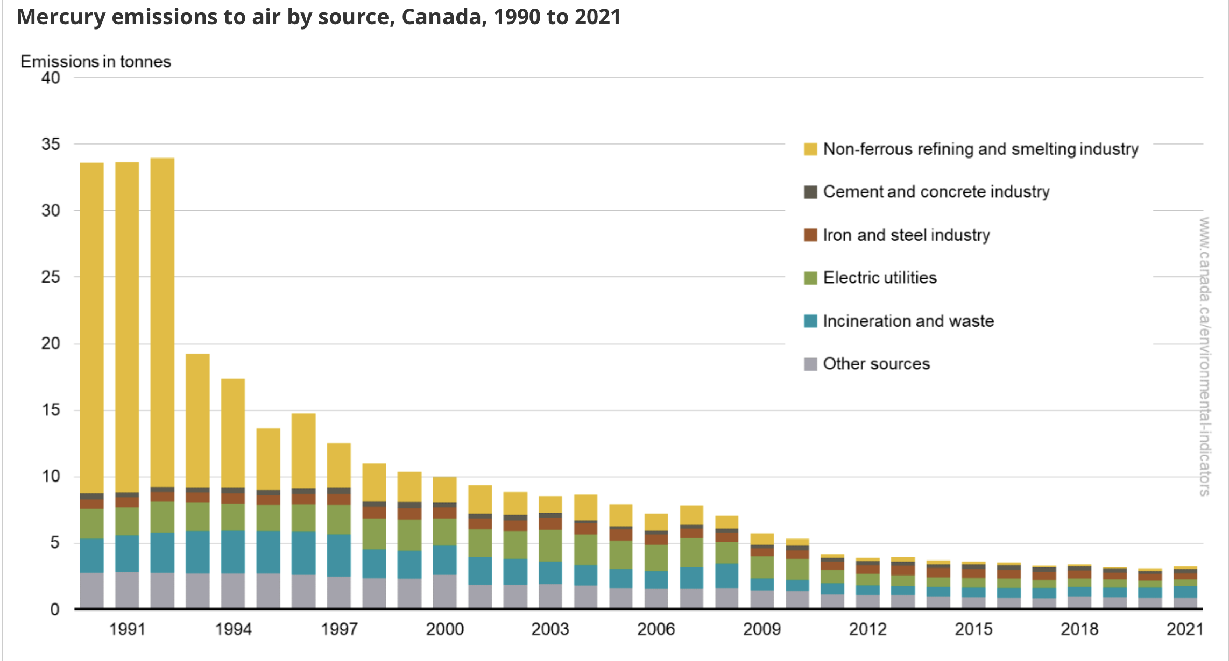
Analysis - Mercury
In 2021, 3.2 tonnes of mercury were emitted in Canada
The ore and mineral industries was the highest emitting sector, representing emissions from the non-ferrous refining and smelting industry, the cement and concrete industry, the iron and steel industry, and other ore and mineral industries. This sector emitted 38% (or 1.2 tonnes) of the annual total
Between 1990 and 2021, mercury emissions decreased by 91% (or 30.4 tonnes)
Following a 43% decrease between 1992 and 1993, emissions have generally declined

Slide 16
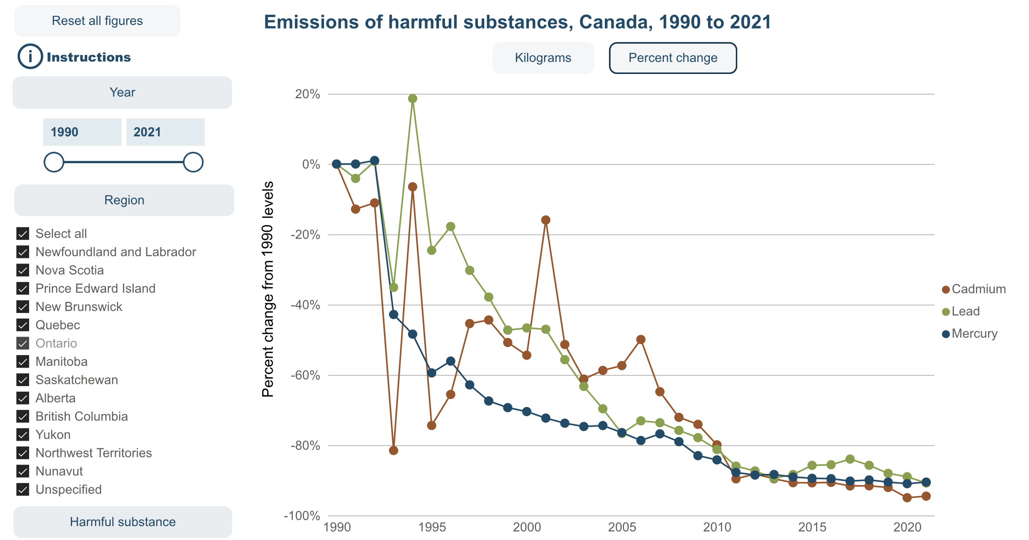
Analysis – Emissions over time
In 2021, mercury, lead and cadmium emissions had decreased by 90%, 91% and 94%, respectively from 1990 levels. The decrease in mercury, lead and cadmium emissions are mostly attributed to a large drop in emissions from the non-ferrous refining and smelting industry. This decline was primarily due to the
Implementation of pollution prevention plans
The closing of outdated smelters, compliance with federal and provincial legislation, and conformance with guidelines introduced over this period
The changes in facility processes and adoption of emission reduction technologies also contributed to the reduction of mercury emissions
Changes in lead concentrations in smelter feed and changes in production levels at some facilities

Slide 17
UX Issues
To much text shown in certain areas
No data source recommendation

Slide 18
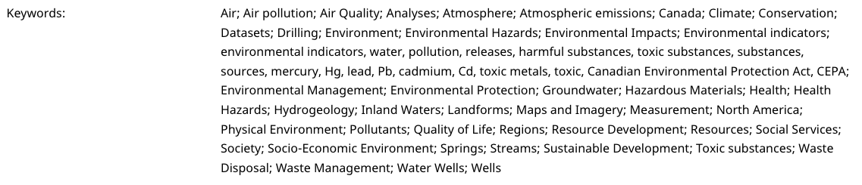
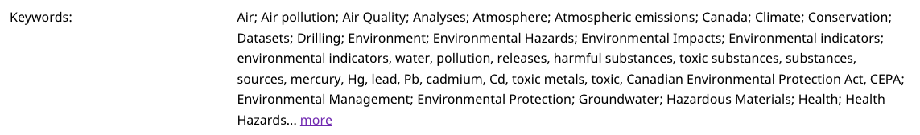
UX Recommendations
Hide text as needed
Before
After

Slide 19
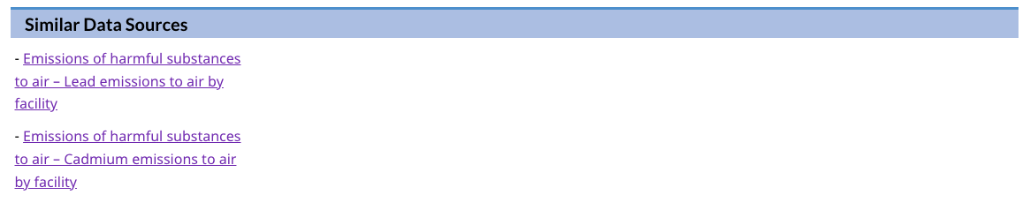
UX Recommendations
Recommend similar data sources
When a search is selected it should show similar datasets
- If Emissions of harmful substances to air – Mercury emissions to air by facility is searched, it should provide similar datasets e.g.
- Emissions of harmful substances to air – Lead emissions to air by facility
- Emissions of harmful substances to air – Cadmium emissions to air by facility

