Slide 1


Impact Circle Hackathon A Greener Future: Analyzing our Environmental Tweet-Bank Team 9

Slide 2

Work Breakdown
Overview
Approach
Objective
High Level Insights
Application design
Demo
Next Steps
2

Slide 3
Overview
About
Environmental non-profit focused on litter cleanup and prevention
Our programs raise awareness about plastic pollution in Lake Ontario, and help communities become good stewards of the environment
2014
6
Started in
Annual reports created
Key Programs
3.2 million
2.7 million
Butt Blitz
Love your lake
Litter art
High school hour
Pieces of litter collected
Cigarette butts collected
3

Slide 4
Approach
Exploratory analysis
Develop data tool
1
3
2
4
Review twitter data
Generate Insights

Slide 5
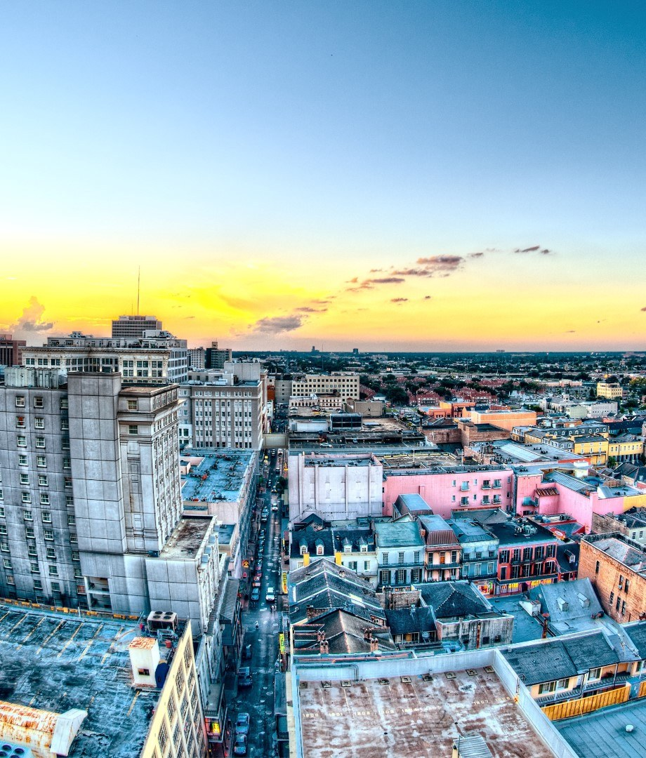
Objective
Key questions
Data
Get Insights on hourly, daily, weekly, or monthly cadence
Find potential accounts to follow
CSV file from twitter
Key data points
Interval
Trend
Keyword
Favorite Count
Retweet Count
858
827
Tweets
Accounts
32
430
Keywords
Trends
5

Slide 6
High level Insights
Date and time Cadence
Top 5 Keywords
Climate Change
Fossil Fuel
Pollution
Global warming
Emissions
1am, 4am, 6pm and 7pm were the best times to post
Monday to Tuesday and Friday were the best times to post
October and November had high retweet numbers
Top 5 Twitter Trends
Top 5 Twitter Accounts
PATAGONIA
#COP26
GLASGOW
GRETA THUNBERG
GRETA
Patagonia
GretaThunberg
RepKatiePorter
MarkRufallo
AJEnglish

Slide 7
Application Design
Explore different tools that can be utilized (Tableau, Excel, Rshiny)
Explore design using Excel and R Shiny
Build prototype in R Shiny and Excel

Slide 8
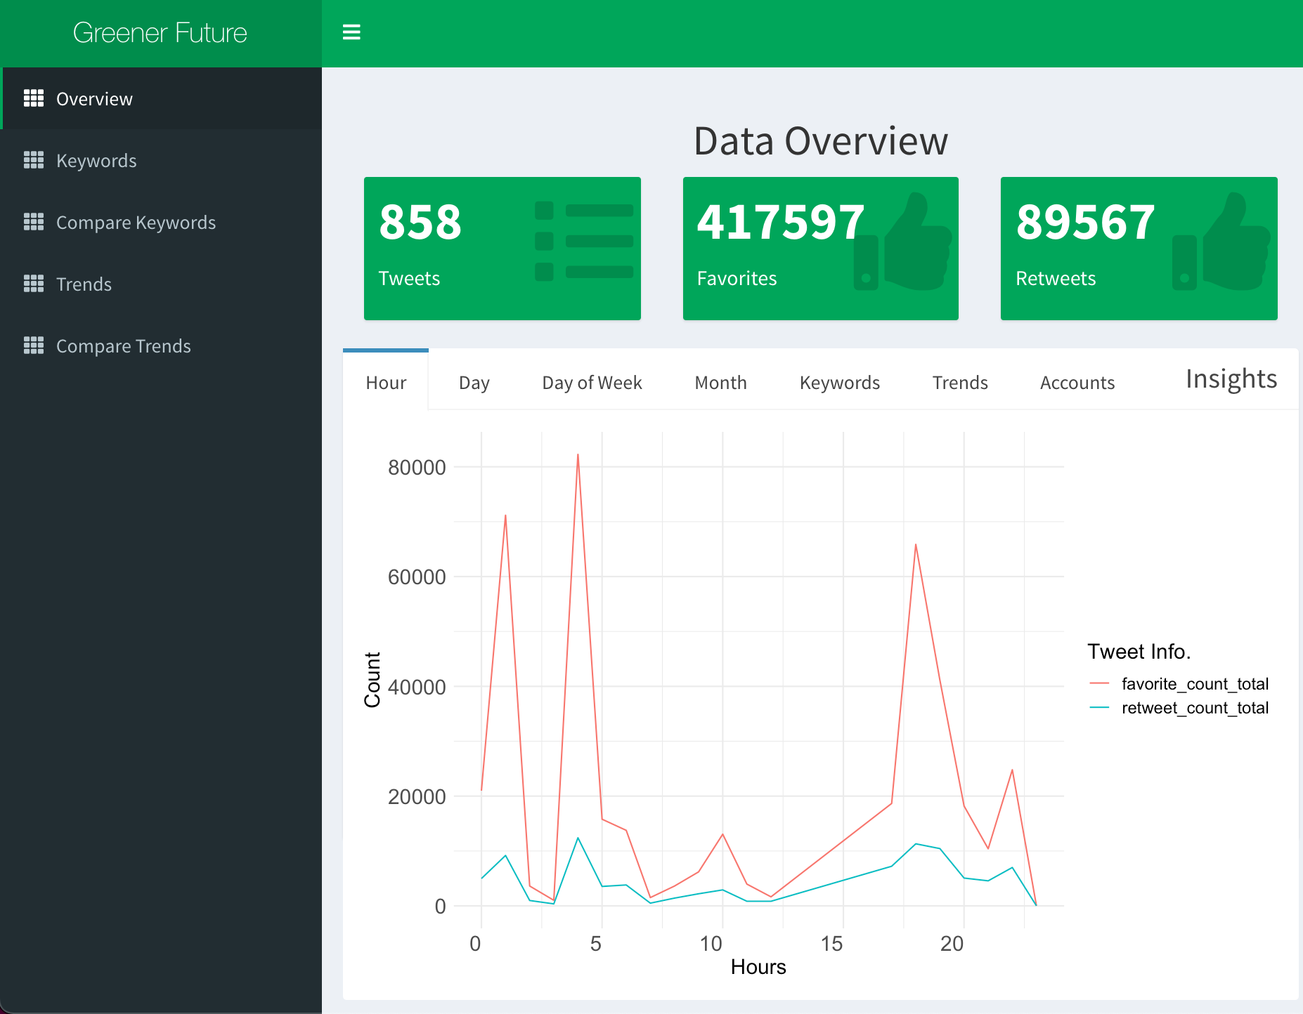
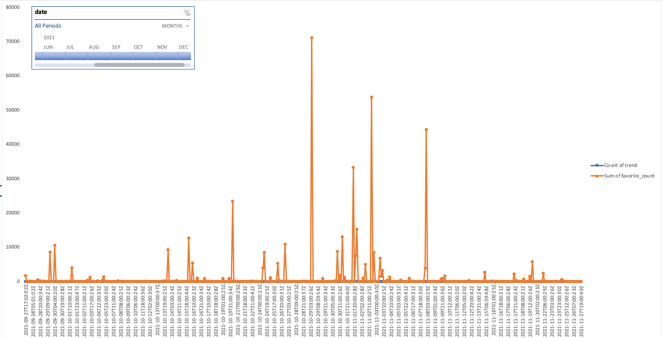
Application Design
Excel Prototype
R Shiny Prototype

Slide 9
Demo

Slide 10
Next Steps
Data
Get more data over a longer period of time
Application
Incorporate data with twitter and other social media data
Perform sentiment analysis

