Slide 1

mydoh
Business Insights

Slide 2
Analysis Approach
Understand mydoh: Mydoh is a Money App & Smart Card for kids (6-18) and parents.
Review data file (Excel)
Review data dictionary and data (18 months work)
Pick data analysis tool (R and RStudio)
Generate data summaries
Check for anomalies
Generate data visualizations
Since no clear business objective is stated will also look at correlations and RFM model

Slide 3
Overall Insights (YTD)
Parent
79165
13251
779167.35
35444
-674812.12
104355.23
Logins
Deposits
Deposit Amount
Transfers
Transfer Amount
Transactions
Child
138905
38016
-516978
35718
686447.70
169469.70
Logins
Purchases
Purchases Amount
Receives
Receives Amount
Transactions

Slide 4
Parent Data Insights

Slide 5
Child Data Insights

Slide 6
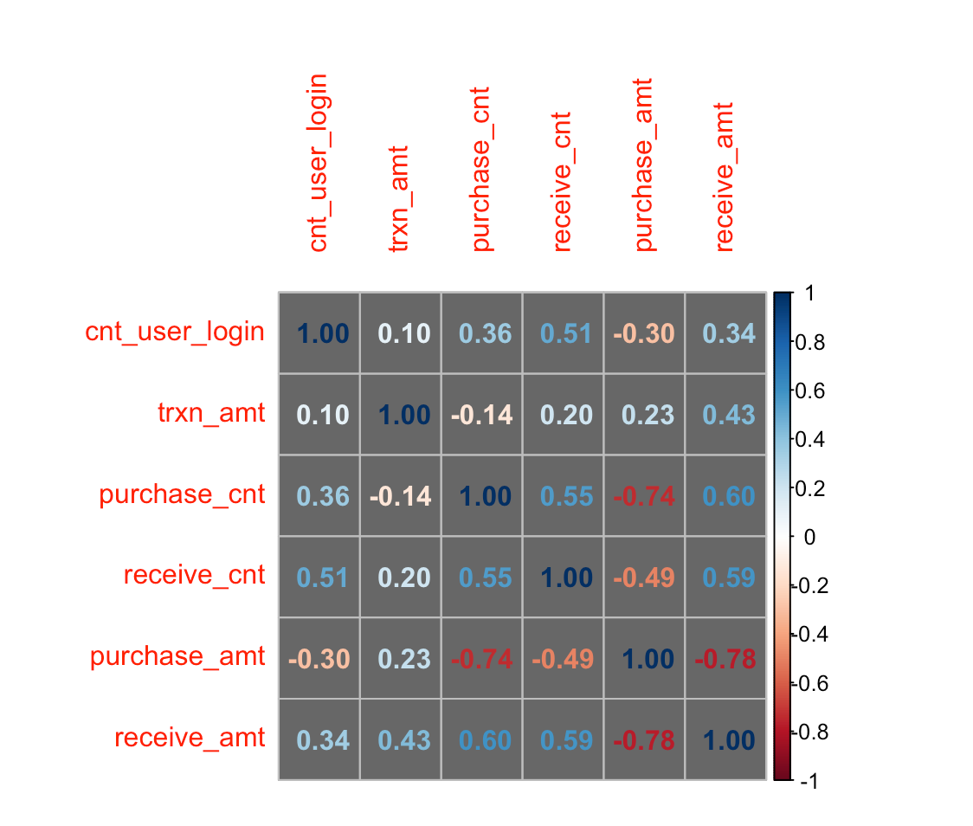
Appendix – Child Data Correlation

Slide 7
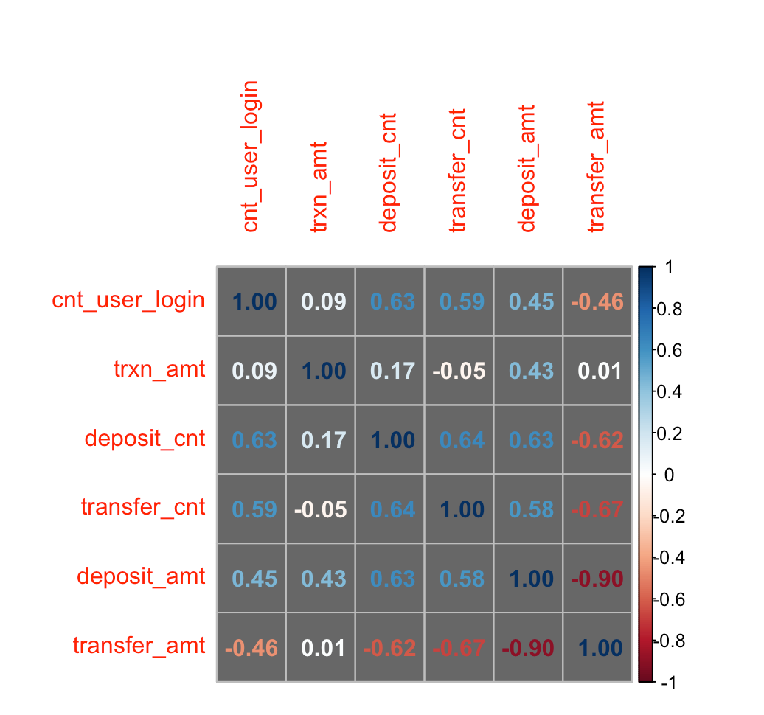
Appendix – Parent Data Correlation

Slide 8
Appendix – Parent RFM Model

