Slide 1


Toronto Parking Tickets Analytics
Powered by Open Data Toronto

Slide 2
Toronto Parking Tickets
About
Approximately 2.8 million parking tickets are issued annually across the City of Toronto
Tickets are issued by Toronto Police Services (TPS) personnel as well as persons certified and authorized to issue tickets by TPS
Objective
Analyze 2017 to 2020 parking data and find key insights, observe trends, and identify impacting factors
Provide fact-based recommendations to improve enforcement, compliance or increase revenue
Key Findings
Parking tickets and amount were consistent prior to the COVID-19 pandemic
Ticket count and amount peaked during weekday business hours and during the warmer months (May – October)
Ontario plated vehicles drove the highest ticket amount
There is an opportunity to target geographical hotspots with better signage

Slide 3
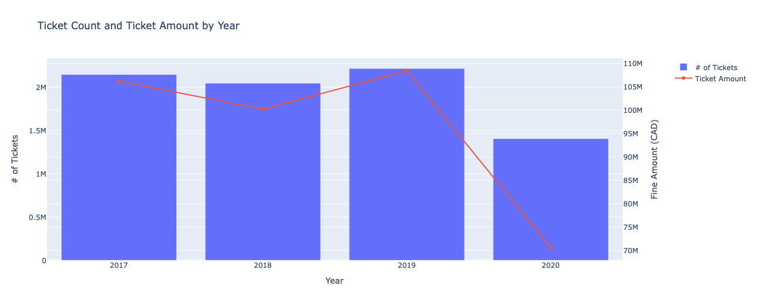
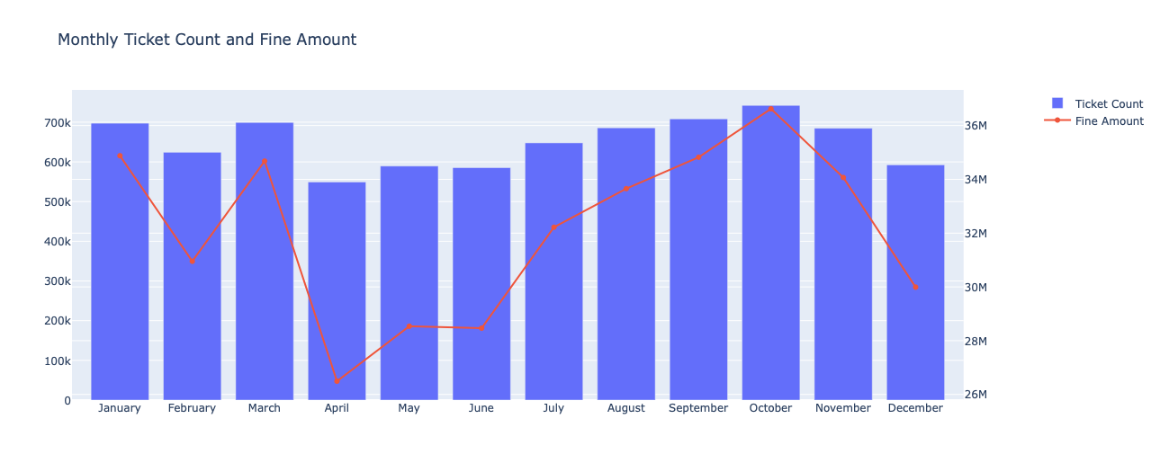
Ticket Trends
Prior to 2020 ticket count and amount showed a consistent pattern. 2020 was impacted by the COVID-19 pandemic
Shows monthly seasonality, with higher ticket counts and amounts during warmer months (May-October) and lower activity in winter (December, January, February)

Slide 4
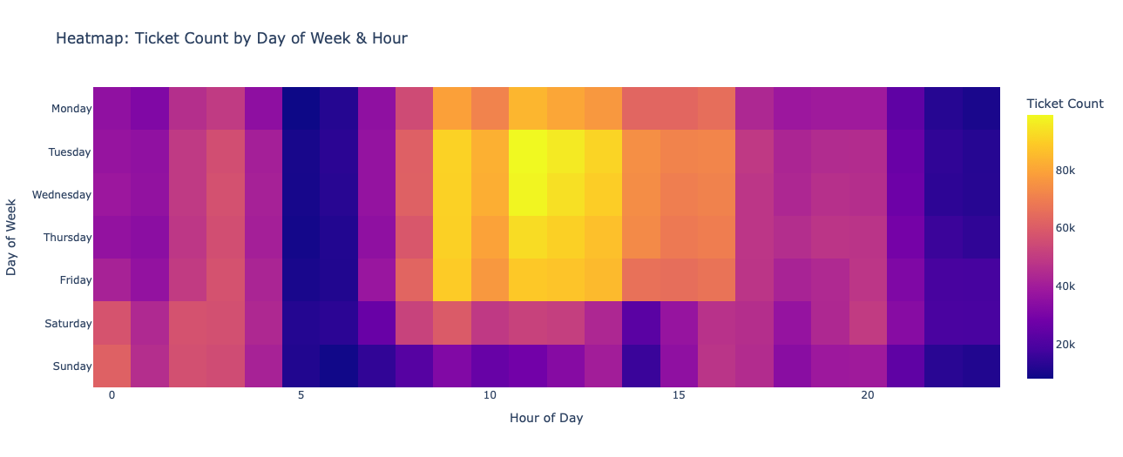
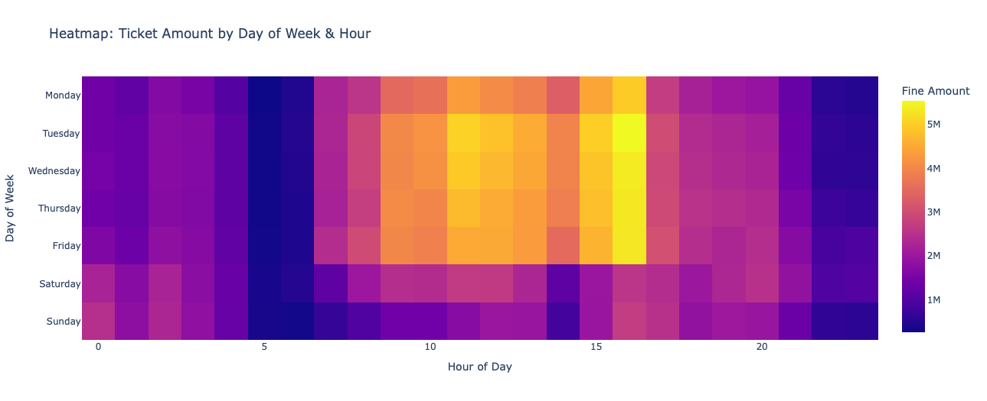
Ticket Window Heatmap
Ticket counts are highest during weekdays, with peak activity concentrated during business hours and early evenings
Similar to ticket counts, the highest fine amounts are generated during weekday business and early evening hours

Slide 5
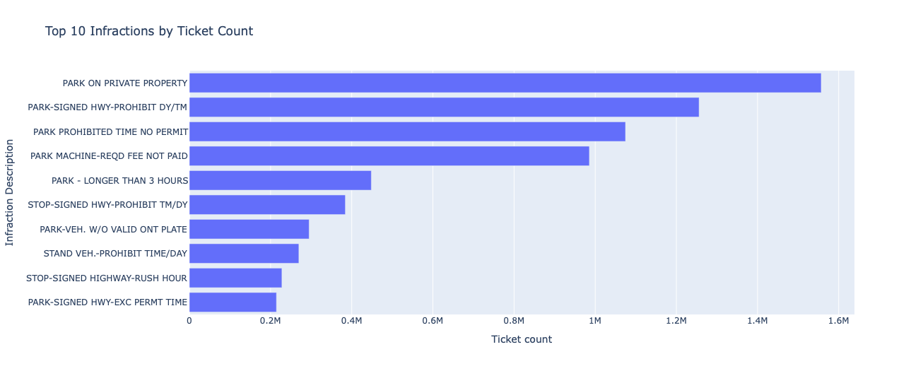
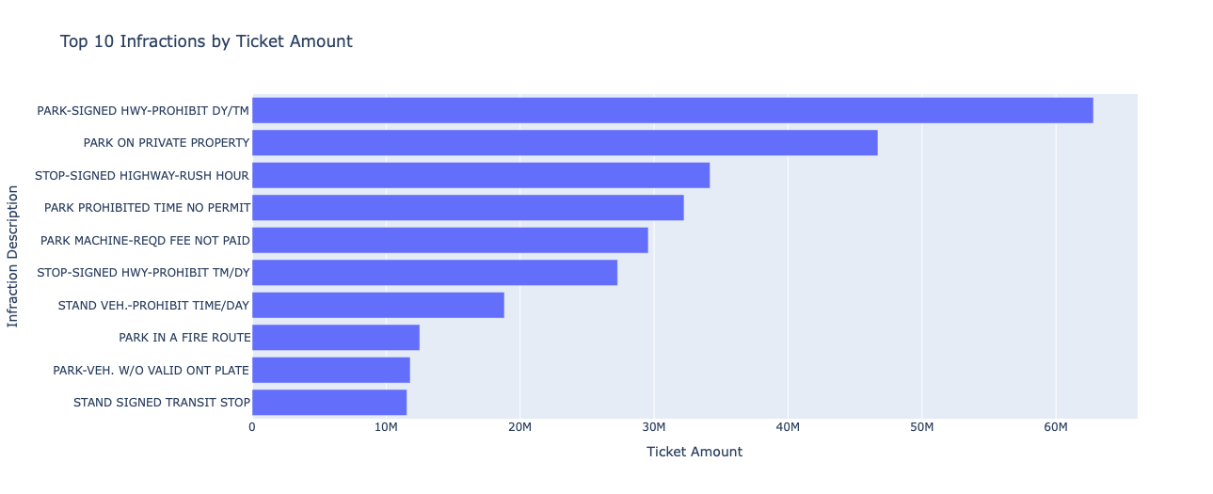
Key Infractions
Identifies the most frequently occurring infractions, highlighting common areas of non-compliance
Identifies infractions that generate the higher ticket amounts, often overlapping with high-count infractions, but also potentially revealing less frequent but higher-value violations.

Slide 6
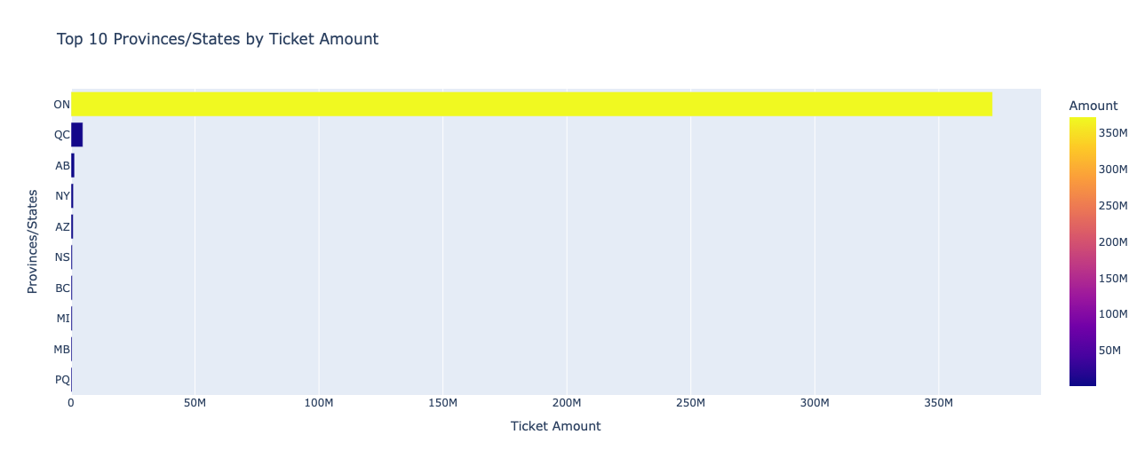
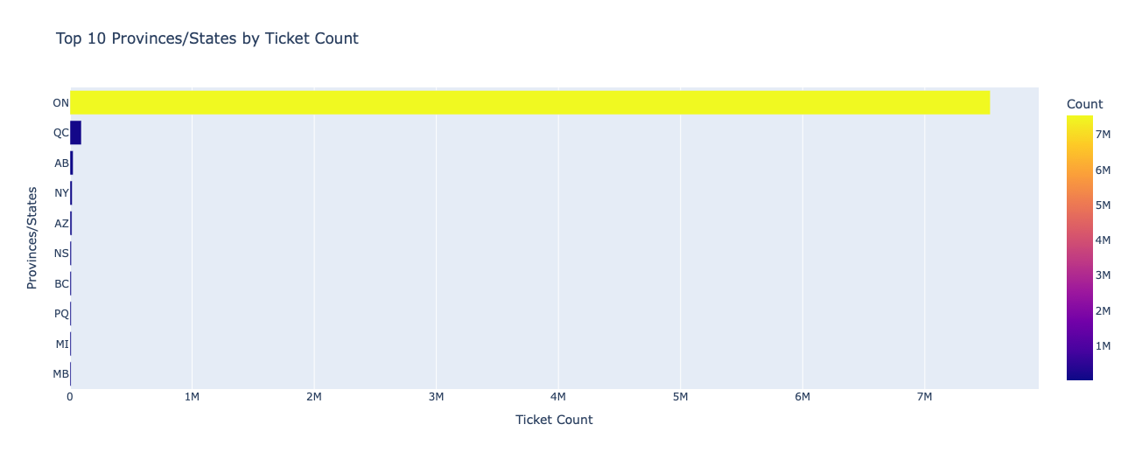
Geographical Hotspots – Province/States
For both ticket amount and count, Ontario was the leading source

Slide 7
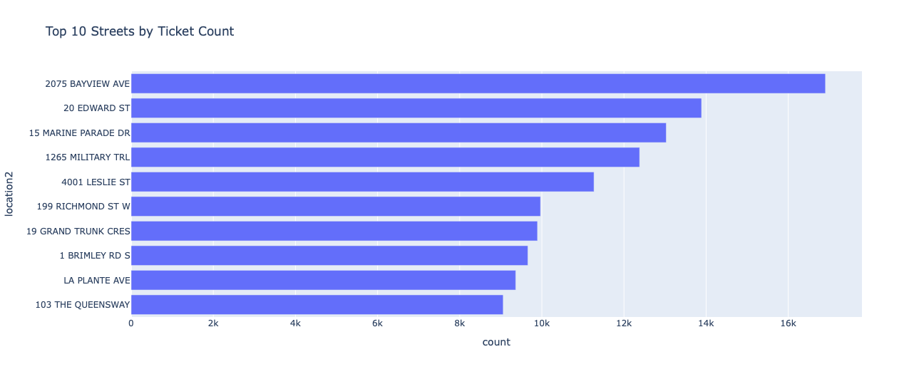
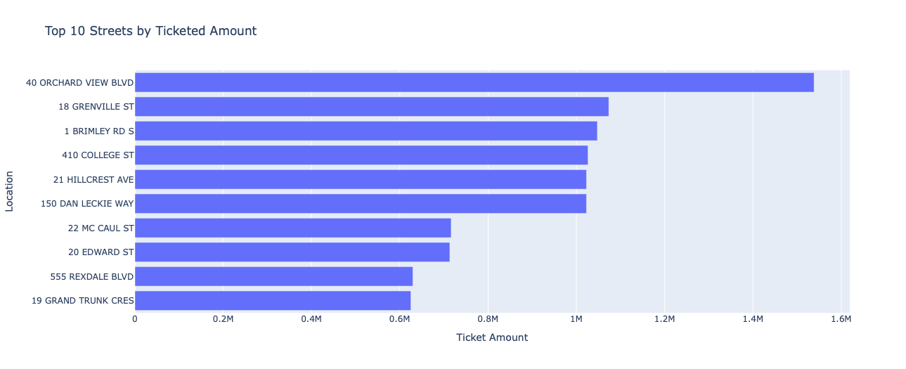
Geographical Hotspot - Streets
The charts pinpoint specific streets that are major geographical hotspots for both high volumes of tickets and ticket amounts

Slide 8
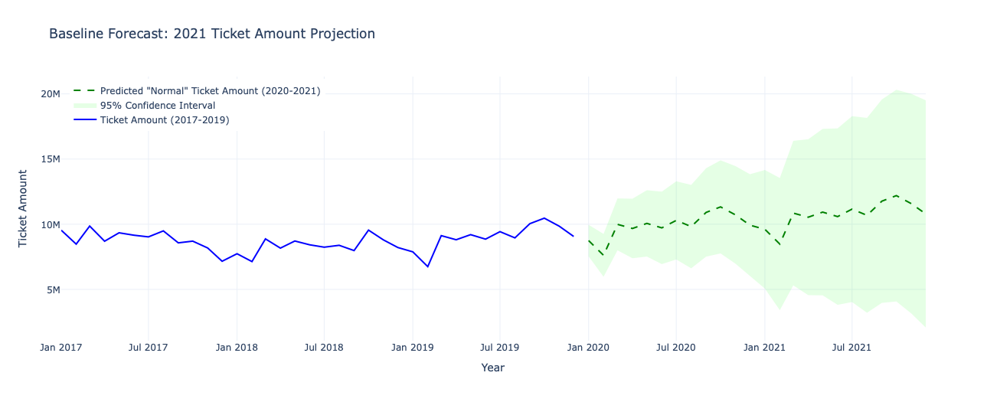
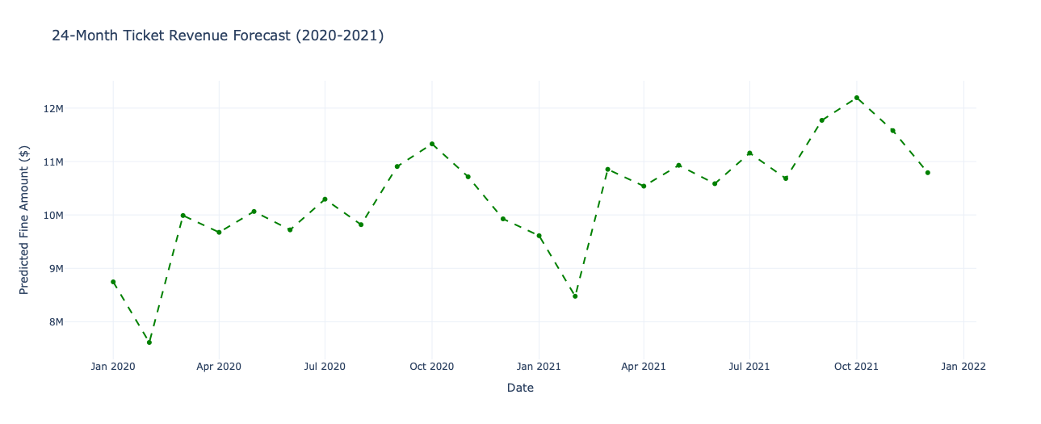
2021 Ticket Amount Forecasting
The forecast (based on pre-2020 trends) provides a 'normal’ ticket amount projection. The significant gap between this forecast and actual 2020 revenue quantifies the financial impact of the pandemic.

Slide 9
Recommendations
Parking Rules Review
Optimized resource planning
Strategic Enforcement
Review the clarity, visibility, and accessibility of parking signage and regulations
Focus enforcement resources on identified geographical hotspots locations with consistently high ticket counts and revenue
Use the observed monthly seasonality in ticket volumes and revenue to strategically plan enforcement
Infraction-Specific Compliance Campaigns
Review of fine structures
Analyze the distribution of fine amounts in conjunction with high-volume and high-revenue infraction types
Targeted public awareness campaigns for high-volume infractions

Slide 10
Next Steps
Integrating postal code and location information from Statistics Canada to improve geographical insights.
Analysis of the current ticket pricing design

