Slide 1

mydoh
Business Insights

Slide 2
Analysis Approach
Understand mydoh: Mydoh is a Money App & Smart Card for kids (6-18) and parents.
Review data file (Excel)
Review data dictionary and data (18 months work)
Pick data analysis tool (R and RStudio)
Generate data summaries
Check for anomalies
Generate data visualizations

Slide 3
Overall Insights (YTD)
Parent
79165
13251
779167.35
35444
-674812.12
104355.23
Logins
Deposits
Deposit Amount
Transfers
Transfer Amount
Transactions
Child
138905
38016
-516978
35718
686447.70
169469.70
Logins
Purchases
Purchases Amount
Receives
Receives Amount
Transactions

Slide 4
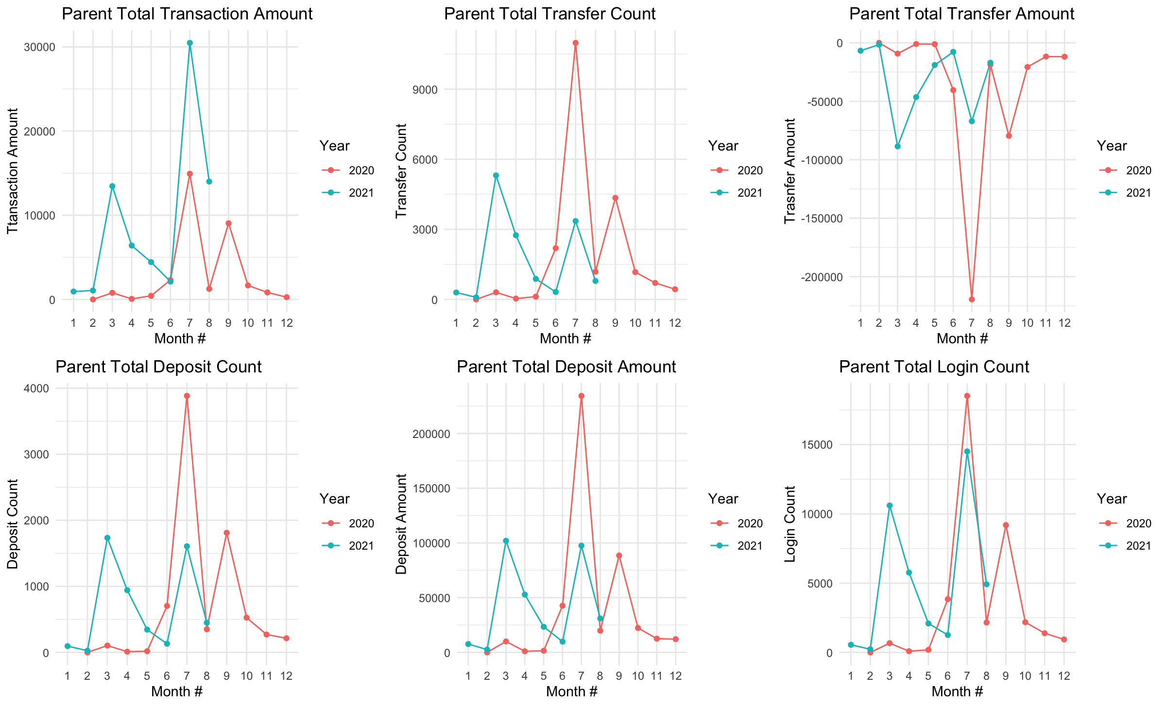
Parent Data Insights
- In 2020 most parents where active primarily in the fall while in 2021 most parents where active both in the winter and summer
- Year over year behavior is quite different. 2020 had a summer peak while 2021 had multiple peaks. Month 7 for 2020 and Month 3 and 7 for 2021. Needs more investigation
- Looks like there is a strong correlation between transfer and deposit amount. Correlation plot in Appendix
- For next steps might be worthwhile looking at RFM modelling

Slide 5
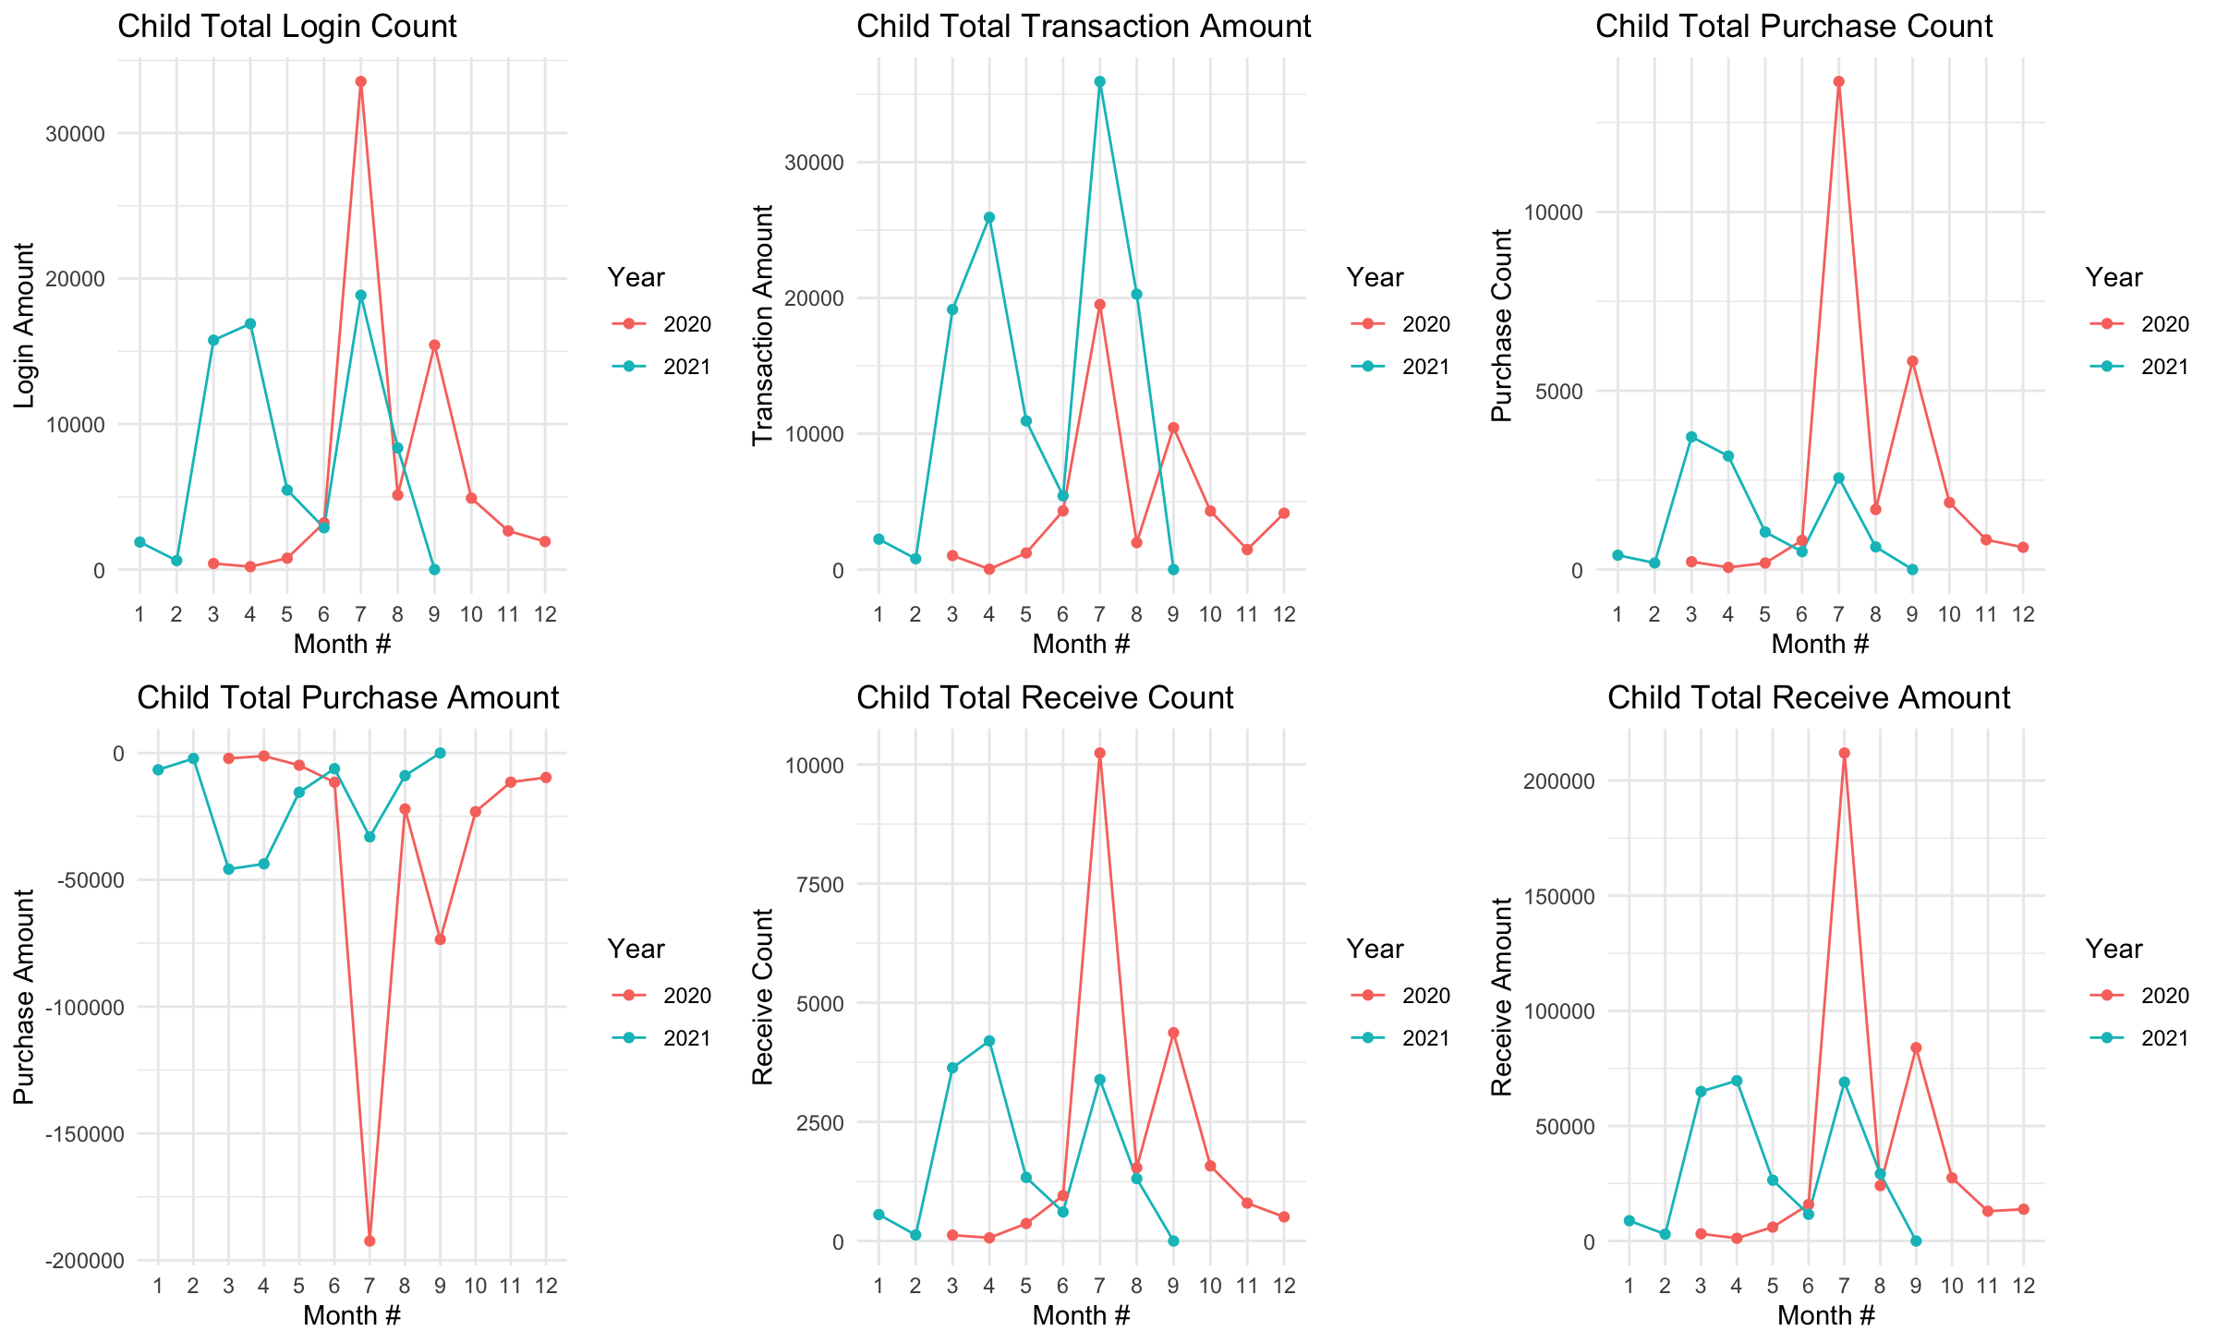
Child Data Insights
- For 2020 month 7 was the most active while in 2021 it had multiple peaks month 4 and 7.
- Purchase and Receive Amount seem to be strongly correlated
- Transactions in 2021 outpaced 2020
- 2020 followed the same pattern across all metrics
- There was a huge pattern change between 2020 and 2021 across all metrics. Needs further investigation

Slide 6
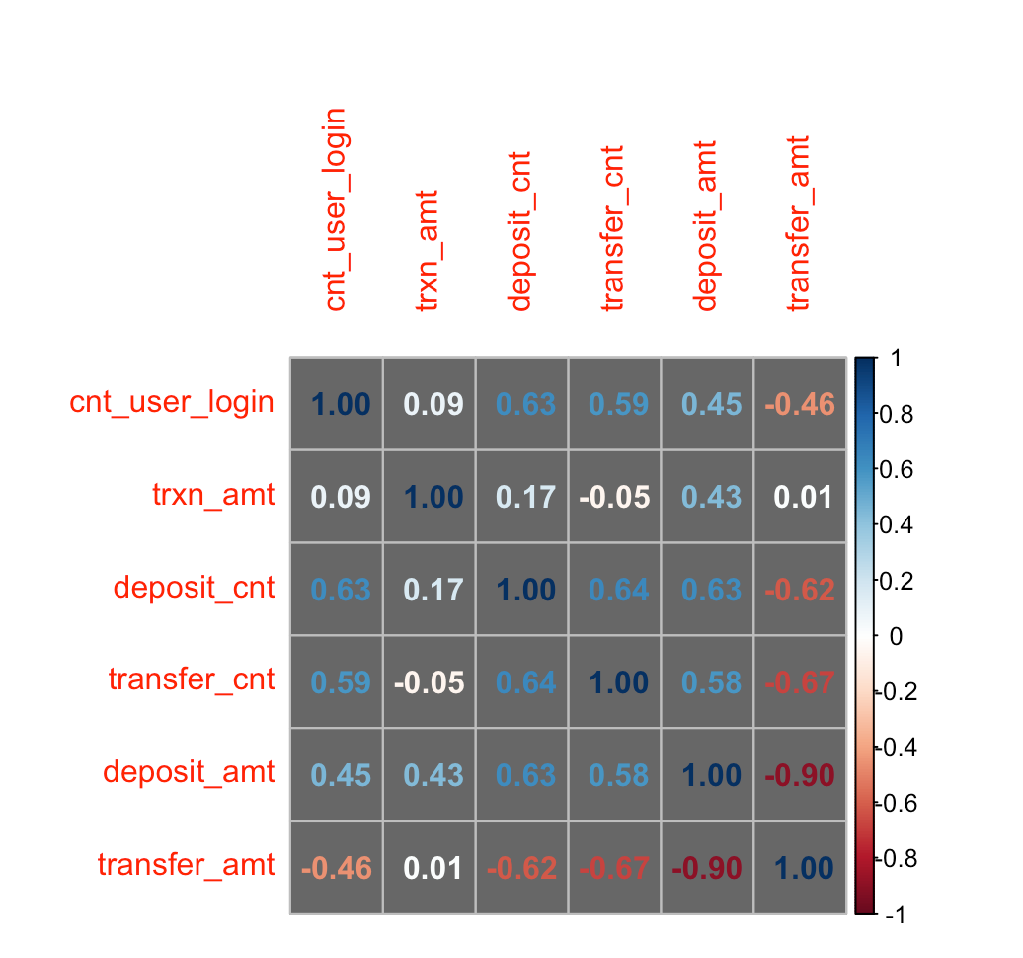
Appendix – Parent Data Correlation
Deposit and Transfer amounts are strongly negatively correlated -0.9.

Slide 7
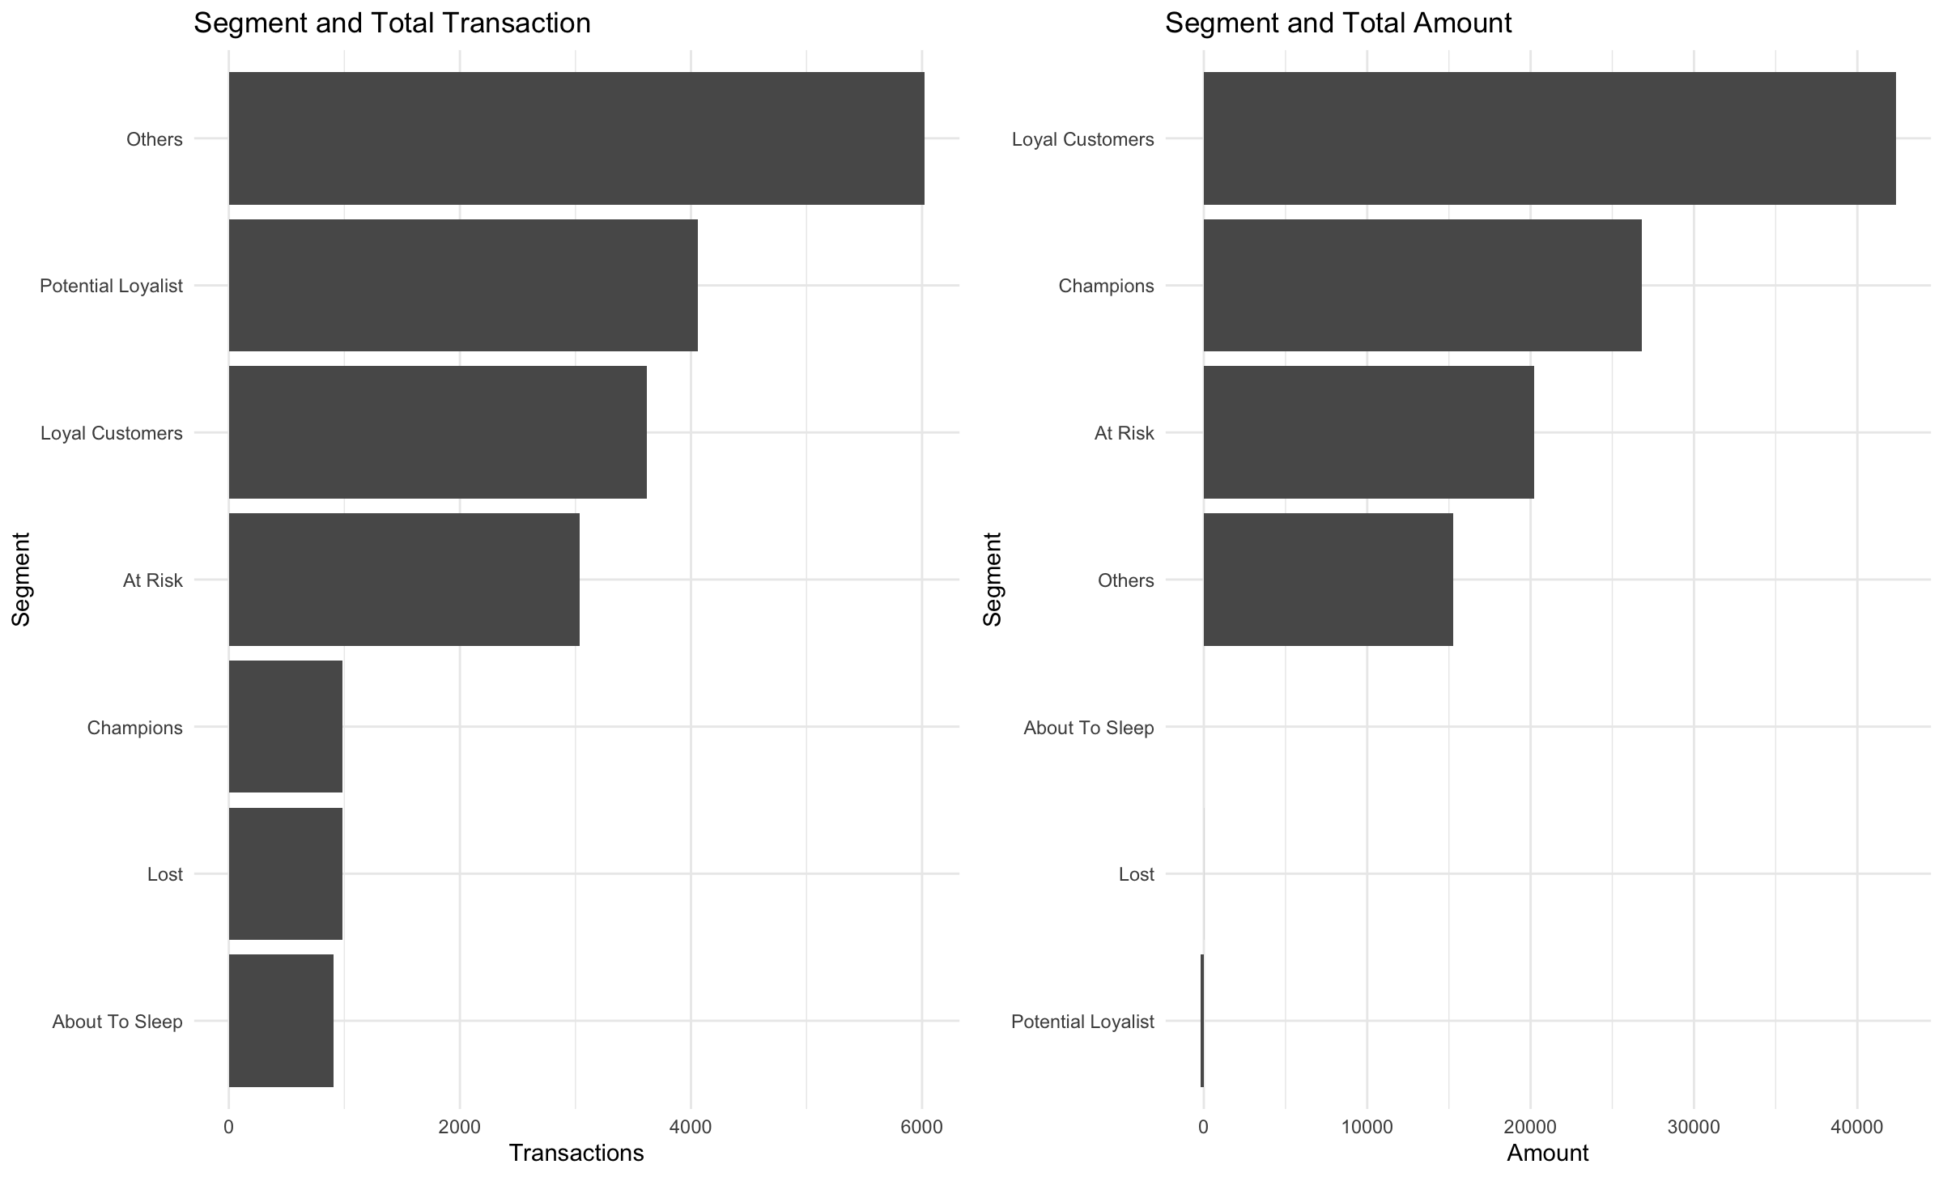
Appendix – Parent RFM Model

