Slide 1

Data Analysis

Slide 2

Work Breakdown
Overview
Approach
Data Quality Assessment
Analysis
Next Steps
2

Slide 3

Overview
Data
Snapshot of 500 unique loan accounts
Information stored in Excel
480
2
Unique Customers
Product Types
Objective
Validate data quality
Perform portfolio analysis
6
12
Sectors
Regions
3

Slide 4
Approach
Review data elements individually
Perform Portfolio Analysis
1
3
5
2
4
Review Excel file
Update data if needed
Generate Insights

Slide 5
Data Assessment
Issues
Action Steps
Interest Rate we charge clients (%): Majority of values are between 1.45 to 8%. There is a value of 77.45% which seems odd
Region: 17 Regions were found instead of 12. It shows both US and Canadian information. Some regions used abbreviations, others were misspelt.
The interest rate information can be validated with the portfolio and data team to check for accuracy
The region should follow the same naming convention.
Full region names should replace the abbreviations
Misspelt names should be updated as well
Should validate with business and data team to see if this is a widespread issue

Slide 6
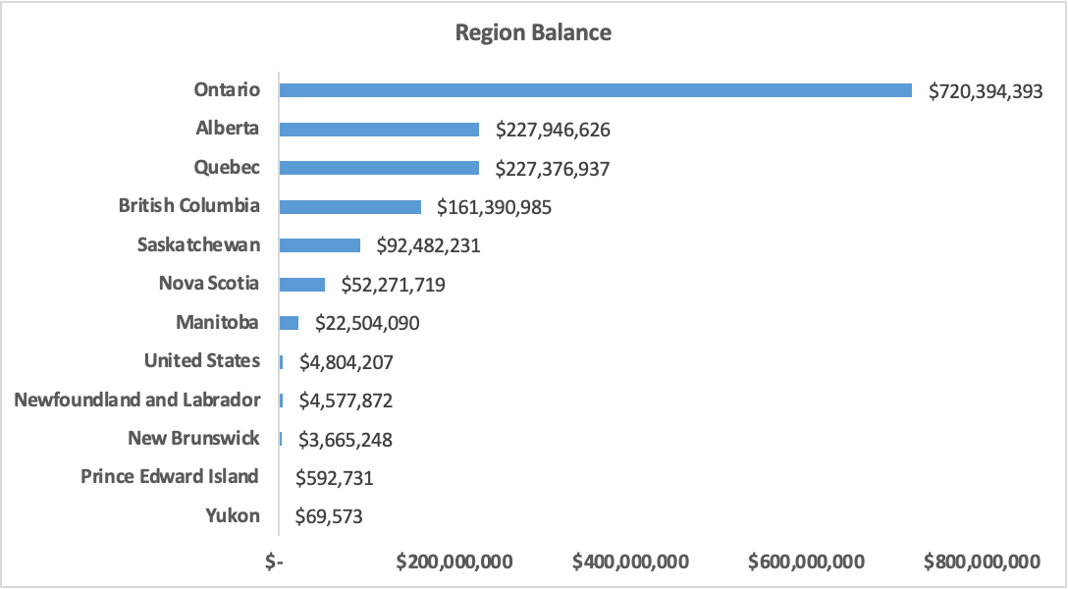
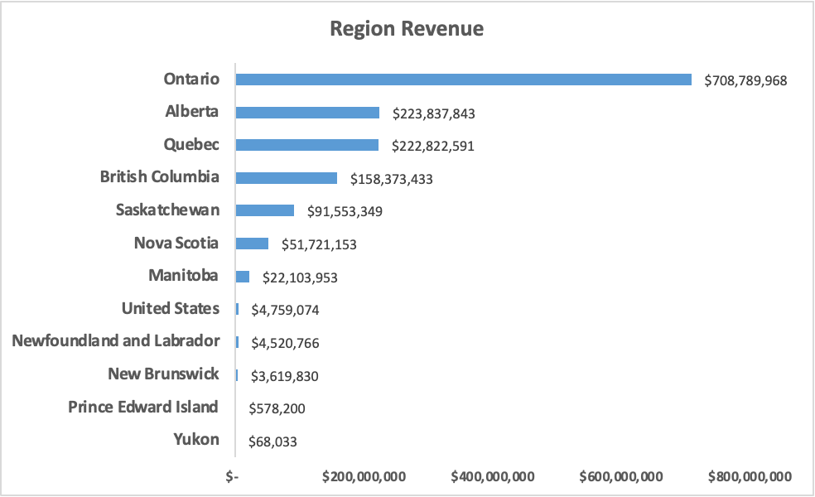
Portfolio Analysis - Region
Insights
Ontario leads and Yukon is at the bottom for both the regional Balance and Revenue
Eastern regions seem to be doing better compared to the Western region
6

Slide 7
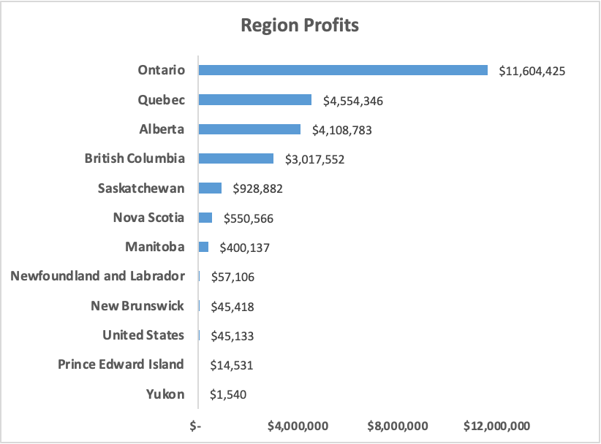
Portfolio Analysis - Region
Insights
Ontario leads and Yukon is at the bottom for regional profits
7

Slide 8
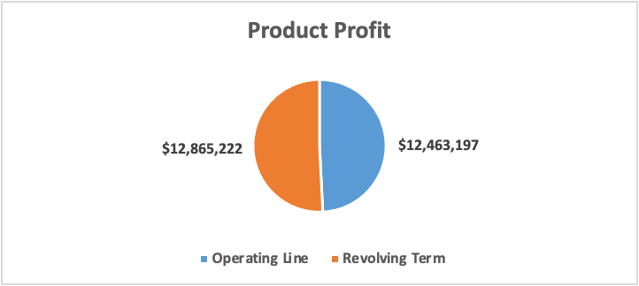
Portfolio Analysis - Product
Insights
Revolving term is the more profitable product
8

Slide 9
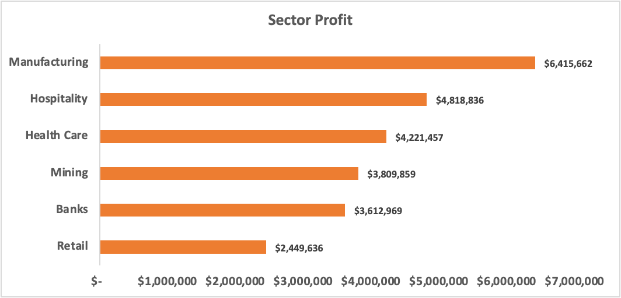
Portfolio Analysis - Sector
Insights
Manufacturing is the most profitable sector
Retail is the least profitable sector
9

Slide 10
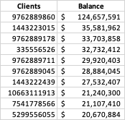
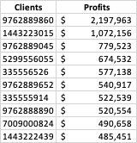
Portfolio Analysis - Clients
Client Information
480 unique clients
Top 10 Clients by Balance
Top 10 clients by Profit
10

Slide 11
Next Steps
Validate Data Quality Issues
Ensure that data elements are analyzed to ensure it is not a systematic issue
Portfolio analysis
Look at the different data elements again but incorporate a time element
11

