Slide 1

BOUTIQUE HOTEL ANALYTICS
YEAR | 2016

Slide 2
Objective
Challenges
KPIs
Revenue Optimization
65.18%
4.48 days
Improve Growth Opportunities
Occupancy Rate
Average Length of Stay
$100.50
$65.51
Average Daily Rate
Revenue per available room

Slide 3
Data Modeling
Data Checks
Solution Design
5 datasets provided
No missing data
No duplicate data
Request ID discrepancies
Year Correction (1916 to 2016)
Merged booking, requests and room details
Combined food order and menu details

Slide 4
Data Insights
BOOKING & REQUEST TREND
# of Bookings
Booking Revenue
Average Stay Duration
Highest in January (3690), lowest in February (3158)
Highest in January (1.65 million) and lowest in February (1.42 million)
Highest in February (4.5 days) and lowest in January (4.4 days)
Average # of Guests
Request Type Revenue
Average Stay Duration
Driven by weddings (53.4) and party (52.8)
Primarily driven by holiday (1.58 million) and business (1.2 million)
Primarily driven by holiday (4.6 days) and business (4.4 days)

Slide 5
Data Insights
ROOM TREND
Average # of Guests
Room Type Revenue
Average Price
Driven by small conference room (47.1) and large conference room (46.1)
Primarily driven by normal room (1.21 million, small conference room (1.04 million and business (0.94 million)
Primarily driven by deluxe room and large conference room ($150)

Slide 6
Data Insights
FOOD TREND
Food Revenue
Food Popularity & Revenue
Dinner is the largest revenue driver (44.74k)
Primarily driven by steak ‘n stuff, surf ‘n turf and vegetarian lasagna

Slide 7
Data Recommendations
Lead Time Data
Customer Satisfaction Score
Marketing Attribution
Knowing how far in advance guests book can help protect room inventory
It costs more to acquire new customers than keep current ones. Can leverage NPS
Tracking where requests originated from can help optimize advertising spend

Slide 8
Next Steps
Continuous Monitoring
Cost Analysis
Enhanced Data collection
Regular tracking of KPIs, booking trends and menu performance to detect shifts and opportunities
Review menu cost data to perform better profit analysis
Collect new data points such as lead sourcing, customer demographics to get more holistic business view and improve decision making
Customer Feedback
Seasonality Impact
Deep Dive Analysis
Gather and analyze feedback for different request types to better serve customers
Analyze longer term impact since data is limited to 3 months
Explore yield management, bundling options

Slide 9
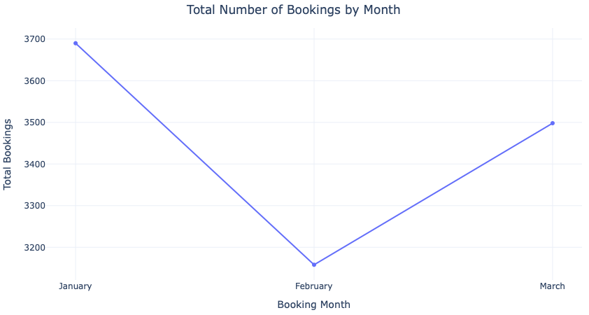
Appendix
Booking Trend
# of Bookings

Slide 10
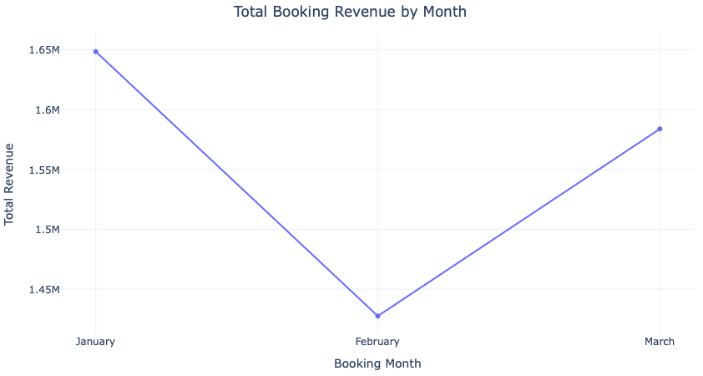
Appendix
Booking Trend
Booking Revenue

Slide 11
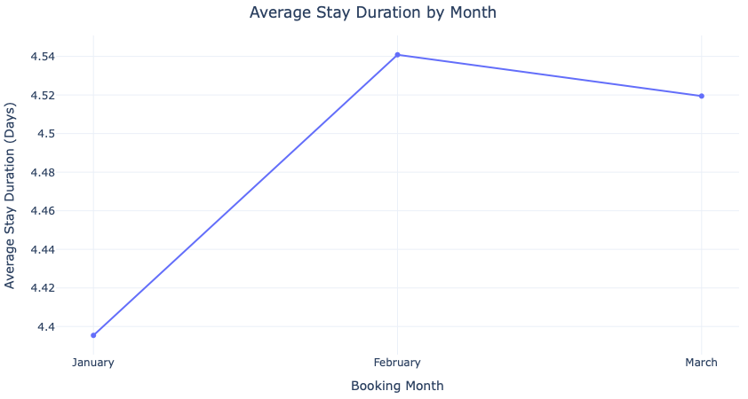
Appendix
Booking Trend
Average Booking Duration (Days)

Slide 12
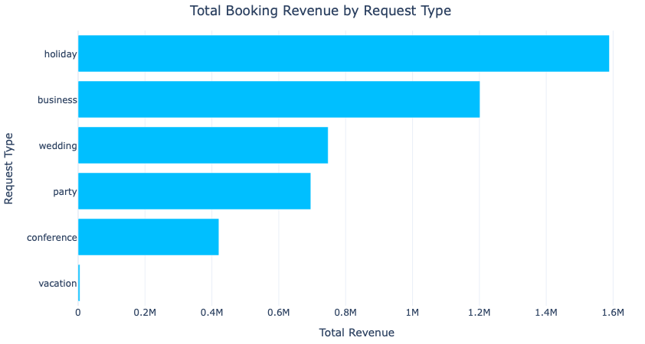
Appendix
Request Type Trend
Total Revenue

Slide 13
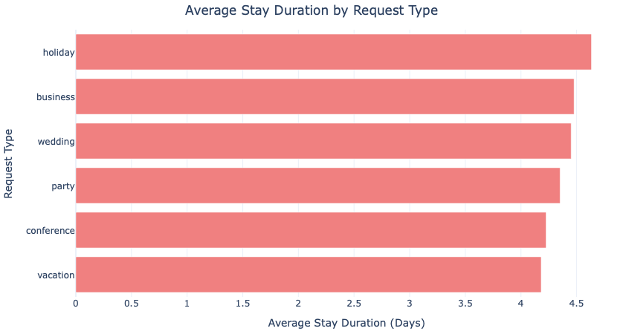
Appendix
Request Type Trend
Average Duration Stay

Slide 14
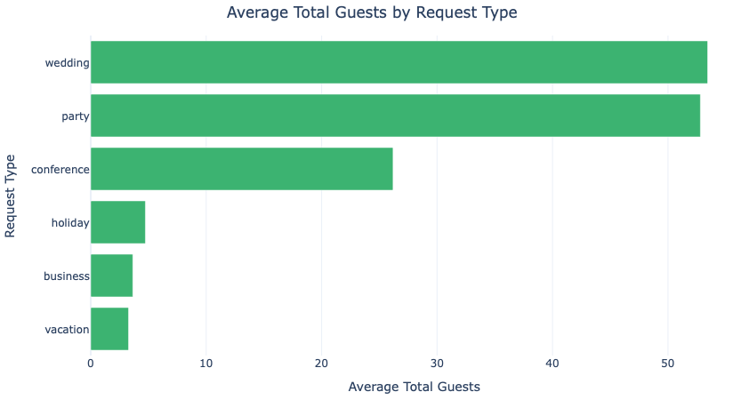
Appendix
Request Type Trend
Average Guest

Slide 15
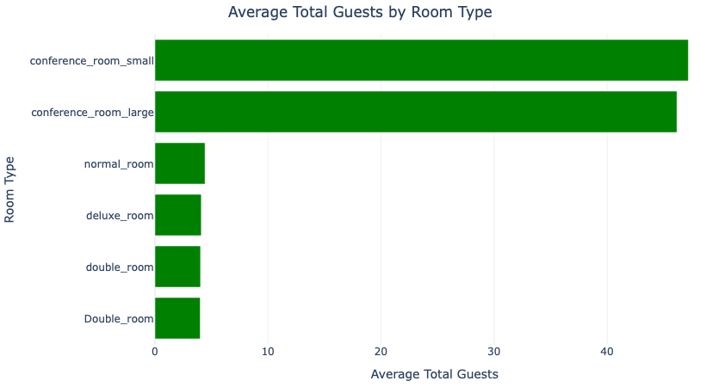
Appendix
Room Trend
Average Guest

Slide 16
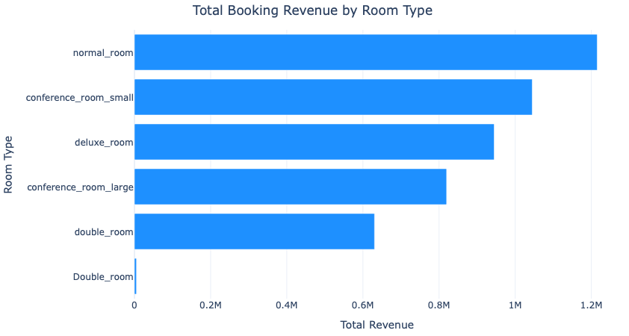
Appendix
Room Trend
Total Revenue

Slide 17
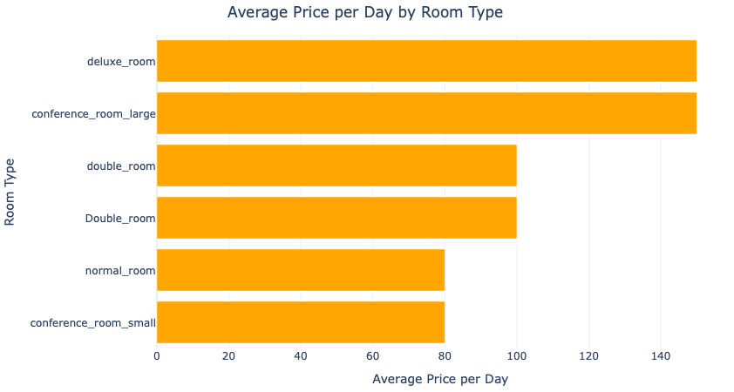
Appendix
Room Trend
Average Room Price

Slide 18
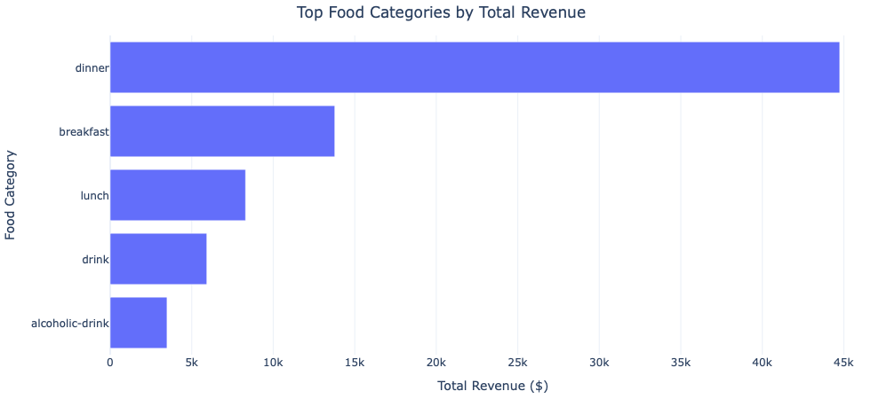
Appendix
Food Trend
Average Room Price

Slide 19
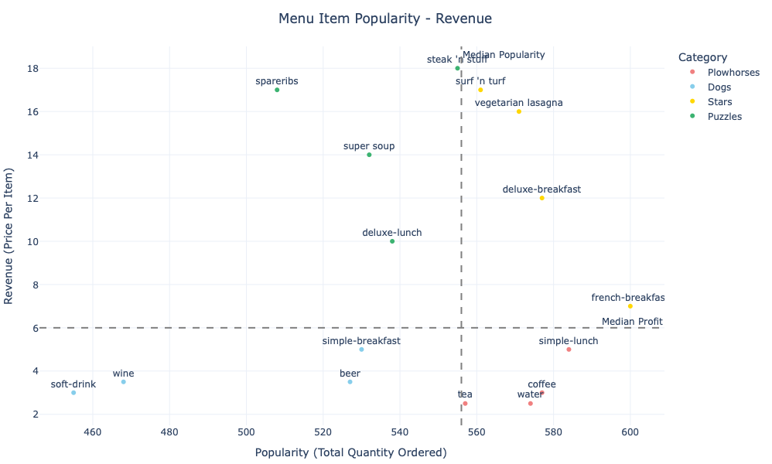
Appendix
Food Trend
Menu Popularity & Revenue

