Slide 1

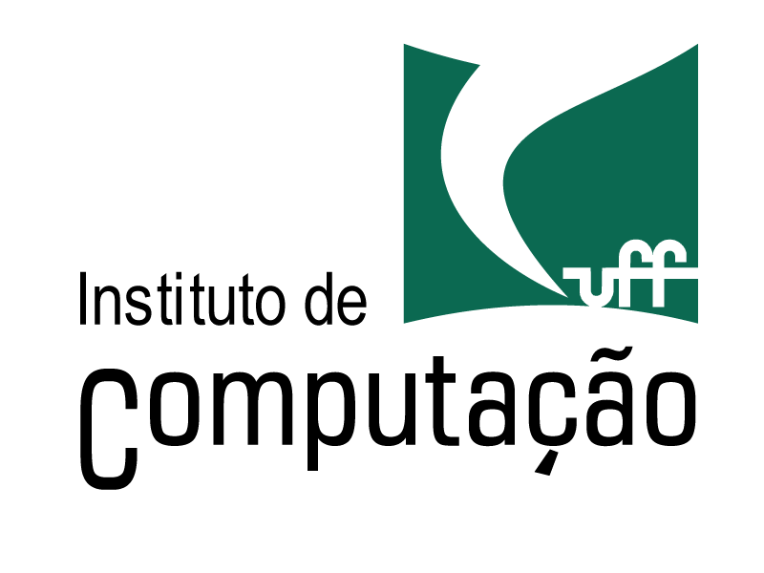


An Approach for Scientific Workflows Provenance Data Publication
on the Semantic Web
Rachel Castro, Renan Souza, Vítor Silva, Kary Ocaña, Daniel de Oliveira, Marta Mattoso

Slide 2
Agenda
Introduction
Publication Methodology on the Semantic Web
Our approach for data publication
PROV-O-Wf
Case Study
Conclusion and Future Works

Slide 3
Computational simulations in large-scale
SciEvol workflow
Validation of a scientific hypothesis
Chaining of scientific programs
Processing of complex computational models
Scientific Workflow Management Systems (SWfMS)
They allow to model, execute and monitor computational simulations by the abstraction of scientific workflows
1. Pre-Processing
FASTA file
2. MSA
Build
3. MSA
Conversion
4. Pre-Processing PHYLIP file
5. Tree
Build
6. Evolutionary Analyses
7. Evolutionary Data Analysis

Slide 4
Workflow Provenance Data
They enable the reproduction of computational simulations
Data about workflow composition and execution
Information about the flow of data between programs
Limitations
They can be stored with some access restrictions (e.g., private databases)
Usage of unstructured files
Limited query capabilities
Without a standard for organizing data

Slide 5
Workflow Provenance Data
Publication process of provenance data can enhance analysis
Sharing of provenance data
Validation of scientific hypothesis
Analysis based on the history of the execution of computational simulations

Slide 6
Semantic Web
An extension of the Web through standards by the World Wide Web Consortium (W3C)
They recommend data formats that facilitate data interchange on the Web
e.g., Resource Description Framework (RDF)
A standard model for data interchange on the web
Semantic Database Management Systems (DBMS) allow to:
Run structured queries
Publish on the Web
Facilitate interoperability
e.g., OpenLink Virtuoso, Jena TDB

Slide 7
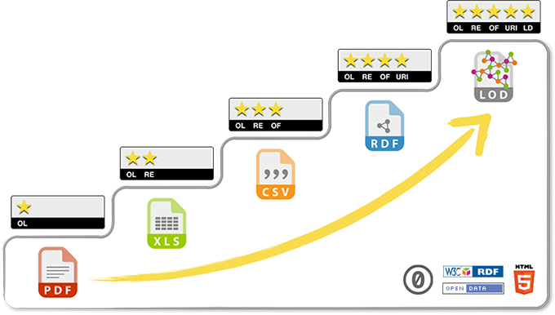
5-star Open Data
1 star → Make your data available on the web
2 stars → Make it available in a structured way
3 stars → Make it available in a non-proprietary open format
4 stars → Use URIs to denote things, so that people can point at your stuff
5 stars → Link your data to other data to provide context
Extracted from 5-star Open Data (http://5stardata.info)

Slide 8
Our approach for data publication in scientific workflow scenario
Adoption of Semantic Web technologies
To publish workflows provenance data on Web in a structured, standardized, open and interoperable manner
Development of an ontology for representing the main concepts in a scientific workflow scenario
PROV-O-Wf
Case study based on a bioinformatics workflow
SciEvol workflow

Slide 9
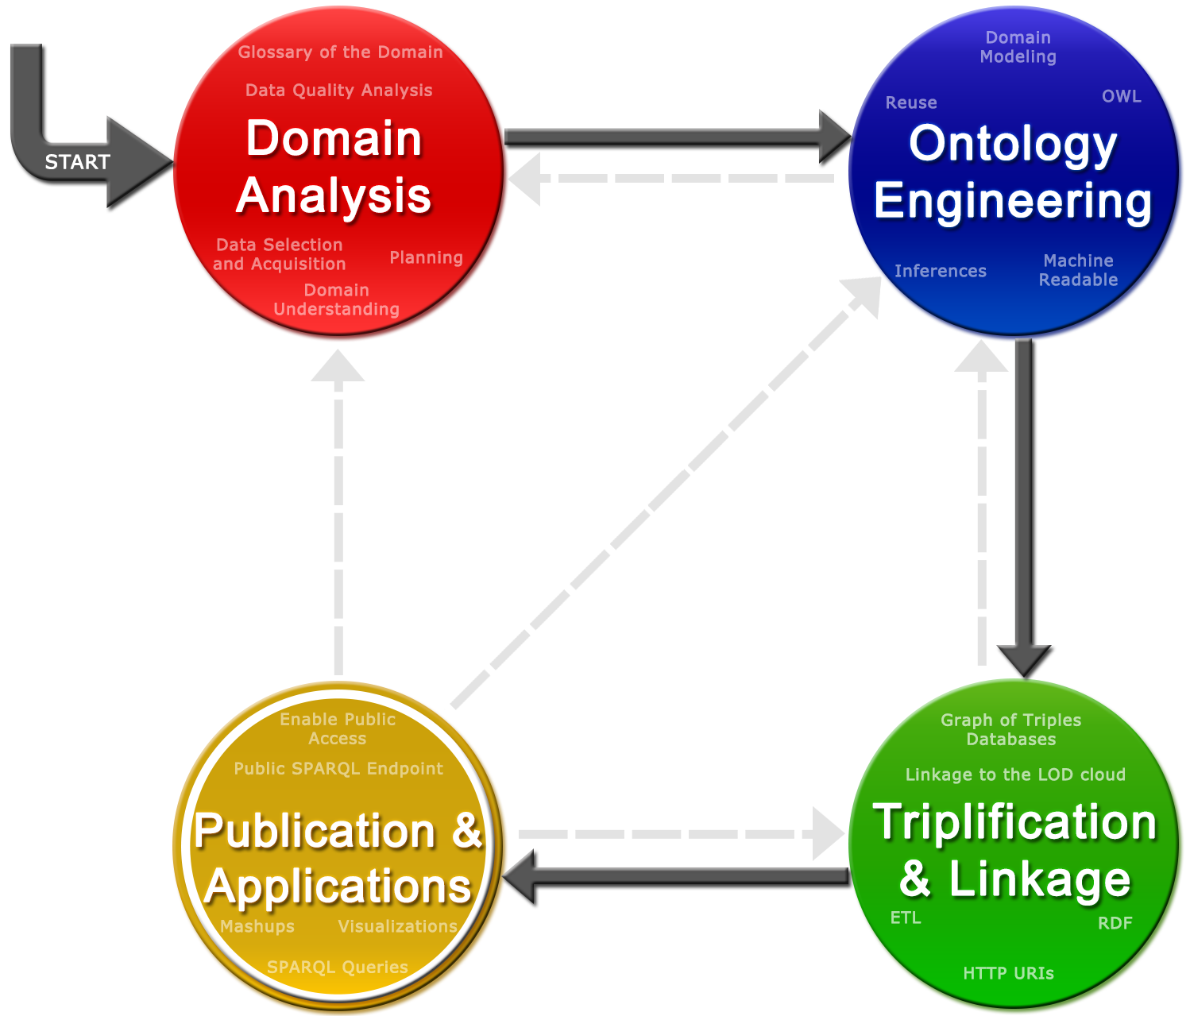
Publication Methodology on the Semantic Web
Souza, R., Cottrell, L., White, B., Campos, M. L. and Mattoso, M. (2014) “Linked Open Data Publication Strategies: Application in Networking Performance Measurement Data”, In: 2nd ASE ^{International} Conference on Big Data Science and Computing, Stanford, CA, USA.

Slide 10
Domain Analysis
Domain analysis based on the scenario of computational simulations
Execution of large-scale scientific workflows on HPC environments
Provenance data should also be gathered during workflow execution
We experimented on a SWfMS that gathers fine-grained provenance data in order to present domain-specific data

Slide 11
Ontology engineering
Ontology reuse as an important characteristic
IntelLeo ontology
SGWfC Taverna → MyGrid
PROV-O and OPMW
They are W3C recommendations and independent of the domain
Data model for representing fine-grained provenance data
PROV-Wf
They were not used
Notes:
A ontologia IntelLeo [Jovanovic et al. 2012], apesar de modelar workflows e apoiar execução paralela, não menciona dados de proveniência, dificultando a sua utilização no nosso domínio
Procurou-se também por ontologias de SGWfC existentes, porém só foi possível encontrar a ontologia do sistema Taverna, chamada de MyGrid [Wolstencroft et al. 2008], a qual foca apenas em workflows da área da bioinformática e a modelagem não utiliza padrões do W3C.
A ontologia PROV-O segue o modelo de dados de proveniência PROV-DM [Moreau et al. 2013], que é uma recomendação do W3C. Já a ontologia Open Provenance Model for Workflows (OPMW) descreve proveniência de workflows e é baseada no Open Provenance Model, um padrão reconhecido [Moreau et al., 2008].
-----------------------

Slide 12
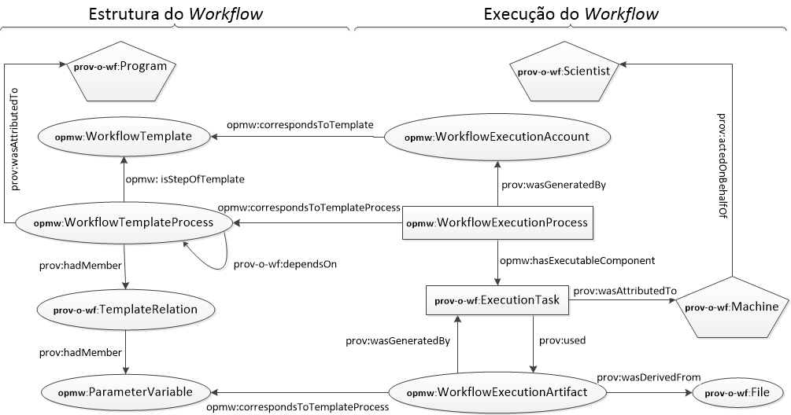
PROV-O-Wf
PROV-O was used as a meta-model to the ontology
Reuse of PROV-Wf for representing provenance data
Workflow composition
Workflow execution
Notes:
entidade (representadas por elipses), atividade (retângulos) e agente (pentágonos)

Slide 13
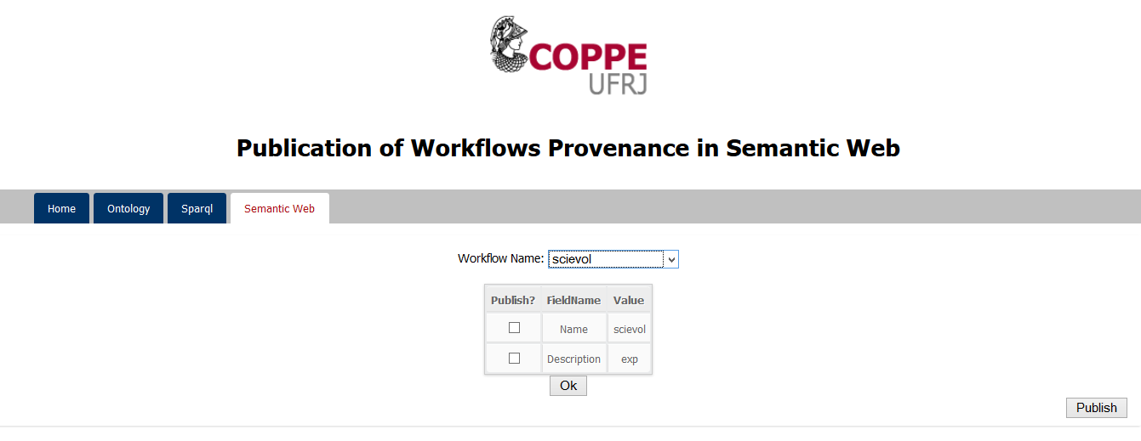
Triplification and Publication
Generation of RDF triples following the ontology PROV-O-Wf
ETL operations
Extracting data from the SWfMS’s provenance database
Web interface
User defines which provenance data will be published
Visualization of published data

Slide 14
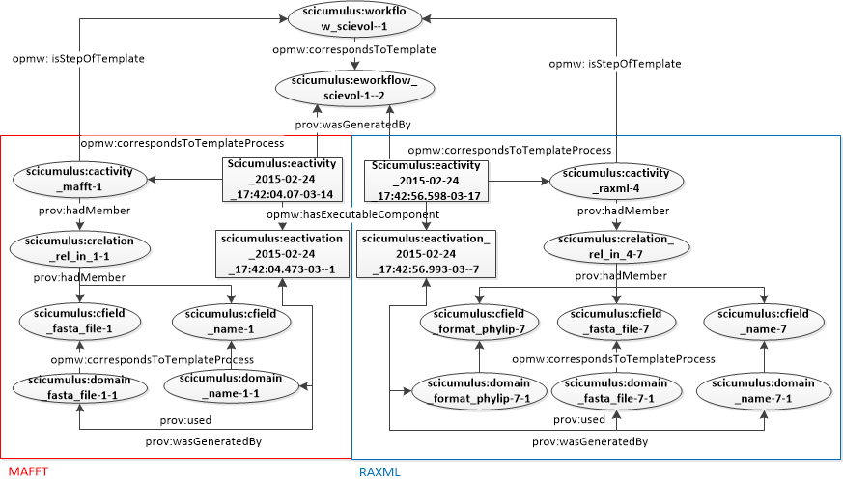
Case study
SciEvol workflow executed using SciCumulus SWfMS
Object-Relational DBMS: Open Link Virtuoso

Slide 15
Conclusion and Future works
We developed an ontology for data publication
PROV-O-Wf
Reuse of standard ontologies
Representation of fine-grained provenance data on the SW
Independent of scientific domain and SWfMS
Future works
Provide relationships with data already published on the cloud of Linked Open Data (LOD)

Slide 16
Thank you!
An Approach for Scientific Workflows Provenance Data Publication
on the Semantic Web
Rachel Castro, Renan Souza, Vítor Silva, Kary Ocaña, Daniel de Oliveira, Marta Mattoso

