Slide 1
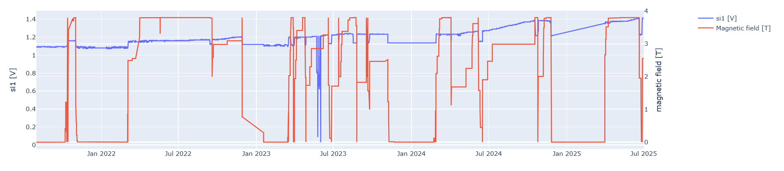
Unfiltered data

Slide 2
Processing steps:
Find intervals with stable magnetic field at maximum value (around 3.8 T)
Find the mode in voltage value for each luminosity value.
Smooth the data
Find deviation from each averaged data point
Calculate flux/dose from voltage

Slide 3
Smoothing algorithm
Walk through data points, keeping track of “current” stable voltage value and assign points to it until a new stable value is found.
Value will be considered stable if it occurs more than w amount of times consecutively.

Slide 4
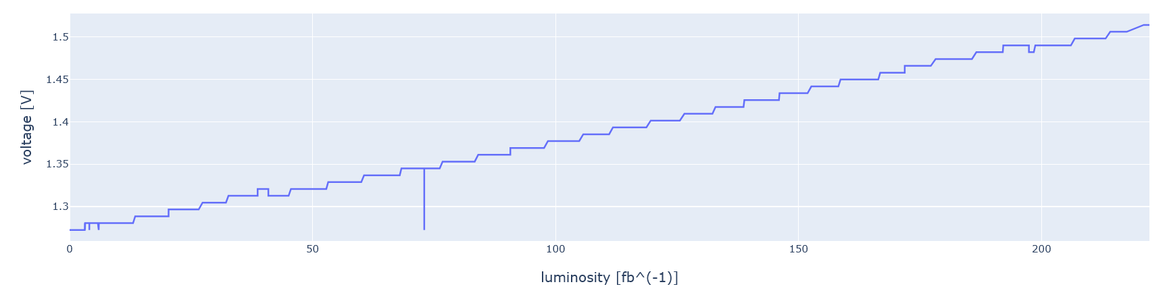
Filtered magnetic field

Slide 5
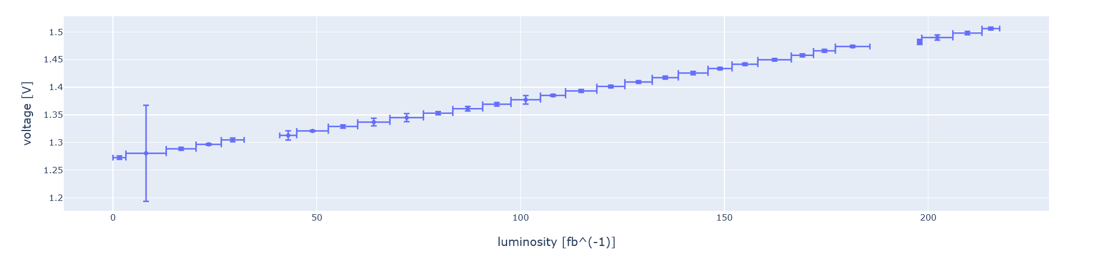
Filtered voltage

Slide 6
Voltage to flux/dose

Slide 7
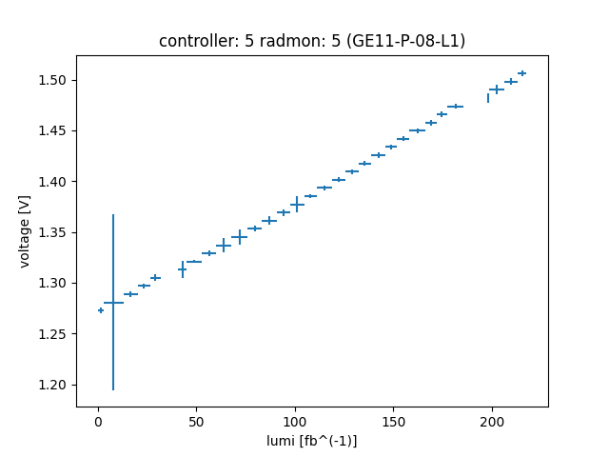
Voltage to flux

Slide 8
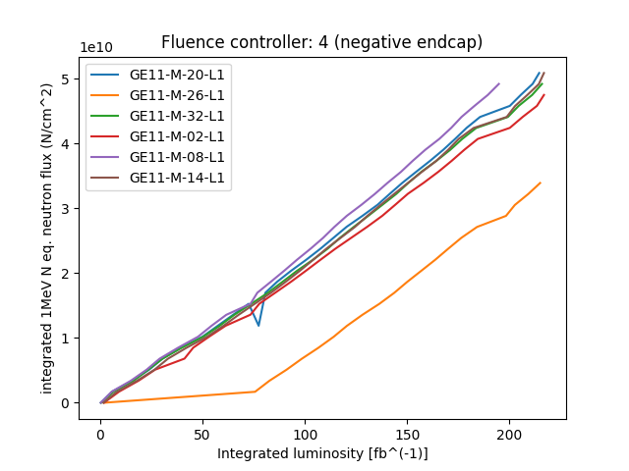
Flux comparison

Slide 9
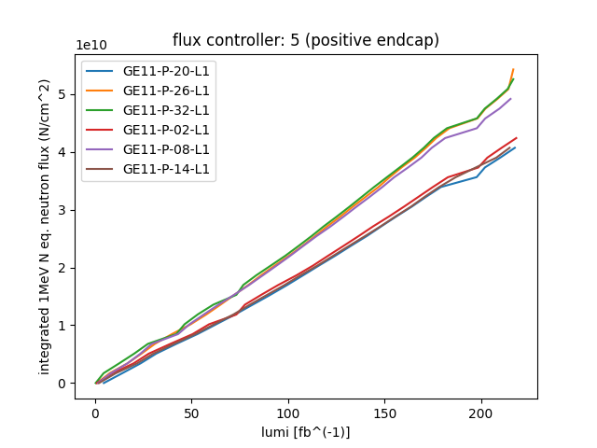
Flux comparison

Slide 10
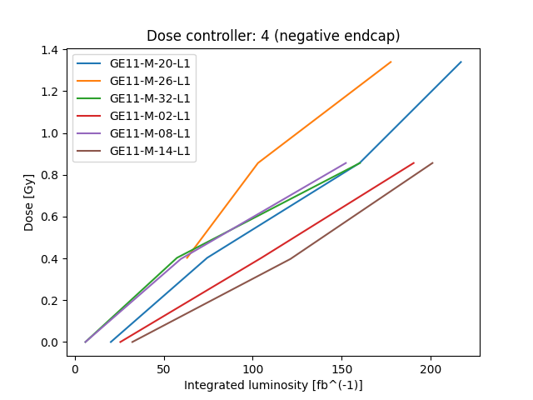
Dose comparison

Slide 11
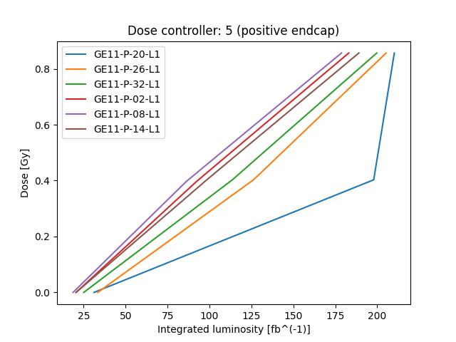
Dose comparison

