Slide 1

Patterns in the UK Flora

Slide 2
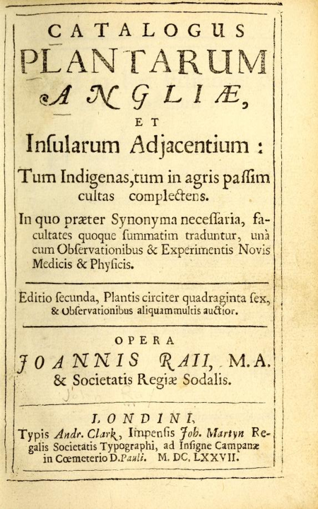
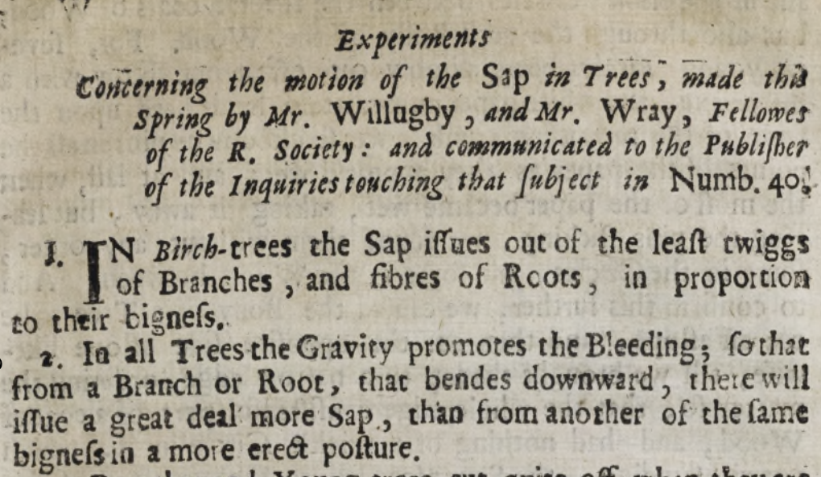
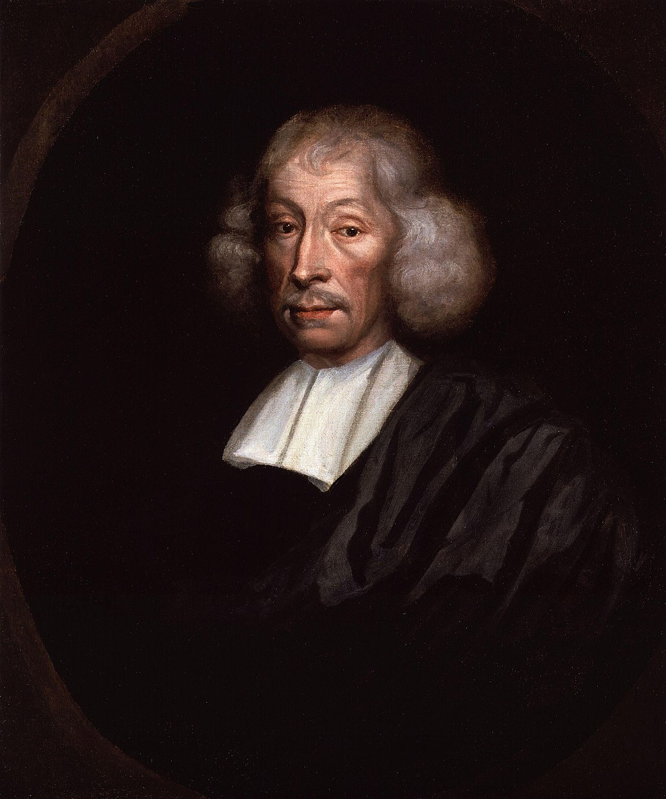
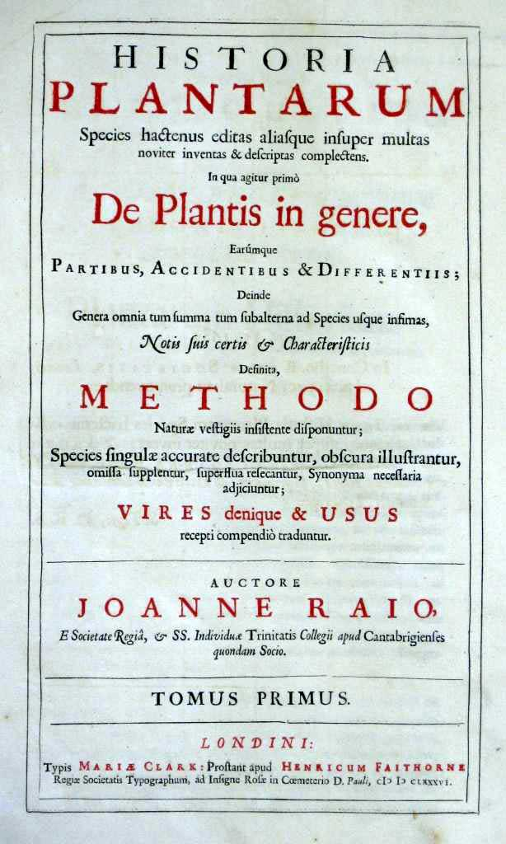
Long history of UK Flora study
Also physiology
Catalogue of English Plants,
1668
“no surer criterion for determining species has occurred to me than the distinguishing features that perpetuate themselves in propagation from seed. Thus, no matter what variations occur in the individuals or the species, if they spring from the seed of one and the same plant, they are accidental variations and not such as to distinguish a species”
Rev John Ray FRS
(1627 – 1705)
And clear definition of species

Slide 3



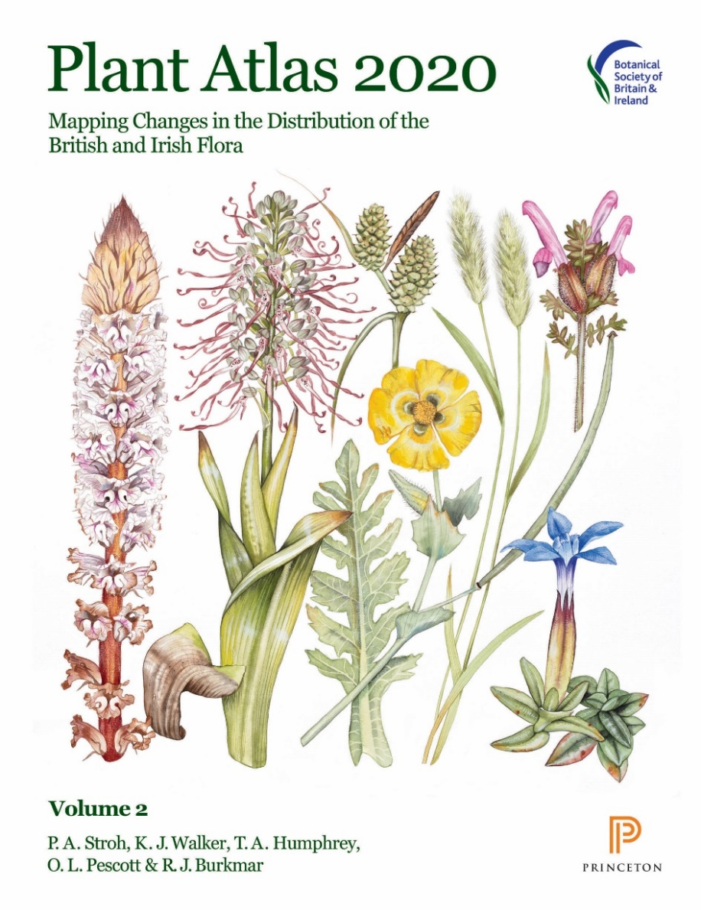
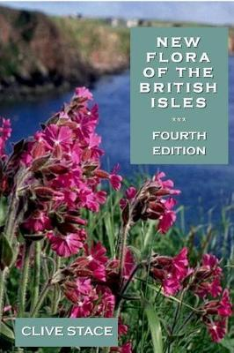

Huge literature!

Slide 4
Advantages to working with the UK Flora
Provide insight into general biological processes
Includes representatives from across the plant tree
of life and from diverse habitats.
Tractability
Manageable size, knowledge of species diversity & natural history…
Resources
Living collections, conservation assessments, ecological data, 40M occurrence records, 735+ genome sizes estimates, 3000+ genetic publications…
Community of researchers
Large amateur botanical recording community and significant academic interest.
Notes:
The Arabidopsis of regional floras

Slide 5
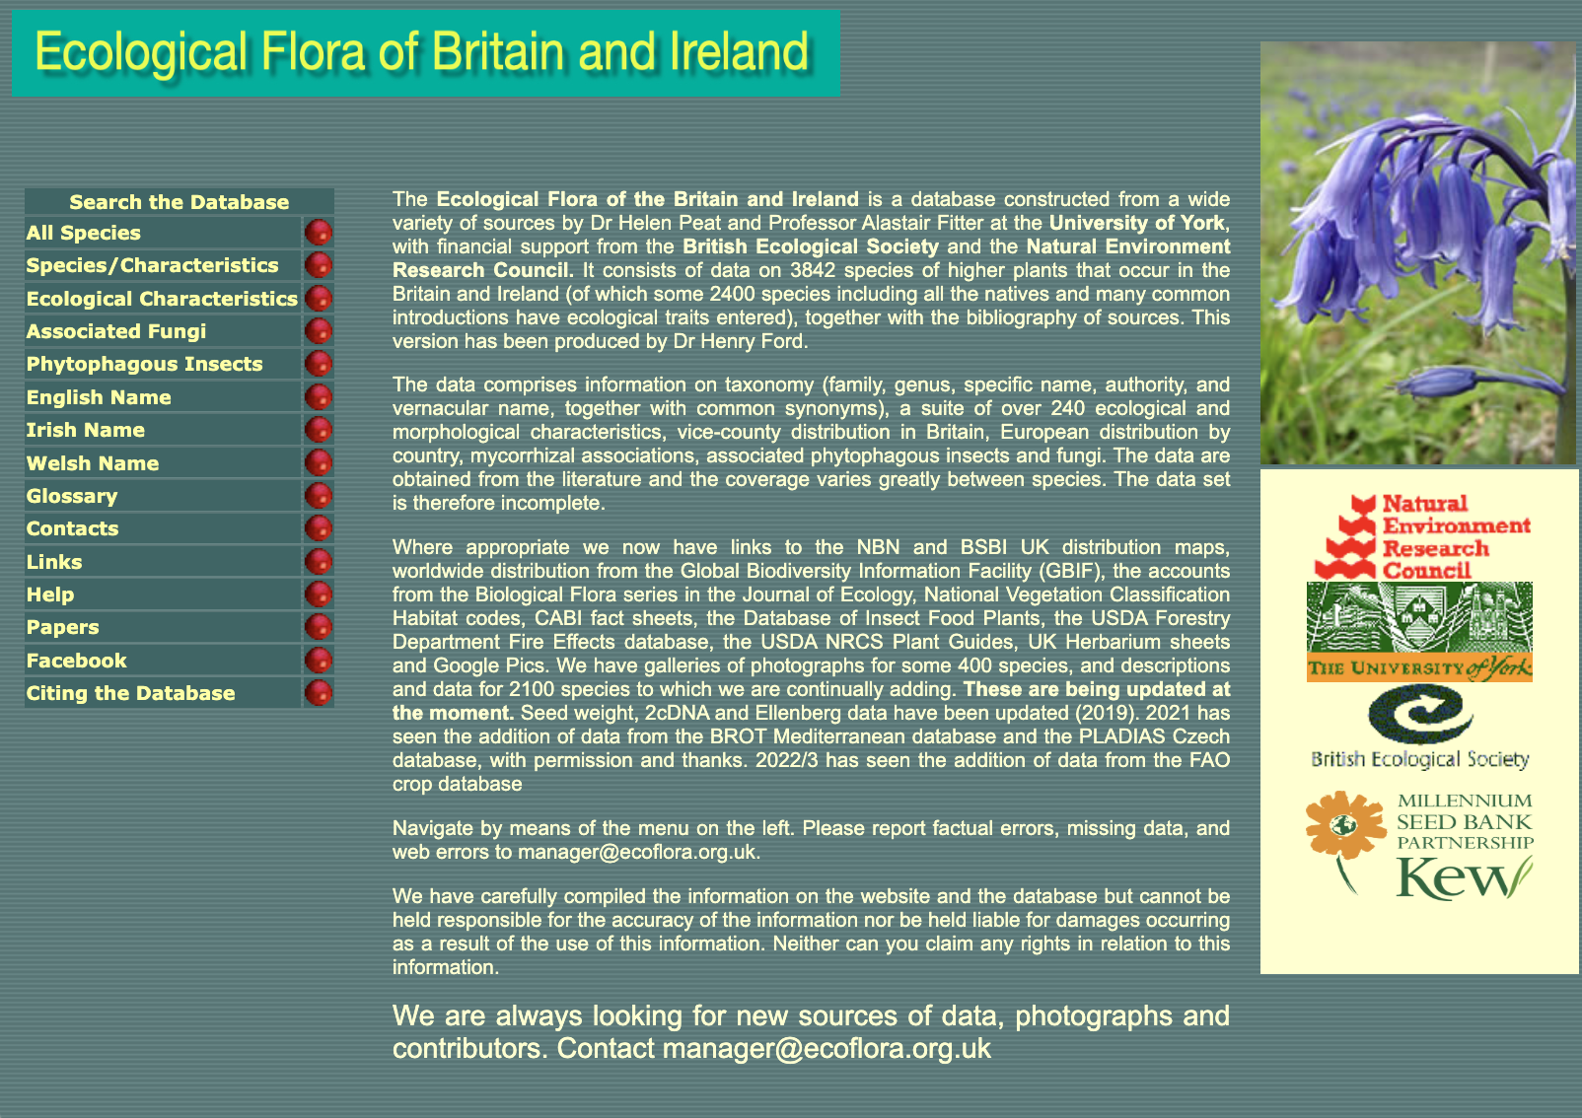
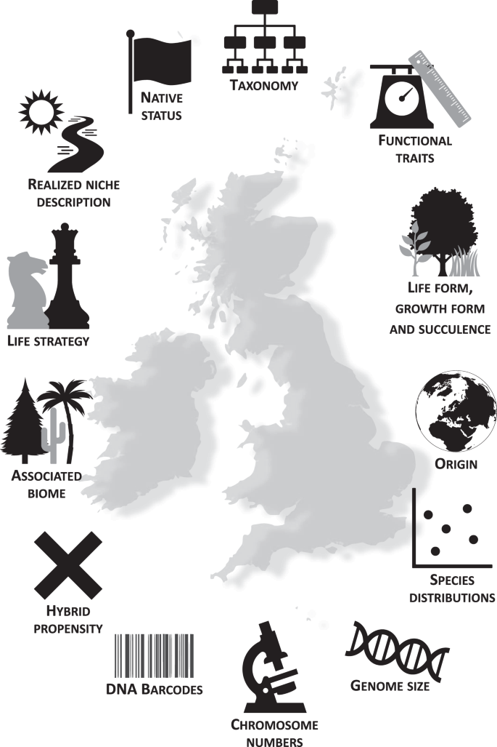
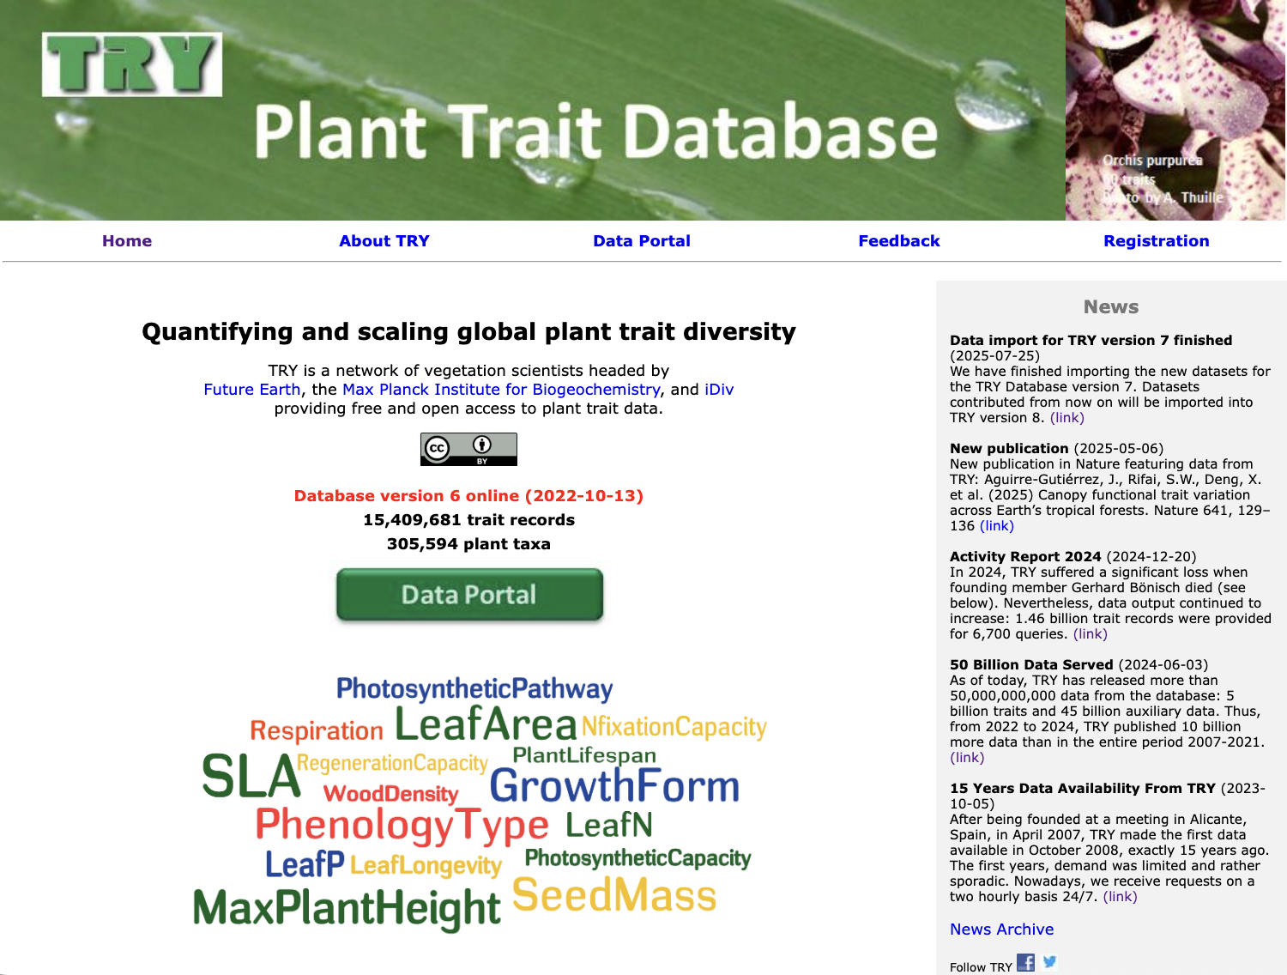
Sources for this dataset
UK Flora Explorer: A taxonomic, genetic and ecological data resource for the vascular plants of Britain and Ireland

Slide 6
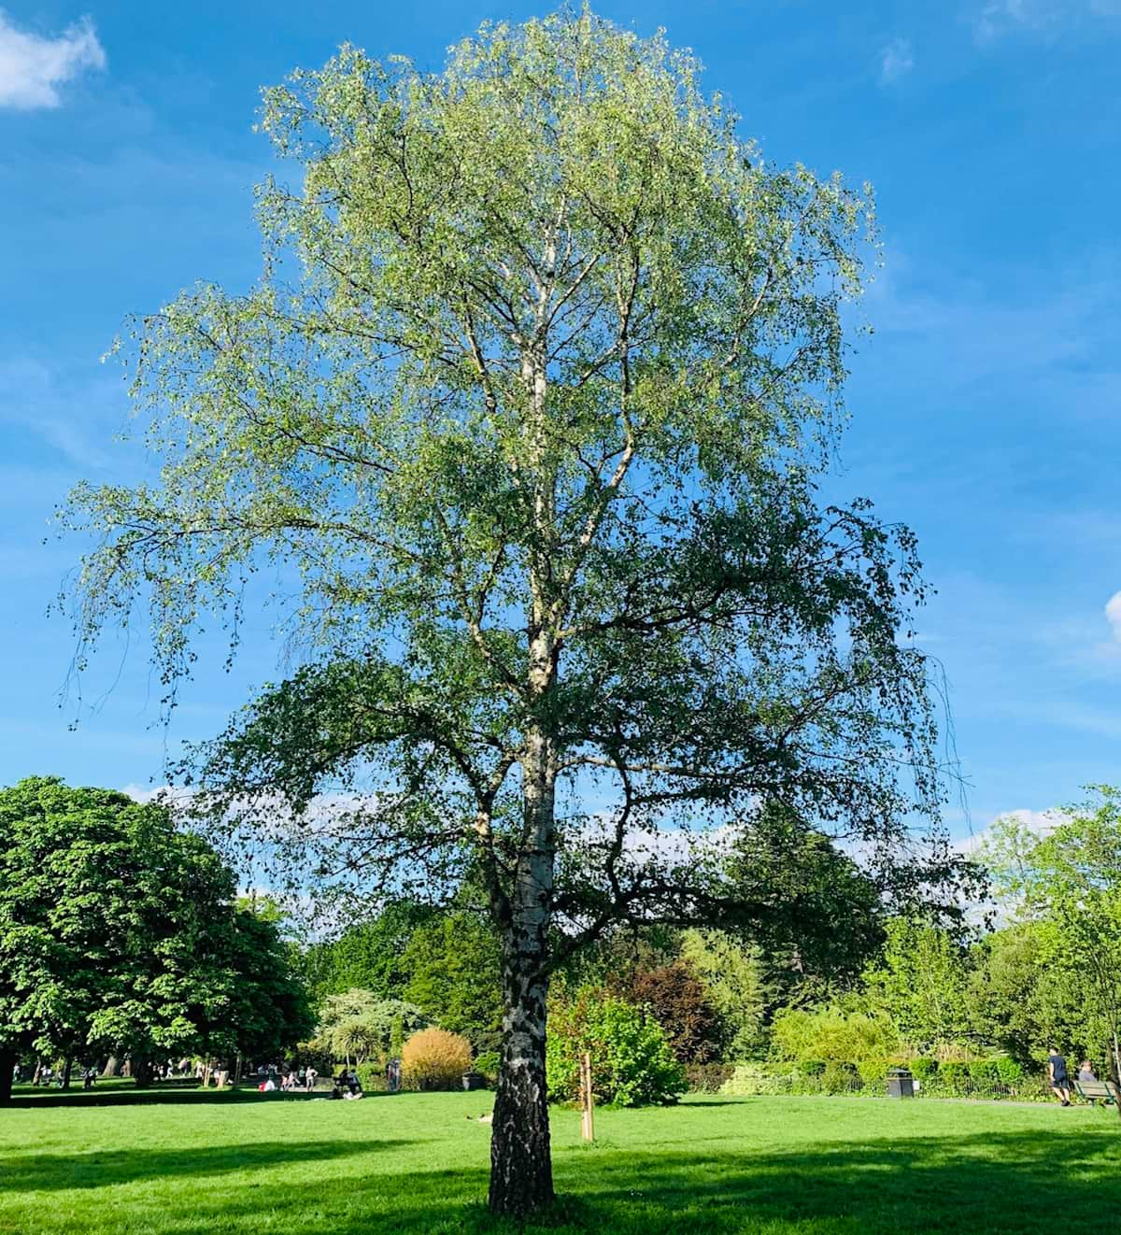
Taxonomy
Binomial betula pendula authors Roth
order Fagales
family Betulaceae
genus Betula
species pendula
WCVP_URL Kew plants of the world https://wcvp.science.kew.org/taxon/295174-1
POWO_URL http://plantsoftheworldonline.org/taxon/295174-1
IPNI_URL International Plant Names index https://ipni.org/n/295174-1

Slide 7
Growth form, succulence and life-form
Growth form: e.g. herb, shrub, tree… aquatic, graminoid, fern
Succulent: succulent vs n/a
Species life-form (defined by where their buds are positioned)
Hydrophyte | Aquatic herb, buds are submerged in water or in soil underneath water, leaves may float or be submerged, flowering parts may emerge (=‘aquatics’)
Helophyte | Buds are fully submerged in water or within water-saturated soil, flowers and leaves emerge fully (=‘emergents’)
Geophyte | Above ground parts die outside the growing season, plant survives as a bulb, rhizome, tuber or root bud
Hemicryptophyte | Herbaceous stems that tend to die back outside the growing season, buds survive on or just under the soil level, includes many biennial and perennial herbs
Therophyte | Life cycle is completed within one growing season, surviving as a seed until the next growing season (=‘annuals’)
Chamaephyte | Herbaceous or woody stems, buds above soil, but not exceeding 50 cm (=‘shrubs’)
Phanerophyte | Persistent, woody stems, buds usually 3 m or more above ground, trees and larger shrubs (=‘trees’)

Slide 8
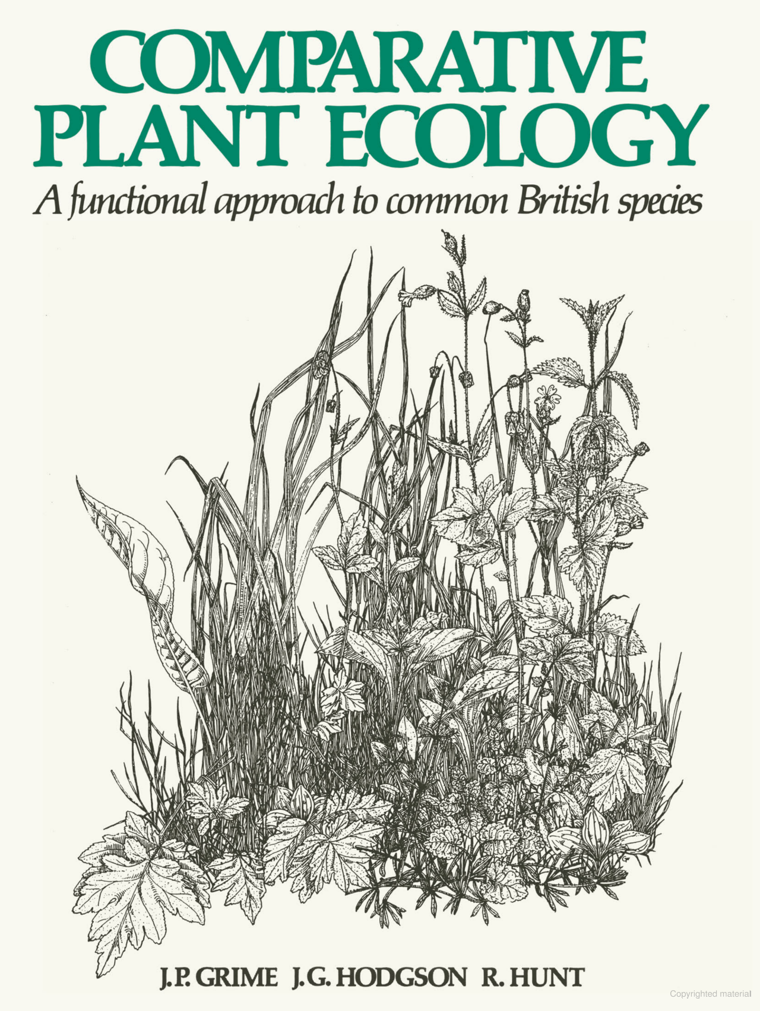
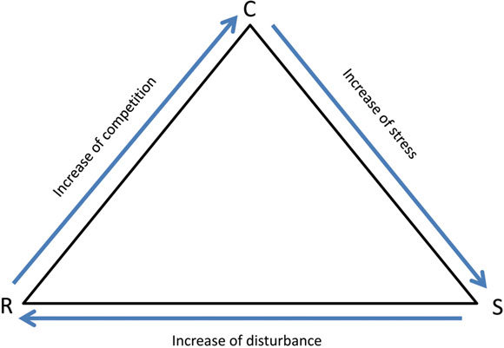
Life strategy
Competitor (C): rapid growth and exclusion of competitors
Stress tolerator (S): protect performance in variable/poor environments
Ruderal (R): invest in propagules to regenerate following disturbance

Slide 9
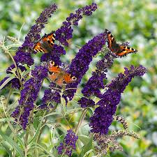
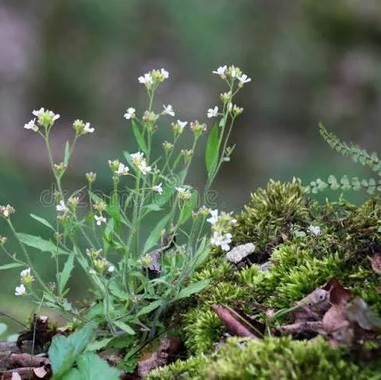
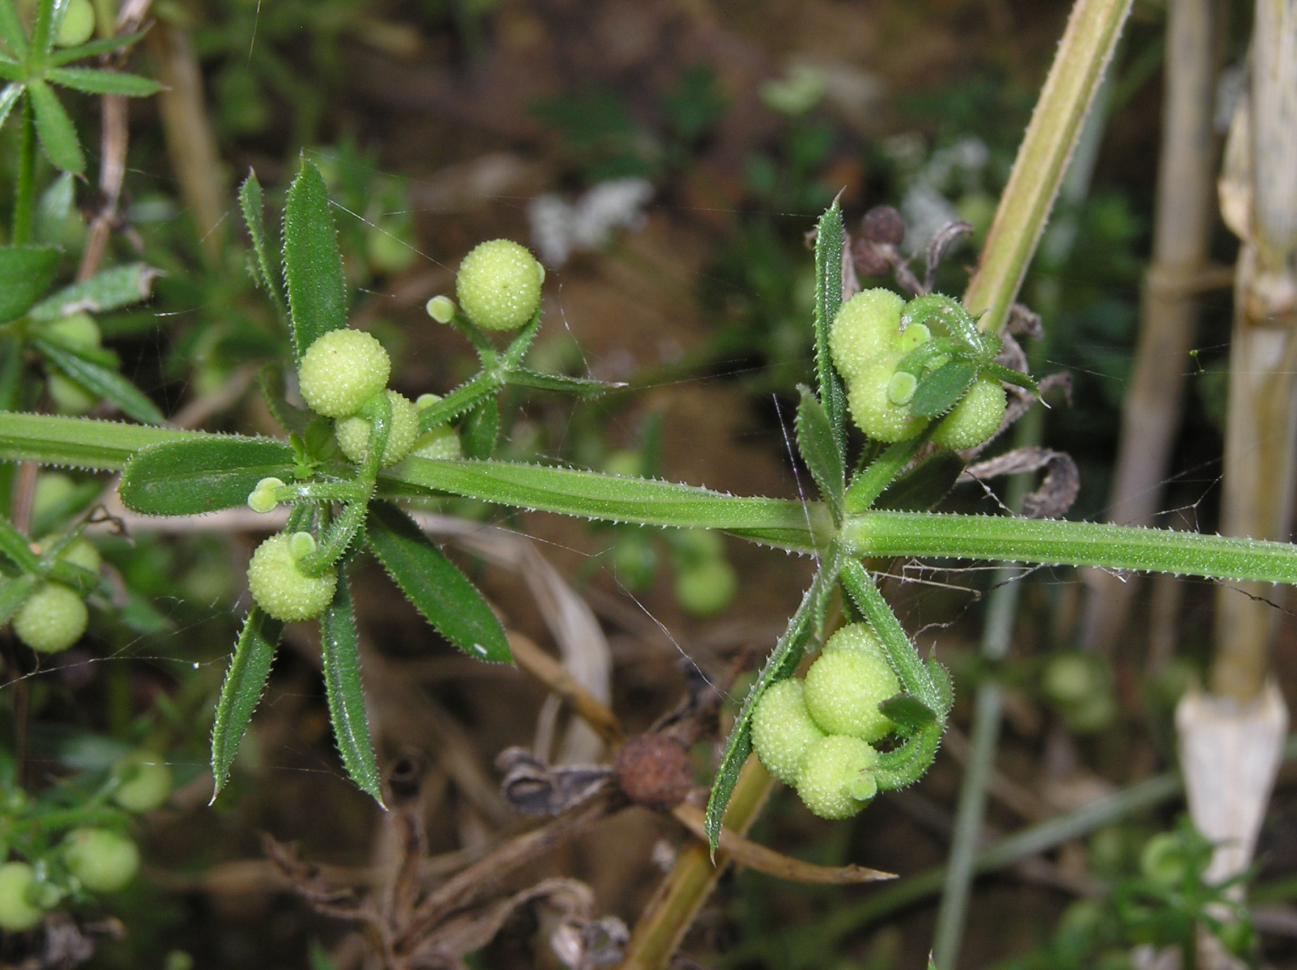
Native status
StaceIV_nativity
according to Stace 2019
Atlas_nativity_viaALIENATT_PLANTATT
according to Atlas of the British Isles
Stace_Crawley_nativity_aliens
according to Alien Plants by Stace & Crawley, 2015
Neophyte – introduced 1896
Native – Naturally arrived after end of ice age (or persisted)
Native endemic – species originated here
Archaeophyte - Plants introduced to the UK before 1500 AD
Neophyte - Plants introduced to the UK after 1500 AD
Alien Casual – occasionally grows here but not established
Arabis arenosa
Alien casual
Archaeophyte –
came in with first farmers
https://bsbi.org/definitions-wild-native-or-alien

Slide 10
Associated biome and origin
The species’ distribution in the Northern Hemisphere.
Arctic montane, Boreal Montane, Boreo-Arctic Montane, Boreo-Temperate, Mediterranean, Mediterranean-Atlantic, Southern Temperate, Temperate, Wide Boreal and Wide Temperate.
Only for native species.
Origin: the region that plants were most likely to have been introduced from.
Only for introductions

Slide 11
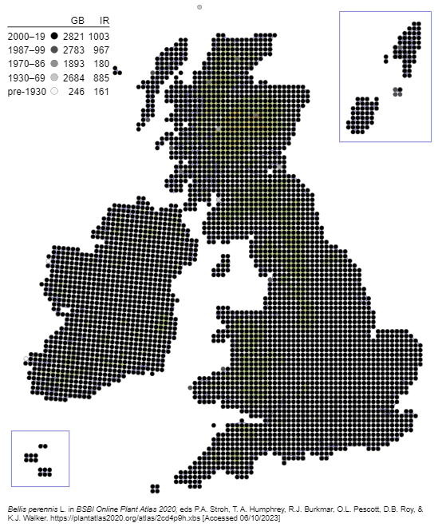
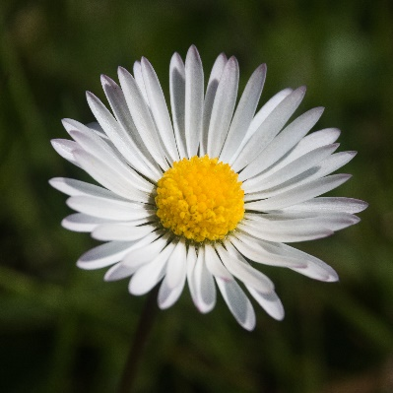
Species distributions
Distribution metrics for each species are given as the number of 10-km square, not corrected for sampling bias (and should therefore only be used as an indication of trends).
Split by area (GB+Man, Ire, CI), and time interval, some of which overlap (1987-1999, post 2000, 2000-2009, 2010-2019).
A treasure trove of information

Slide 12
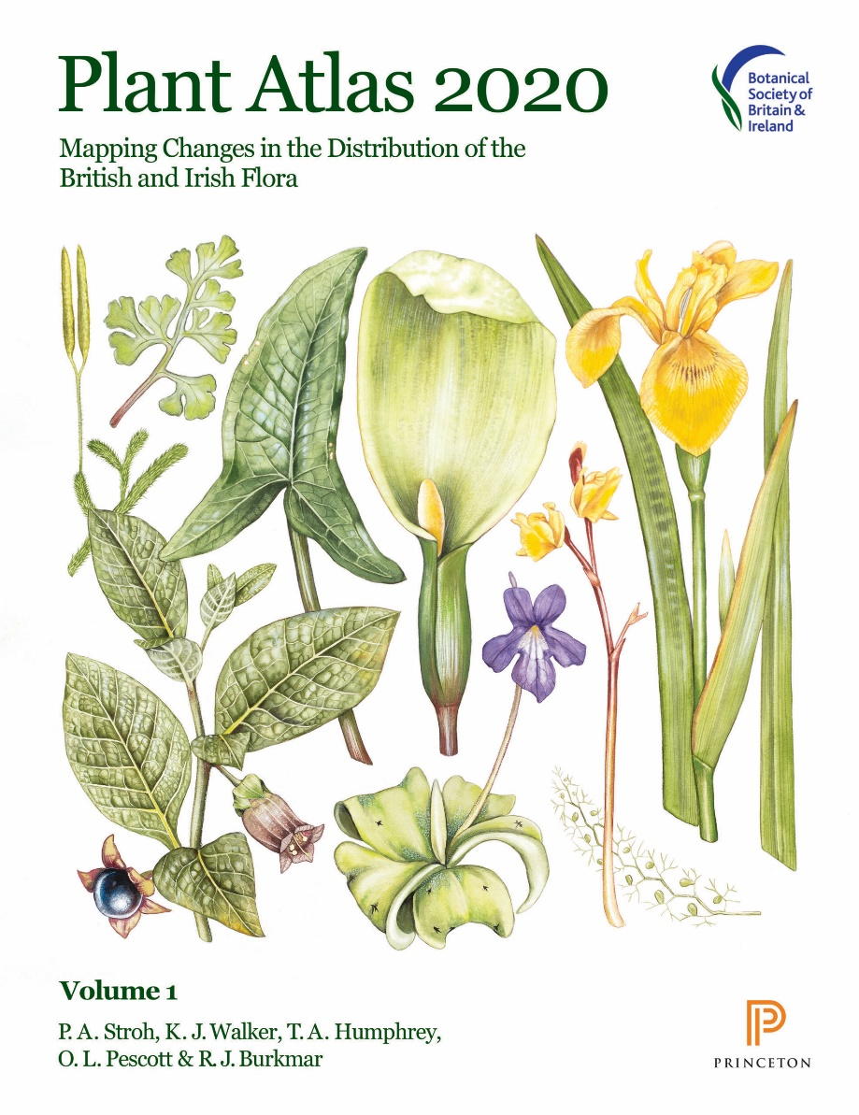
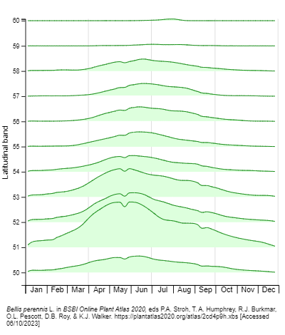
Species distributions
https://plantatlas2020.org
Apparency

Slide 13
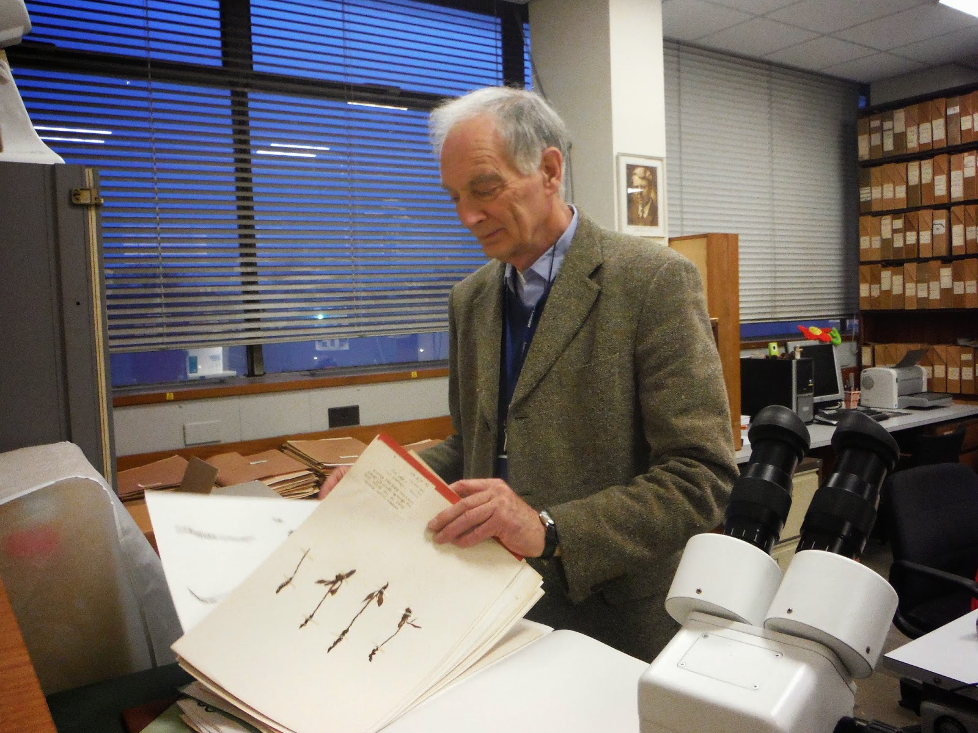
Hybrid propensity
Natural hybridisation: cross mating of different species in the wild.
Hybrid propensity: number of hybrids a given species forms.
Scaled hybrid propensity: weighting hybrid propensity score by the number of intrageneric combinations for a given genus, to account for the greater opportunities of hybridization in larger genera.
Clive Stace in the Herbarium at Leicester

Slide 14
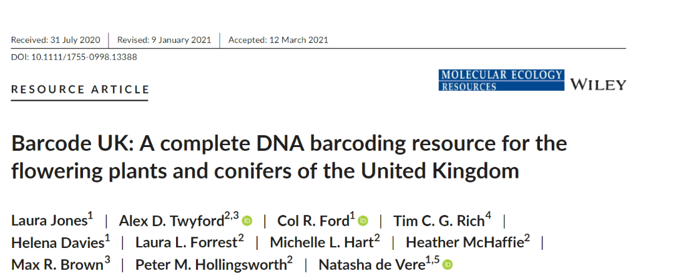
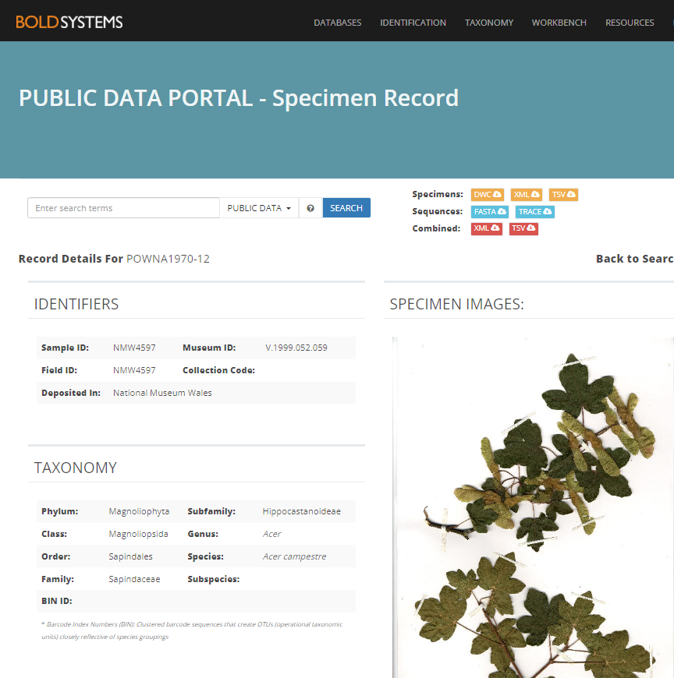
DNA barcode
matK, rbcL, ITS
6100 specimens from 1482 species
81% herbarium specimens
Links to the Barcoding of Life Database…

Slide 15
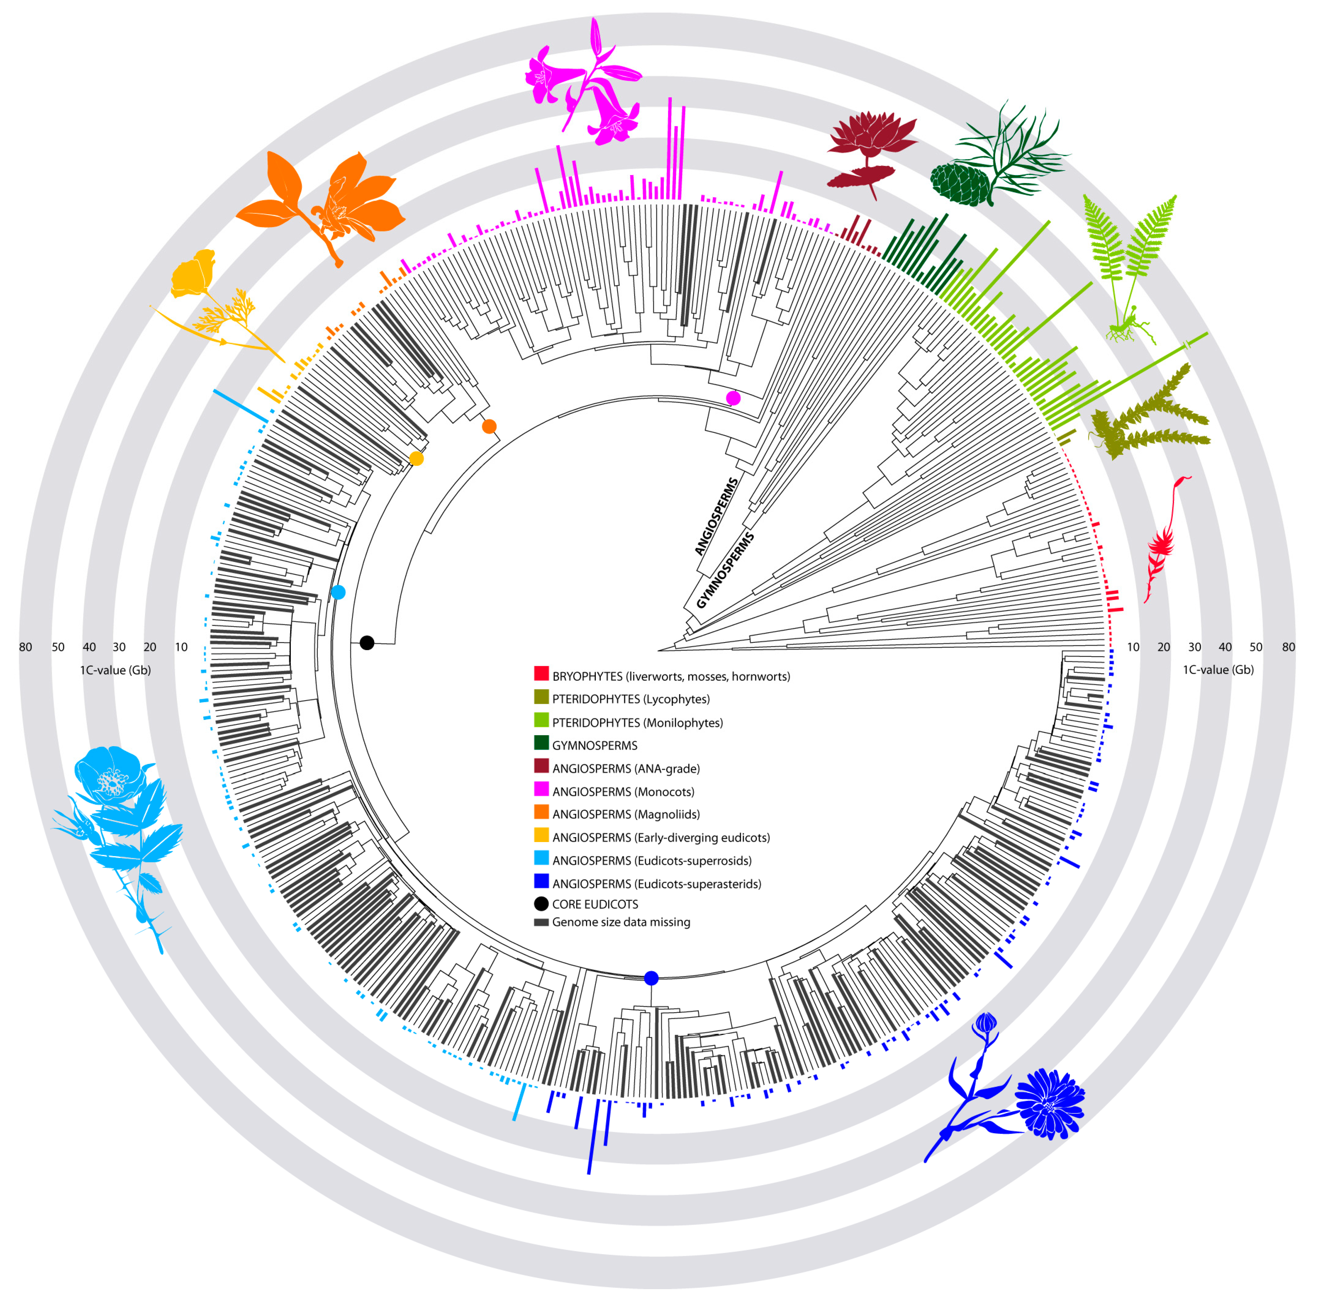
Plant genome sizes vary wildly
C-value = picograms (pg) DNA in a haploid nucleus
1 pg = 978 Mbp
GS_1C_pg
GS_2C_pg
GS_1C_Mbp
GS_2C_Mbp
Pellicer et al., (2018) Genes

Slide 16
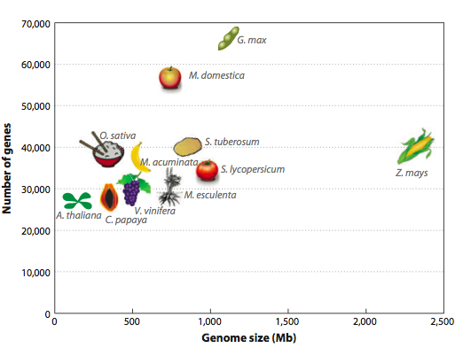
Large genomes not due to lots of genes
Notes:
Why do some groups have genomes so much bigger than others? It’s not more genes. This plot shows the number of gene by genome size for some key crop plants. Even maize, with a giant monocot genome of nealy 2500Mb has about 30-40,000 genes. The outliers her are apple and soybean with 60-70,000 genes. Both of these species are recent polyploids – their genomes doubled, and this is reflected in nearly twice the normal number of genes.

Slide 17

Genome expanders
Simple repeats
Transposons
Duplications
Polyploidy
An example repeat – many thousands of copies of this in B. heracleifolia
Begonia species
Other Cucurbitales species
Other examples with active TEs
Other crop species
Notes:
So what’s in the giant genomes? All kinds of stuff. I’ve mentioned polyploidy , which happens A LOT in plants and I will discuss in more detail later. There is also lots of smaller scale duplication of genes. The majority of non-genic space in genomes is made up of repeats and transposons. A repeat is any short sequences which appears many times in the genome. This histogram gives you a idea of the variation here. Between 10 and 90% of the genome can be repeats – here maize is on the far right . Highlighted in pink are some of the Begonia species which I work on, one of things we are studying is the evolution of the repeat fraction of the genome and you can see how much variation there is even within a single genus.

Slide 18
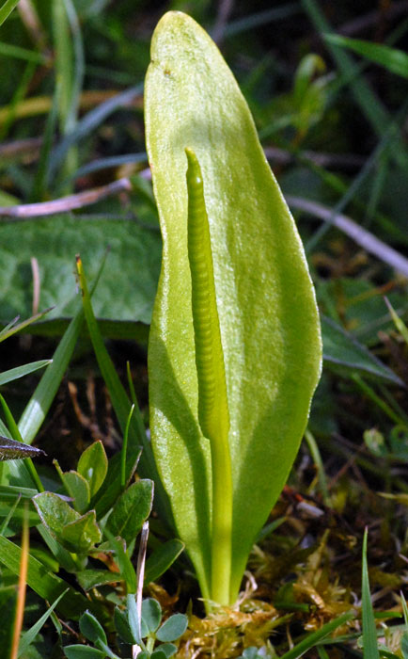
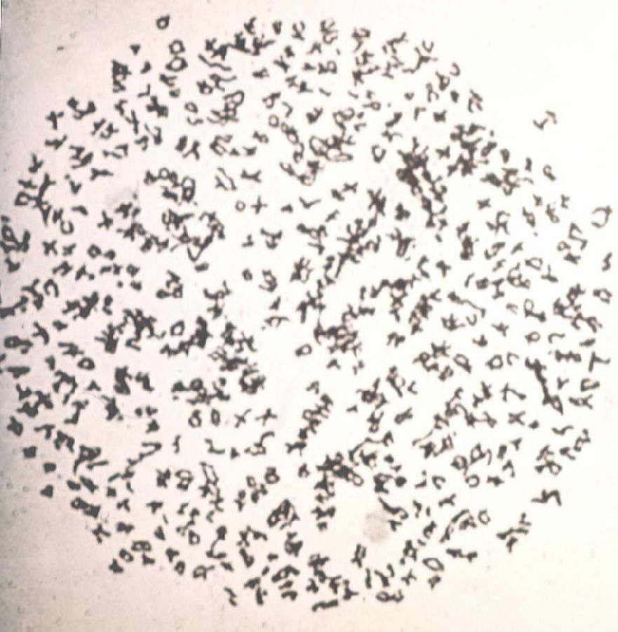
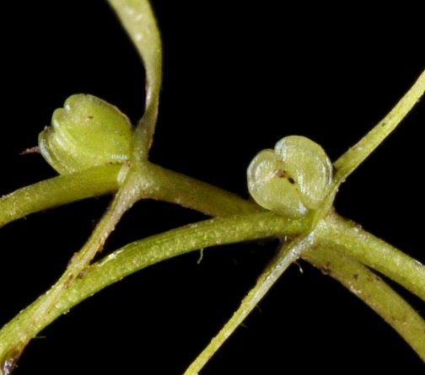
Chromosome number
Chromosome numbers for 1,410 species from the BI.
Image: Gerry Carr
Callitriche hermaphroditica
2n=6
Ophioglossum vulgatum
2n=520

Slide 19
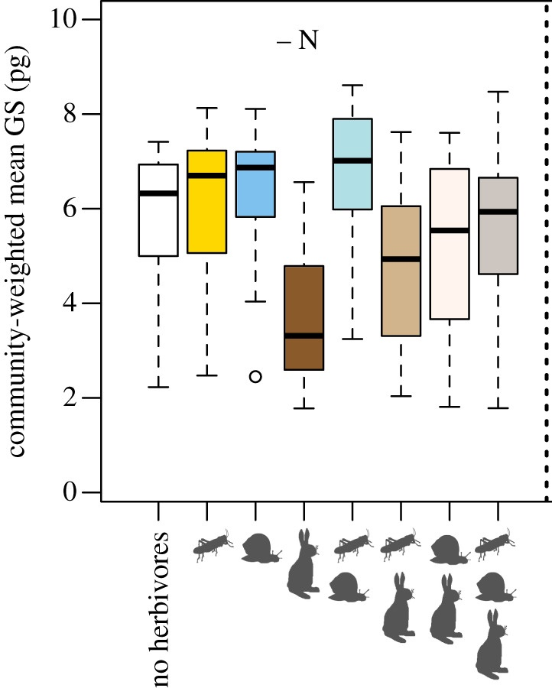
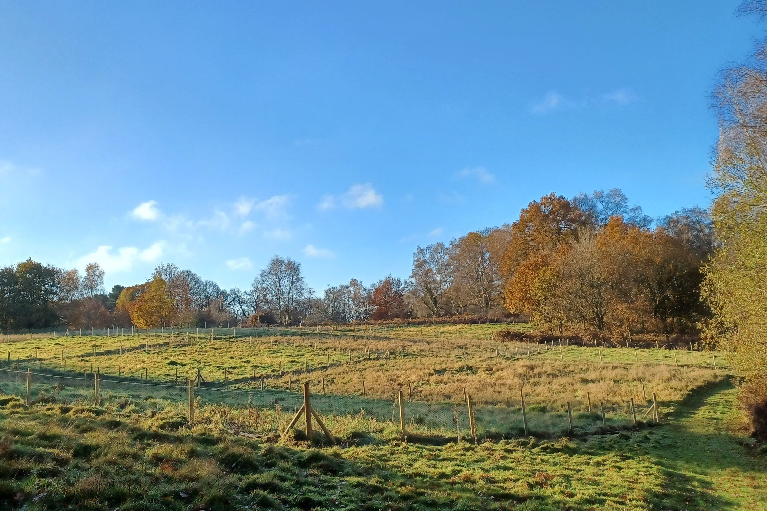
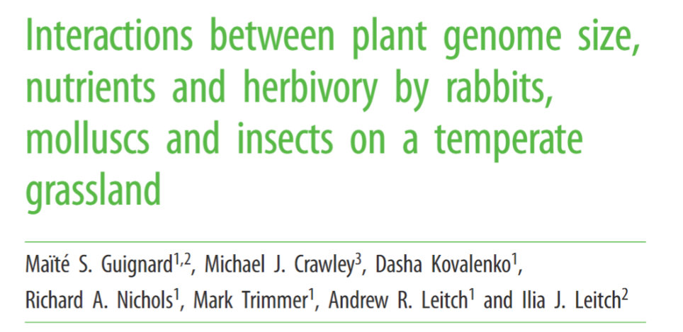
Does genome size affect community composition?
Nash’s Field in Silwood Park
Rabbit grazing associated with smaller genomes.
Rabbits preferentially eat plant taxa with large genomes?
Plant taxa with smaller genomes are better able to recover from the rabbit grazing pressure?

Slide 20
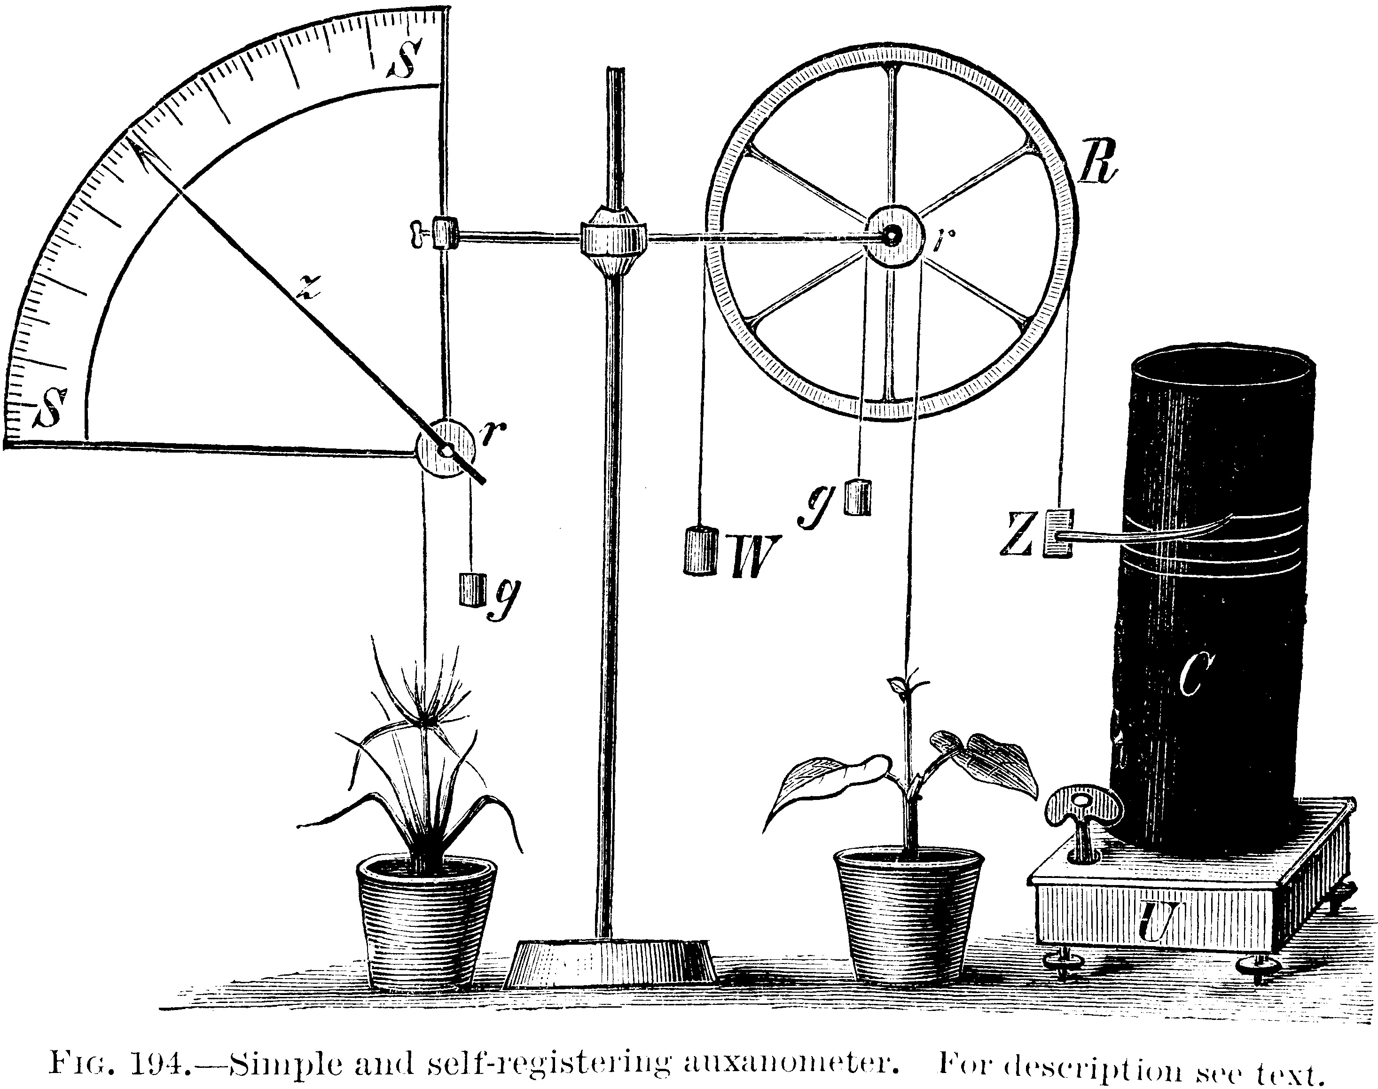
Functional Traits
Fundamental characteristics that influence the performance and ecological role of plants
Easy to measure:
Seed Mass
Plant height
Leaf Area to Mass ratio (SLA)
Leaf dry matter content (LDMC)
Trickier to measure:
Root phosphate content
Xylem conductivity
Stomatal conductance
Photosynthetic capacity
Sobral, Mar. "All traits are functional: An evolutionary viewpoint." Trends in Plant Science 26, no. 7 (2021): 674-676.

Slide 21
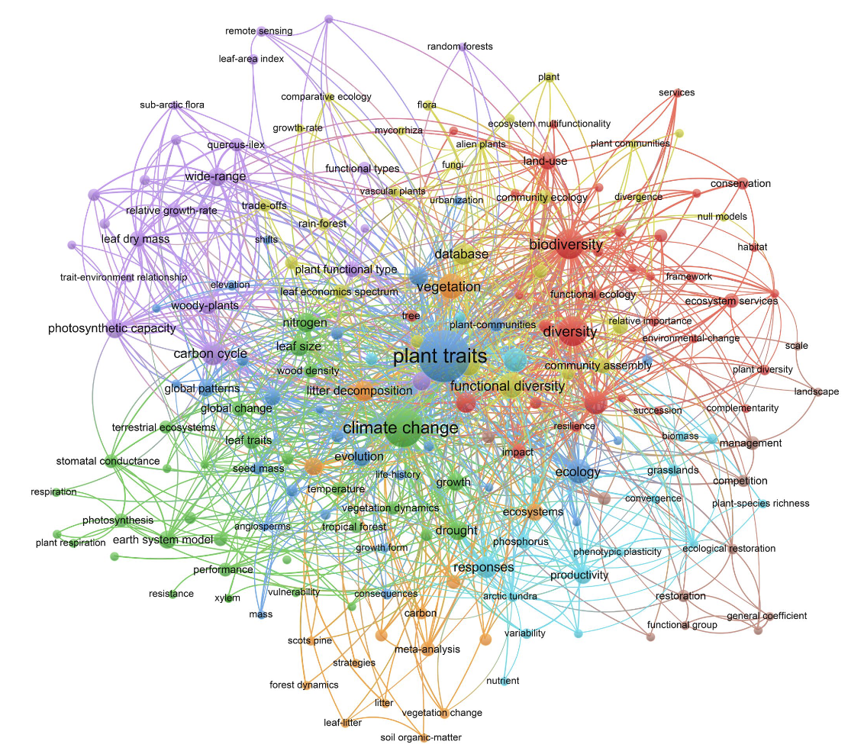
Functional traits
SLA = 91.722, LDMC = 0.169
SLA 15.540, LDMC 0.357

Slide 22
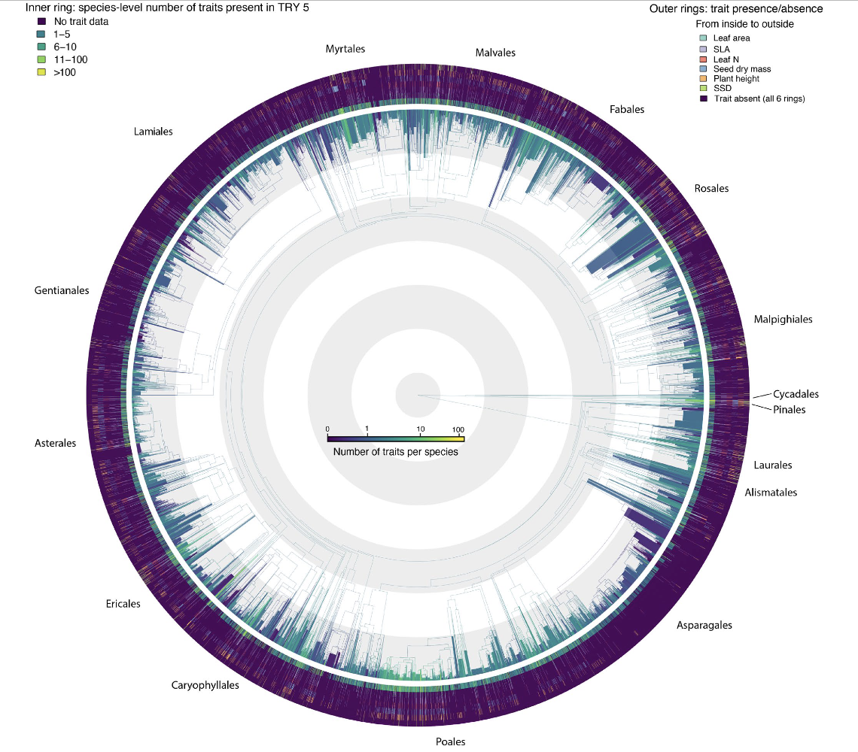
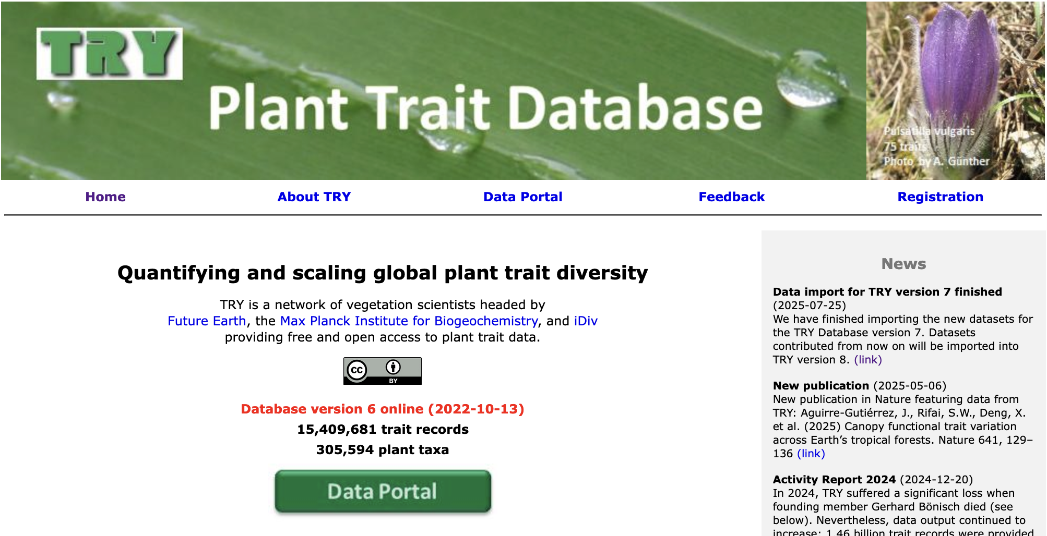
Open Access
Extensive
Diverse

Slide 23
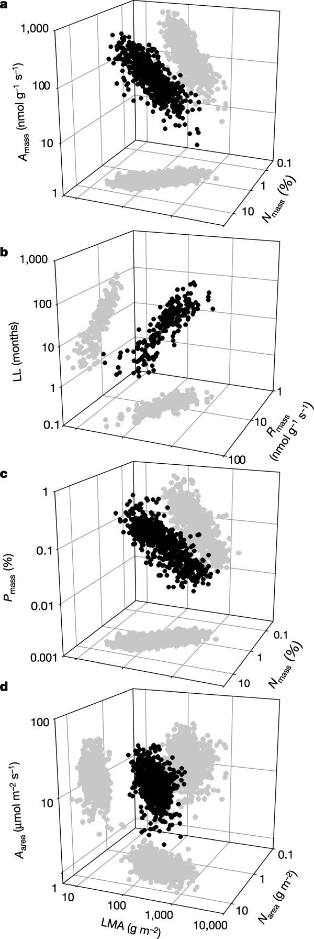
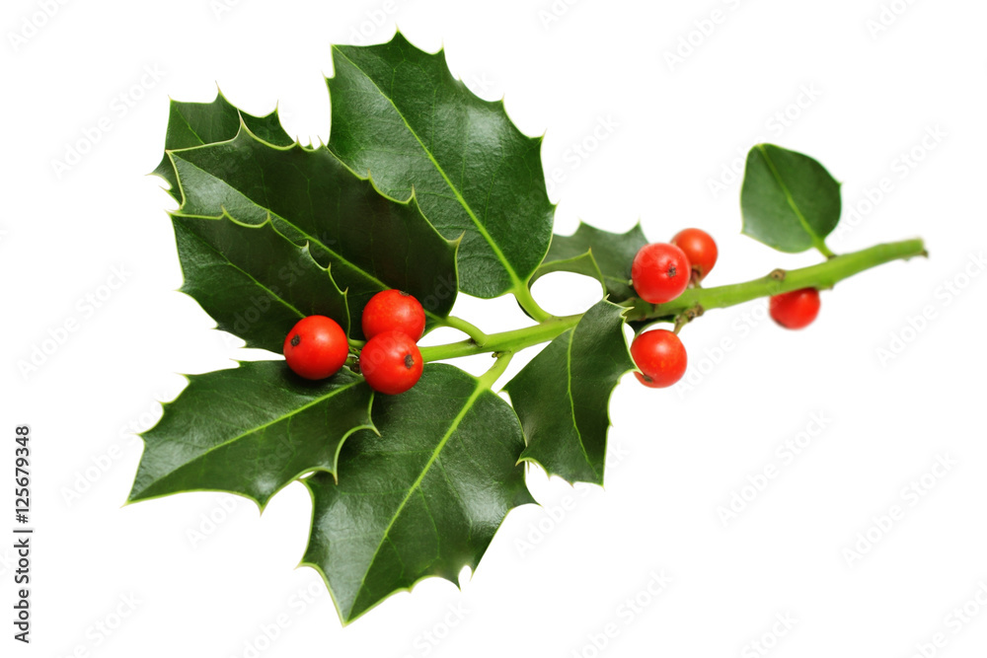
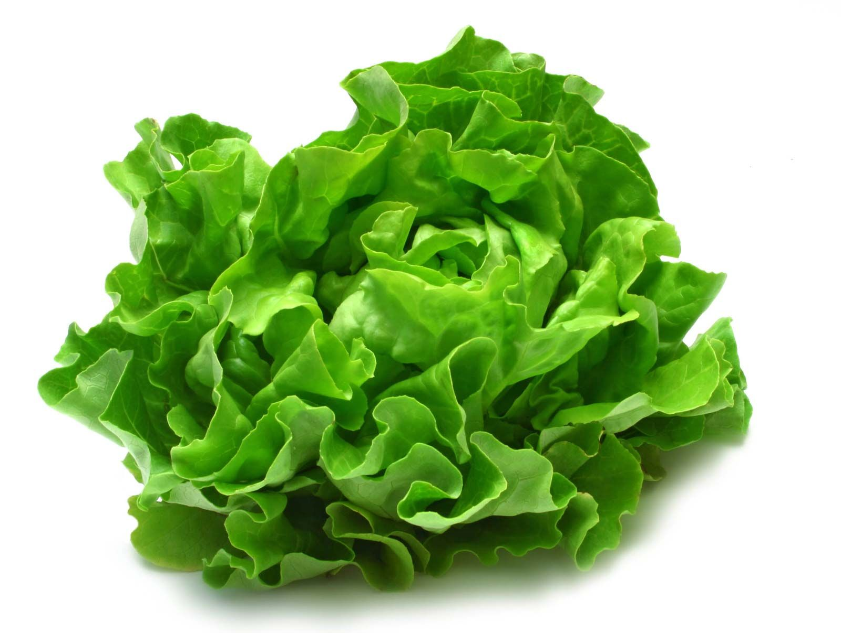
The leaf economic spectrum
Spectrum runs from quick to slow return on investments of nutrients and dry mass in leaves, and operates largely independently of growth form, plant functional type or biome
A_{mass.} photosynthetic capacity,
R_{mass} Dark respiration rate
LMA Leaf mass per area
LL Leaf lifespan
N_{mass} Leaf nitrogen
P_{mass} Leaf phosphorus
Quick
Cheap
Short lived
Slow
Expensive
Long lived
Wright, I., Reich, P., Westoby, M. et al. The worldwide leaf economics spectrum. Nature 428, 821–827 (2004). https://doi.org/10.1038/nature02403

Slide 24
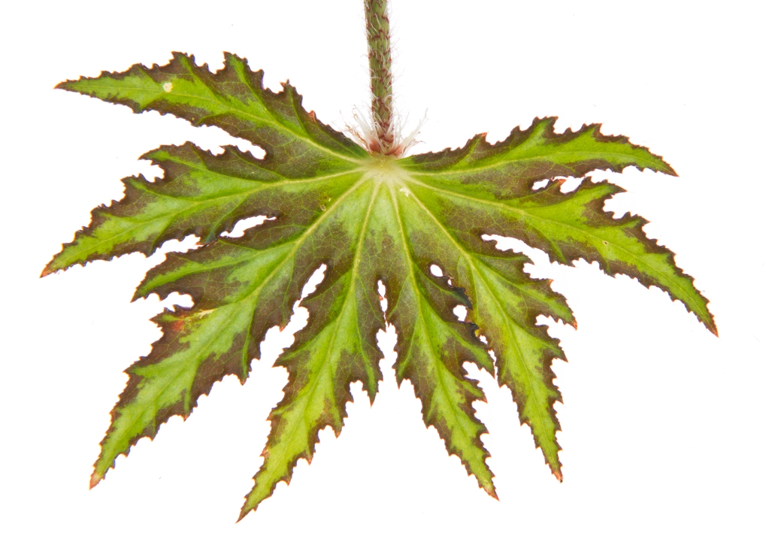
Leaf Relative water content (water content / water content at saturation)
Leaf Water content (molar) per leaf dry mass (WCd)
Leaf Water content saturating (molar) (WCs)
Leaf Water content total (molar) (WCt)
Leaf area index of the site (LAI)
Leaf area: in case of compound leaves undefined if leaf or leaflet; undefined if petiole and rhachis in- or excluded
Leaf carbon content per area
Leaf carbon content per dry mass
Leaf carbon/nitrogen (C/N) ratio
Leaf carotenoid content per dry mass
Leaf chlorophyll a content per dry mass
Leaf chlorophyll a+b content per area
Leaf chlorophyll a/b ratio
Leaf chlorophyll b content per dry mass
Leaf chlorophyll content (a+b) per dry mass
Leaf compoundness
Leaf dry matter content per leaf water-saturated mass (LDMC)
Leaf lamina thickness
Leaf lifespan (longevity, retention time, LL)
Leaf nitrogen content per area (Narea)
Leaf nitrogen content per dry mass (Nmass)
Leaf petiole length
Leaf phenology type
Leaf phosphorus content per area (Parea)
Leaf phosphorus content per dry mass (Pmass)
Leaf respiration per area at leaf temperature
Leaf respiration per dry mass
Leaf thickness
Leaf tissue density
Leaf transpiration (molar) per dry mass
Leaf transpiration rate per dry mass (daytime)
Leaf water content per leaf dry mass
Leaf water content per leaf water-saturated mass (LWC, 1-LDMC)
Leaf water content saturating
Leaf water content total
Leaf water saturation deficit
36 Leaf traits from the TRY database
Photosynthesis
Shape and size
Water balance
Investment
Production/lifespan
Light interception
Temperature regulation
Herbivore avoidance
Pleiotropic effects
Hydraulic constraints
Biomechanical constraints
Leaves are the interface between the plant and the arial environment
Leaves are the primary lateral organ of the plant

Slide 25
Precipitation of Warmest Quarter
First historical record
Clonality
Stomata density
Maximum depth of leaves in the canopy
Typical abundance where naturally occurring
214 extra traits!
Fine root diameter
Plant age at first flowering
Tolerance to grazing
Dispersal syndrome (agent)
Appendages on dispersal unit
Minimum temperature at which 50% seeds germinate
Number of European countries in which native
Seedbank longevity
Flower pollen ovule ratio

Slide 26

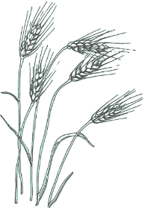
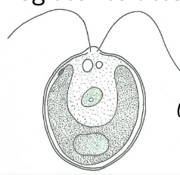

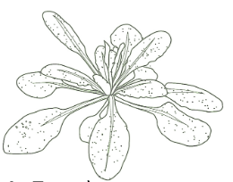


Register Here by 2nd December:

