Slide 1
Climate, Environment and Sustainability Research
…Starting 2017

Slide 2
Goals
Assess extent of climate-related research.
Create a baseline of climate-related research funding.
Disaggregate data based on important areas of focus.
Develop a series of high impact case studies.
Visualize findings and data.

Slide 3
Questions
Which are the primary funding bodies?
What is the application success rate?
How is research funding distributed among colleges/schools?
What is the distribution of active projects?
How is the research distributed around the world?
What are the major domains of research?
How are research findings communicated?

Slide 4
Methods and limitations
Automated workflow using R software
Access to UKRI API, ERO direct download
Data cleaning
Keyword mining
Visualization
ERO | UKRI
Titles | Titles + Abstracts + Descriptions
One keyword at a time | Multiple keywords at a time
Applications, Awards | Awards
No impact information | Planned Impact

Slide 5
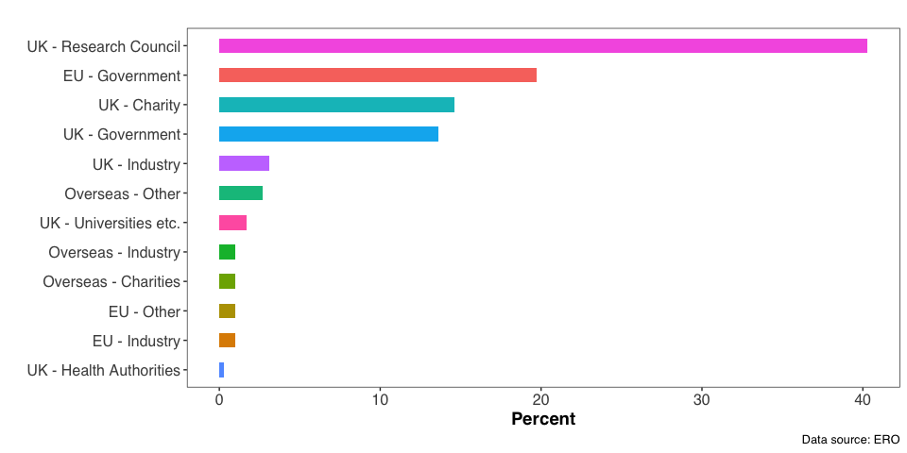
Source of Funding (2021)

Slide 6
Source of Funding (2021)

Slide 7
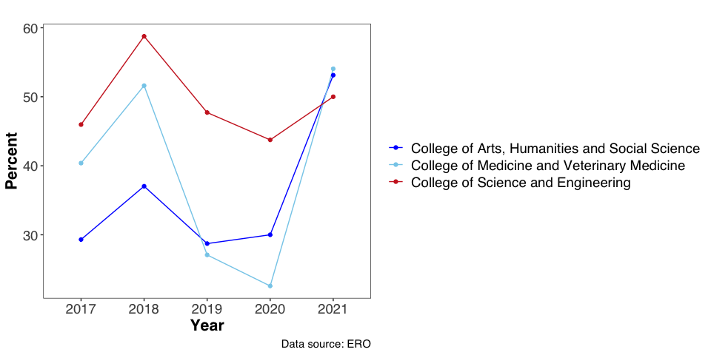
Application Success Rate

Slide 8
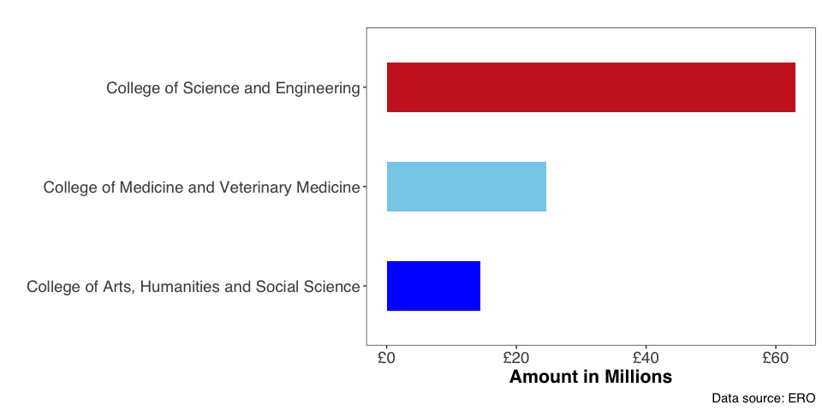
Research Income (2021)

Slide 9
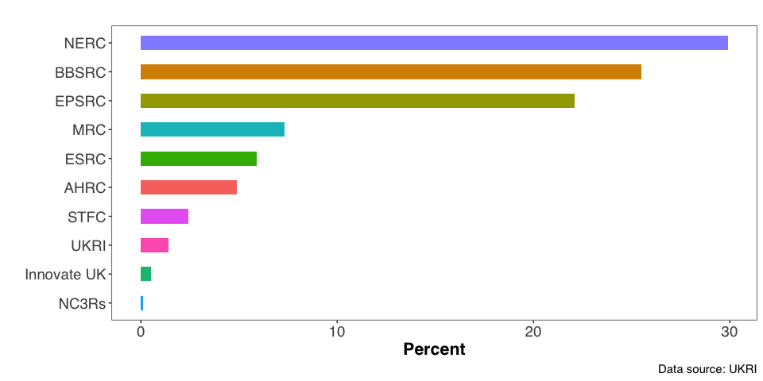
Source of Funding (Active projects)

Slide 10
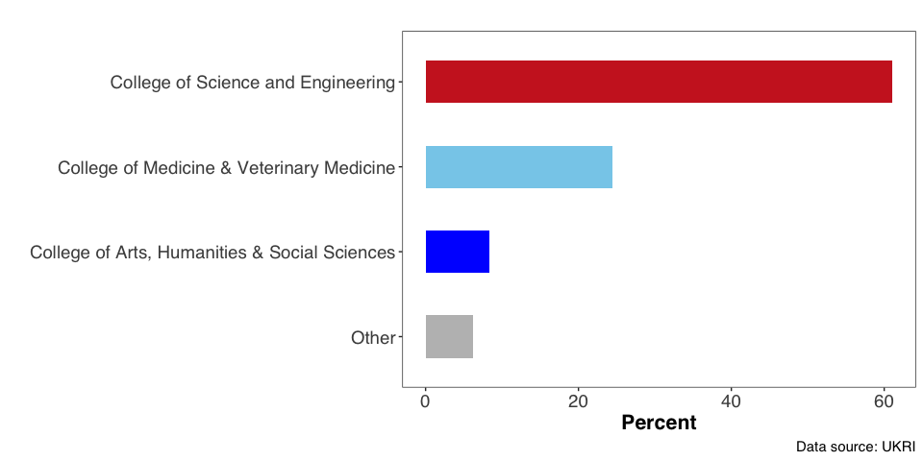
Distribution of active projects within colleges

Slide 11
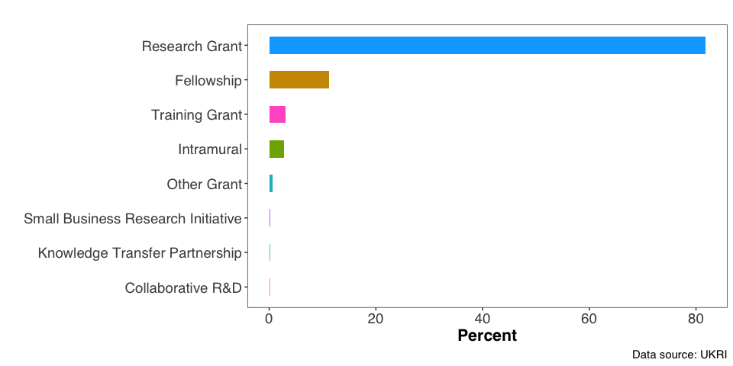
Categories of Projects

Slide 12
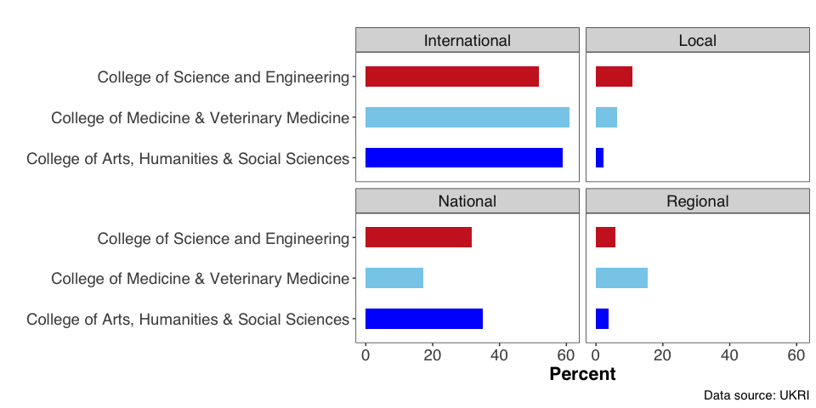
Geographic reach by College

Slide 13
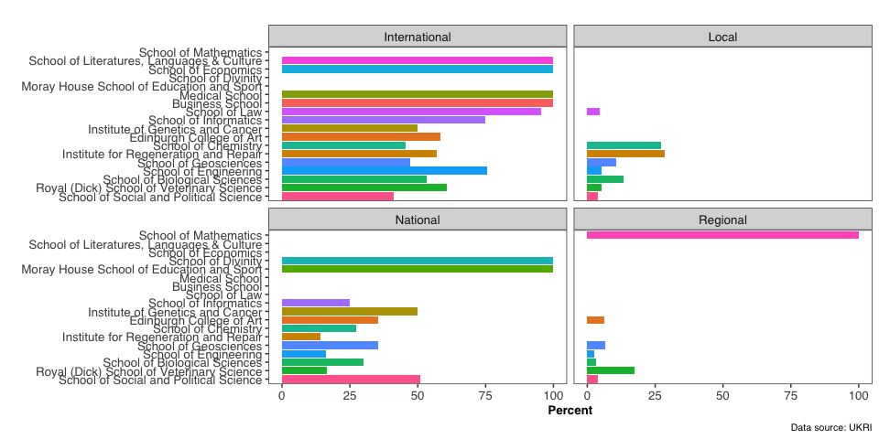
Geographic reach by School

Slide 14
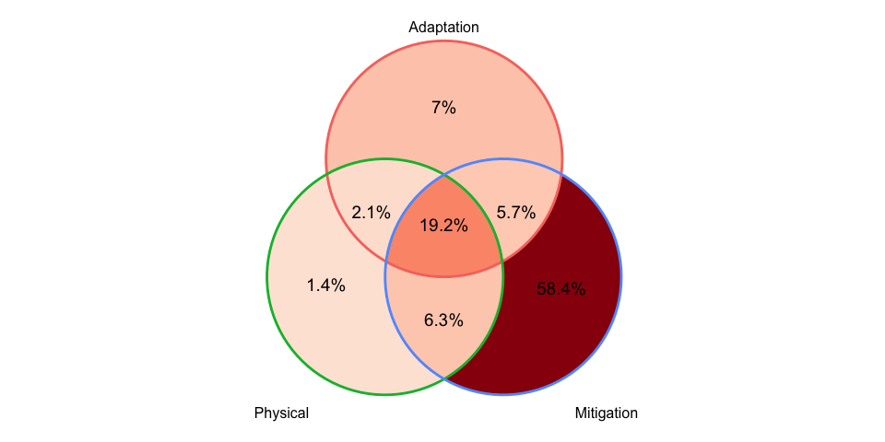
Domains of research
Most of the projects are focused on climate change mitigation

