Slide 1
Climate, Environment and Sustainability Research
…Starting 2017

Slide 2
Goals
Assess extent of climate-related research.
Create a baseline of climate-related research funding.
Disaggregate data based on important areas of focus.
Develop a series of high impact case studies.
Visualize findings and data.

Slide 3
Questions
Which are the primary funding bodies?
What is the application success rate?
How is research funding distributed among colleges/schools?
What is the distribution of active projects?
How is the research distributed around the world?
What are the various research outcomes from projects?
What are the major domains of research?

Slide 4
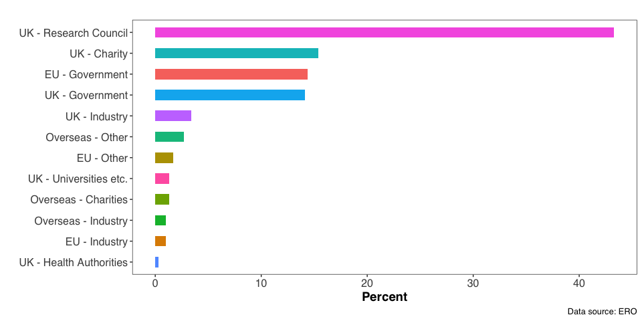
Source of Funding (2021)

Slide 5
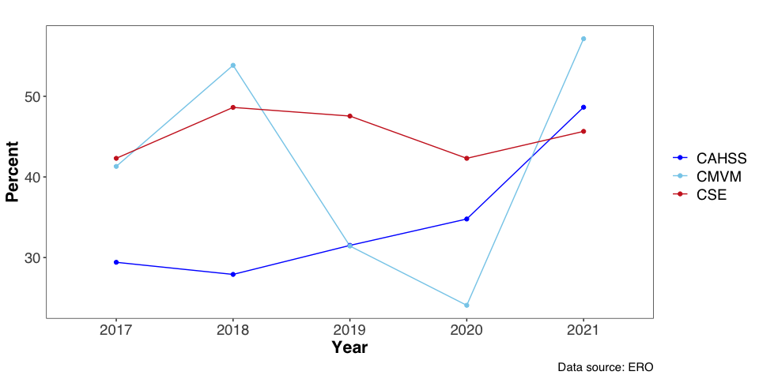
Application Success Rate

Slide 6
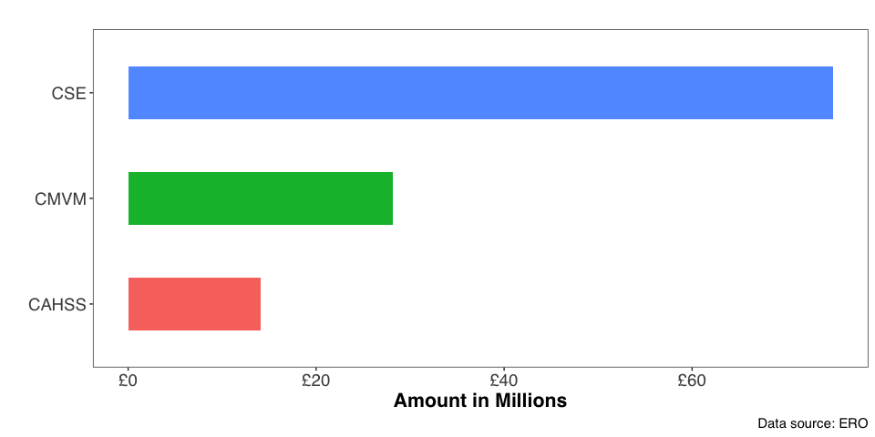
Research Income (2021)

Slide 7
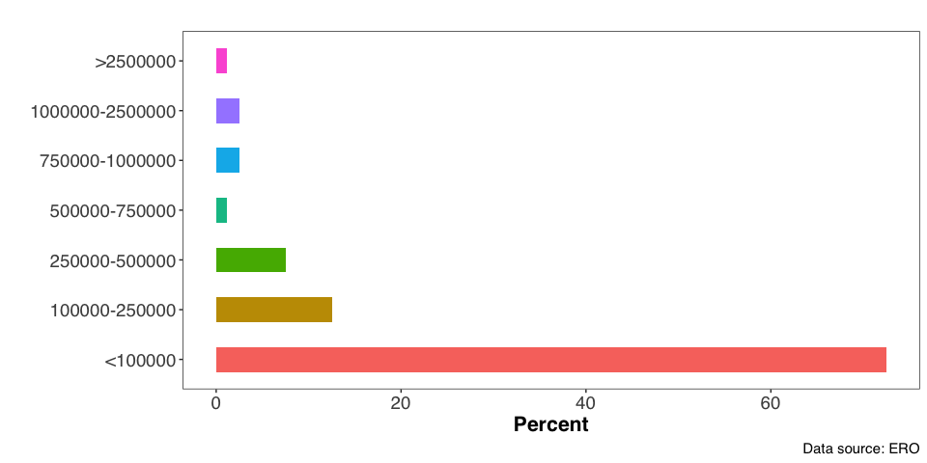
Size of Grants

Slide 8
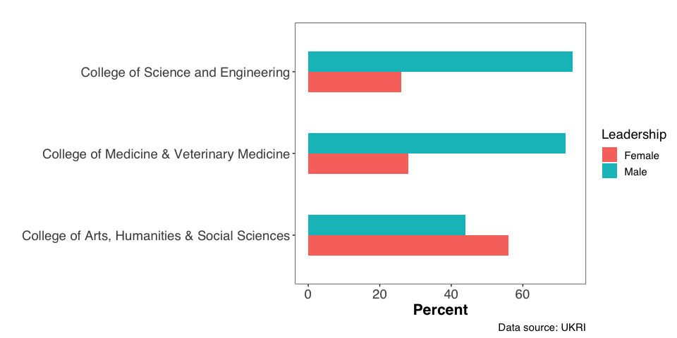
Leadership by Gender

Slide 9
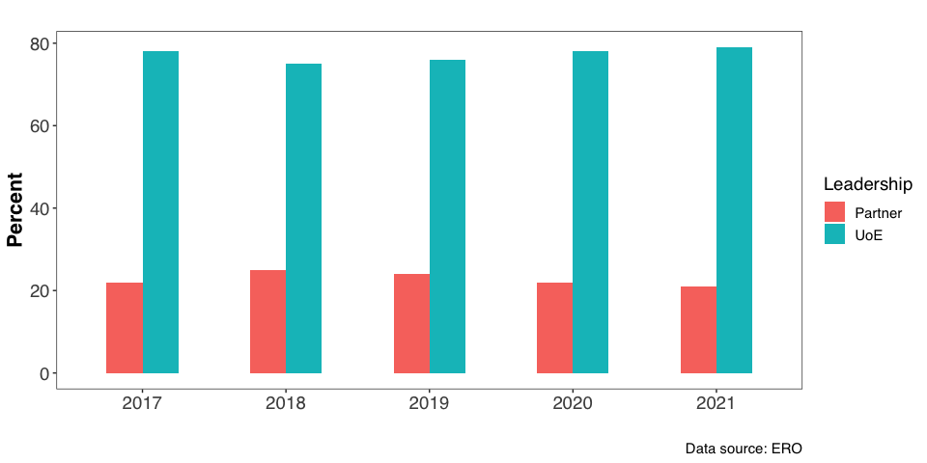
Leadership (UoE, Partners)

Slide 10
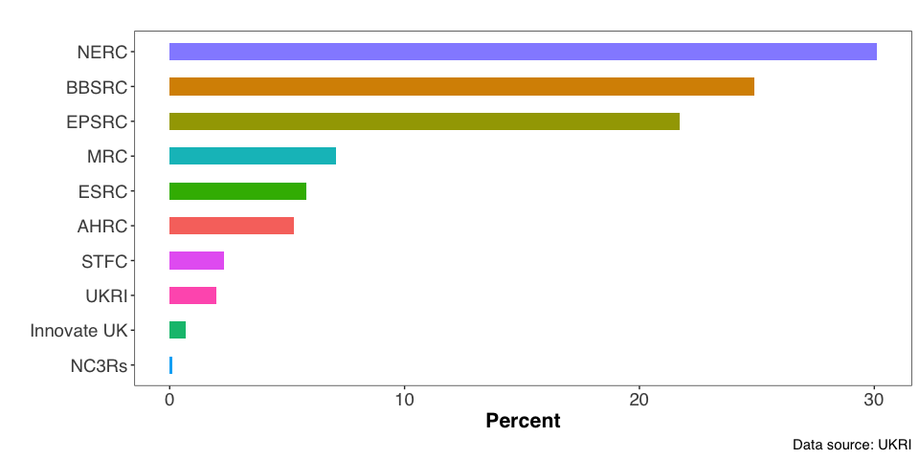
Source of Funding (Active projects)

Slide 11
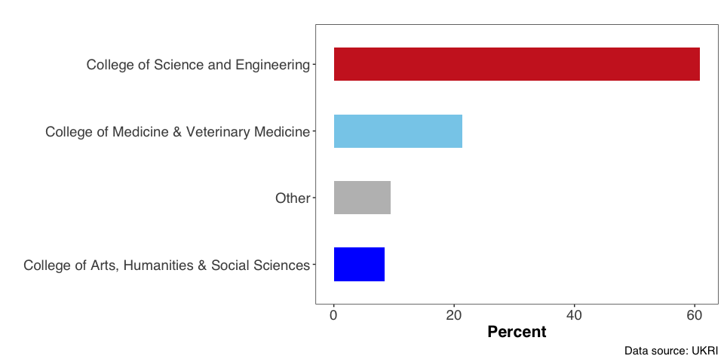
Distribution of active projects within colleges

Slide 12
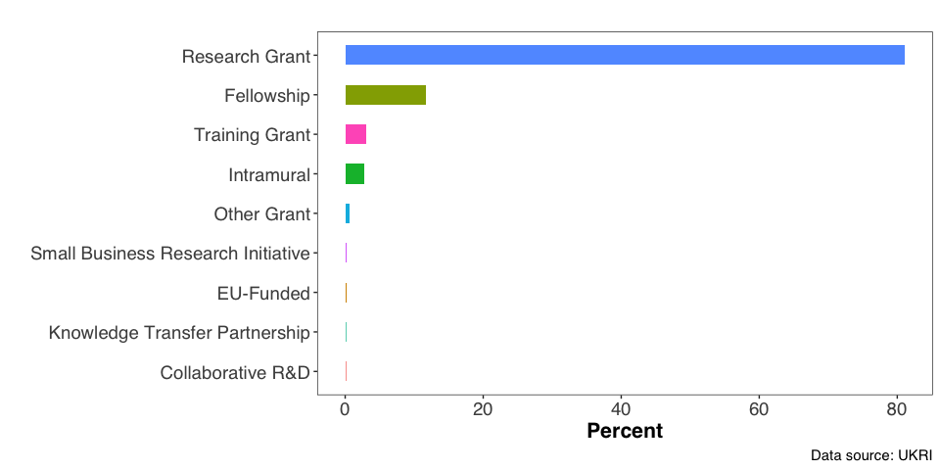
Categories of Projects

Slide 13
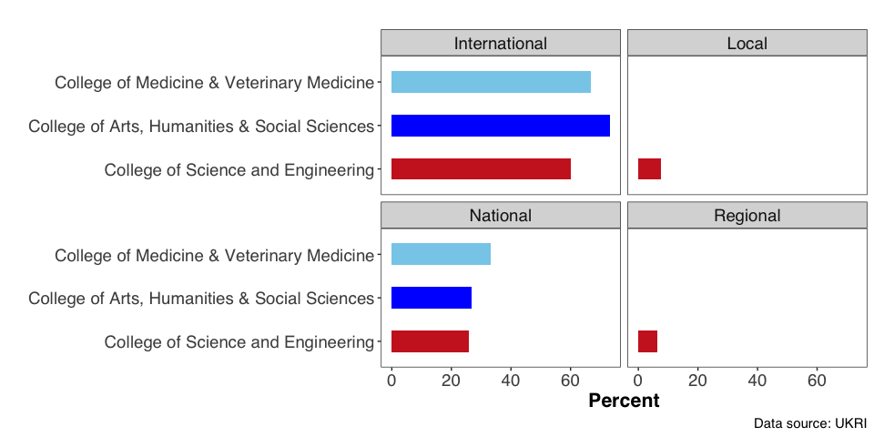
Geographic reach by College

Slide 14
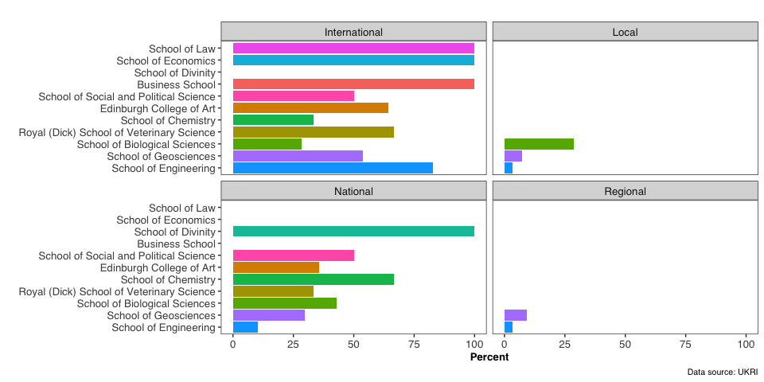
Geographic reach by School

Slide 15
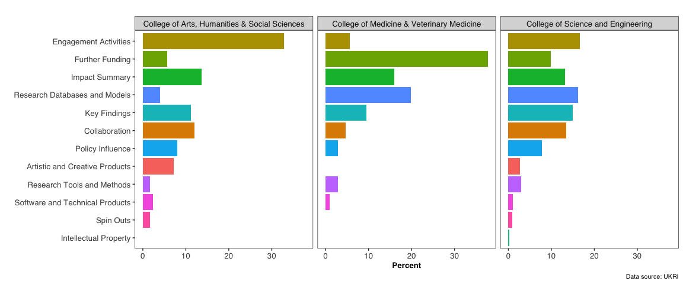
Research outcomes

Slide 16
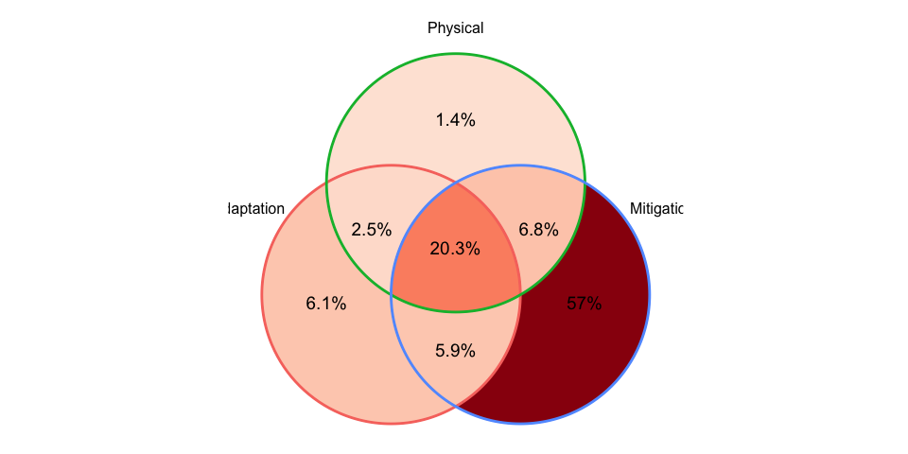
Domains of research

