Slide 1
Climate, Environment and Sustainability Research
…Starting 2017

Slide 2
Goals
Assess extent of climate-related research.
Create a baseline of climate-related research funding.
Disaggregate data based on important areas of focus.
Develop a series of high impact case studies.
Visualize findings and data.

Slide 3
Questions
Which are the primary funding bodies?
What is the application success rate?
How is research funding distributed among colleges/schools?
What is the distribution of active projects?
How is the research distributed around the world?
What are the various research outcomes from projects?
What are the major domains of research?

Slide 4
Methods and Limitations
Automated workflow using R software
Access to UKRI API; ERO direct download
Data cleaning
Keyword mining
Visualization
# | ERO | UKRI
What | Titles | Titles + Abstracts + Descriptions
Keywords | One at a time | Multiple at once
Funding | Applications, Awards | Awards
Outcomes | No | Yes

Slide 5
Sources of University funding
UKRI is the dominant funding institution

Slide 6
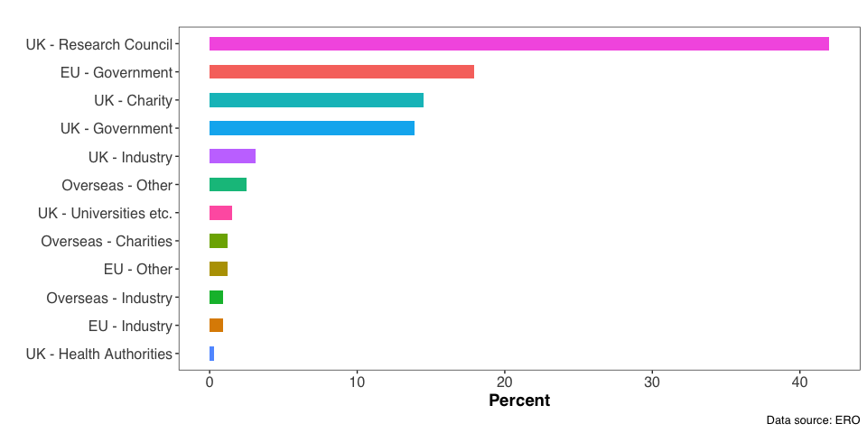
Source of Climate Funding (2021)

Slide 7
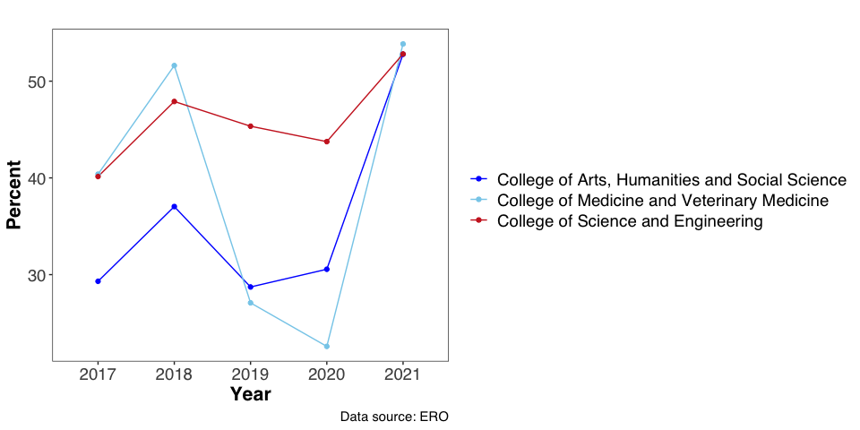
Application Success Rate

Slide 8
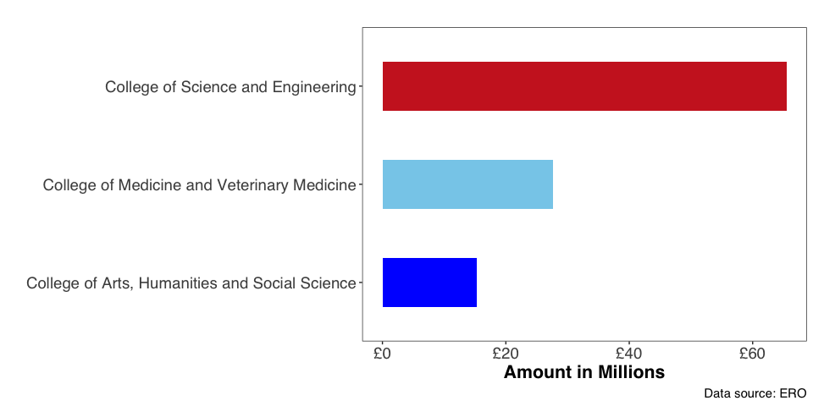
Research Income (2021)

Slide 9
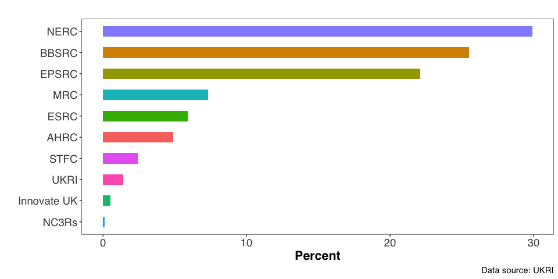
Source of Funding (Active projects)

Slide 10
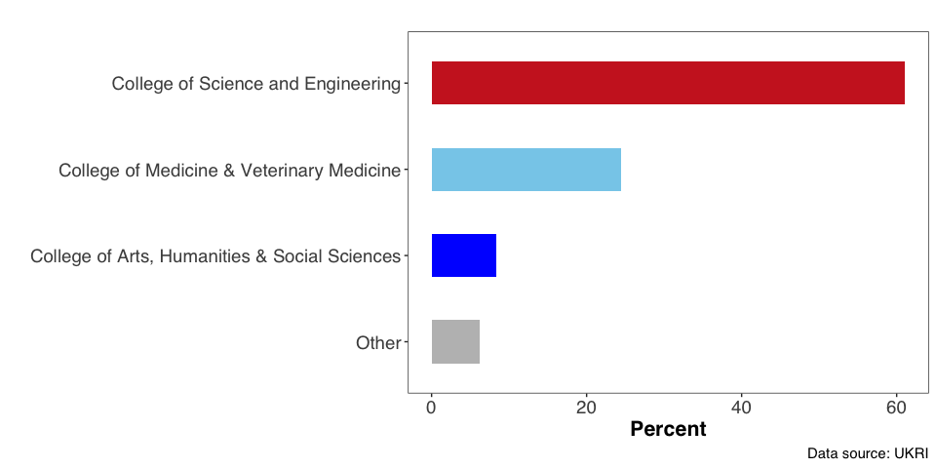
Distribution of active projects within colleges

Slide 11
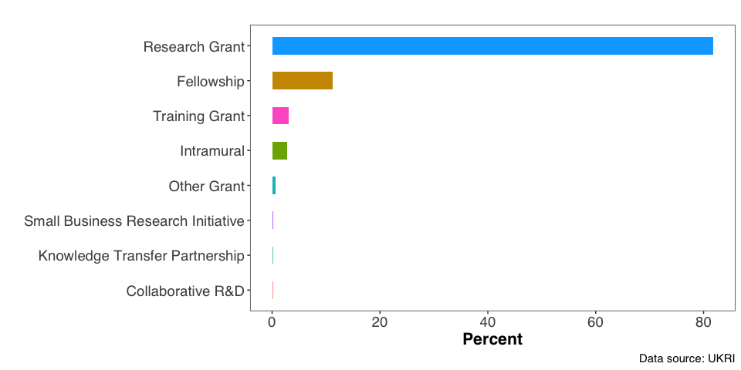
Categories of Projects

Slide 12
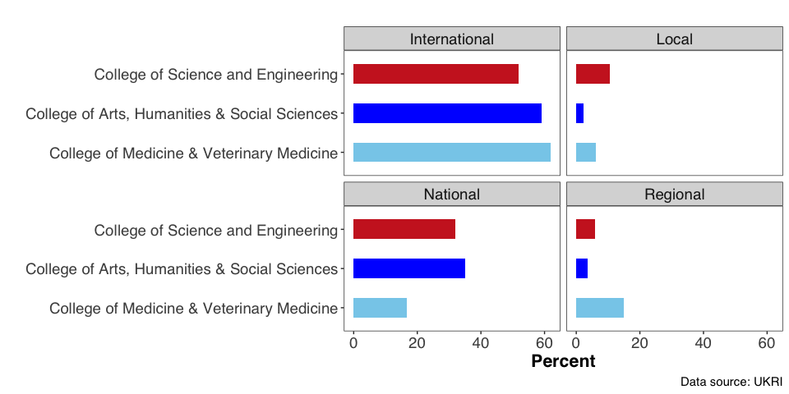
Geographic reach by College

Slide 13
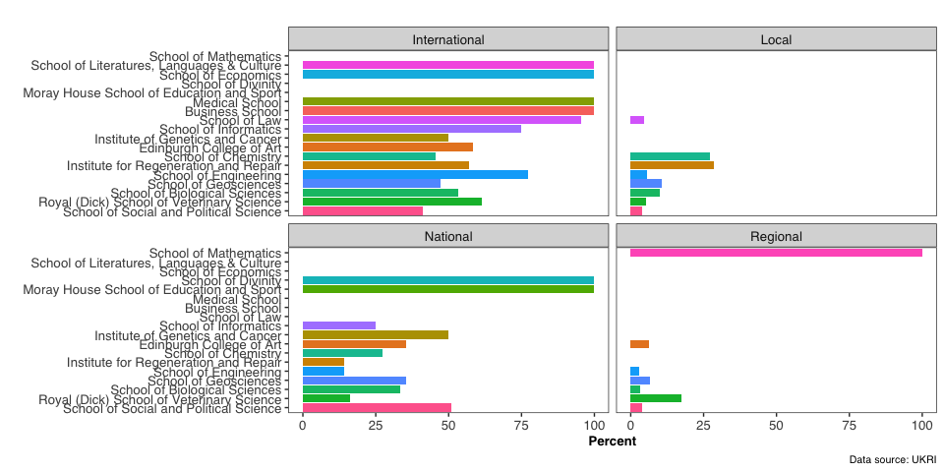
Geographic reach by School

Slide 14
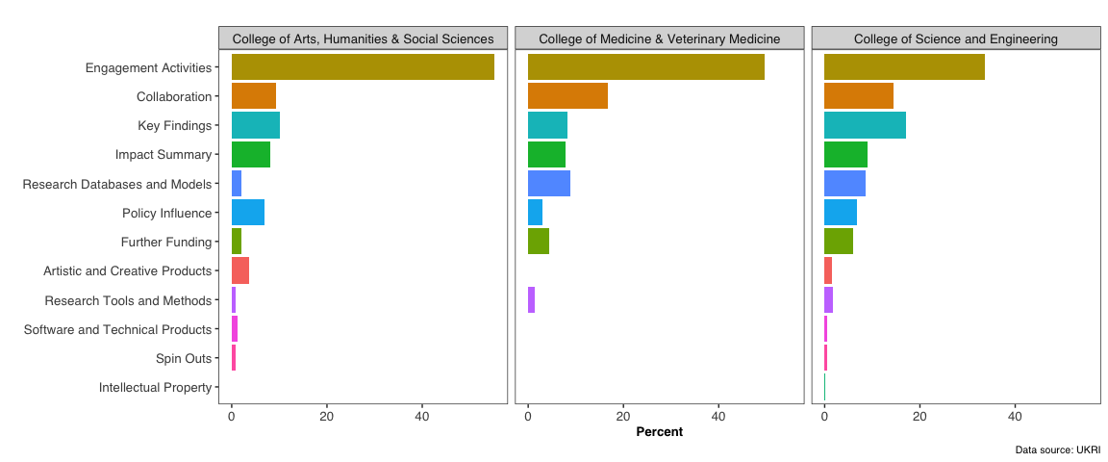
Research outcomes

Slide 15
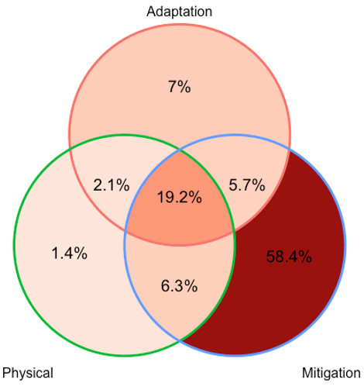
Domains of Research
Adaptation
Most of the projects are focused on climate change mitigation
Physical Science
Mitigation

