Slide 1
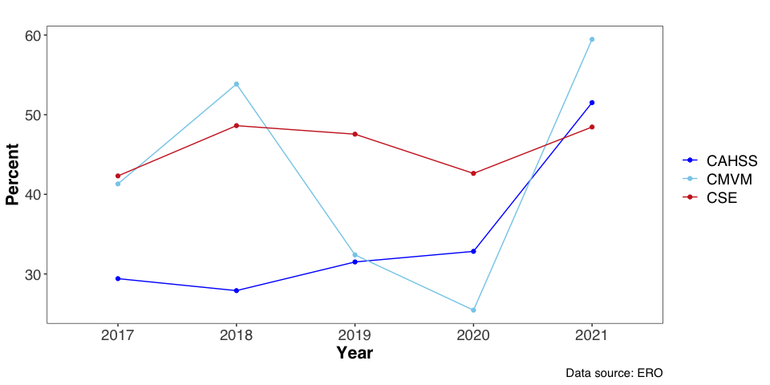
Application Success Rate
UoE average: 42%
Average since 2017
CAHSS | 33%
CMVM | 41%
CSE | 45%

Slide 2
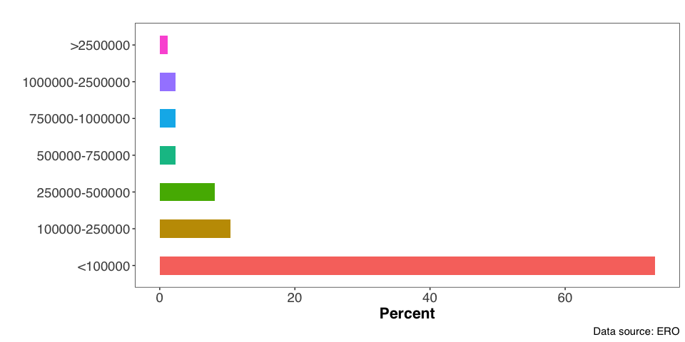
Size of Grants

Slide 3
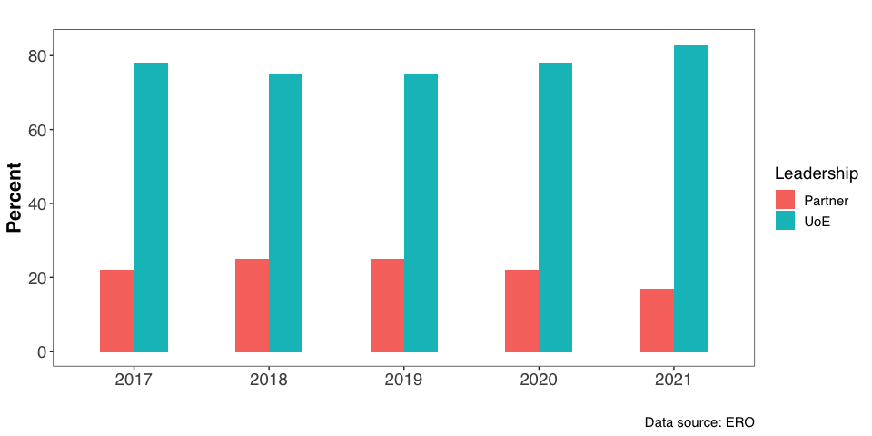
Leadership - UoE versus partner

Slide 4
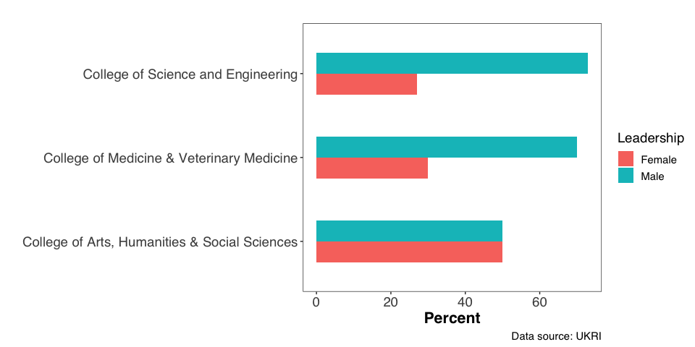
Leadership - Gender

