Slide 1
Concept
Identify stakeholders' needs
Explore concepts
Propose viable solutions
Development
Refine system requirements
Create solution description
Build system
Verify and validate system
Production
Produce systems
Inspect and test
Utilisation
Operate system to satisfy users' needs
Support
Provide sustained system capability
Retirement
Store, archive or dispose of system

Slide 2
Development
Concept
Production
Utilisation
Retirement
Support

Slide 3
Power / influence
Keep
satisfied
Manage closely
High
Monitor
Keep informed
Low
Interest /
importance
Low
High

Slide 4

push
fetch
deploy
deploy
Development
Test
Production
Project
├ Dir1
│ └ File1
├ File2
└ File3
Project
├ Dir1
│ └ File1
├ File2
└ File3
Project
├ Dir1
│ └ File1
├ File2
└ File3
Workstation / laptop
Server / cloud
Server / cloud

Slide 5




Start task
Save working versions
Complete task
1
5
Common starting point
Combined end point
4
3
2

Slide 6
Shared repo
Commit
Clone
Dev 1
Dev 2
Dev 3

Slide 7
Current versions
Older versions

Slide 8
Creation
Assignment
Implementation
Merge
Selection
Elaboration
Review

Slide 9
Creation
Assignment
Implementation
Merge
Selection
Elaboration
Review

Slide 10
Creation
Assignment
Implementation
Merge
Selection
Elaboration
Review

Slide 11
Creation
Assignment
Implementation
Merge
Selection
Elaboration
Review

Slide 12
Creation
Assignment
Implementation
Merge
Selection
Elaboration
Review

Slide 13
Creation
Assignment
Implementation
Merge
Selection
Elaboration
Review

Slide 14
Creation
Assignment
Implementation
Merge
Selection
Elaboration
Review

Slide 15
Creation
Assignment
Implementation
Merge
Selection
Elaboration
Review

Slide 17
Analysis
Design
Implementation
Testing
Maintenance

Slide 18
1
Increment 1
2
3
4
5
1
Increment 2
2
3
4
5
1
Increment 3
2
3
4
5
Time

Slide 19
Analysis
Design
Implementation
Testing
Maintenance

Slide 20
Requirements
Acceptance testing
Analysis
System testing
High-level design
Integration testing
Low-level design
Unit testing
Coding

Slide 21
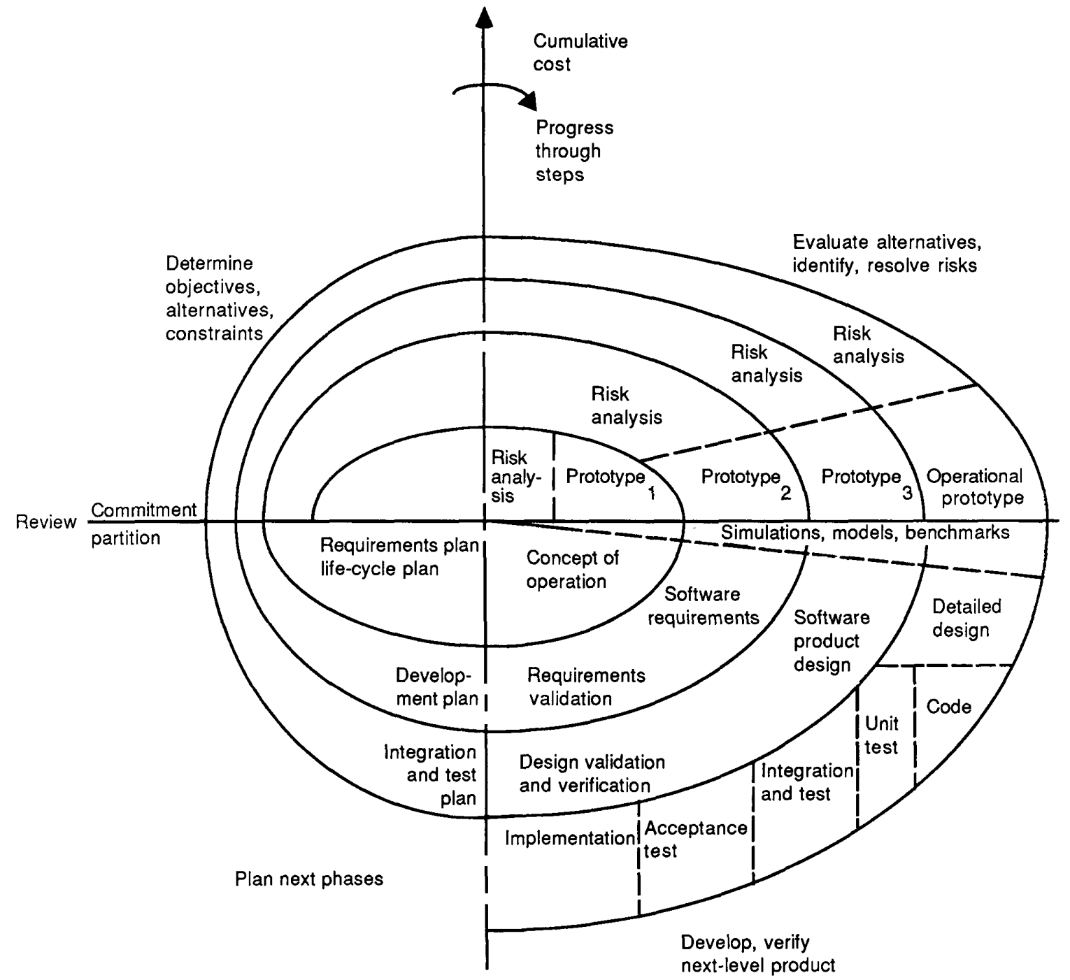

Slide 22
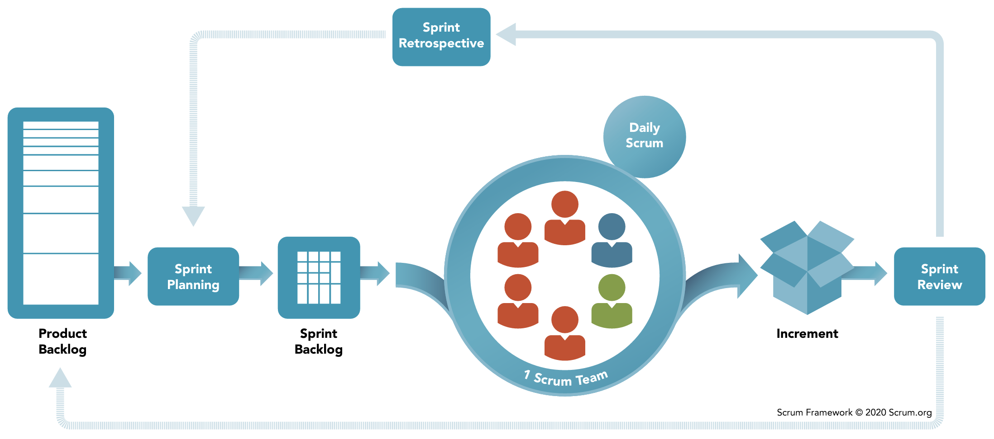
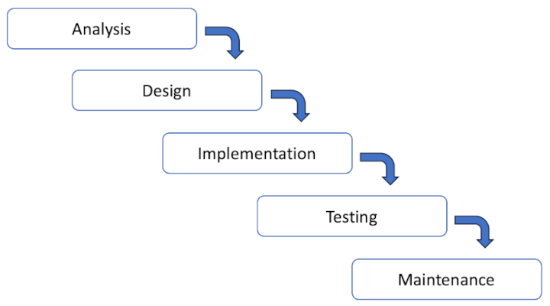
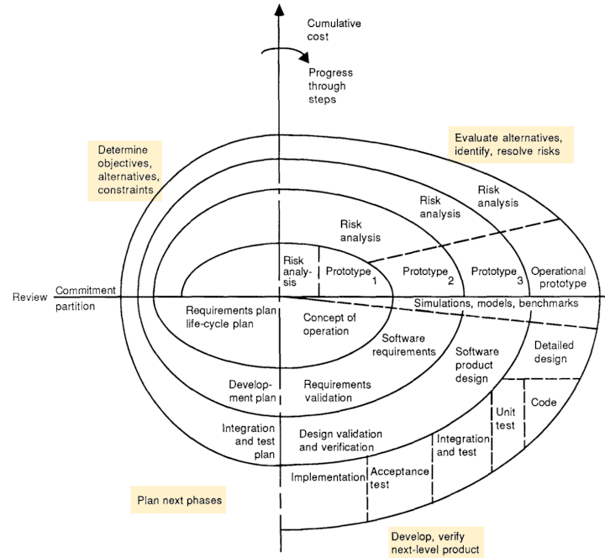
BS ISO/IEC 25000:2014
Environment
System
Inputs
Outputs
Feedback

Slide 23
Effect of
software product
Process
Software product
Influences
Influences
Influences
Quality in use
External properties
Quality in use
Process quality
Internal properties
Quality in use
Contexts of use
Depends on
Depends on
Depends on
Process
measures
Internal
measures
External
measures
Quality in use
measures

Slide 24
Class A
Object 1
id | column_a | column_b
1
2
Id
Property a: “….”
Property b: 999
Property c:
ORM
id | column_x | column_y | FK
100 |  |  | 1
101 |  |  | 1
102 |  |  | 1
103 |  |  | 1
104 |  |  | 2
105 |  |  | 2
Object 2
Id
Property a: “….”
Property b: 999
Property c:

Slide 25
Make changes to class definitions
Generate migration scripts
Apply changes to the database
The software engineer updates the code.
The ORM generates uprade and downgrade scripts. Scripts contain data definition statements such as ALTER TABLE.
The ORM applies the upgrade script to the database.

Slide 26
Initial project requirements
High level design
Low level design
Final product
Generate high level descriptions
Evaluate against requirements
Repeat
Generate module code
Apply standards, debug, test, integrate
Refactor
Repeat

Slide 27
Windows
Mac/Linux
C:\
│
├─ Program Files\
│ │
│ ├─ Application\
│ │ │
│ │ ├─┄
│ ╎ ╎
│
├─ Program Files (x86)\
│
├─ Windows\
│ │
│ ├─ System\
│ │ ╎
│ │
│ ├─ System32\
╎ ╎ ╎
/
├─ bin/
│
├─ etc/
│
├─ usr/
│ │
│ ├─ bin/
│ │
│ ├─ local/
│ │ │
│ │ ├─ bin/
│ ╎ ╎
│
├─ opt/
│
├─ home/
│ │
│ ├─ bin/
│ │ ╎

Slide 28
Windows
Mac/Linux
C:\
├── Program Files
│ └── Application
│ └── ...
├── Program Files (x86)
└── Windows
├── System
│ └── ...
└── System32
└── ...
/
├── bin
├── etc
├── usr
│ ├── bin
│ └── local
│ ├── bin
│ └── ...
├── opt
└── home
└── userdir
├── bin
└── ...

Slide 29
Database

Slide 30

Plan
Threat
The exploit potential
Vulnerability
The weak spot to be exploited
Assess
Attack
The targeted exploit performed
Execute
Compromise
The impact of the successful exploitation

Slide 31
C
Confidentiality
I
Integrity
A
Availability
CIA triad

Slide 32
Weaknesses in the source code
Misconfigured system components
Trust configurations
Weak credentialling practices
Lack of (strong) encryption
Insider threat
Psychological vulnerability
Inadequate authentication
Injection flaws
Sensitive data exposure
Insufficient monitoring and logging
Shared tenancy vulnerabilities
Network Vulnerabilities
These are issues with a network’s hardware or software that can expose it to possible intrusion by an outside party. Examples may include insecure Wi-Fi access points and poorly configured firewalls.
System Vulnerabilities
These are vulnerabilities within a particular operating system (OS) that hackers may exploit. They use this type of vulnerability to access or damage an asset where the OS is installed. Examples include default superuser accounts that may exist in some OS installations and hidden backdoor programs.
Human Vulnerabilities
The weakest link in many cybersecurity architectures is the team members. And while it’s understandable for humans to make mistakes, these errors can easily expose sensitive data, create exploitable access points for attackers, or disrupt systems.
Process Vulnerabilities
Some vulnerabilities can be created by specific process controls (or a lack thereof). One example would be the use of weak passwords, which may also fall under human vulnerabilities.
However, Farr says that knowing the types isn’t the main concern; you should care more about handling the most critical vulnerability first.

Slide 33
Plan
Code
Build
Test
Deploy
Monitor

Slide 34
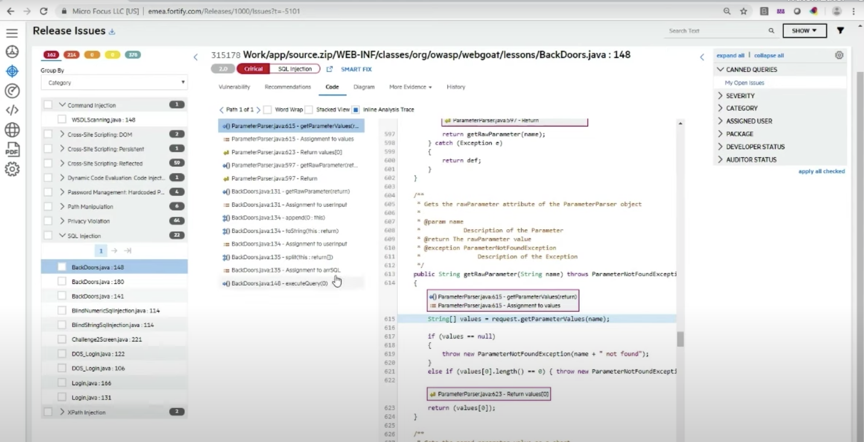
1
3
2

Slide 35
Load testing
Will the system deliver acceptable performance within expected limits?
Stress testing
What are the limits of system performance under extreme conditions?
Non-functional requirement target

Slide 36
Source code checkout
Approval and merging
Build
Dependency installation
Automated testing
Deployment to staging

Slide 37
Source code checkout
Approval and merging
Build
Dependency installation
Automated testing
Deployment to staging

Slide 38
Source code checkout
Approval and merging
Build
Dependency installation
Automated testing
Deployment to staging

Slide 39
Source code checkout
Approval and merging
Build
Dependency installation
Automated testing
Deployment to staging

Slide 40
Source code checkout
Approval and merging
Build
Dependency installation
Automated testing
Deployment to staging

Slide 41
Source code checkout
Approval and merging
Build
Dependency installation
Automated testing
Deployment to staging

Slide 42
Client
Server
SSH
Port: 22
Port: 22
Handled in application code
Handled by server config
Port: 3307
Port: 3306

