Slide 1
Alan Peddie, Project Coordinator
Alan.Peddie@ed.ac.uk
Notes:
Hi welcome etc.

Slide 2

Zero by 2040
Notes:
https://www.youtube.com/watch?v=7wRcj969Fr4

Slide 3

What is the Department for Social Responsibility and Sustainability?
Notes:
https://www.youtube.com/watch?v=HOAa-OgwMLE

Slide 4
What I do
Waste and Circular Economy
Sustainability Training
Sustainable Buildings
Notes:
3 main areas of project work
Waste and Circular Economy
Sustainability Training
Sustainable Campus Work

Slide 5
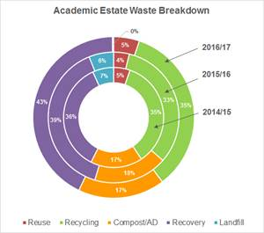
Waste at the Uni
Notes:
36,500 students and 13,500 academic and support staff
3,500 tonnes of waste arising
Waste contractor Biffa gives us waste data and a breakdown
Other sub contactors either go through Biffa if they don’t process themselves or give it to us directly
Such as our WEEE contractor CCL North

Slide 6
Waste strategy
Legislation – we have to follow the law
UK and Scot Gov plans
Zero Waste University

Slide 7
Recycling – pointless (almost)
China amazing!
1/3 recycled
We have passed the Rubicon
Transformational change

Slide 8
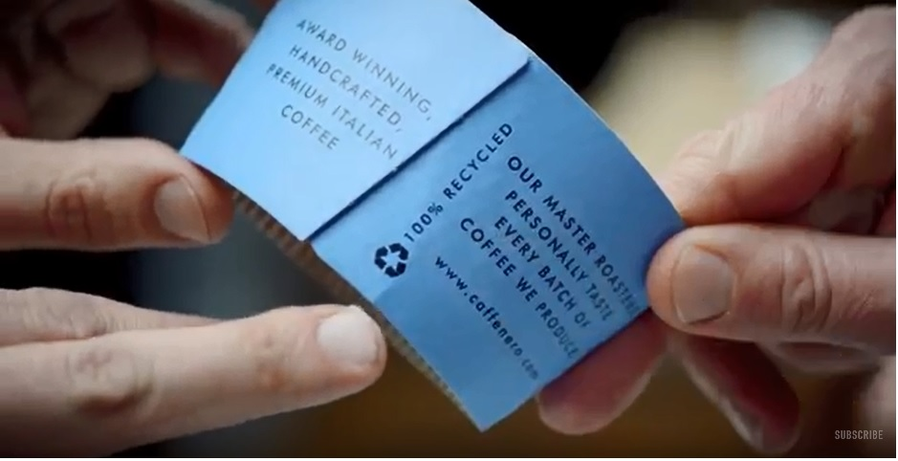
Coffee Cup Challenge
Notes:
Around 1 million disposable cups sold at the University
Do this as a group to get them all thinking and show them the video of why it is so difficult
https://www.youtube.com/watch?v=LGcd5aNBr4c

Slide 9

Bio packaging both works and doesn’t
Notes:
Explain how it works and why it doesn’t work with out waste contractor

Slide 10

Reusable Items – Keep Cups
 | 2017/2018 | 2018/2019 | Variance | %
August | 39,277 | 21,502 | 17,775 | 45%
September | 52,769 | 31,600 | 21,169 | 40%
Notes:
1,500 free cups issued Sep 2018, 25p latte levy
Student group inverse pricing amongst a host of other recommendations

Slide 11
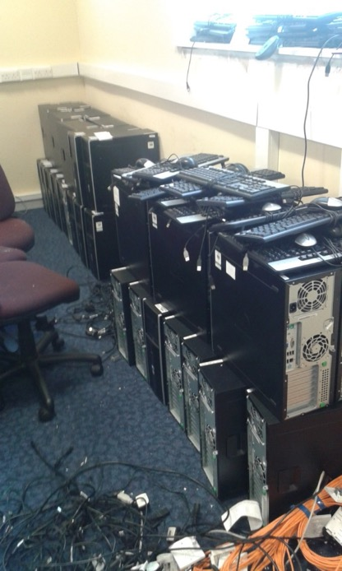
Reuse Projects – IT Reuse Project
Notes:
Annually around 3,000 desktop PCs go the our waste contractor for recycling
IT reuse project

Slide 12
Other reuse – Lab and Furniture
Storage
Aesthetics
Funding

Slide 13

Food
Our food v your food
Food Sharing Edinburgh

Slide 14
Next steps
Water stations
Cars keep exploding
Truly Circular Economy essential
Everyone needs to help
Stage a revolt!

