Slide 1
DATA, DESIGN & THE CITY
JAMES STEWART & MORGAN CURRIE
24 JANUARY 2020

Slide 2
announcements
Data tracking exercise
Notes:
James at Transition Edinburgh, Sampsa’s remarks, Anton’s presentation is an example of a pitch. http://www.socialpolicy.ed.ac.uk/events/seminar_series/2018_2019/influencing_politics_and_business_the_greenpeace_way._a_practitioners_view

Slide 3
schedule
Reflective exercise
Guests:
Dean Drobot, Energy & Utilities Management, Estates
Sabine Rolle, Department of European Languages & Culture, EFI
Fieldwork Prep & Research Ethics

Slide 4
Just writing
(5 minutes)

Slide 5
Today’s prompts
Which do I prefer: talking or listening?
What makes a team work well?
Can you think of some team projects in your past? What made them successful, or not?

Slide 6
Dean Drobot & Sabine Rolle

Slide 7
Fieldwork preparation

Slide 8
What is data?

Slide 9
What is data?
Datum: “some difference or lack of uniformity within some context” – Floridi, 2017
Data: “a set of systematic observations that have been symbolically encoded and stored in material form” – Offenhuber, 2017, p. 7
Data: “an interpretation of the phenomenal world, not inherent in it.” – Drucker, 2011

Slide 10
What is data?
Requires a method of observation and collection
A symbolic system to represent it (eg a taxonomy)
A method to encode the observation into symbols
Storage in physical form

Slide 11
Data gathering

Slide 12
Field notes
Primary observations: physical details of people and place, time of events, quotes
Photographs, drawings, recordings
Reflections
Analysis of emerging themes and insights
Feelings and emotional reactions
Forward planning on what’s next
* Keep confidentiality (alter names)

Slide 13
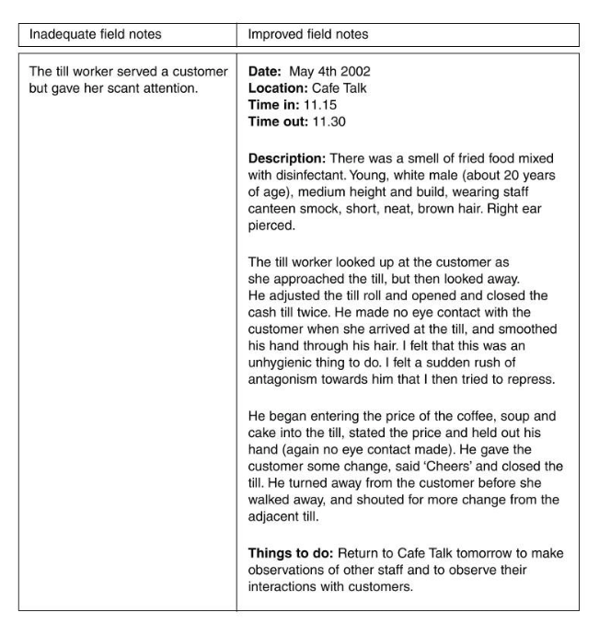

Slide 14
Structured observation
More quantitative
Typically tallies events
Often classified in advance

Slide 15
Research ethics

Slide 16
What we’ll go over:
Idea of ethics
Public and private spaces and activities: what can we observe?
Informed consent, consent forms
Data management and protection

Slide 17
What we’ll go over:
This is a basic orientation to some ethics issues and paperwork you need for your projects
The goal is to make you aware of requirements and responsibilities and set your ‘ethics alarm’
It will NOT tell you everything you need to know about ethics for your group’s project. You will need to look things up.

Slide 18
Research ethics as rules & standards
‘Ethics’ comes from Greek ethos meaning rules or customs
Ethics are rules of right conduct underpinned by a set of moral values
Ethics establish a framework within which action (or research work) is considered acceptable. Outside of this framework, it is not.
“The ethics of research concern the appropriateness of the researchers’ behaviour in relation to the subjects of the research or those who are affected by it” (Gray, 2013, 58)

Slide 19
Why research ethics?
You should be aware of external requirements to approve human participation and handling of data
It is the right thing to do. To act morally and with integrity as designers, researchers, members of the community
Pushes us to do clear advance planning, practice communicating about our research, and reflect on what information we need/want to collect and disseminate.
Consider: Nuremberg Code 1947, Tuskegee experiments 1932-1972, Stanford prison experiments 1971
Notes:
History has shown us the need for this: Nuremberg Code of 1947 resulted after Nazi experiments on humans. The Tuskegee experiments in Alabama, 40 years in the US, allowed black males to carry a disease that could have been prevented, in the name of science. The Stanford prison experiment 1971– toyed with people psychologically.

Slide 20
Guiding ideas
Seeking to achieve the greatest good through research, seeking to avoid harm and distress to participants (and communities)
Weighing the potential risks and benefits of doing a piece of research in a certain way (privacy vs public right to know)
Acting with honesty and integrity, as researchers and professionals
Respect for people’s rights and dignity, including their privacy and anonymity (legal protection varies!)
Notes:
Values: invasion of privacy vs public right to know. Consider under cover actors who reveal workplace abuse towards workers or animals.
Observing in communities where your different norms might make them uncomfortable. Example of someone volunteering at a refuge for abused women and never concealing that they are a researcher nor every following back up after leaving. What this does is generally erode trust for the research community.
What are some communities or situations where harm might come to those being observed? Undocumented immigrants, prison populations, LGTBQ communities, political dissidents (Jess’s work), children, especially when it involves their physical and mental health.

Slide 21
Codes and forms
Professional, national, University ethics codes seek to provide guidance for decision-making and priorities
Codes may also establish punishments for poor conduct
Ethical approval forms and processes are a form of “checks and balances”: someone else looks at planned research and also considers its risks, benefits, alternatives.
Notes:
http://www.sps.ed.ac.uk/research/research_ethics
https://www.ed.ac.uk/arts-humanities-soc-sci/research-ke/support-for-staff/res-ethics-policies/ethics
https://ukrio.org/publications/code-of-practice-for-research/
https://www.ed.ac.uk/records-management/guidance/research/data-protection

Slide 22
public vs private spaces
Notes:
People as their own gatekeepers. In research ethics, the burden of protection is not on the subjects but on you. Also, the second definition shows how it’s not just information, but also physical access and interference

Slide 23
privacy
“The control of information about natural living persons, by those persons.” (Michael, 1984, p.135, as cited in Homan 1991, p. 42).
Vs.
“I shall define privacy as the condition of being protected from unwanted access by others-- either physical access, personal information, or attention.” (Bok, 1984, p.10-11, as cited in Homan 1991, p. 42)
Notes:
People as their own gatekeepers. In research ethics, the burden of protection is not on the subjects but on you. Also, the second definition shows how it’s not just information, but also physical access and interference

Slide 24
Naturalistic observation
Is generally ok when
We are respecting privacy as much as possible (space, information) and with reference to the norms of the place and culture we are in.
Any violations of privacy are fairly small, and are outweighed by possible benefit
There is no risk of individual persons being identified (i.e. people are anonymous) or harmed by your data collection. This means that notes are generally always safe, but photos and videos become problematic
Our observation does not disturb or change the subjects’ behaviour
We ONLY observe, and do not approach or interact with subjects

Slide 25
Naturalistic observation
“If the study occurs in a place where anyone could be observed by anyone else, then consent is not needed”
(Koocher & Keith-Spiegel, 1998, as cited in Goodwin, 2008).
“Unless those observed give their consent to being observed, observational research is only acceptable in situations where those observed would expect to be observed by strangers. Additionally, particular account should be taken of local cultural values and of the possibility of intruding upon the privacy of individuals who, even while in a nominally public space, may believe they are unobserved.” (British Psychological Society Guidance, as quoted in Gray 2014, p 77)

Slide 26
Activity: Is that a public space?
Counting the number of people who used waste and recycling bins at an on-campus cafe
Filming outside of Pollock Halls
Filming people walking through a farmer’s market
Observing and taking notes on shopper behaviour inside of a store
Wall posts and comments on a Facebook group
What people say at a face-to-face meeting of an Edinburgh student group
Notes:
Is this a public space? Could we observe without consent?

Slide 27
Informed consent
Notes:
Is this a public space? Could we observe without consent?

Slide 28
Informed consent
Where we are not observing anonymous, public behaviour, people must explicitly agree to participate in your research
This means using an information sheet as starting point to inform people about the work, information collected, how we will use it
People can ask questions and freely say yes or no to all (or part) of participation, recorded on a consent form
People can withdraw from the study at any time with no consequences
Informed Consent = Saying yes or no, without coercion, to something I can understand.
Notes:
A person might consent to taking part in a focus group, but not being videotaped.
They must be able to ask questions
They can withdraw at any time with no consequences
They are told how the data will be used – you will need to get additional consent if you decide to use the data in some other way
Consent is a dialogue

Slide 29
Informed consent
Not just ‘consent’.
An information sheet explains:
Aims of research
Who is undertaking it
Who is being asked to participate
What kind of information is being sought
How much time is required
That participation is voluntary and can be withdrawn
Whether there is benefit, lack of benefit, or possible harm
How data is stored and who will access it
How data will be used
How anonymity of respondents will be preserved
It should be simple, direct, and easy for an non-specialist to understand

Slide 30
Informed consent
Exception!
Anonymous questionnaires/surveys that collect no personal information do not need informed consent

Slide 31
Data management
“Data management refers to all aspects of creating, housing, delivering, maintaining, and archiving and preserving data.” (MANTRA data management unit)
Essential for responsible research, and your sanity!
About having a plan for what data you will collect, who will have access, storage, naming, documentation...
Notes:
https://mantra.edina.ac.uk/index.html
Research data management policy
https://www.ed.ac.uk/information-services/about/policies-and-regulations/research-data-policy

Slide 32
Data management
Choice of naming conventions and file formats to be used across project (saves your sanity when working across teams!)
Identifying software and tools you will need to collect, store, analyse, visualise data
Addressing copyright and intellectual property issues
Deciding who is responsible for data management and maintenance during and after project
Plan for backing up data!!!
Documentation re: how data collected, when, what it is (will you know what that spreadsheet was a year later?)
Notes:
https://mantra.edina.ac.uk/index.html

Slide 33
Data protection
Data protection is a legal responsibility
Overlaps with data management, but is not the same thing!
From MANTRA unit on data protection: “Data protection refers to the rights of the individuals whose data are being collected, held, and processed. Individuals have the right to have inaccuracies corrected and to know what data are being held and how they are being used."
GDPR: contains provisions and requirements pertaining to the processing of personal data of individuals (formally called data subjects in the GDPR) inside the EU and EEA
Notes:
https://mantra.edina.ac.uk/index.html

Slide 34
Personal data
“Personal data simply refers to records or other information that on its own or linked with other data, can reveal the identity of an actual living person. So, for example, you may use numbers rather than names as identifiers in a survey, but if you hold another record linking those numbers to the actual names, then each record is considered to contain personal information.” (UoE MANTRA course unit on data management)
There is also sensitive personal information (e.g. race, political beliefs) BUT you are unlikely to deal with this in your projects.

Slide 35
Activity: Personal data
Make a few notes for yourself:
Try to define personal information in your own words—in a simple way that you can remember it.
Try to generate two examples each of something that IS, and something that IS NOT personal information.

Slide 36
Team exercise
Each person has 5 mins to talk to two other people not in their team:
What data can you find out about study patterns from the person you are talking to?
You’ll need to phrase your question appropriately
Record your findings
Share results with other members of the team
Each team feeds back answer to “What is data?” to whole class

Slide 37
Next class
Two guests: Charles Raab (SPS) & Bettina Nissen (Design Informatics)
Readings on collecting primary data through observation, data protection, and design probes
Be sure to discuss with your group what subtheme you want to explore during next Friday’s design sprint.
Look at the Study Information Sheet on Week 3 – you will need to tailor this to your subtheme for next week’s design sprint

Slide 38
Any closing issues, general questions

