Slide 1
DATA, DESIGN & THE CITY
JAMES STEWART & MORGAN CURRIE
15 FEBRUARY 2019

Slide 2
Just writing
(5 min.)
The role that I often occupy in a group is...
The role I’ve been playing in DDC so far is…

Slide 3
Today’s schedule
More about data & data management (9:15-9:45)
Group planning break-out (9:45-10:20)
Group discussion (10:20-10:50)

Slide 4
What is data?
Notes:
Prompt the students

Slide 5
What is data?
Floridi (2014):
Epistemic: evidence or a collection of facts
Informational: can be processed as information
Computational: collection of electronic binary elements
Diaphoric: capture and denote variabiity
Notes:
But not all data are ‘facts’ – some might be untrue. Facts, actually, often come from data
Informational – all about the ability to process something, whether or not it’s factual. But this also poses difficulty because we think of information as arising from data. Also, some data don’t contain information about anything, such as data on a CD or DVD.
Computational – reduced to material support
Diaphoric – a signal that can be interpreted

Slide 6
What is data?
Floridi (2014):
Epistemic: evidence or a collection of facts
Informational: comprises information
Computational: collection of electronic binary elements
Diaphoric: lack of uniformity
Economic
Civic

Slide 7
What is data?
Kitchin (2014):
data are discrete and intelligible, aggregative, have associated metadata, and can be linked to other datasets to provide insights not available from a single dataset.
Data are not given but “are taken”
Notes:
Rather than get at its essence, describes its features:
Discreet: versus information
Aggregative: requires categories
In the aggregate, and through processing, data can accrue value
Takes a lot of work to derive data. They don’t exist out in the world but are an act of interpretation. Even automated data captured by machines have been captured in a particular way, and to process them requires acts of interpretation as well.
Google captures your data in a specific way, mostly targeted to helping it sell ads that target you.
It interprets your searches as representative of something you want or desire, though your searches may be done on behalf of another person, etc.

Slide 8
What is data?
Gitelman and Jackson Raw Data Is An Oxymoron (2013):
Data are abstractions that require material expression
Data are aggregative, discreet: they exist in bits
Data can be mobilised graphically to explain things
Notes:
Title:
-data are cooked. Data are not entirely objective but always frame the world in a particular way. How they are cooked matter and should be subject to scrutiny. Acts of abstraction and classification are never inevitable but can be done in many ways. The metric system was created at some point. The ‘bit’ – unit of information that a computer can carry – was a creation
Data in are head are not of much value. It’s through material supports that they can be manipulated in useful, powerful ways. Paper in the 18th century. Today it is electronic servers. Algorithms and automation. How data are materialized also matter: it shapes the affordances of data and how we interpret them.
Data are inevitably classified for this reason. “the imagination of data is in some measure always an act of classification.”
We structure data in databases.
Data are better able to ‘tell’ us something when they are structured and visualized in some way

Slide 9
What is data?
Offenhuber (2018):
Requires a method of observation and collection
A symbolic system to represent it (taxonomy)
A method to encode the observation into symbols
Storage in physical form

Slide 10
Kinds of data
Quantitative (numerical record)
Qualitative

Slide 11
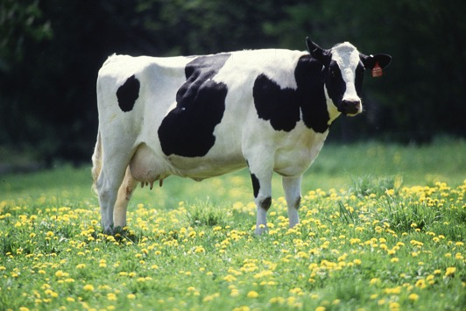
Clusters of numbers indicating brightness, patches of “colour”, or “a cow”?

Slide 12
Law: Data Protection Act
Data means information which –
(a) is being processed by means of equipment operating automatically in response to instructions given for that purpose,
(b) is recorded with the intention that it should be processed by means of such equipment,
(c) is recorded as part of a relevant filing system or with the intention that it should form part of a relevant filing system,
(d) does not fall within paragraph (a), (b) or (c) but forms part of an accessible record as defined by section 68, or
(e) is recorded information held by a public authority and does not fall within any of paragraphs (a) to (d).
UK Information Commissioner’s Office: “Paragraphs (a) and (b) make it clear that information that is held on computer, or is intended to be held on computer, is data”
Notes:
https://ico.org.uk/for-organisations/guide-to-data-protection/key-definitions/

Slide 13
Kinds of data
Types:
Structured
Semi-structured
Unstructured

Slide 14
Kinds of data
Types:
Structured
Semi-structured
Unstructured
Primary
Secondary
Tertiary

Slide 15
Kinds of data
Types:
Structured
Semi-structured
Unstructured
Primary
Secondary
Tertiary
Ways to generate:
Captured (humans or machines)
Exhaust (bi-products)
Transient (exhaust data of no value)
Derived (captured/exhaust data of value)
Notes:
Bi-products of data include all the data you leave behind by going to different websites, or from your searches
More and more ‘transient’ data is becoming valuable. Google’s entire economic model came about from realizing that search data could be monetized for ad sales. Credit card transactions. Open data from cities being used for new analysis or purposes, like transit information being used on google maps. For instance, using data on New data being collected. putting sensors on trucks to help with routes
We are heading towards more captured data, therefore more exhaust data, and more derived data from captured and exhaust data

Slide 16
NYC Noise Complaint Data Map
Notes:
aaBi-products of data include all the data you leave behind by going to different websites, or from your searches
More and more ‘transient’ data is becoming valuable. Google’s entire economic model came about from realizing that search data could be monetized for ad sales.

Slide 17
Kinds of urban data
Opportunistic sensing
Credit card transactions
Telecommunications data
Smart dust
Google Streetview
Nanosensors
Trash Track
Crowdsensing
Tweets
Yelp reviews
OpenStreetMap
Notes:
Bi-products of data include all the data you leave behind by going to different websites, or from your searches
More and more ‘transient’ data is becoming valuable. Google’s entire economic model came about from realizing that search data could be monetized for ad sales. Credit card transactions. Open data from cities being used for new analysis or purposes, like transit information being used on google maps. For instance, using data on New data being collected. putting sensors on trucks to help with routes

Slide 18
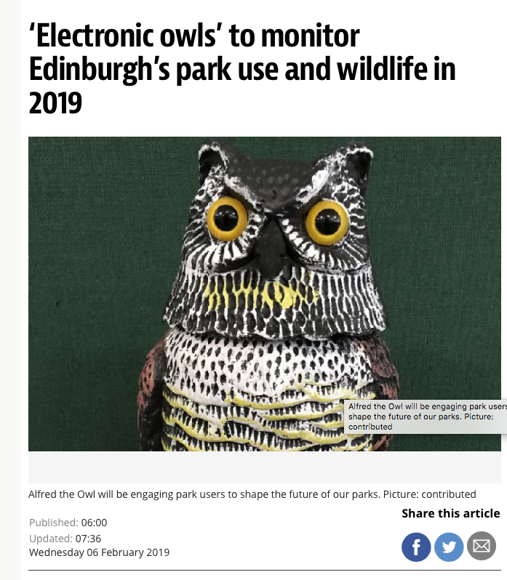
Notes:
aaBi-products of data include all the data you leave behind by going to different websites, or from your searches
More and more ‘transient’ data is becoming valuable. Google’s entire economic model came about from realizing that search data could be monetized for ad sales.

Slide 19
metadata
Descriptive (para-data) – for identification and discovery
Structural – about the organisation of the data
Administrative – details of its creation and technical specs

Slide 20
RESEARCH DATA
“collected, observed, or created, for the purposes of analysis to produce and validate original research results.” -MANTRA
It is situational
Notes:
MANTRA: research data management training

Slide 21
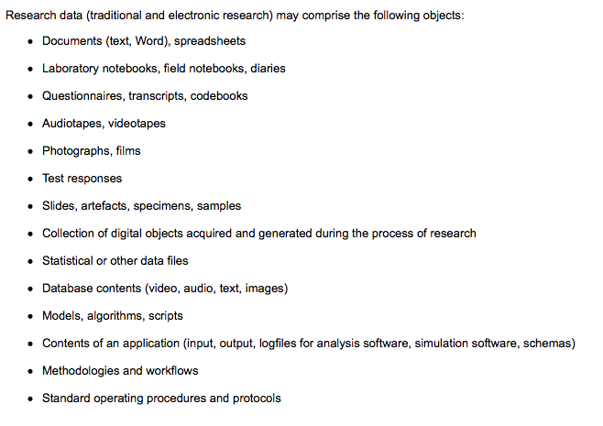
RESEARCH DATA
-MANTRA
Notes:
What types are you collecting?

Slide 22
Technical considerations
Representativeness: how well the data capture what they seek to represent. Sampling.
Reliability: repeatability
Bias: consistent pattern of error due, e.g. to the instrument of data collection or ideologies of the researcher

Slide 23
Data & ddc
Be aware of your data collection process: of the categories you make, of the sample you select
Be aware of how you represent the data
Be critical of existing data you find and use. Look into the data collection methodology (categories, what was collected), when it was collected, who commissioned and funded it
Be careful of how you handle and store data
Notes:
Paper in the 18th century. Today it is electronic servers
Data are different from information in the way they can be discreet. They are inevitably classified for this reason.
“the imagination of data is in some measure always an act of classification.”
We structure data in databases.
Data do not ‘tell’ us anything until they are structured and visualized in some way

Slide 24
data management
DataStore Instructions
https://edinburghlivinglab.github.io/ddc/data_store/

Slide 25
Advance planning
Clarify your goals
Prepare 4 questions to elicit qualitative data, e.g.
Explanations, interpretations, experiences
Exploratory questions to elicit thoughts about your design ideas
Prompt people to explain what would change their behaviour
Identify time slot, space
Recruit 5 participants
Assign team roles
Find/book equipment
Start your research ethics form

Slide 26
For next class (27 feb)
Bring your audio/video files
Bring your notes
Bring a copy of your research data ethics form
Bring your signed consent forms
Have your data organised in DataStore

