Slide 1



Exercicio2
View in Power BI
Last data refresh:
24/03/2022 12:21:59 UTC
Downloaded at:
24/03/2022 19:12:29 UTC

Slide 2
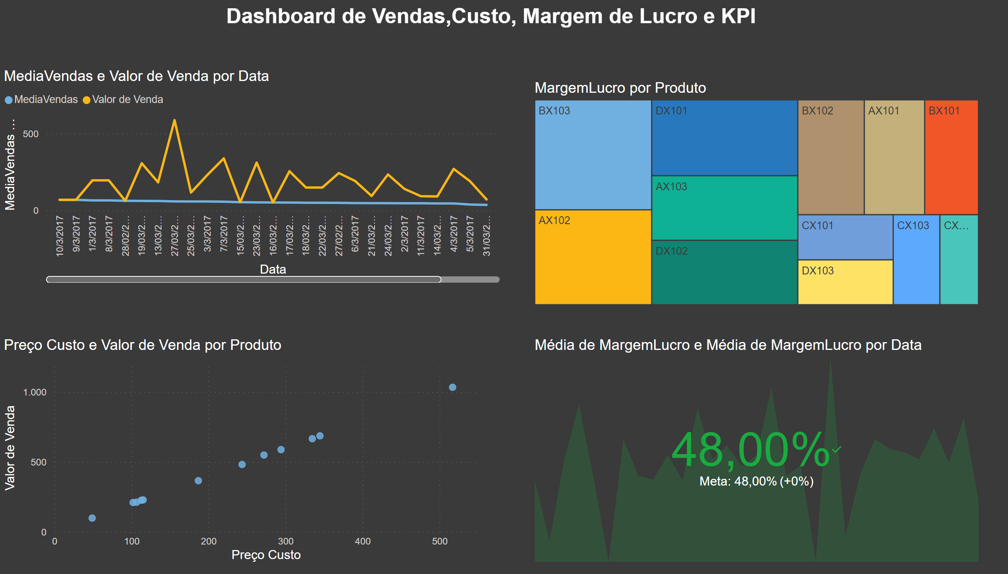
Exercicio2
Notes:
lineChart
No alt text provided
treemap
No alt text provided
scatterChart
No alt text provided
kpi
No alt text provided
textbox
No alt text provided

