Slide 1
ECE 157B/272B Homework 3
Edward Ding

Slide 2
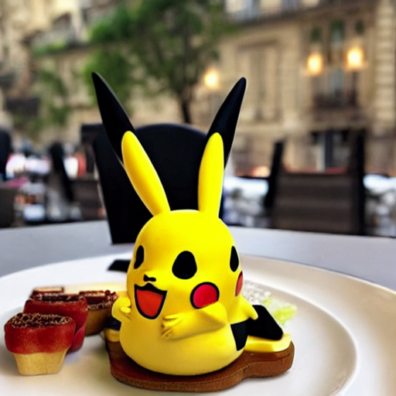
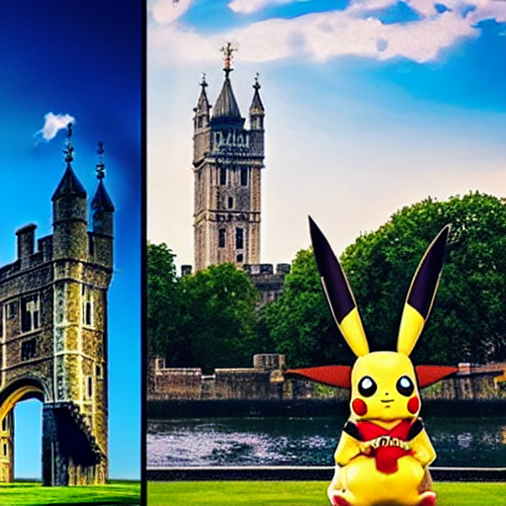
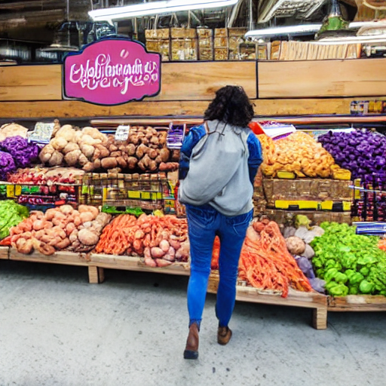
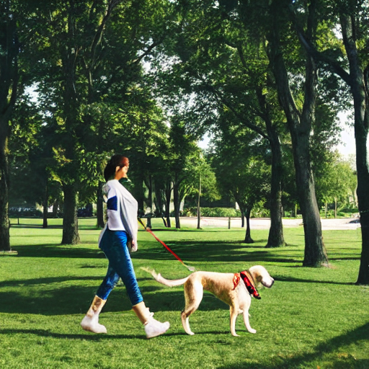
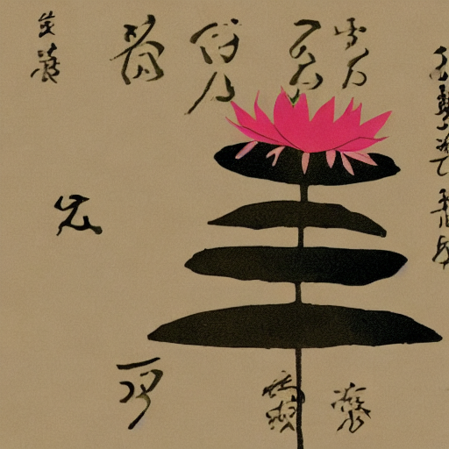
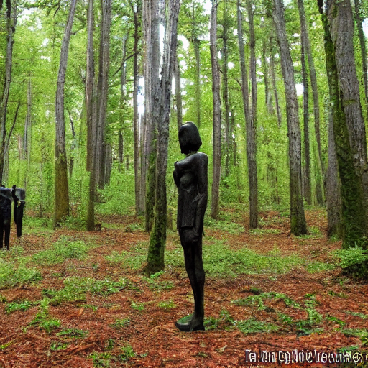
Stable Diffusion - Text-to-Image Generation – without Promptist
A pikachu fine dining with a view to the Eiffel Tower
A pikachu fine dining with a view to the Tower of London
A walking, talking eggplant shopping at Trader Joe's
A person walking a dog through a park
A visual representation of a haiku
Many ominous figures standing in a forest

Slide 3
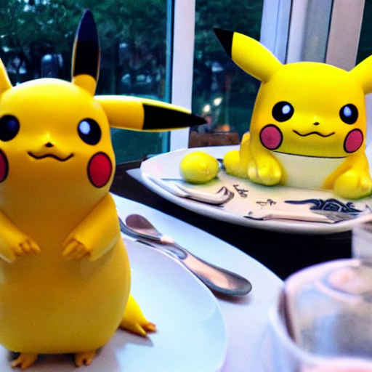
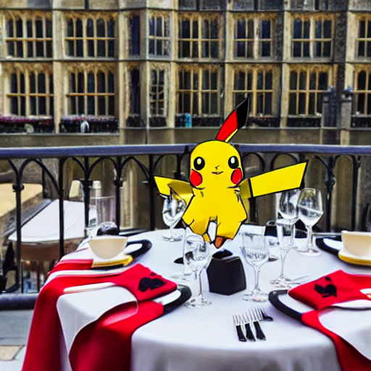
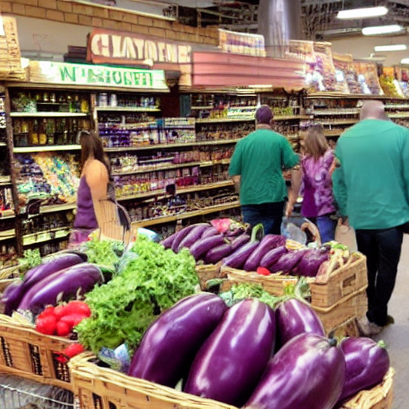
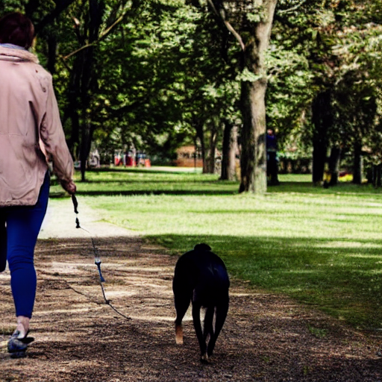
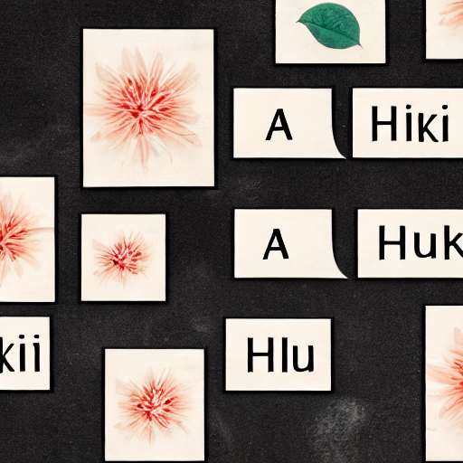
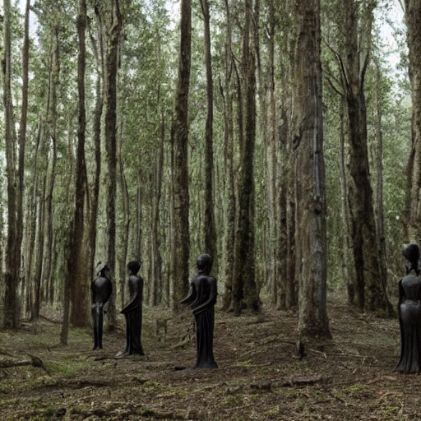
Stable Diffusion - Text-to-Image Generation – with Promptist
A pikachu fine dining with a view to the Eiffel Tower. Using a pikachu at a pikachu offering food and shelter by Robinutkowski, by stanley artgerm, by greg rutkowski,
A pikachu fine dining with a view to the Tower of London by Naoto Shinkai, Ruan Jia and Kenneth Loracter Frank Frazetta Greg Rutkowski digital painting, trending on artstation °C by Isaac Clarke and Ar
A walking, talking eggplant shopping at Trader Joes at midnight. Elegant. independent painting. 3D illustration. Trending on artstation. Greg Rutkowski + Ola Fitzgerald 8k
A person walking a dog through a park with a dog walking through a park with a park, illustrated by Greg Rutkowski, Craig Mullins, artstation, 4k, digital art, high detail, epic composition, dark
A visual representation of a haiku by Greg Rutkowski and Fabian Schönberger, 27, highly detailed, cinematic contain, 30mm photography image, artstation, cinematic lighting, 4k resolution, deep studio
Many ominous figures standing in a forest guarded by settlers, tall buildings and plants on it, with tall buildings and impenetrable movers, surrounded by a moat.

Slide 4
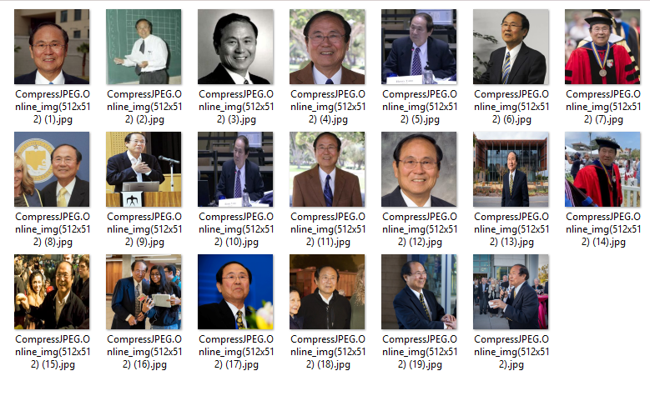
DreamBooth – Adding a Person to the Model
Screenshots of the folder containing the training images of the person you choose

Slide 5
DreamBooth – Adding a Person to the Model
Your training parameters
num_class_images: 1500
max_training_steps: 500
learning_rate: 0.000002
The checkpoint number that gave you the best model: 400
Inference parameters:
scheduler_name: DPMSolverMultistep,
num_inference_steps: 50
guidance_scale: 7.5

Slide 6

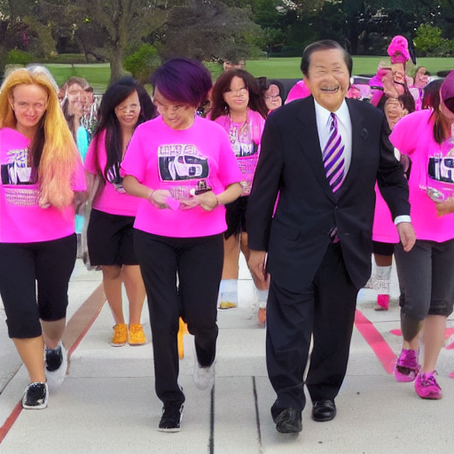
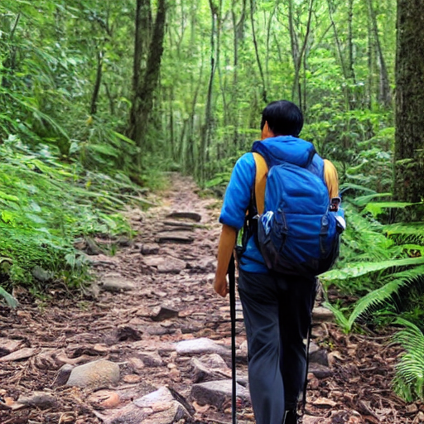
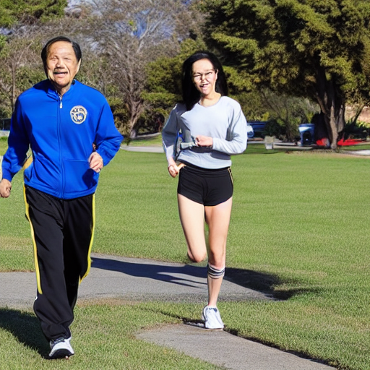
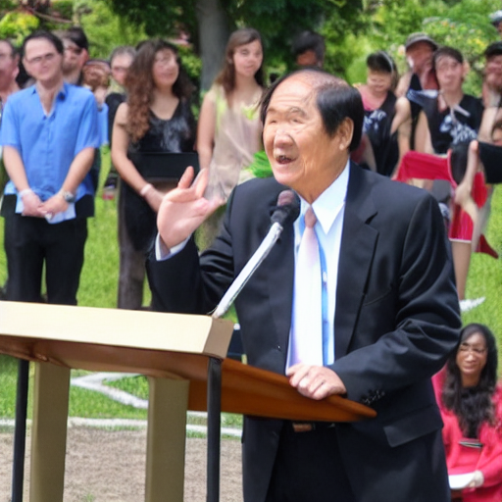
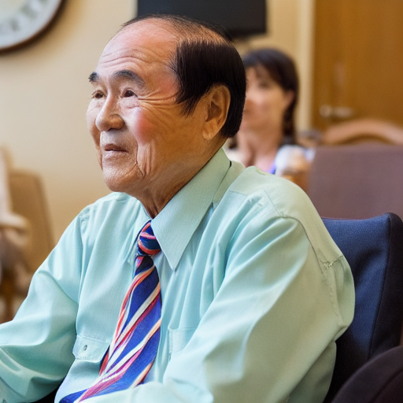
DreamBooth
12 images of the person you trained on in various contexts (e.g. different hair color, outfit, background, art style, etc...) along with their respective prompts
a sks person wearing chef uniform
a sks person with hot pink hair
a sks person taking a hike in the forests
a sks person wearing jogging gear
a sks person giving a passionate speech from a pulpit
a sks person sitting in a retirement home

Slide 7
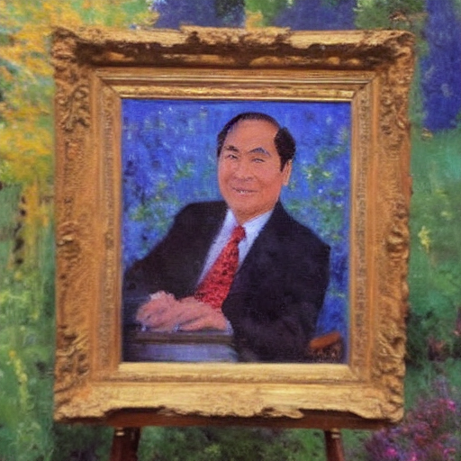
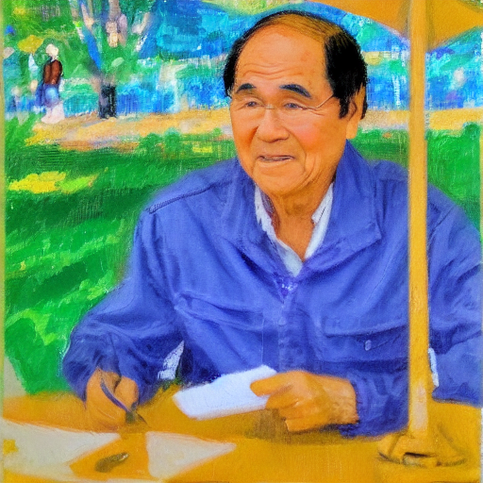
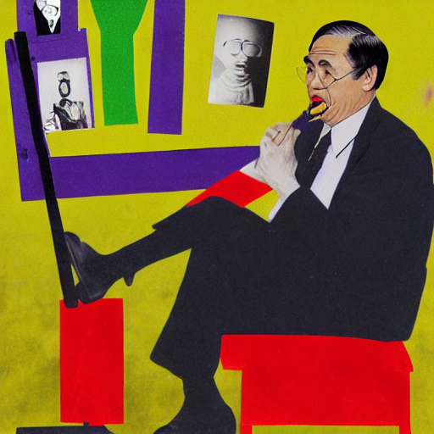
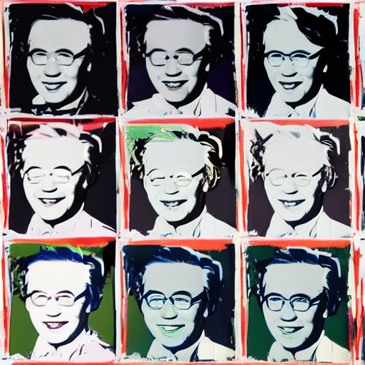
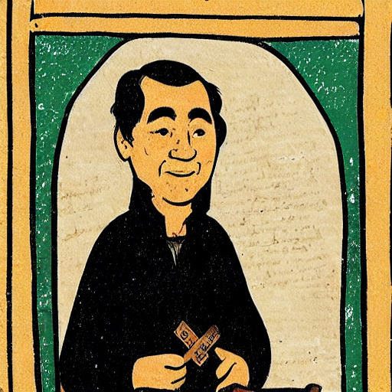
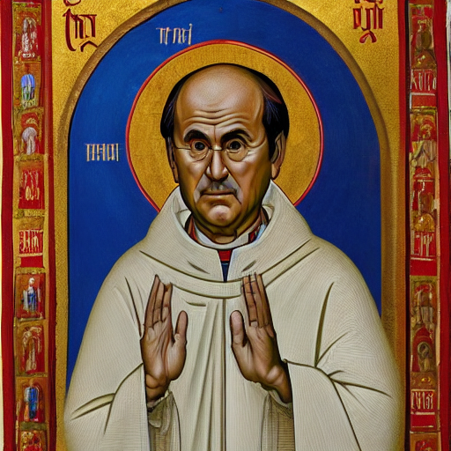
DreamBooth
12 images of the person you trained on in various contexts (e.g. different hair color, outfit, background, art style, etc...) along with their respective prompts
a sks person as an impressionist painting
A sks person in the style of an sketch
a sks person in the style of the Dada movement from the 20th century
a sks person in the style of Andy Warhol's Marilyn Diptych
a sks person in the style of a medieval book illustration
a sks person in the style of Byzantine religious art

