Slide 1
ECE 157B/272B Homework 2
Edward Ding

Slide 2
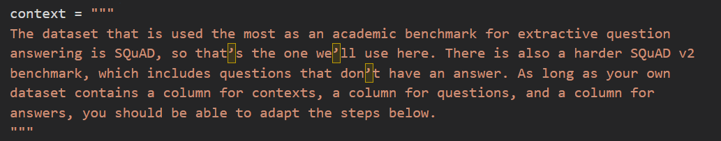
🤗 QA Tasks – “What dataset is used in this tutorial?”
My answer:
SQuAD
Context:
Model Output Screenshot:
RAG Output Screenshot:
Comment on Both Model’s Answer:
The model’s answer is correct and it’s short and concise.
Example Slide. Replace with your own content.

Slide 3
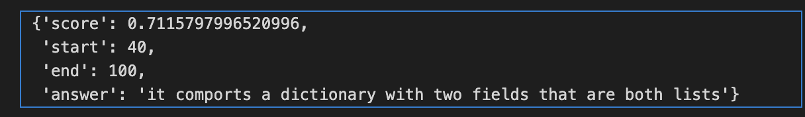
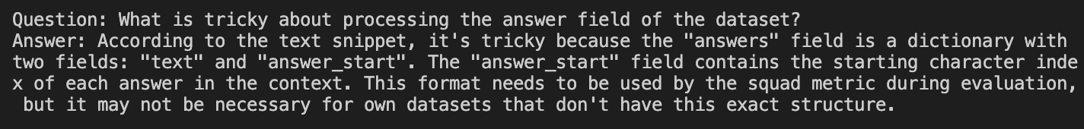
🤗 QA Tasks – “What is tricky about processing the answer field of the dataset?”
My answer: it comports a dictionary with two fields that are both lists
Context:
The answers field is a bit trickier
as it comports a dictionary with two fields that are both lists. This is the format that will be expected
by the squad metric during evaluation; if you are using your own data, you dont necessarily need
to worry about putting the answers in the same format. The text field is rather obvious, and the
answer_start field contains the starting character index of each answer in the context.
Model Output Screenshot:
RAG Output Screenshot:
Comment on Both Model’s Answer:
The model’s output is very short and concise, very much exactly what we are looking for. The RAG’s response is also correct but is substantially more detailed and long, probably because of the increased context of the entire PDF. Additionally the RAG is less specific. However, this is probably just due to the focused context that we gave the model we trained, where the answer was directly in the paragraph.

Slide 4
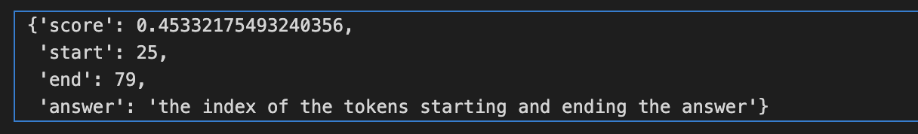
🤗 QA Tasks – “How are the labels for the answer formatted?”
My answer: the index of the tokens starting and ending the answer
Context: The labels will then be the index of the tokens starting and ending the answer, and the model will
be tasked to predicted one start and end logit per token in the input, with the theoretical labels
being as follow:
Model Output Screenshot:
RAG Output Screenshot:
Comment on Both Model’s Answer: Both are equally good here with the RAG being slightly more verbose. Picking one or the other depends on personal preferences regarding the verbosity/readability of the answer. The RAG does also give an example, whereas the model just tells you the answer.

Slide 5
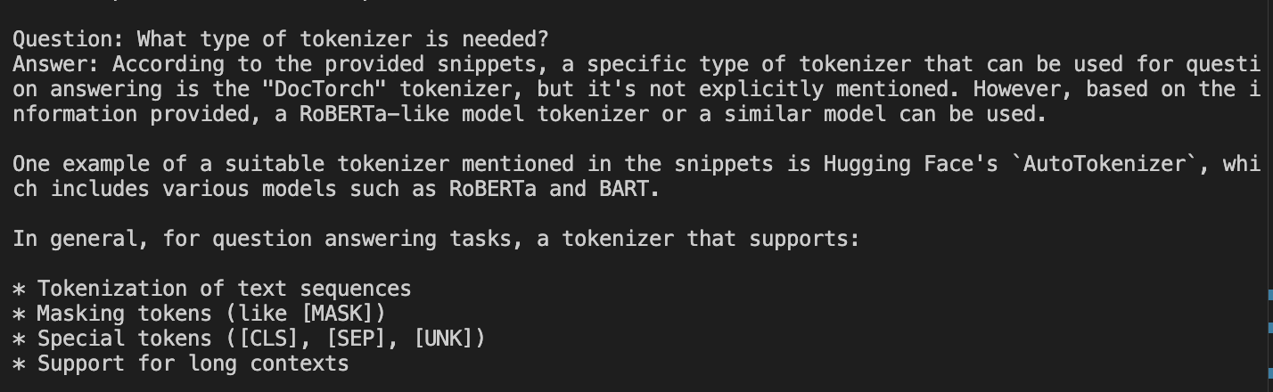
🤗 QA Tasks – “What type of tokenizer is needed?”
My answer: fast
Context: As mentioned previously, well be fine-tuning a BERT model, but you can use any other model type
as long as it has a fast tokenizer implemented. You can see all the architectures that come with a
fast version in this big table, and to check that the tokenizer object youre using is indeed backed
by 🤗 Tokenizers you can look at its is_fast attribute:
Model Output Screenshot:
RAG Output Screenshot:
Comment on Both Model’s The model came out with a very simple single word answer, whereas the RAG went into an in depth technical analysis of what is necessary. To be fair, this question was also difficult to answer and it’s subjective as to which answer is preferable, but the RAG’s answer is more technically complete.

Slide 6
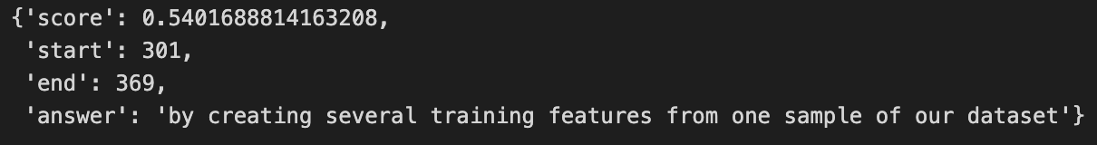
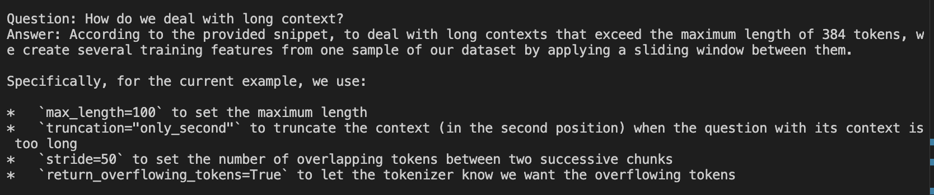
🤗 QA Tasks – “How do we deal with long context?”
My answer: by creating several training features from one sample of our dataset
Context: In this case the context is not too long, but some of the examples in the dataset have very long
contexts that will exceed the maximum length we set (which is 384 in this case). As we saw in
Chapter 6 when we explored the internals of the question-answering pipeline, we will deal with
long contexts by creating several training features from one sample of our dataset, with a sliding
window between them.
Model Output Screenshot:
RAG Output Screenshot:
Comment on Both Model’s Answer: Once again the RAG outperforms the model, although the model effectively extracts the best answer from the context given, the context of having the entire PDF wins here as the RAG is able to articulate the implementation, such as the sliding window concept of context.

Slide 7
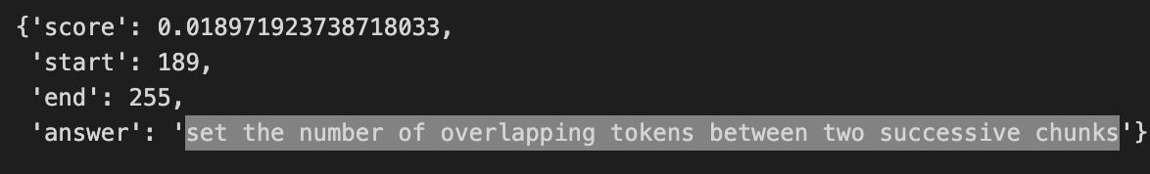
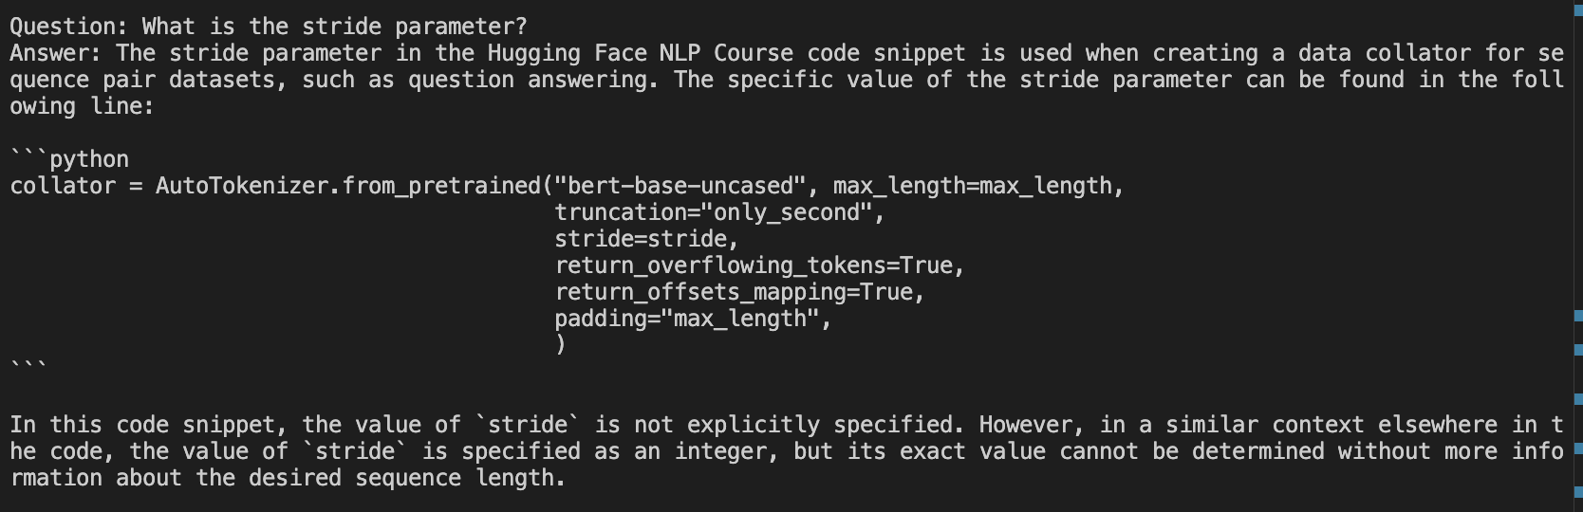
🤗 QA Tasks – “What is the stride parameter?”
My answer: set the number of overlapping tokens between two successive chunks
Context:max_length to set the maximum length (here 100)
truncation="only_second" to truncate the context (which is in the second position) when
the question with its context is too long
stride to set the number of overlapping tokens between two successive chunks (here 50)
return_overflowing_tokens=True to let the tokenizer know we want the overflowing tokens
Model Output Screenshot:
RAG Output Screenshot:
Comment on Both Model’s Answer:The previously mentioned patterns hold here. With the increased context afforded by processing the entire PDF, the RAG is able to draw on more data than the model, creating a better response. However, the model still does a decent job of extracting the best answer from the information given.

Slide 8
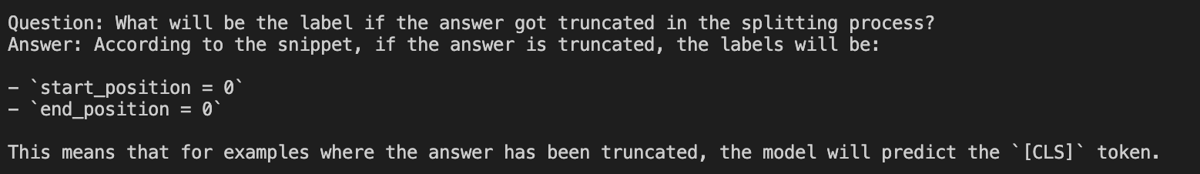
🤗 QA Tasks – “What will be the label if the answer got truncated in the splitting process?”
My answer: theindex
Context: As we can see, our example has been in split into four inputs, each of them containing the questionand some part of the context. Note that the answer to the question (“Bernadette Soubirous”) onlyappears in the third and last inputs, so by dealing with long contexts in this way we will create sometraining examples where the answer is not included in the context. For those examples, the labelswill be start_position = end_position = 0 (so we predict the [CLS] token). We will also setthose labels in the unfortunate case where the answer has been truncated so that we only have thestart (or end) of it. For the examples where the answer is fully in the context, the labels will be theindex of the token where the answer starts and the index of the token where the answer ends.
Model Output Screenshot:
RAG Output Screenshot:
Comment on Both Model’s Answer: This question was difficult for both me and the ML models to understand. We see that the modle actually does a little better here, as with a vague question having too much contexts confuses the RAG model a little bit. It writes a lot of stuff that is either not very correct or not very relevant. The Model we trained could use a slightly longer answer to explain that the ‘theindex’ refers to the index of the token where the answer starts and the index of the token where the answer ends.

Slide 9
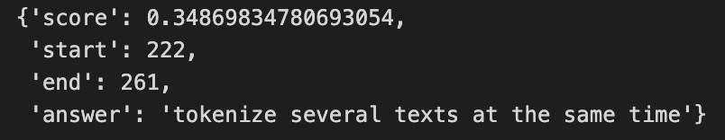
🤗 QA Tasks – “What is the purpose of overflow_to_sample_mapping?”
My answer: tokenize several texts at the same time
Context: As we can see, we get back the usual input IDs, token type IDs, and attention mask, as well as theoset mapping we required and an extra key, overflow_to_sample_mapping. The correspondingvalue will be of use to us when we tokenize several texts at the same time (which we should do tobenefit from the fact that our tokenizer is backed by Rust). Since one sample can give severalfeatures, it maps each feature to the example it originated from. Because here we only tokenizedone example, we get a list of 0s:
Model Output Screenshot:
RAG Output Screenshot:
Comment on Both Model’s Answer: This one is where both models had the same answer(ish) but interestingly the RAG start talking about how the tokenizer is

Slide 10

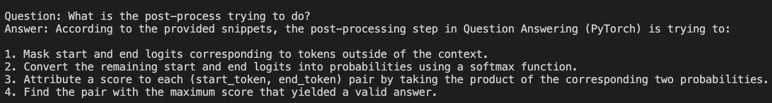
🤗 QA Tasks – “What is the post-process trying to do?”
My answer: modelpredictions into spans of text in the original examples
Context: The training code for this example will look a lot like the code in the previous sections — the hardest thing will be to write the compute_metrics() function. Since we padded all the samples to the maximum length we set, there is no data collator to define, so this metric computation is really the only thing we have to worry about. The difficult part will be to post-process the model predictions into spans of text in the original examples; once we have done that, the metric from the 🤗 Datasets library will do most of the work for us.
Model Output Screenshot:
RAG Output Screenshot:
Comment on Both Model’s Answer: Here the model is partially correct, the response is vague but it does extract the important segment “predictions into spans of text.” The RAG gives a decent response that summarizes the pdf, with a useful bullet-point format. It doesn’t use the specific phrasing of ”spans of text” but it more or less describes the same thing, the process of finding the pair with the maximum score.

Slide 11
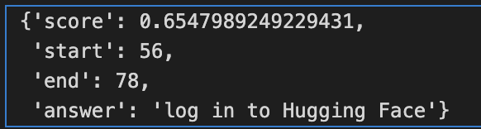
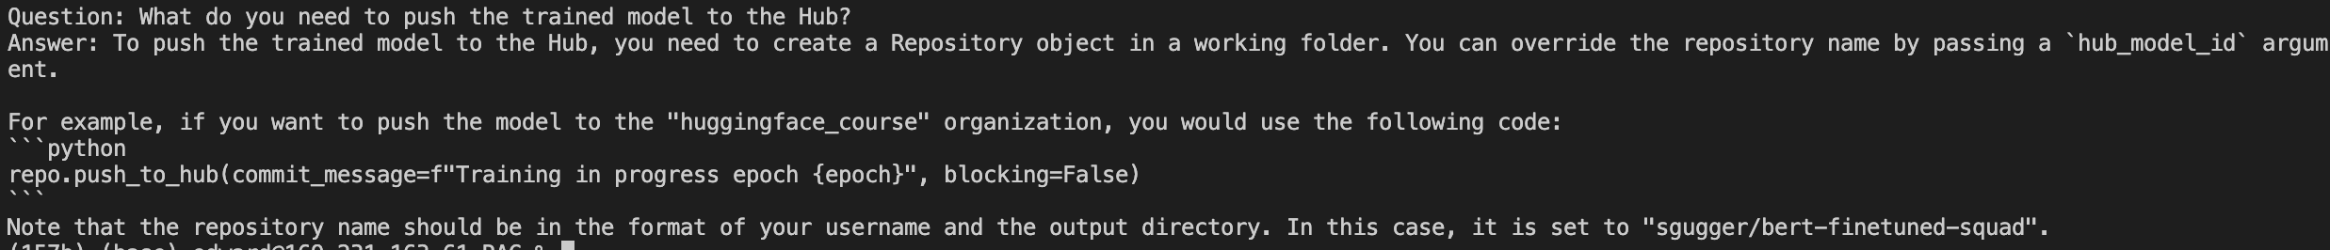
🤗 QA Tasks – “What do you need to push the trained model to the Hub?”
My answer: log in to Hugging Face
Context: To be able to push our model to the Hub, weʼll need to log in to Hugging Face. If youʼre running thiscode in a notebook, you can do so with the following utility function, which displays a widget whereyou can enter your login credentials:
Model Output Screenshot:
RAG Output Screenshot:
Comment on Both Model’s Answer: Here the RAG model fails as once again the abundance of context serves as a distraction. The RAG model says a lot that seems right but is definitely wrong, knowing the real answer. However, the model we trained is spot on and very concise, but this might be because of the very clear answer that is in the context.

Slide 12
Compare the precision and relevance of answers provided by the BERT and RAG models. Which model performed better overall, and why do you think that is the case? What are the strengths and weaknesses for both models?
Generally speaking, BERT performs the best in situations where the answer to the problem is in the limited context that we gave it. Situations like the login instructions for Hugging Face, where the question can be encapsulated by a single answer like “log into HuggingFace.” However in most of the cases, the extra context afforded by processing the entire PDF allows the RAG model to generate much better responses in general with greater technical detail. It can even pull together information from different parts of the PDF, as opposed to BERT which can only pull information from the paragraph given.
However, it’s worth noting that the playing field isn’t exactly equal here – the BERT model relies on the user copying over the paragraph that contains the information. In essence, a lot of the work is already done by the user instead of the model. The RAG model is forced to look through the entire context to determine what’s important. It’s also worth nothing that the RAG model didn’t result in uniformly better results as sometimes the extra context appeared to distract the model from the real answer whereas BERT would do a better job zooming into the answer.

Slide 13
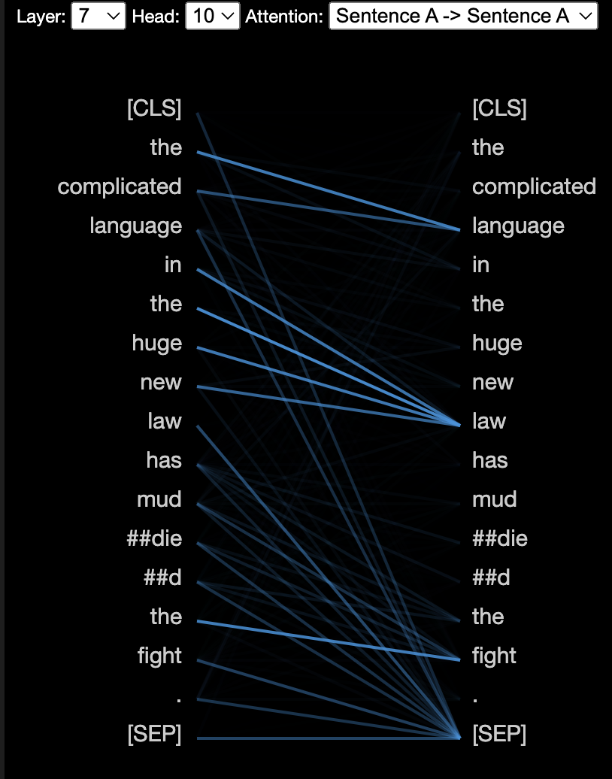
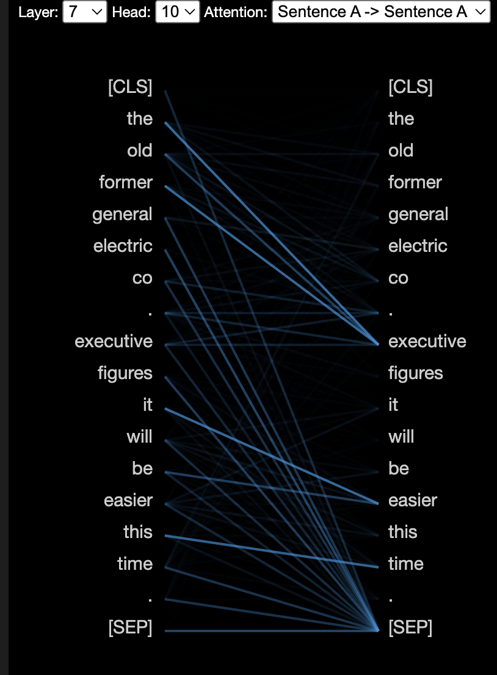
BERT Attention Head Visualization Tasks
The BERT model that is used:
model_type = 'bert'
model_version = 'bert-base-uncased'
model = BertModel.from_pretrained(model_version, output_attentions=True)
The attention layer and head that performs noun modifier:
Layer 7 Head 10
Screenshots of the attention for sentence
“The complicated language in the huge new law has muddied the fight.”
Screenshots of the attention for sentence
“The 45-year-old former General Electric Co. executive figures it will be easier this time.”

