Slide 1
Wine Quality Analysis
Dinesh Ghanta

Slide 2
Introduction
“Age appears best in four things: old wood to burn, old wine to drink, old friends to trust, and old authors to read.”
—Francis Bacon
Regardless of whether you like and consume wine or not, it will definitely be interesting to analyze the physicochemical attributes of wine and understand their relationships and significance with wine quality and types.
Since we will be trying to predict wine types and quality, the supervised Machine Learning task involved here is classification.
In 2014, $180 billion USD spent on wine (27 billion liters) worldwide
Steady growth predicted from 2015 to 2020

Slide 3
Analytical Challenges and Objectives
Identify relationships between physiochemical properties of wine and perceptions of quality
Identify additional analyses to provide insights for wine production and marketing decisions

Slide 4
Methodology
The purpose of this work is to understand the relationships physicochemical attributes of wine and their relationships with wine quality and types. Also to discuss the performance of different models (Decision tree and Random Forest algorithms) to find wine quality. Furthermore, to rank the influence of predictors/parameters in the prediction.
Objective
Data Exploration & Feature Creation
Train/ Test Data
Model Fitting
Model Evaluation
Insights

Slide 5

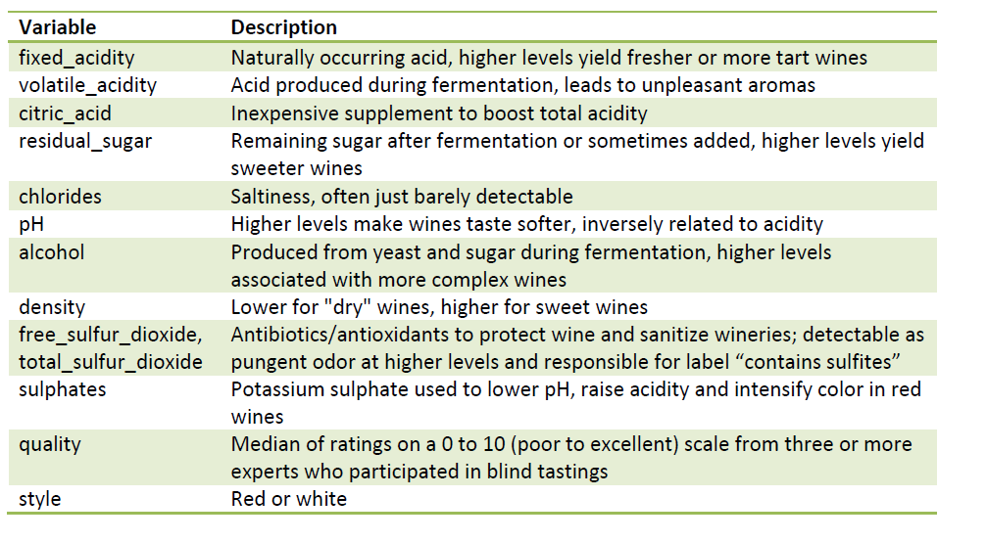
Data Description
The dataset consist of 12 measurements on 6497 samples of white and red styles of Vinho Verde wines.
There are no missing data

Slide 6
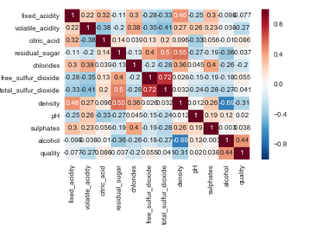
Correlation
While most of the correlations are weak, as observed , we can see a strong negative correlation between density and alcohol and a strong positive correlation between total and free sulfur dioxide, which is expected

Slide 7
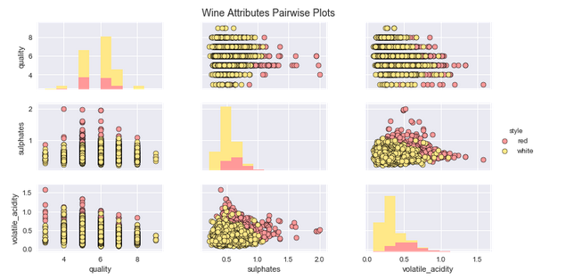
Exploratory Analysis
Presence of higher sulphate levels in red wines as compared to white wines
Lower sulphate levels in wines with high quality ratings
Lower levels of volatile acids in wines with high quality ratings
Presence of higher volatile acid levels in red wines as compared to white wines

Slide 8
Model Fitting
Techniques used – Decision Tree and Random forest Classifiers
Feature selection using REF
Verified Decision Tree and Random forest classification with hyper parameter tuning.
Hyper parameters were optimized through grid search

Slide 9
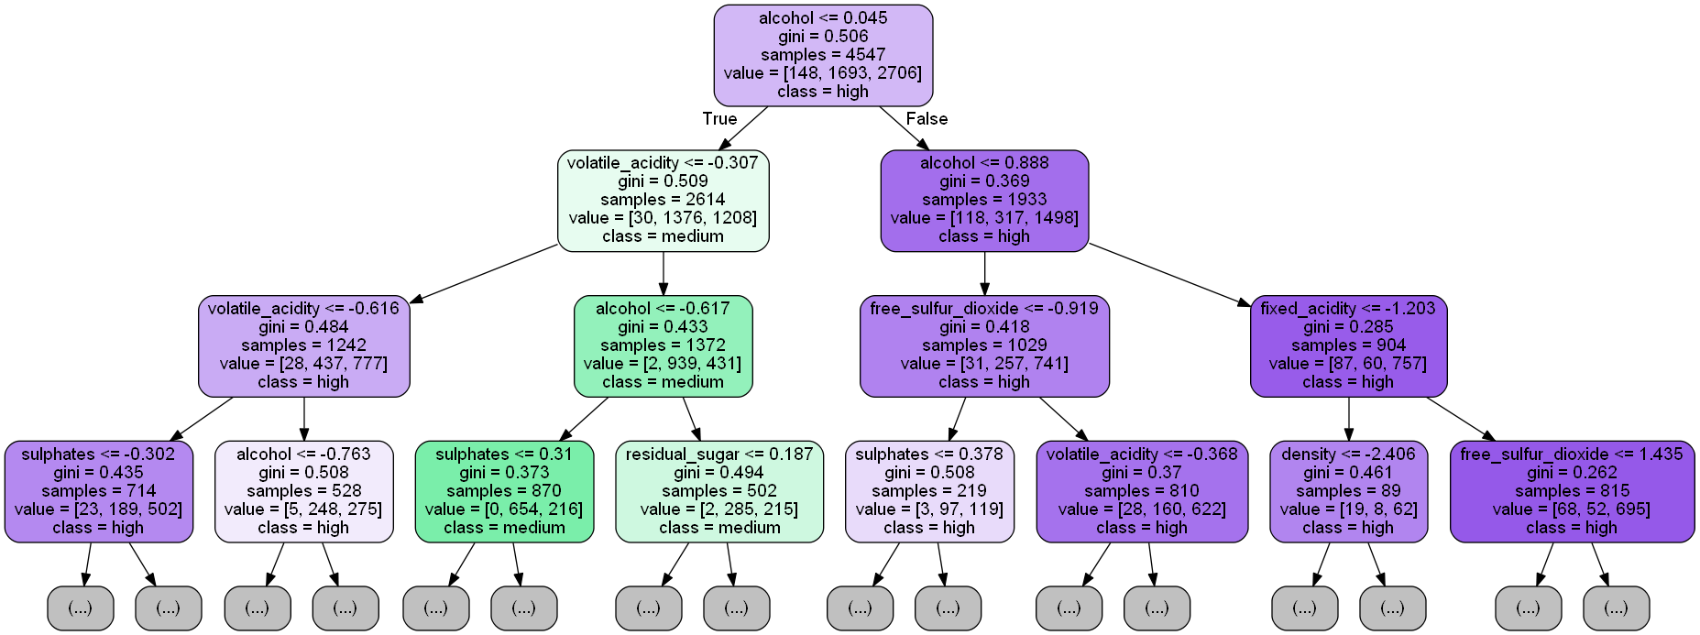
Model Decision Tree
Our decision tree model has a huge number of nodes and branches hence we visualized our tree for a max depth of three based on the preceding snippet.
We can start observing the decision rules from the tree in Figure where the starting split is determined by the rule of alcohol <= 0.045 and with each yes\no decision branch split, we have further decision nodes as we descend into the tree at each depth level.
The class variable is what we are trying to predict, i.e. wine quality being low, medium, or high and value determines the total number of samples at each class present in the current decision node at each instance.

Slide 10
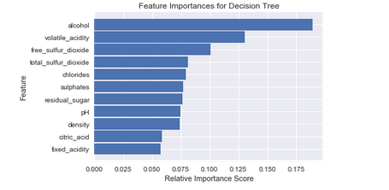
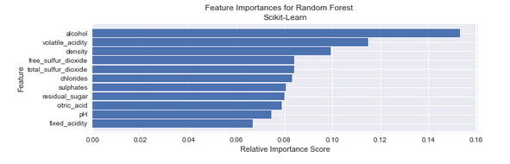
Model Interpretation and Features
Alcohol and volatile acidity occupy the top two ranks and total sulfur dioxide seems to be one of the most important features for classifying both quality.

Slide 11

Model Results
The model prediction results on the test dataset depict an overall F1 Score and model accuracy of approximately 79%, as seen in Figure 9 This is quite good considering we got an improvement of 1.5% from the initial random forest model before tuning and overall we got an improvement of 7% from the base decision tree model.

Slide 12
Conclusion
The results show us the features that were primarily responsible for the model to predict the wine quality . We can see that the most important feature was alcohol, which makes sense considering what we obtained in our analyses so far from feature importance and model decision surface interpretations.

Slide 13
Code Repository
https://github.com/edingha/WineQualityAnalysis

Slide 14
Thankyou

