Slide 1
10번째 미팅발표
2021-12-08
임에딘

Slide 2
코멘트
Knowledge distillation 훈련 후 결과
저번 미팅시간에 나온 아이디어(선택적 KD) 구현

Slide 3
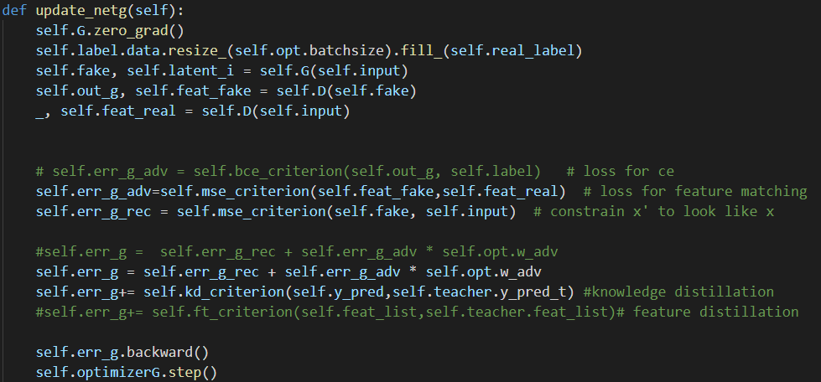
손실 함수
f(x)와 f(x’)의 손실
x와 x’의 손실
knowledge distillation 손실
1
2
3

Slide 4



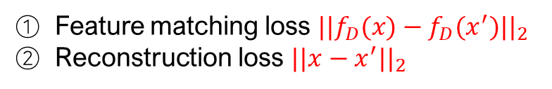
structure
Teacher
Teacher Model
Total loss
$$i$$
1
2
$$t$$
Feature matching loss ${||f_{D}(x)−f_{D}(x^{′})||}_{2}$
Reconstruction loss ${||x−x^{′}||}_{2}$
t_output
③ Knowledge distillation loss
$$D_{KL}(softmax(\frac{f_{s}(x;θ_{s})}{T})||softmax(\frac{f_{t}(x;θ_{t})}{T}))$$
3
Student
s_output
Student Model
$$i$$
1
2
Total loss
$$t$$
1
2
3

Slide 5

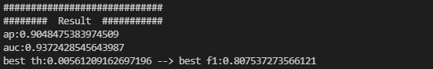


teacher model & train/eval student model Result
Train
Teacher
Eval
Teacher
1
2
1
2
3
Train
Student
Eval
Student

