Slide 1
9번째 미팅발표
2021-12-01
임에딘

Slide 2
코멘트
손실함수 통합 케이스로 나눠서 결과 비교
Teacher model이 fixed 되어있는지 확인
Diversity Matters When Learning From Ensembles 논문 리뷰

Slide 3
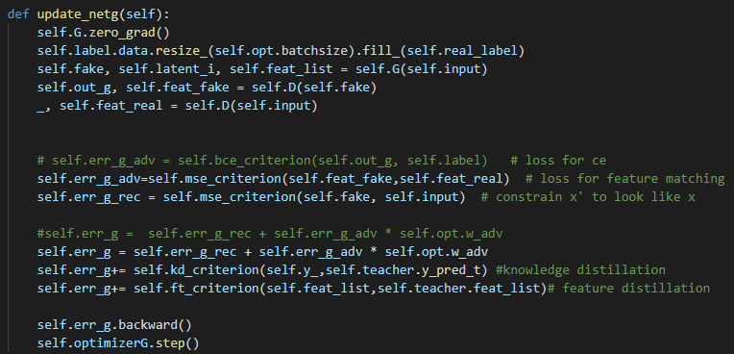
손실 함수 통합
f(x)와 f(x’)의 손실
x와 x’의 손실
knowledge distillation 손실
feature distillation 손실
1
2
3
4

Slide 4


structure
Teacher
(1) f(x), f(x’) loss
Teacher Model
$$i$$
1
2
(2) x, x’ loss
Total loss!
1
2
$$t$$
t_output
t_feature_list
3
(3) KD loss
Student
s_output
Student Model
1
2
Total loss?
s_feature_list
4
(4) FD loss

Slide 5

structure
Teacher
(1) f(x), f(x’) loss
Teacher Model
$$i$$
1
2
Total loss!
1
2
$$t$$
(2) x, x’ loss
t_output
t_feature_list
3
(3) KD loss
Student
s_output
* cases
Student Model
-
1
2
3
1
2
Total loss
-
1
2
4
-
1
2
3
4
s_feature_list
4
(4) FD loss

Slide 6
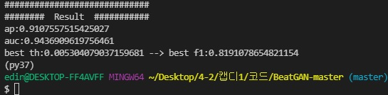
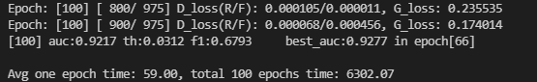
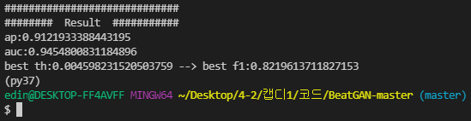
teacher model & train/eval student model Result
1
2
3
4
+KD loss
+FD loss
(Pretrained)
Teacher
Train
Student
Test
Student

Slide 7
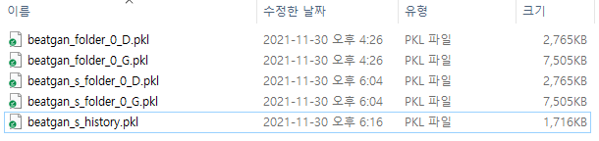
load, save G/D models
Teacher
Student

Slide 8
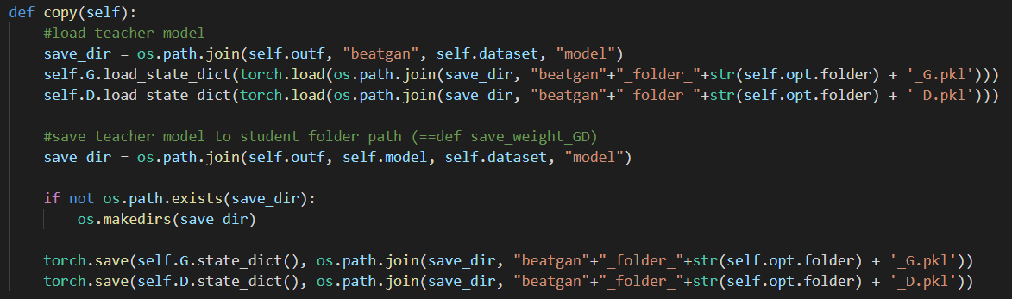
load, save G/D models
Teacher
Student
기존에는
self.model로 save해서
beatgan_s_folder..로 저장됨
하지만 distill되어야할 모델은
변경되어서는 안되므로
파일명을 달리하여 저장하여
변경하도록 수정

Slide 9
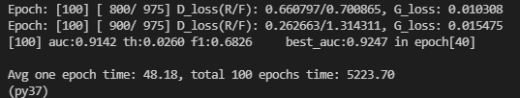
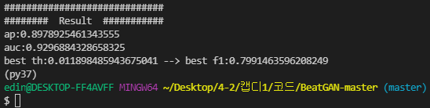
teacher model & train/eval student model Result
1
2
3
+KD loss
- FD loss
(Pretrained)
Teacher
Train
Student
Test
Student

Slide 10
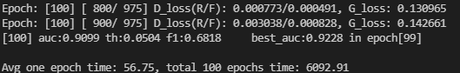
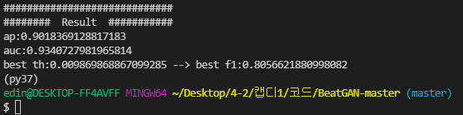
teacher model & train/eval student model Result
1
2
4
- KD loss
+FD loss
(Pretrained)
Teacher
Train
Student
Test
Student

Slide 11
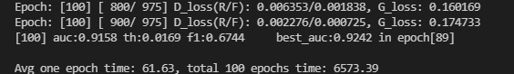
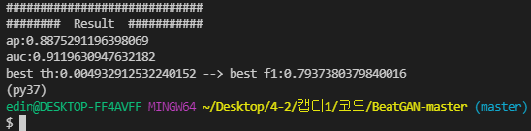
teacher model & train/eval student model Result
1
2
3
4
+KD loss
+FD loss
(Pretrained)
Teacher
Train
Student
Test
Student

