Slide 1
Advanced Web Development
Edward Instance
Supervisor - Christos Dexiades

Slide 2
What will this cover
Introduction
Context
Concepts
Progress
Next steps
Summary
Questions

Slide 3
Context
There are 2.71 billion digital buyers [1] and it is still growing.
Why should we pay a platform for everything we do, would it be better to pay a monthly fee and have unlimited access?
Broad range of features needed.
Chance to work with potential users and translate their feedback into the application.
Improve my skills at web development and explore new technologies.
https://www.oberlo.com/statistics/how-many-people-shop-online

Slide 4
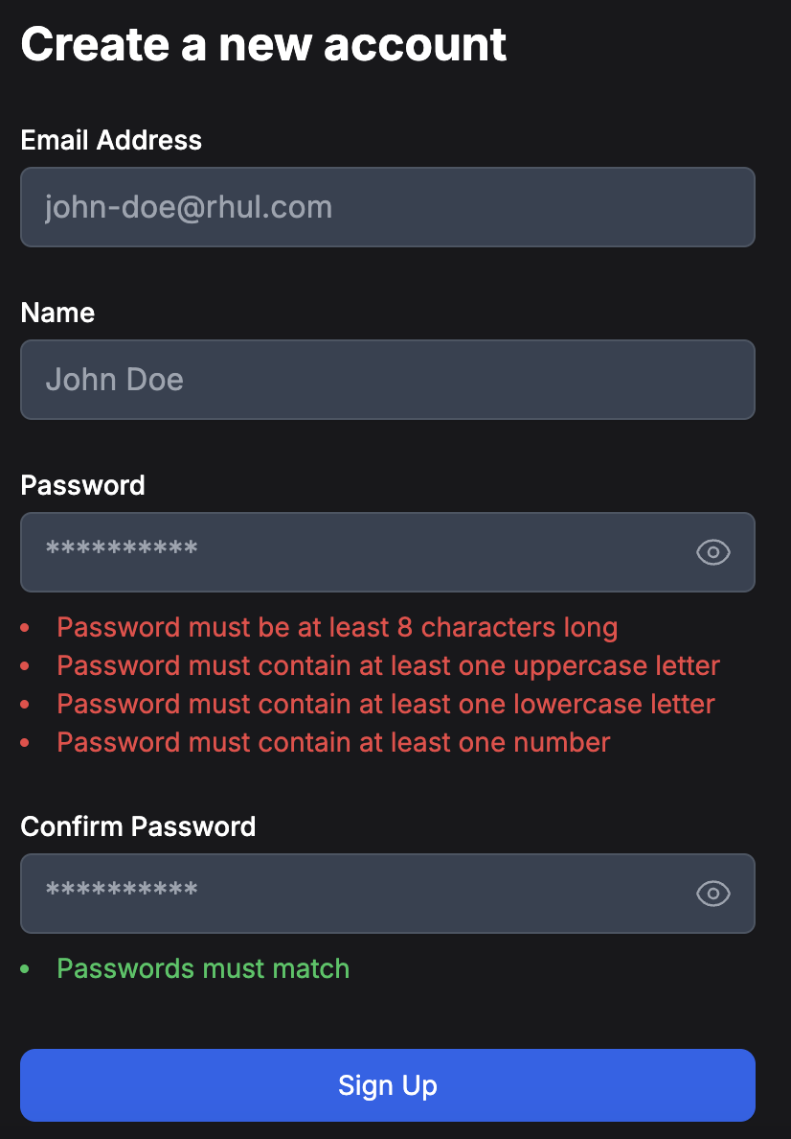
Main Concepts
Account based service with different features based on account type.
Subscription based service.
No buying or selling fees.
Ability to buy and sell items.
Option to search and filter for specific items
Messaging system for buyers and sellers, as well as a chatbot for help.
Multiple payment options.
Security features.

Slide 5
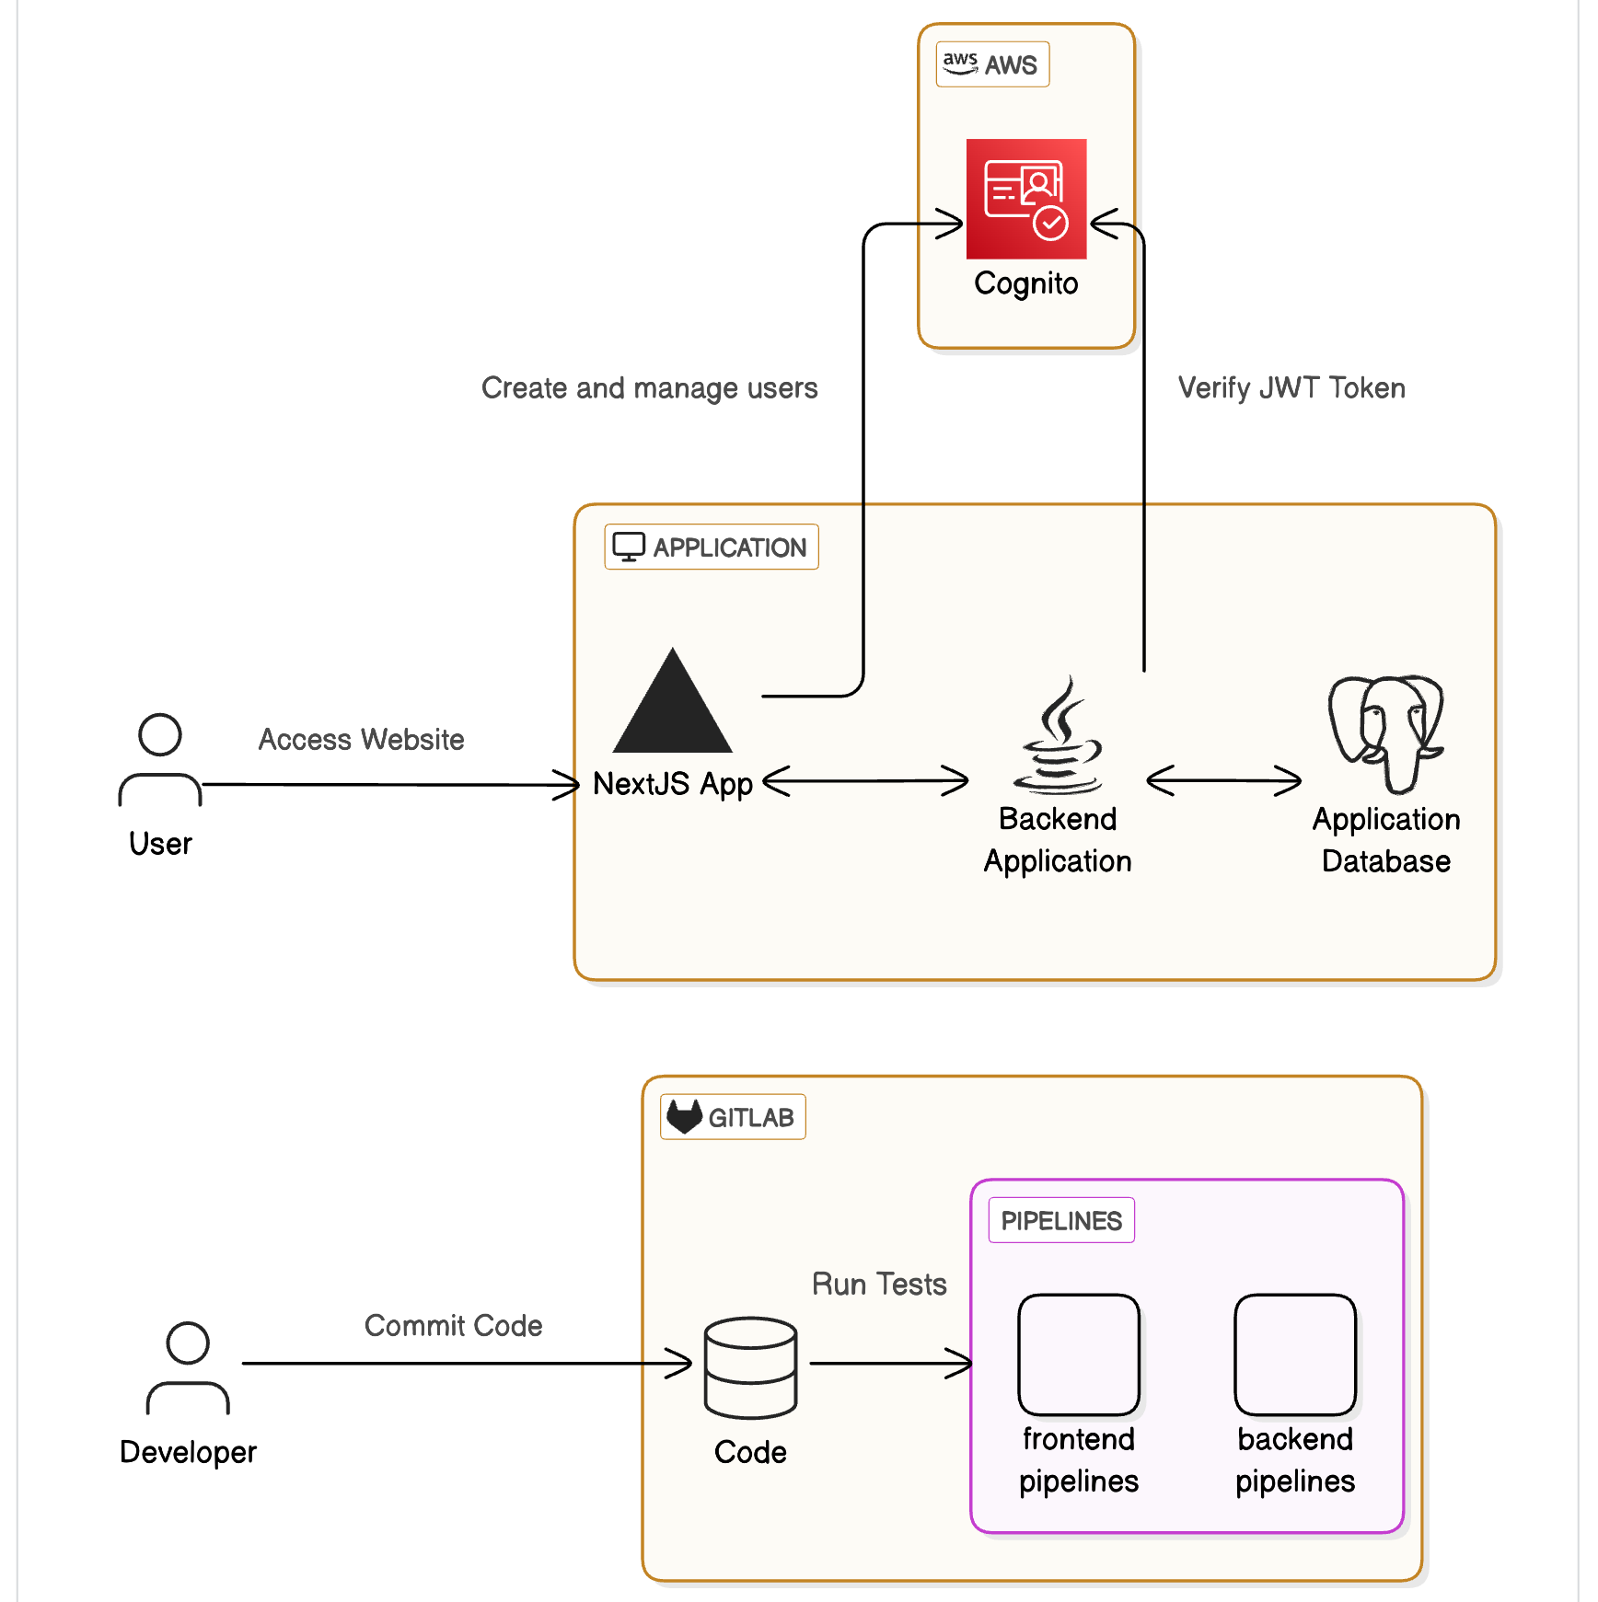
Progress so far
Fully integrated application using GraphQL
Next.js frontend
Spring Boot with Netflix DGS backend
PostgreSQL database
CI/CD using Gitlab pipelines
AWS cognito configured using infrastructure as code
JWT security
End to end, Component Integration and Unit tests
Containerised application

Slide 6


Next Steps
Finish setting up subscriptions and user to user payments using stripe.
Create production and test environments on AWS.
Create pipelines for automated deployments.
User Interface uplift and additional features.
Work with potential users to understand their needs.

Slide 7
Summary
Why I am doing this.
What I have accomplished so far.
What I will do continuing forward.
How my project has and will change.
Some of the mistakes I have made.
Key points of the project.

Slide 8
Thank you for listening
Any questions are welcome

