Slide 1
Dead simple ML.NET for Scientists, Researchers and Engineers
Edir Garcia

Slide 2
Before we even start
Download and install.NET Core 3.1 SDK and 2.1 https://dotnet.microsoft.com/download
Download and install Anaconda https://www.anaconda.com/products/individual
(optional) Download and install Graphviz https://graphviz.gitlab.io/download/

Slide 3

What is ML.NET?
ML.NET is a free, open-source, cross-platform machine learning framework made specifically for .NET developers.
With ML.NET, you can develop and integrate custom machine learning models into your .NET applications, you can also train models, not just consume.
ML.NET is an extensible platform, with tooling in Visual Studio as well as a cross-platform CLI, accessible through multiple programming languages, it also has an outstanding AutoML

Slide 4
Ways to train/use your models
C#
F#
Python (NimbusML)
CLI

Slide 5

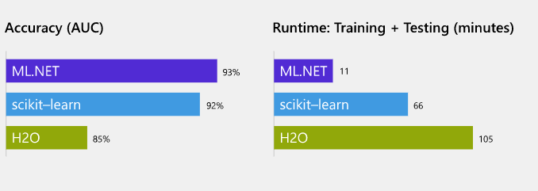
Why ML.NET?
.NET
Open Source
Cross-Platform
It’s fast!
It’s accurate!

