Slide 1
Really simple ML.NET for Scientists, Researchers and Engineers
Edir Garcia Lazo
Notes:
Hello, Introduction

Slide 2
Before we even start…
Do the Setup Instructions from GitHub:
https://github.com/edirgarcia/ml_net_lab
(You still have time)
Notes:
If you want to do the follow-along section
When testing for all of this I bumped into this:
https://github.com/dotnet/try/issues/844 so please install 3.1.103

Slide 3
Also…
This time we’re an FHL, please register
https://garagehackbox.azurewebsites.net/hackathons/2114/details/general
and S+C AI Community Event
aka.ms/scaicommunity
Notes:
If you want to do the follow-along section
When testing for all of this I bumped into this:
https://github.com/dotnet/try/issues/844 so please install 3.1.103

Slide 4

What is ML.NET?
ML.NET is a free, open-source, cross-platform machine learning framework made specifically for .NET developers.
With ML.NET, you can develop and integrate custom machine learning models into your .NET applications, you can also train models, not just consume.
ML.NET is an extensible platform, with tooling in Visual Studio as well as a cross-platform CLI, accessible through multiple programming languages, it also has an outstanding AutoML
Notes:
Like TLC but external, most of our support is shifting to ML.NET
Free, costs no money to use.
Open Source https://github.com/dotnet/machinelearning
.NET, both core and framework
You can train and consume
Multiple programming languages, CLI, a really good AutoML

Slide 5
Ways to train/use your models
C#
F#
Powershell 😲
Python (NimbusML)
CLI

Slide 6

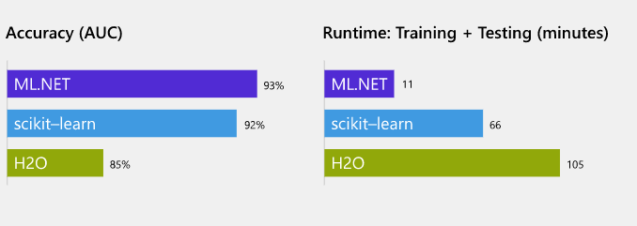
Why ML.NET?
.NET
Open Source
Cross-Platform
It’s fast!
It’s accurate!
Notes:
Using a 9GB Amazon review data set, ML.NET trained a sentiment analysis model with 95% accuracy
Paper from a bunch of people over at MS Artificial Intelligence Platform team
https://arxiv.org/pdf/1905.05715.pdf

Slide 7
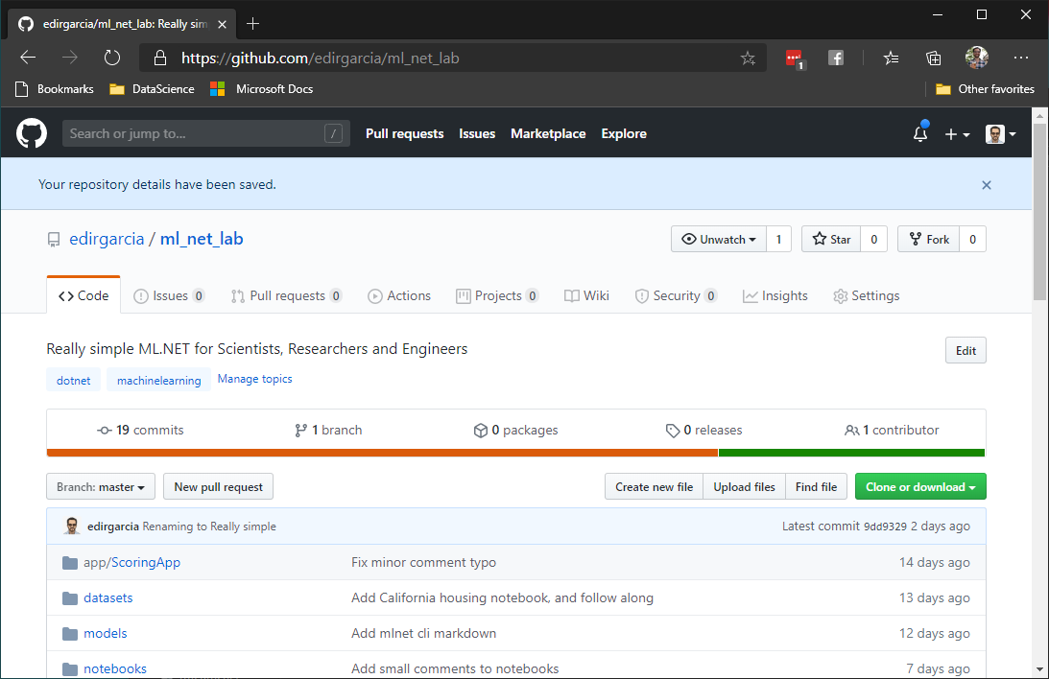
Ok, ok, show me now!
Notes:
https://github.com/edirgarcia/ml_net_lab
Why on github?

