Slide 1
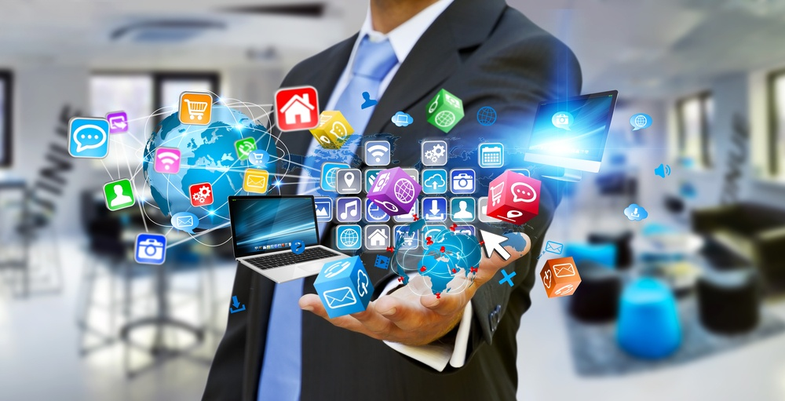
Digital Workplace
Find the perfect time, Location and Experts

Slide 2
Hallo, ich bin Alfred und helfe dir gerne einen Termin zu organisieren…
Alfred The Butler - I’ll help you out

Slide 3
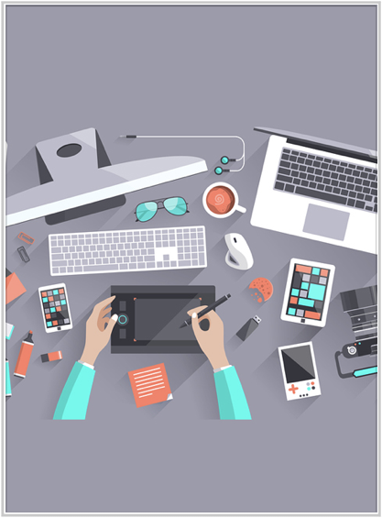
Clients
Desktop
Smartphone
Smartwatch
Voice Devices

Slide 4
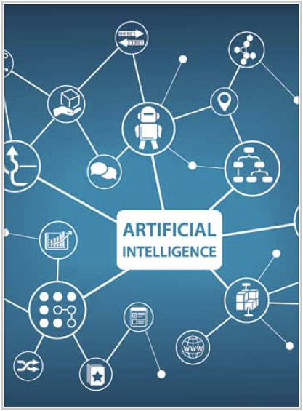
Intelligence
Time
Location
Experts
History

Slide 5
Intelligence
Time
Location
Experts
History

Slide 6
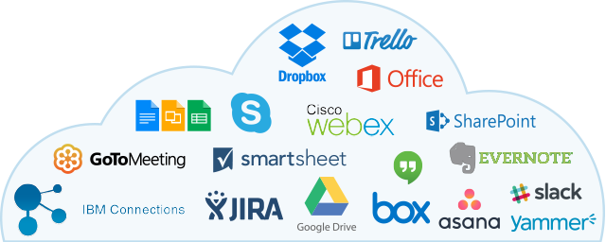
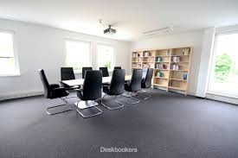
Integration
Outlook
Cisco Spark
Confluence
Traditional Rooms

Slide 7
Alfred The butler
Showcase…

