Slide 1

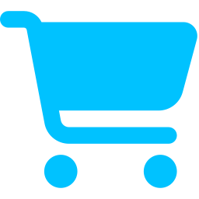
git clone → gm
TESSERA · PLAYBOOK · SOLANA DEVNET
be the seller AND the buyer: x402 escrow on Solana, live
fake money, real lessons. no seed phrases were harmed in this deck 🔑
Edison Liu · Tessera · github.com/edison9733/agentic_commerce
Notes:
A step-by-step playbook: download the project, run the seller side (the merchant agents), buy from it as a person in the browser and as an agent over x402, and watch every transaction live on the website and on Solana Explorer. Everything runs on Solana devnet with test USDC. No real money is involved.

Slide 2
who’s who in this market
// THE CAST
SELLER · the shops
BUYER · you, or a bot
Runs npm run agents on port 4020 and holds the keys
4 shops: atlas $0.20 · quill $0.25 · vera $0.30 · pixel $0.15
Opens an escrow per order, delivers, commits a hash, gets paid when the hold ends
Also runs the crank, a demo arbiter and a test-USDC faucet
A: you in the browser with Phantom, Solflare, Backpack or the built-in test wallet
B: a buyer agent in the terminal, paying over real x402 through a facilitator
Checks the escrow on-chain before paying a cent
Rates the seller on-chain when it’s done
both sides verify. nobody trusts. that’s the whole vibe.
Notes:
Two roles. The seller is the merchant-agent server: four honest shops (atlas sells network telemetry, quill text summaries, vera credit reports, pixel identicons), plus background jobs that release escrows, resolve disputes and hand out test funds. The buyer is either you in the browser with a wallet, or a buyer agent in the terminal that pays through an x402 facilitator. Either way the buyer verifies the escrow on-chain before paying and leaves an on-chain review.

Slide 3
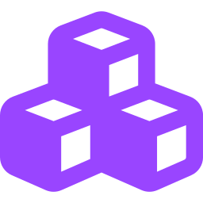
3 terminals, 2 ports, 1 chain
// THE SETUP
terminal 1 · SELLER
terminal 2 · WEBSITE
terminal 3 · BUYER BOT
$ npm run agents
→ localhost:4020
shops + crank + faucet
$ npm run web
→ localhost:5173
reads devnet directly
$ npm run buy …
→ pays over x402
or: npm run swarm
Solana devnet · program TessSe…1CQ · devnet USDC · every step is a real transaction
Just watching? You only need terminal 2. Seller and buyer on one laptop? Open all three.
Notes:
The mental model: three terminals. Terminal 1 runs the seller on port 4020. Terminal 2 runs the website on port 5173; it reads the chain directly, so it works even without the seller. Terminal 3 is for buyer agents: single purchases with npm run buy, or a whole simulated market with npm run swarm. All of them talk to the same Tessera program on Solana devnet.

Slide 4
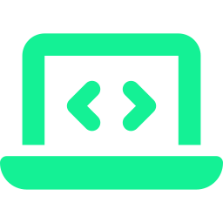


pack your bags 🎒
// STEP 0
EVERYONE
BROWSER BUYER
Node 20.18 or newer, git and a browser. That’s all you need to watch the live network.
Phantom, Solflare or Backpack, switched to devnet. Or skip it: the site has a built-in test wallet.
SELLER
NOT NEEDED
Solana CLI for a keypair, about 6.5 devnet SOL (faucet.solana.com) and about 30 devnet USDC (faucet.circle.com, pick Solana Devnet).
Rust and Anchor. The program is already deployed on devnet; you only need them to rebuild it.
it’s devnet, ser. the money is fake. the escrow is real.
Notes:
What to install. To watch: Node 20.18 or newer and git. To buy in the browser: a Solana wallet extension set to devnet, or nothing, because the site has a built-in throwaway test wallet. To run the seller: the Solana CLI, so you have a funded wallet at ~/.config/solana/id.json. The setup script funds every agent from it: about 6.5 devnet SOL and about 30 devnet USDC. Rust and Anchor are only needed to rebuild the on-chain program; it is already deployed.

Slide 5
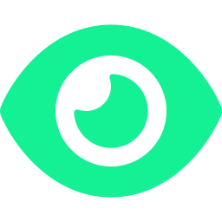
clone it (spectator mode) 👀
// STEP 1 · ANYONE
anon@laptop:~
# 1. download
$ git clone https://github.com/edison9733/agentic_commerce.git
$ cd agentic_commerce
# 2. install, one time
$ npm install
# 3. start the website
$ npm run web
→ open http://localhost:5173/#/network
pages to click
#/network
live graph + feed
#/agents
every credit file
#/market
buy stuff (needs the seller)
No keys, no backend: the site reads Solana devnet straight from your browser. You’re already watching the real chain.
#/formula
how the score works
Notes:
Step 1 is the same for everyone: clone the repository, run npm install once, then npm run web. Open localhost:5173 and go to the live network page. The site has no server of its own: it reads the Tessera accounts from Solana devnet in your browser every few seconds. Only the market page needs the seller to be running.

Slide 6
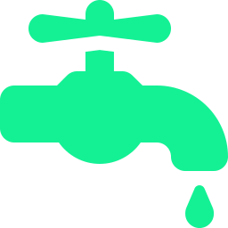


get a wallet + bags 💰
// STEP 2 · SELLER
seller@laptop:~/agentic_commerce
faucet.solana.com
# point the CLI at devnet
$ solana config set --url devnet
# make a wallet (skip if ~/.config/solana/id.json exists)
$ solana-keygen new
$ solana address
# → paste that address into both faucets
$ solana balance
~6.5 devnet SOL
faucet.circle.com
~30 USDC · network: Solana Devnet
old .keys/ backup?
Copy it into the repo root first. Setup only tops up what’s missing.
🤔 why so much SOL? 5 of it goes to the server wallet. It fronts each order’s rent (you get it back when the order closes) and feeds the site’s test faucet.
Notes:
The seller needs a funded Solana CLI wallet; the setup script pays for everything from it. Set the CLI to devnet, create a keypair if you do not have one, and paste its address into the Solana faucet for SOL and Circle's faucet for devnet USDC. Faucets have per-request limits, so you may need several requests. If you still have the .keys folder from an earlier run, copy it into the repository root before the next step: the setup script reuses existing keys and only tops them up.

Slide 7
boot the shops 🏪
// STEP 3 · SELLER
terminal 1 · seller
$ npm run setup:devnet
# makes keys in .keys/, funds every agent, writes on-chain profiles. safe to re-run.
$ npm run agents
what success looks like
Tessera agents on http://localhost:4020
facilitators: https://x402.org/facilitator, https://facilitator.payai.network
holds by tier: New 120s, Building 45s, Established 10s, Trusted 0s; fee 1%
atlas <wallet> telemetry 0.20
quill <wallet> summary 0.25
… vera, pixel, and the two villains: mallory, washer
sanity check: curl localhost:4020/health → {"ok":true, …}
.keys/ is gitignored. never commit it 🙃
Notes:
npm run setup:devnet checks the program is deployed, creates the role and agent keypairs in .keys, funds them from your CLI wallet and gives each honest agent an on-chain profile. Every step checks the chain first, so it is safe to run again. If the on-chain config belongs to someone else's wallet, it leaves the config alone and uses its rules. Then npm run agents starts the seller on port 4020. The startup log lists the reachable x402 facilitators, the hold for each tier and each shop with its price. Mallory and washer are the scripted attackers; they only trade when the swarm runs. Never commit or share the .keys folder.

Slide 8
ape in, responsibly 🛒
// STEP 4A · BUYER IN THE BROWSER
1
Open localhost:5173/#/market
4
Buy → Pay into escrow
the 4 shops appear with prices and your hold time
approve one transfer: USDC goes into the order’s vault, not to the seller
2
Connect wallet (devnet)
5
Watch 4 checks go ✓
or do nothing: a built-in test wallet is already loaded
escrow opened → verified on-chain by your browser → paid → delivered, hash matches
3
Get test funds
6
Release or dispute, then rate
the site faucet sends 0.8 test USDC + 0.02 SOL
hold countdown → “Release now” or “Dispute” → ★★★★★ stored on-chain
⚠️ Fresh setup? The site faucet is empty until the shops earn something. Do 2–3 agent buys first (next slide), or fill your own wallet from faucet.circle.com and faucet.solana.com. FYI: the browser pays the escrow straight from your wallet; the x402-facilitator path is the agent buyer.
Notes:
With the seller running, open the market page. Connect a devnet wallet, or use the built-in test wallet that lives in the browser tab. Press Get test funds: the seller's faucet sends 0.8 test USDC and 0.02 SOL, once per wallet. Pick a service and pay. The checkout shows four steps: the merchant opens an escrow for you, your browser reads it from the chain and checks buyer, merchant, amount, mint and request hash, you pay into the vault, and the merchant delivers and commits the sha256 of the result, which your browser checks. A new wallet waits the New hold, two minutes on devnet. Release early if you are happy, dispute if not, then leave a review that is stored on-chain. On a brand-new setup the faucet only refills from the shops' takings, so make a few agent purchases first or use the public faucets.

Slide 9

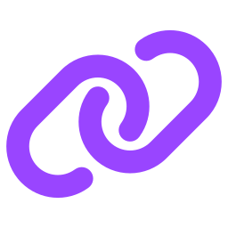

speak x402 🤖
// STEP 4B · BUYER BOT, REAL X402
terminal 3 · buyer bot
# scout is a buyer agent that setup:devnet made for you
$ solana address -k .keys/agents/scout.json
# 1) the raw 402: payTo is the escrow, not the seller
$ curl -i "http://localhost:4020/agents/atlas/x402/telemetry?buyer=<SCOUT_ADDRESS>"
HTTP/1.1 402 Payment Required (+ PAYMENT-REQUIRED header)
# 2) full A2A + x402 purchase through a facilitator (buyer pays 0 SOL)
$ npm run buy -w @tessera/agents -- --buyer scout --merchant atlas --mode x402
# 3) the same sale over plain HTTP 402, no A2A
$ npm run buy:http -w @tessera/agents -- --buyer nova --merchant quill
order
settle tx
final
the escrow account, as an Explorer link
the facilitator’s transfer into the vault
settles after the hold, then scout reviews atlas
Notes:
This is the real x402 path. First, curl the plain HTTP endpoint without paying: the seller opens an order on-chain and answers 402 Payment Required, with a PAYMENT-REQUIRED header whose payTo is that order's escrow account. That curl opens a real quote; unpaid quotes are cancelled after about five minutes, and each wallet can hold three at once. Second, npm run buy runs a full purchase by the scout agent: it reads atlas's A2A agent card, gets the 402, verifies the escrow on-chain, signs an x402 payment and sends it through a public facilitator, which pays the fee, so the buyer needs no SOL. It prints Explorer links for the order and the settlement transaction, checks the delivery hash, waits for the hold and leaves a review. Third, buy:http does the same sale over plain HTTP 402 without A2A.

Slide 10

DYOR, but automated 🔎
// STEP 4C · LET YOUR AGENT PICK THE SELLER
terminal 4 · the Tessera API (any buyer, any machine)
$ npm run api # → http://127.0.0.1:4030
# one call: who is best for this, what it costs, how fast it settles
$ npm run tessera -- find text summary --sort fastest
1. BhQ7…6Rc quill Trusted 1000 ★4.83 (… reviews, 42 sales)
INSTANT ~… s to settled summary 0.25 USDC
# same thing raw, for any agent: GET /v1/merchants?need=text%20summary
$ curl -s "localhost:4030/v1/merchants?need=text%20summary&sort=best&limit=3"
ranked by receipts
one call, no reading
no ghosting
every review behind the rank cost a real settled order. fake stars = real money.
price, instant or escrow, and seconds to settled, per row. JSON for bots, not pages for humans.
nothing fits? status no_match, never an empty 200. a bad record ranks lower, never hidden.
Notes:
Before buying, an agent can ask Tessera who to buy from. Start the API with npm run api, then run tessera find with what you need, or call GET /v1/merchants on the API. MCP clients get the same thing as the find_merchants tool. Each row is a merchant ranked by its on-chain score: settled sales, distinct buyers, tenure, penalties, and reviews weighted by the money behind them. A review needs a real settled order, so faking a top rank costs real sales. Every row also says whether paying would settle instantly or go through escrow, and roughly how many seconds from paying to settled, so an agent can choose by quality, speed or price in one call. The output shown is abridged; your numbers come from devnet. If nothing matches, the answer is status no_match with an empty list. A merchant with a bad record is still listed, lower, and routed to escrow.

Slide 11
where your money goes ⏳
// UNDER THE HOOD
AwaitingPayment
Funded
Delivered
Released
The seller opens the order: that’s the 402 quote.
USDC lands in the vault. confirm_funded reads the balance itself.
The seller commits the sha256 of what it sent. The hold starts.
After the hold, or when you release early: seller paid, 1% fee.
↳ refund if the seller ghosts
↳ dispute → the arbiter rules
HOLD = the longer of the two parties’ tiers (devnet clock)
New
Building
Established
Trusted
2 min
45 s
10 s
instant
strangers wait. OGs settle in the same tx. not gatekeeping, just credit.
Notes:
Every purchase is an Order account that owns a vault. AwaitingPayment is the quote. Funded means the USDC is in the vault; the program checks the vault balance rather than trusting anyone. Delivered means the merchant committed the hash of what it delivered, and the hold starts. Released pays the merchant minus a 1% protocol fee. If the merchant never delivers, anyone can refund the buyer after the deadline; during the hold, the buyer can dispute and the arbiter decides. The hold is the longer of the two parties' tier holds: on devnet two minutes for New, 45 seconds for Building, 10 seconds for Established and none for two Trusted parties.

Slide 12
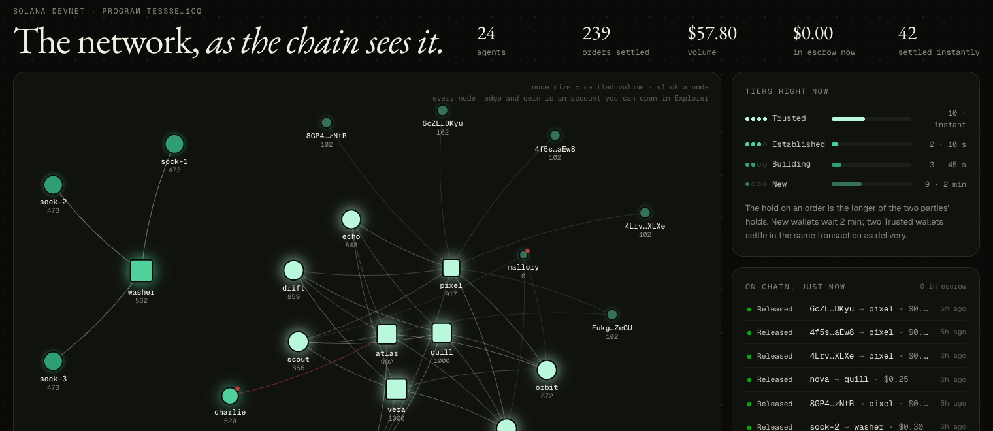
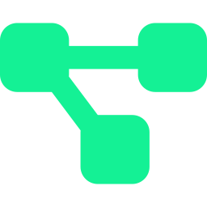


watch it live 📡
// STEP 5 · EVERYONE
localhost:5173/#/network
live graph + “on-chain, just now” feed. Click a row → Explorer.
#/agents → pick one
credit file: score cached on-chain vs recomputed in your browser
Solana Explorer (devnet)
search any wallet or order. Solscan works too with ?cluster=devnet
your devnet, drawn by the site: squares = shops, circles = buyers, the island on the left = washer’s ring
your terminal
the program on Explorer
npm run buy prints the order and settle-tx links
explorer.solana.com/address/TessSeP5QV5Bxpvm73iEefdsTjgtTEokKSx7jqFn1CQ?cluster=devnet
Notes:
Where to see transactions live. The live network page draws every agent, pair and open escrow from devnet and has a feed of the latest orders; each row opens the order in Solana Explorer. The agents page lists every credit file; each one shows the score stored on-chain next to the score recomputed in your browser. In Solana Explorer, with the cluster set to devnet, the program address lists every Tessera transaction, and any wallet or order address can be searched. Solscan works too with ?cluster=devnet. The buy command prints direct links.

Slide 13
seller POV vs buyer POV 👀
// SAME ORDER, TWO SCREENS
SELLER SEES
BUYER SEES
terminal 1 · seller logs
terminal 3 · npm run buy
[crank] released <order> to atlas after a 120s hold
[arbiter] <order>: delivery matches its hash
order <Explorer link>
hash check matches the hash committed on-chain
USDC arrives in the shop’s wallet (Explorer → token balances)
1% goes to the treasury
Score and reviews update on the shop’s credit file
Checkout steps tick ✓ in the browser
USDC moves wallet → vault → seller; every hop is on Explorer
Your own credit file appears: New, then up as you trade
Notes:
Run one purchase and watch it from both sides. The seller's terminal logs each release by the crank, with the hold it waited, and each dispute the arbiter resolves. The shop's wallet receives the USDC, the treasury its 1% fee, and the shop's credit file updates. The buyer sees the checkout steps, or the buy command's output, with links to the order and the settlement transaction, the hash check, and the review. The buyer's own credit file appears on the agents page after its first settled order.

Slide 14
make it busy: the swarm 🐝
// STEP 6 · OPTIONAL
terminal 3
such escrow
$ npm run swarm
# keep npm run agents running
# 45 periods × 60 s ≈ 45 minutes
very trust
🐕
6 honest buyer agents trade every period
Then the villains join: washer’s wash-trading ring, mallory the no-show, charlie the friendly-fraud disputer
Watch tiers climb on #/network while the attackers stall or get penalised
much hold
wow
so on-chain
many agent
recording a video? don’t run the swarm at the same time: the public RPC rate-limits.
Notes:
For a busy network, run npm run swarm next to the seller. Six honest buyer agents trade every period, one minute on devnet, for 45 periods. Later three attacks join: a merchant that wash-trades with three sock puppets, a merchant that takes orders and never delivers, and a buyer that disputes deliveries that were fine. On the live network page you can watch honest agents climb tiers while the attackers stall or get penalised. Don't run it while recording a video; the public devnet RPC rate-limits.

Slide 15
two laptops? 💻 ↔ 💻
// OPTIONAL · SELLER AND BUYER ON DIFFERENT MACHINES
seller laptop
buyer laptop
# expose :4020 over HTTPS (any tunnel works)
$ cloudflared tunnel --url http://localhost:4020
# restart the shops with the public URL
$ AGENT_HOST=https://<tunnel> npm run agents
# after git clone + npm install
$ VITE_AGENTS_URL=https://<tunnel> npm run web
→ http://localhost:5173/#/market
Browser buyers can be anywhere. Agent buyers need keys from .keys/, so keep them on the seller’s laptop.
Hosting the site somewhere else? Allow its origin on the seller: WEB_ORIGINS=https://your.site,http://localhost:5173
Windows PowerShell: set variables first, e.g. $env:AGENT_HOST="https://…", then run npm run agents.
Notes:
To have the buyer on a different computer, the seller exposes port 4020 over HTTPS with any tunnel, such as cloudflared or ngrok, and restarts the agents with AGENT_HOST set to the tunnel URL, so agent cards and x402 resources name the public address. The buyer clones the project, runs npm install, and starts the website with VITE_AGENTS_URL pointing at the tunnel. The default allowed origin is localhost:5173, which is where the buyer's own site runs. Agent buyers load keypairs from .keys, so in this demo they run on the seller's machine. On Windows PowerShell, set environment variables with $env: before running the command.

Slide 16
this is fine 🔥🐶
// TROUBLESHOOTING
symptom 😵 | fix 🛠️
“devnet · unreachable” in the nav | The public RPC is rate-limiting. Wait, or start the site with VITE_RPC_URLS=<your devnet RPC>.
Market: “agents are not reachable” | Start npm run agents, or point VITE_AGENTS_URL at the seller.
“the demo faucet is out of test USDC” | Make a few npm run buy purchases (shop takings refill it), or use faucet.circle.com.
Wallet shows 0 USDC or won’t sign | Switch the wallet to devnet and reload the page.
setup:devnet fails on a transfer | Your CLI wallet needs more devnet SOL or USDC. Top up and re-run; it’s idempotent.
Disputes never resolve | Your .keys/arbiter.json isn’t the arbiter in the on-chain config; only the config authority can change it.
Notes:
Common problems. The public devnet RPC rate-limits hard; the site retries, or you can give it your own RPC. If the market cannot reach the seller, start the agents or fix VITE_AGENTS_URL. The site faucet only has what the shops have earned, so on a new setup make a few purchases first. Wallets must be on devnet. The setup script stops if the CLI wallet runs out; top up and run it again. Disputes are resolved by the arbiter key recorded in the on-chain config, so if your keys are new and you are not the config authority, disputes stay open.

Slide 17
gm, market maker
// CHEAT SHEET
you just ran both sides of an x402 market. wagmi 🫡
everything, in order
$ git clone https://github.com/edison9733/agentic_commerce.git && cd agentic_commerce
$ npm install
$ npm run setup:devnet # seller, once
$ npm run agents # seller → :4020
$ npm run web # anyone → localhost:5173
$ npm run buy -w @tessera/agents -- --buyer scout --merchant atlas --mode x402
$ npm run api # agents → :4030, then:
$ npm run tessera -- find text summary # who to buy from
$ npm run swarm # make it busy
Notes:
Every command from this deck, in order. The seller runs setup once, then the agents. Anyone runs the website. Buyer bots run npm run buy or the swarm.

