Slide 1




Large-scale Spatiotemporal Kernel Density Visualization
(Edison) Tsz Nam Chan¹, Pak Lon Ip², Bojian Zhu³, Leong Hou U²,
Dingming Wu¹, Jianliang Xu³, Christian S. Jensen⁴
¹Shenzhen University ²University of Macau
³Hong Kong Baptist University ⁴Aalborg University

Slide 2
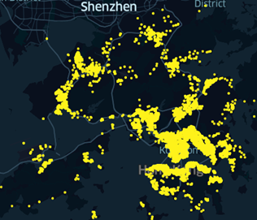
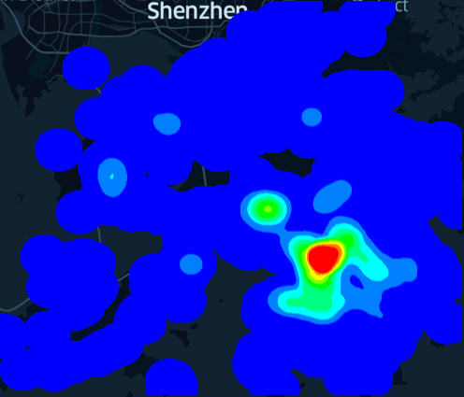
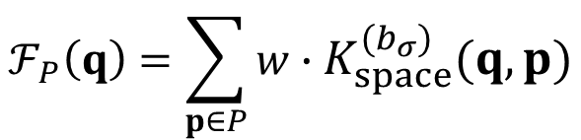
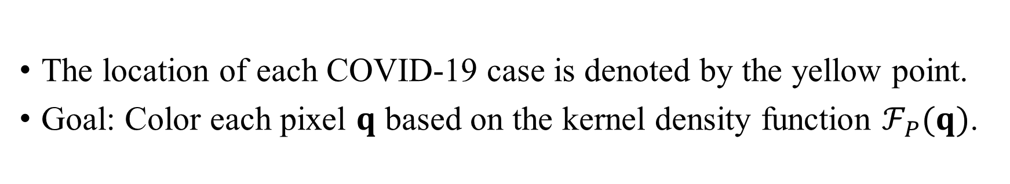
Overview of Kernel Density Visualization (KDV)
Hong Kong COVID-19 cases
Hotspot map (based on KDV)
The location of each COVID-19 case is denoted by the yellow point.
Goal: Color each pixel $q$ based on the kernel density function $ℱ_{P}(q)$.
$$ℱ_{P}\left(q\right)=\sum_{p∈P}{w}∙K_{space}^{(b_{σ})}(q,p)$$

Slide 3
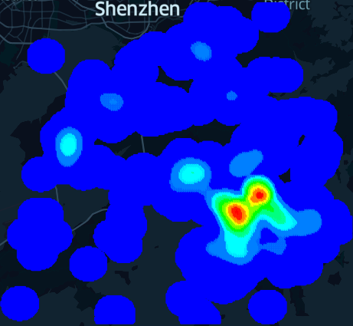
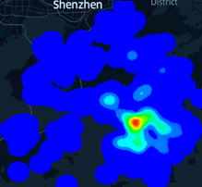
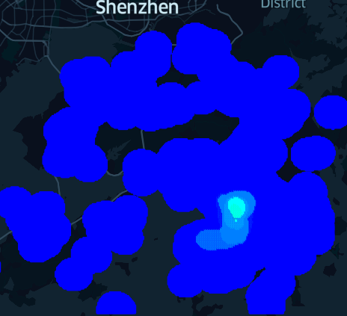
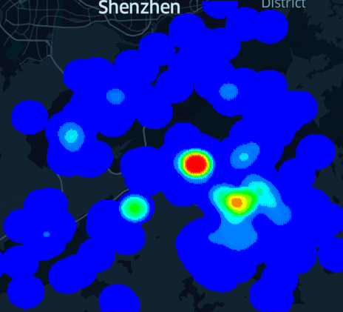
Weakness of KDV
Does not consider the occurrence time of each geographical event ☹
2nd August 2020
6th December 2020
Hong Kong COVID-19 cases
Hotspot map (based on KDV)
28th February 2021
28th January 2022

Slide 4
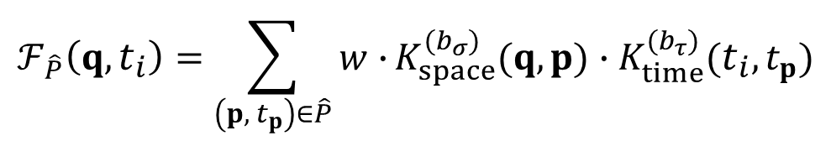
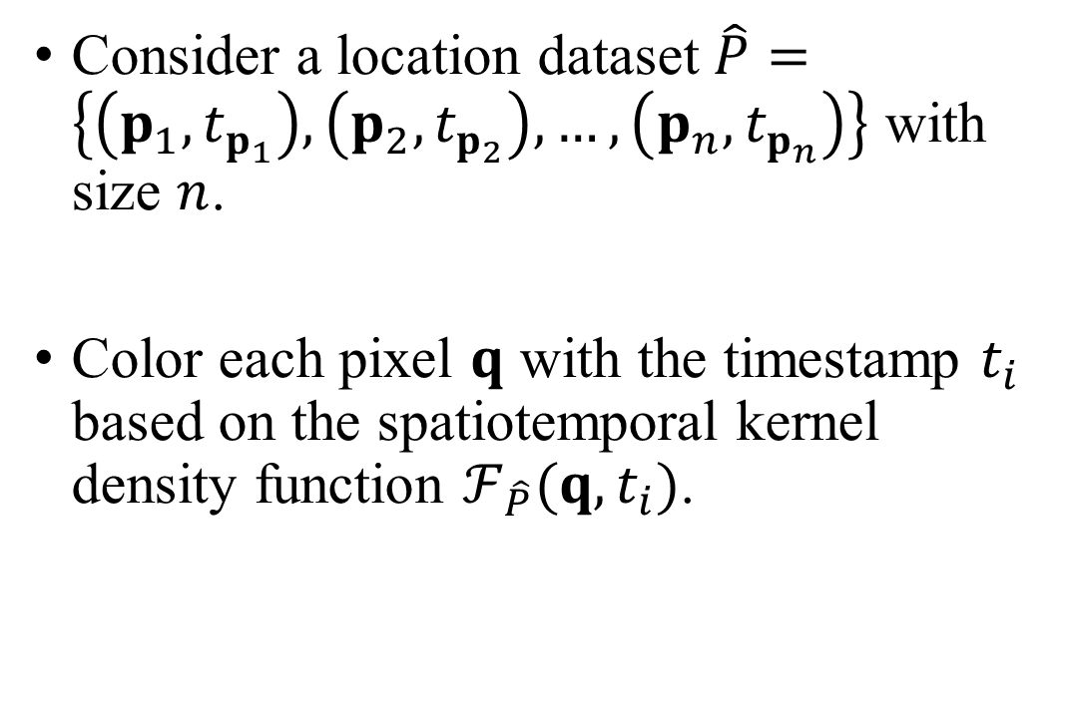
Spatiotemporal Kernel Density Visualization (STKDV)
Consider a location dataset $\hat{P}=\left\{\left(p_{1}, t_{p_{1}}\right),\left(p_{2}, t_{p_{2}}\right),…,\left(p_{n}, t_{p_{n}}\right)\right\}$ with size $n$.
Color each pixel $q$ with the timestamp $t_{i}$ based on the spatiotemporal kernel density function $ℱ_{\hat{P}}(q,t_{i})$.
2nd August 2020
6th December 2020
$$ℱ_{\hat{P}}\left(q,t_{i}\right)=\sum_{\left(p, { t}_{p}\right)∈\hat{P}}{w∙}K_{space}^{(b_{σ})}(q,p)∙K_{time}^{(b_{τ})}(t_{i},t_{p})$$
28th February 2021
28th January 2022

Slide 5
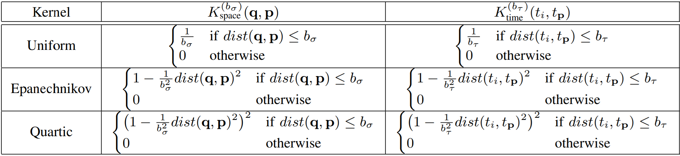
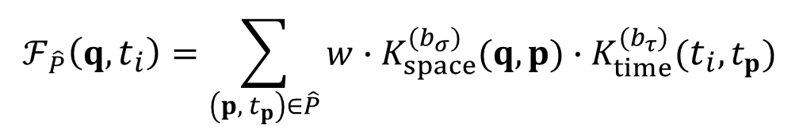

Spatiotemporal Kernel Density Visualization (STKDV)
Some representative spatial and temporal kernel functions that are used in the spatiotemporal kernel density function $ℱ_{\hat{P}}(q,t_{i})$.
$$ℱ_{\hat{P}}\left(q,t_{i}\right)=\sum_{\left(p, { t}_{p}\right)∈\hat{P}}{w∙K_{space}^{(b_{σ})}(q,p)∙K_{time}^{(b_{τ})}(t_{i},t_{p})}$$

Slide 6
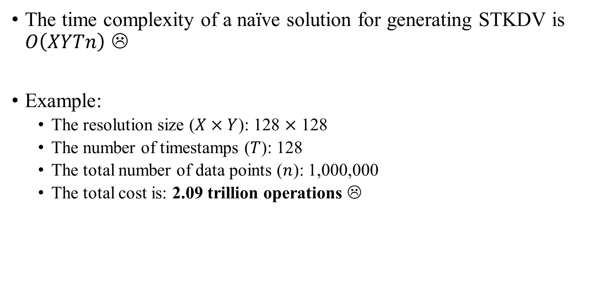
STKDV is Slow!
The time complexity of a naïve solution for generating STKDV is $O\left(XYTn\right)$ ☹
Example:
The resolution size ($X×Y$): 128 $×$ 128
The number of timestamps ($T$): 128
The total number of data points ($n$): 1,000,000
The total cost is: 2.09 trillion operations ☹

Slide 7
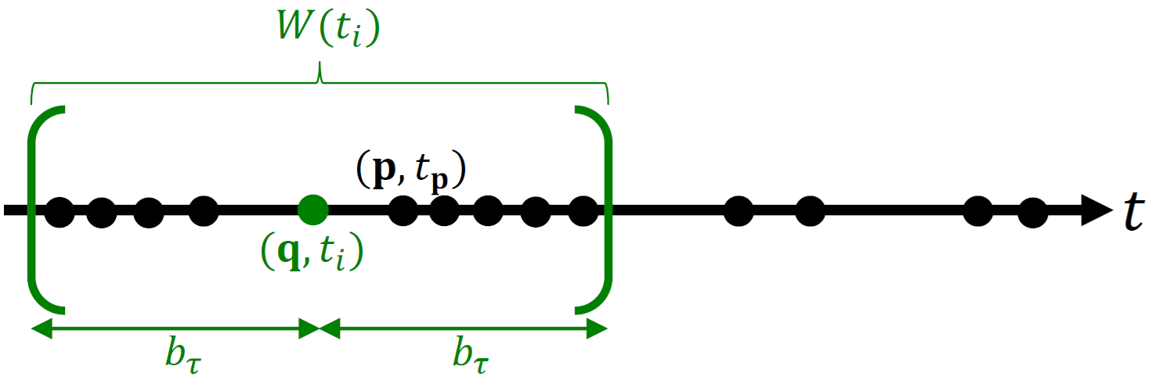
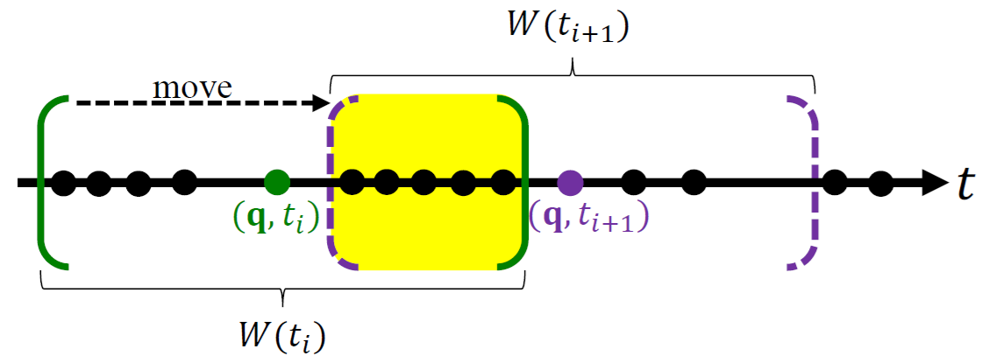
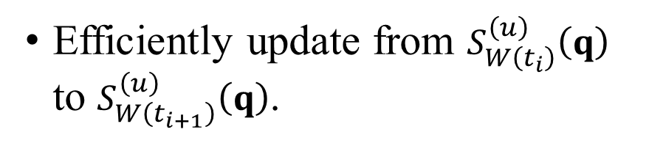

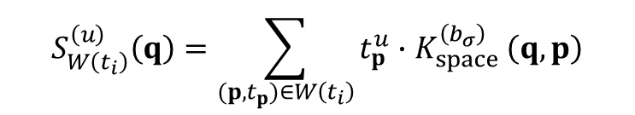
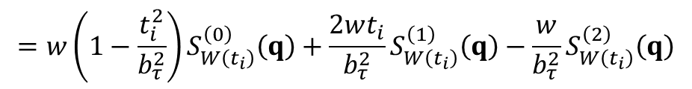
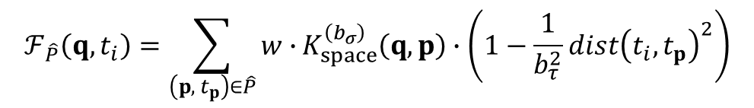
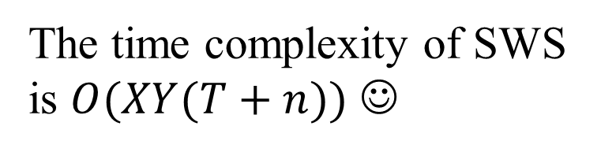
Sliding-Window-based Solution (SWS)
Only those data points $(p, t_{p})$ in $W(t_{i})$ can contribute to $ℱ_{\hat{P}}\left(q,t_{i}\right)$.
Efficiently update from $S_{W\left(t_{i}\right)}^{\left(u\right)}\left(q\right)$ to $S_{W\left(t_{i+1}\right)}^{\left(u\right)}\left(q\right)$.
$$ℱ_{\hat{P}}\left(q,t_{i}\right)=\sum_{\left(p, { t}_{p}\right)∈\hat{P}}{w∙}K_{space}^{\left(b_{σ}\right)}\left(q,p\right)∙\left(1−\frac{1}{b_{τ}^{2}}{dist\left(t_{i},t_{p}\right)}^{2}\right)$$
The time complexity of SWS is $O(XY(T+n))$ ☺
$$=w\left(1−\frac{t_{i}^{2}}{b_{τ}^{2}}\right)S_{W\left(t_{i}\right)}^{\left(0\right)}\left(q\right)+\frac{2wt_{i}}{b_{τ}^{2}}S_{W\left(t_{i}\right)}^{\left(1\right)}\left(q\right)−\frac{w}{b_{τ}^{2}}S_{W\left(t_{i}\right)}^{\left(2\right)}\left(q\right)$$
where
$$S_{W\left(t_{i}\right)}^{\left(u\right)}\left(q\right)=\sum_{(p,t_{p})∈W\left(t_{i}\right)}{t_{p}^{u}{∙K}_{space}^{\left(b_{σ}\right)}\left(q,p\right)}$$
T. N. Chan, P. L. Ip, L. H. U, B. Choi, J. Xu. SWS: A Complexity-Optimized Solution for Spatial-Temporal Kernel Density Visualization. PVLDB 2022 (vol 15), pages 814-827.

Slide 8
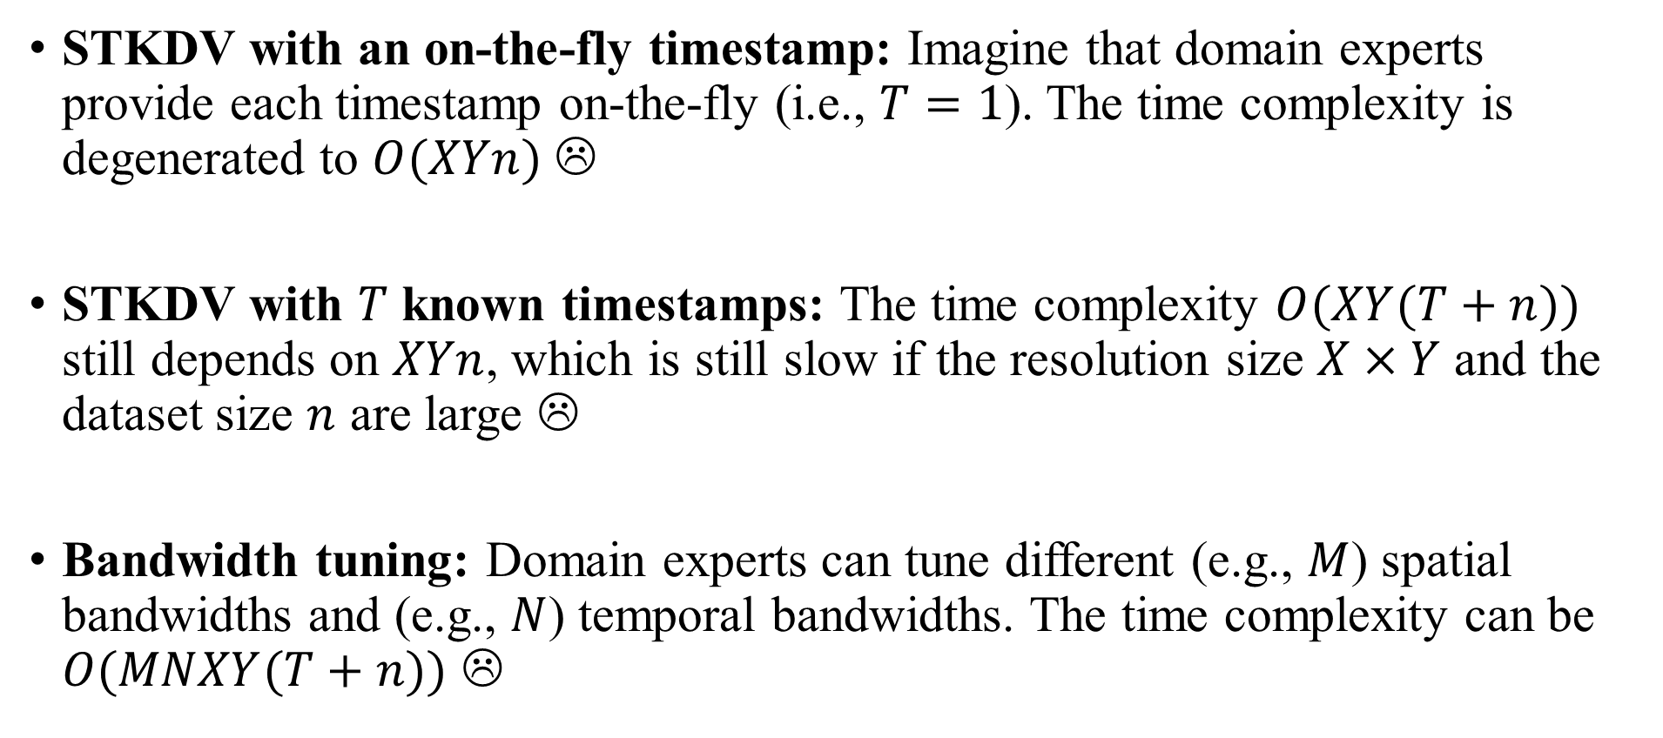
Weakness of SWS
STKDV with an on-the-fly timestamp: Imagine that domain experts provide each timestamp on-the-fly (i.e., $T=1$). The time complexity is degenerated to $O(XYn)$ ☹
STKDV with $T$ known timestamps: The time complexity $O(XY(T+n))$ still depends on $XYn$, which is still slow if the resolution size $X×Y$ and the dataset size $n$ are large ☹
Bandwidth tuning: Domain experts can tune different (e.g., $M$) spatial bandwidths and (e.g., $N$) temporal bandwidths. The time complexity can be $O(MNXY(T+n))$ ☹

Slide 9
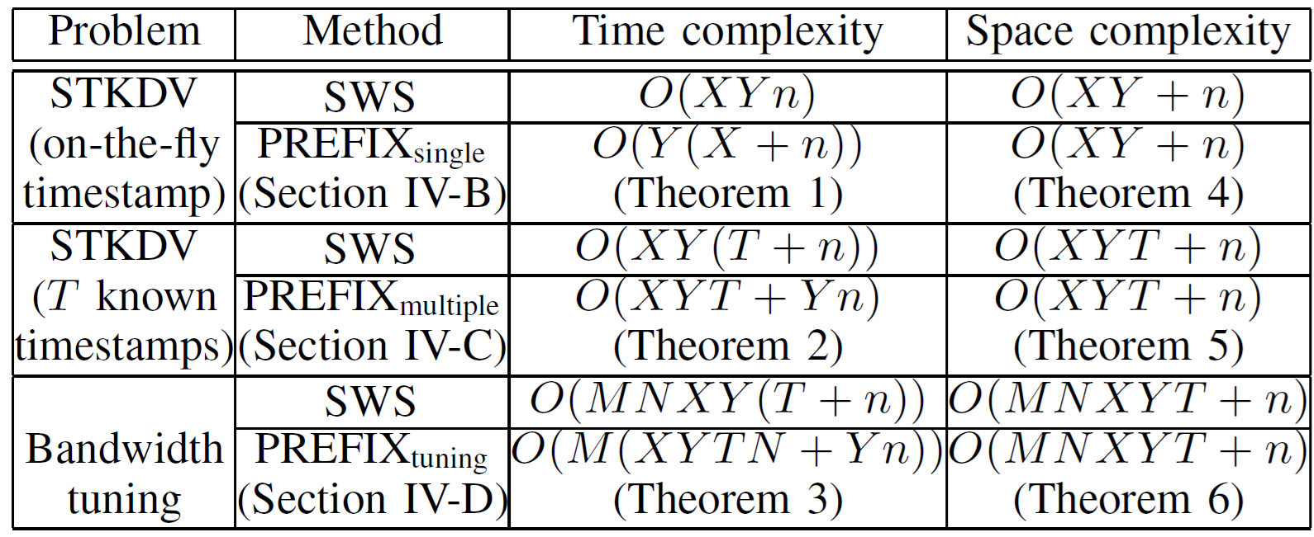
Prefix-set-based Solution (PREFIX)
Theoretical results: Simultaneously reduces the time complexity for these three settings, without increasing the space complexity.
Practical results: Achieves 115x to 1906x speedups compared with SWS.

Slide 10
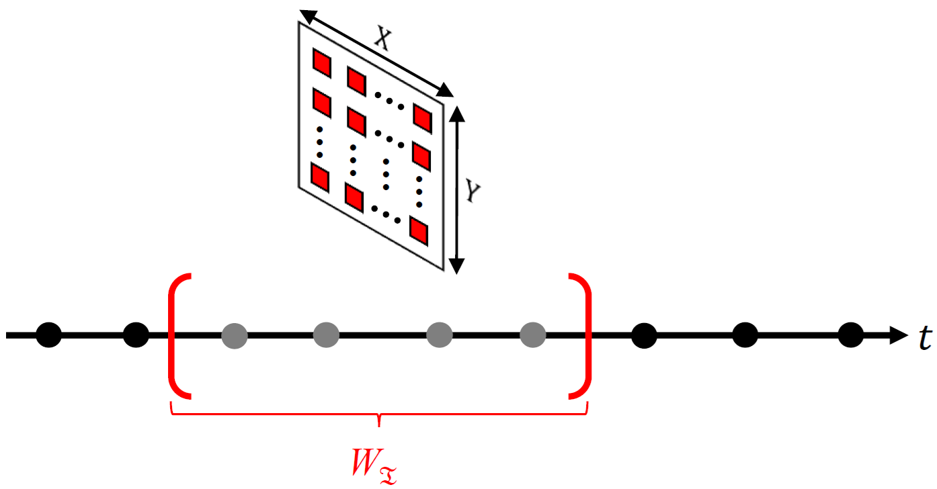
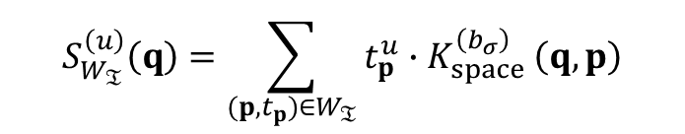
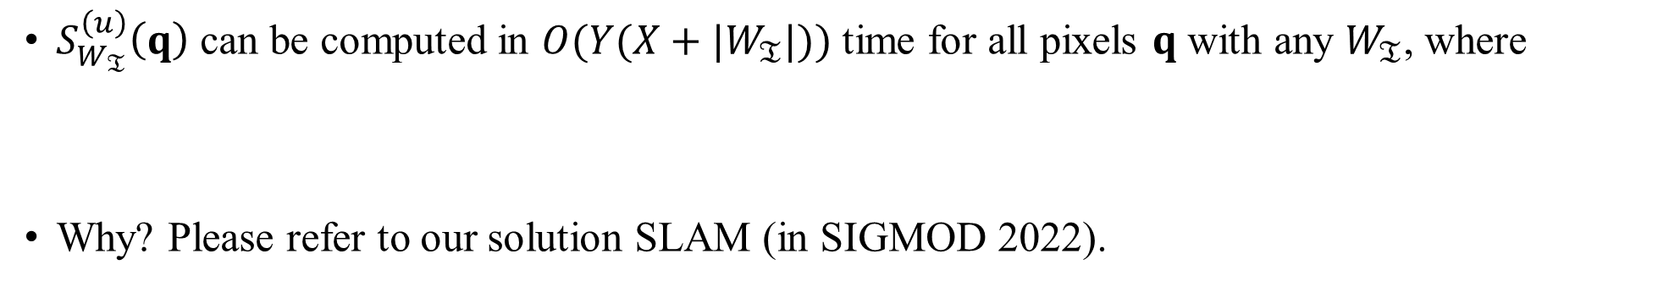
Core Idea 1: From a Single Pixel to a Matrix
$S_{W_{𝔗}}^{\left(u\right)}\left(q\right)$ can be computed in $O(Y(X+|W_{𝔗}|))$ time for all pixels $q$ with any $W_{𝔗}$, where
Why? Please refer to our solution SLAM (in SIGMOD 2022).
$$S_{W_{𝔗}}^{\left(u\right)}\left(q\right)=\sum_{(p,t_{p})∈W_{𝔗}}{t_{p}^{u}{∙K}_{space}^{\left(b_{σ}\right)}\left(q,p\right)}$$
T. N. Chan, L. H. U, B. Choi, J. Xu: SLAM: Efficient Sweep Line Algorithms for Kernel Density Visualization. SIGMOD 2022, pages 2120-2134.

Slide 11
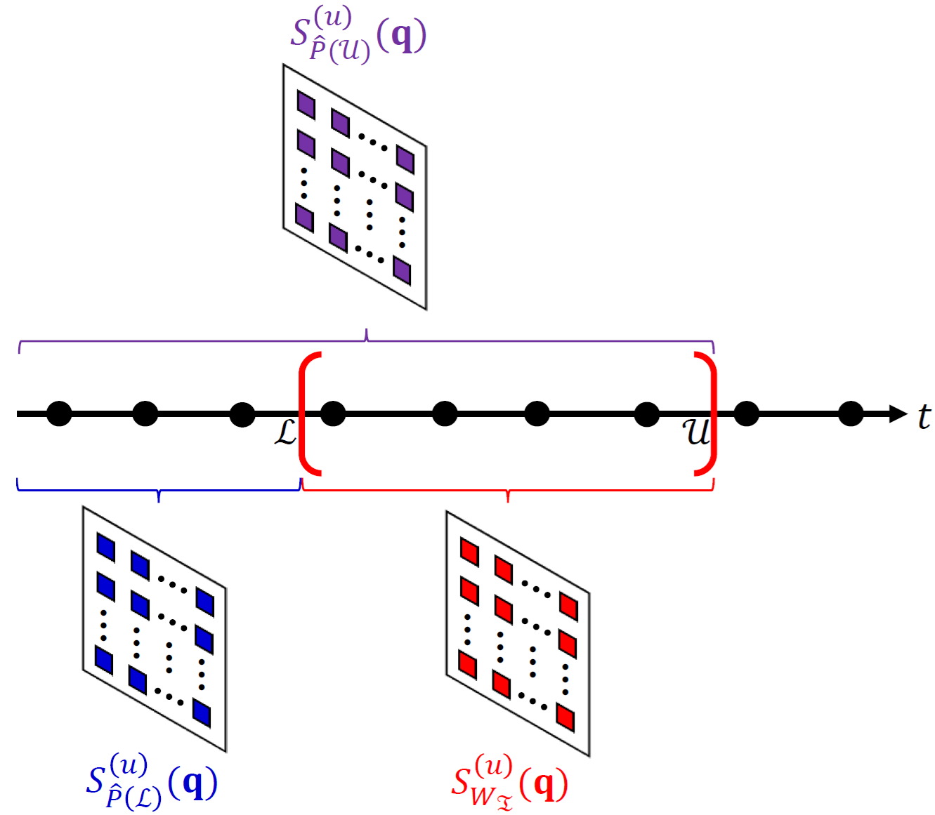
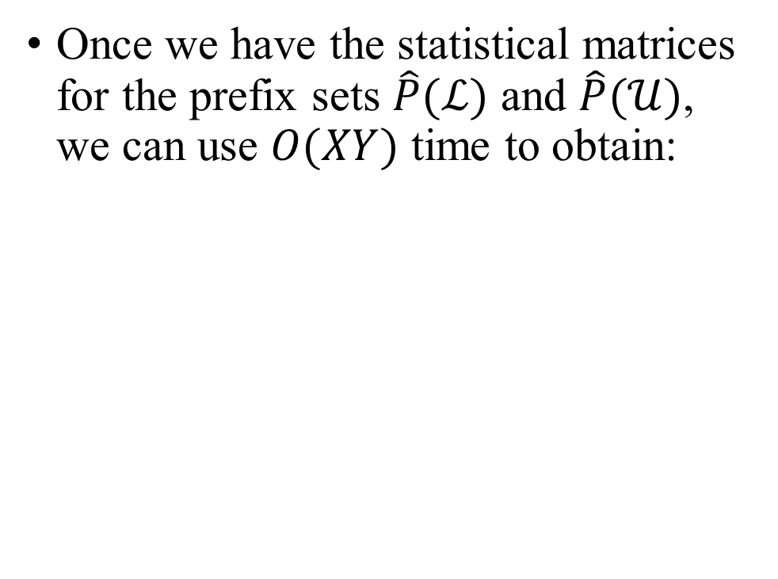
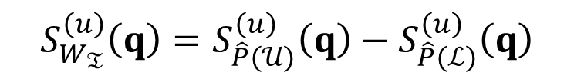
Core Idea 2: Prefix Sets
Once we have the statistical matrices for the prefix sets $\hat{P}(ℒ)$ and $\hat{P}(𝒰)$, we can use $O(XY)$ time to obtain:
$$S_{W_{𝔗}}^{\left(u\right)}\left(q\right)=S_{\hat{P}(𝒰)}^{\left(u\right)}\left(q\right)−S_{\hat{P}(ℒ)}^{\left(u\right)}\left(q\right)$$

Slide 12
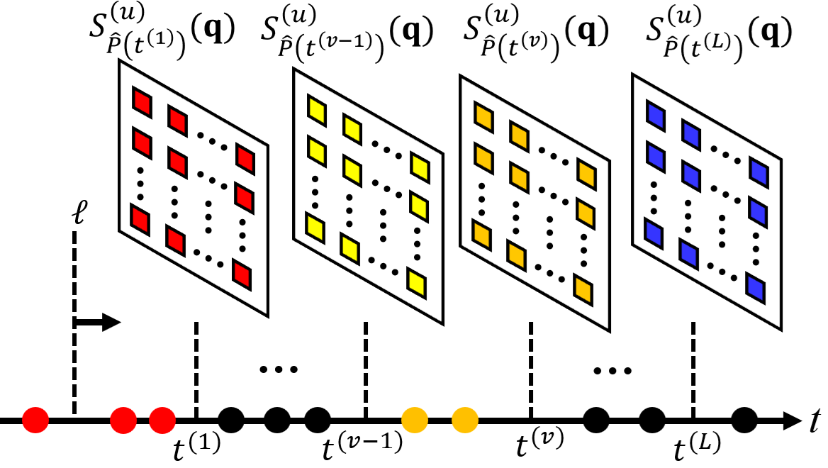
Core Idea 3: Computing Statistical Matrices of Prefix Sets is Fast!
Consider $L$ arbitrary timestamps. Maintaining the statistical matrices for $L$ timestamps takes $O(XYL+Yn)$ time. Why? (Refer to our paper.)

Slide 13
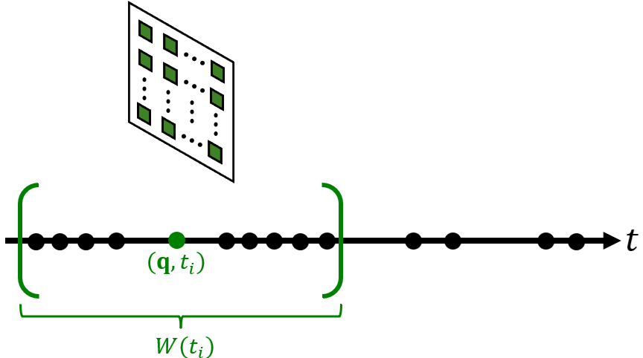
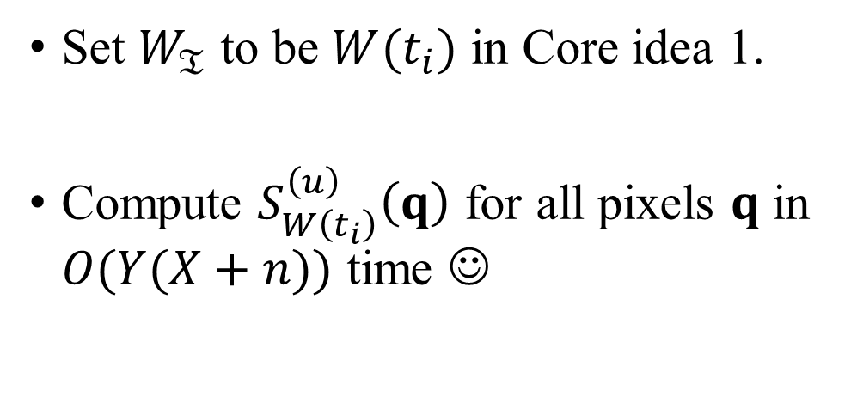
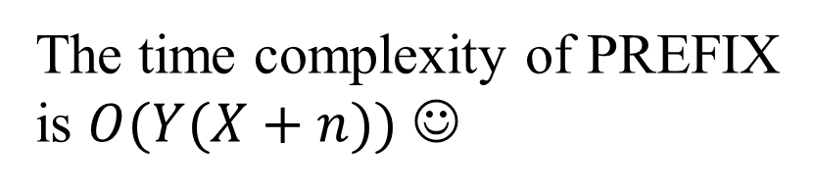
PREFIX for STKDV with an On-the-fly Timestamp
Set $W_{𝔗}$ to be $W(t_{i})$ in Core idea 1.
Compute $S_{W\left(t_{i}\right)}^{\left(u\right)}\left(q\right)$ for all pixels $q$ in $O(Y(X+n))$ time ☺
The time complexity of PREFIX is $O(Y(X+n))$ ☺

Slide 14
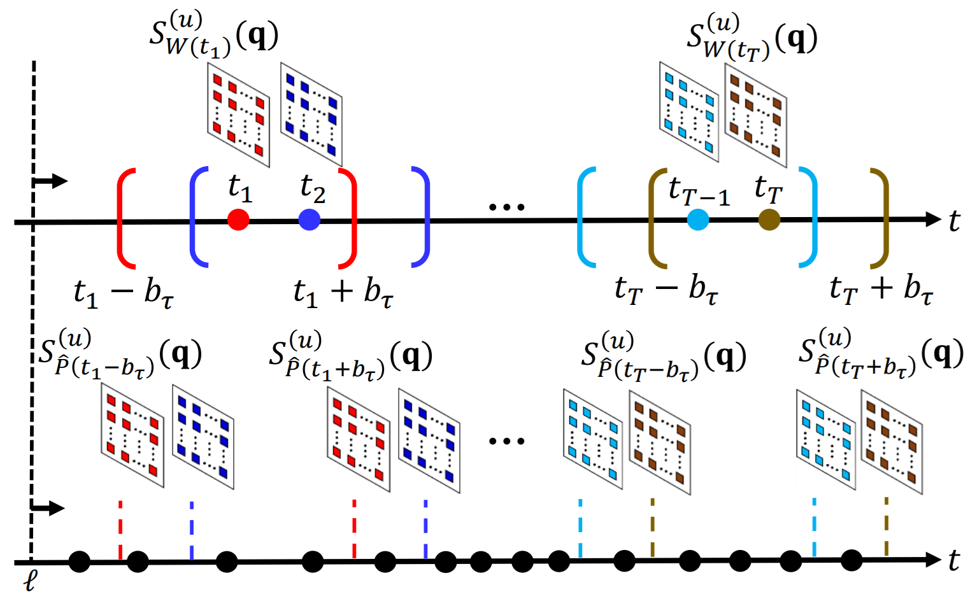
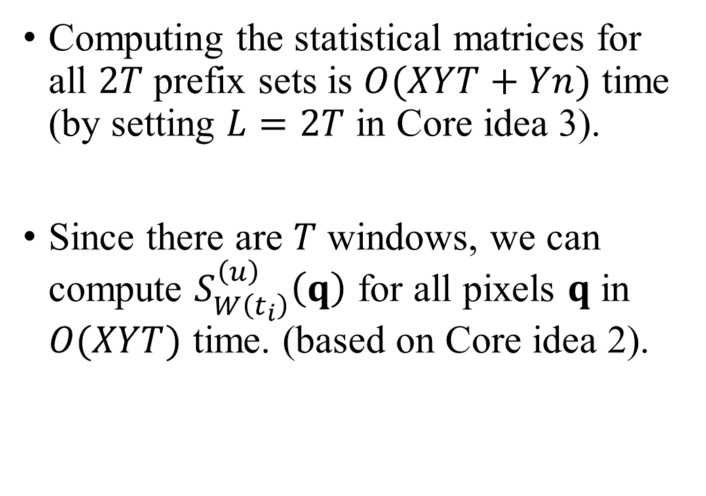
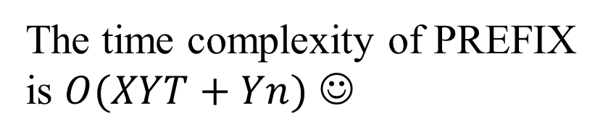
PREFIX for STKDV with Multiple Timestamps
Computing the statistical matrices for all $2T$ prefix sets is $O(XYT+Yn)$ time (by setting $L=2T$ in Core idea 3).
Since there are $T$ windows, we can compute $S_{W\left(t_{i}\right)}^{\left(u\right)}\left(q\right)$ for all pixels $q$ in $O(XYT)$ time. (based on Core idea 2).
The time complexity of PREFIX is $O(XYT+Yn)$ ☺

Slide 15
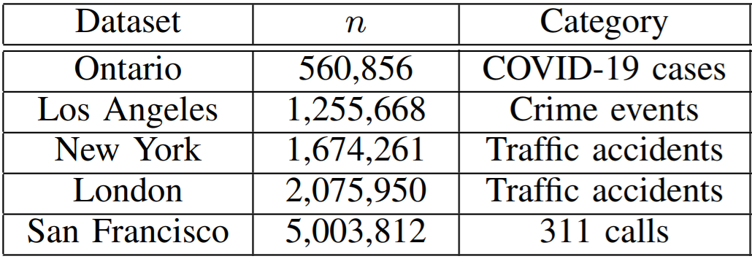
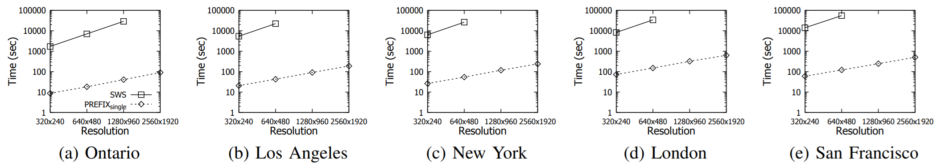
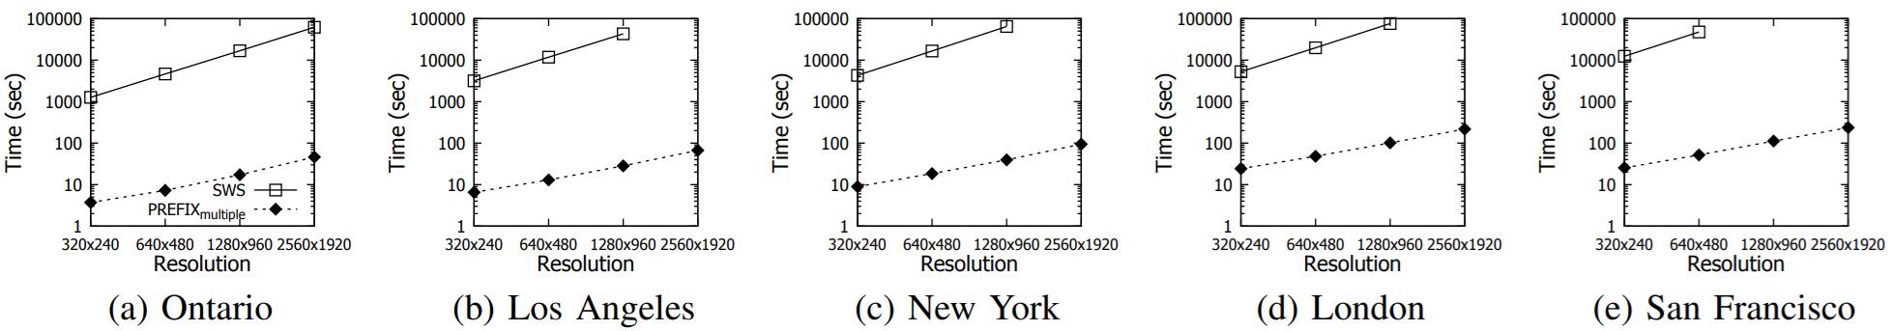
Our Experiments

Slide 16
Future Work
Develop efficient algorithms for other operations of spatiotemporal analysis, including spatiotemporal K-function, spatiotemporal Moran’ I, and spatiotemporal Getis-Ord General G.
Develop an efficient QGIS/ArcGIS plugin for supporting commonly used operations of spatiotemporal analysis.
Develop efficient python and R packages for supporting commonly used operations of spatiotemporal analysis.

