Slide 1
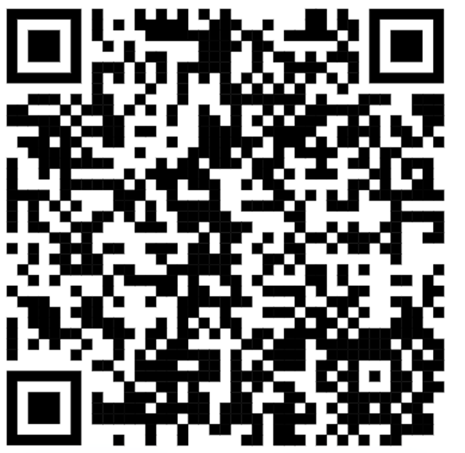
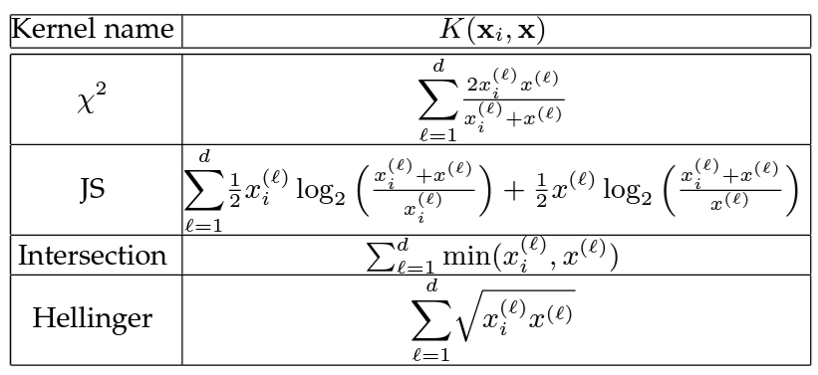
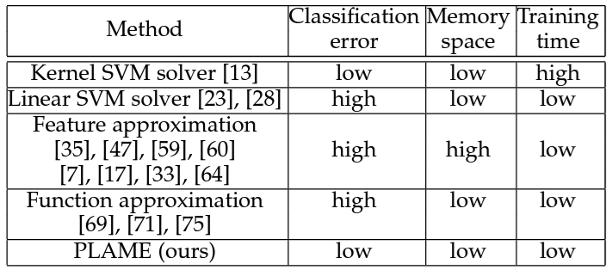
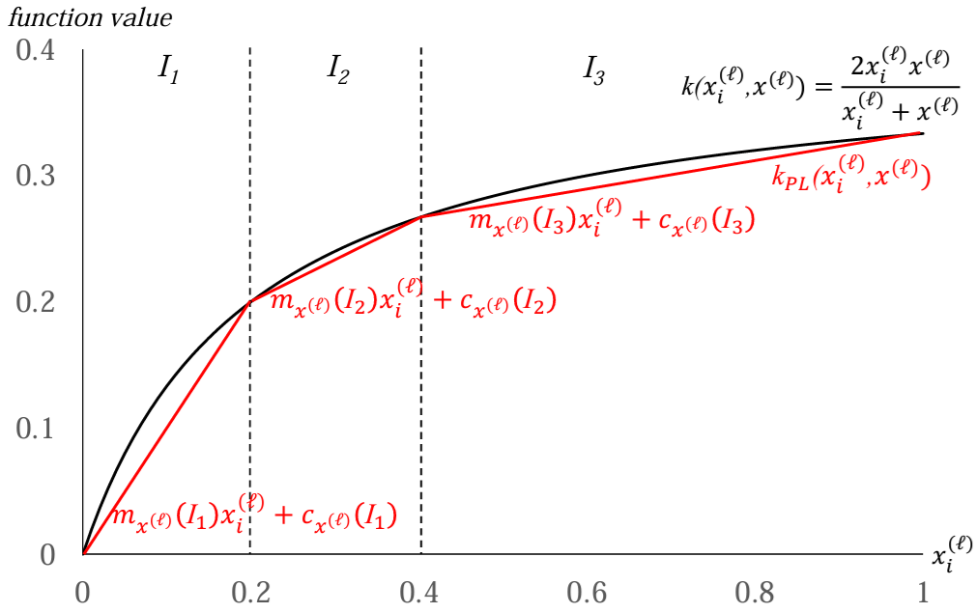
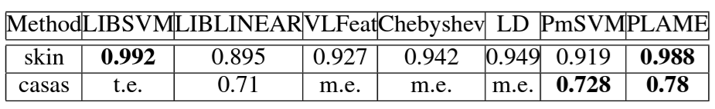
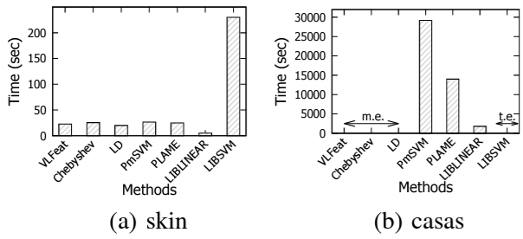
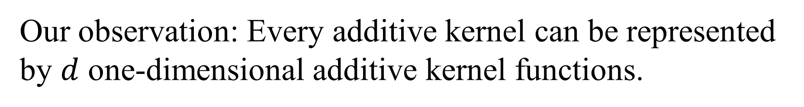


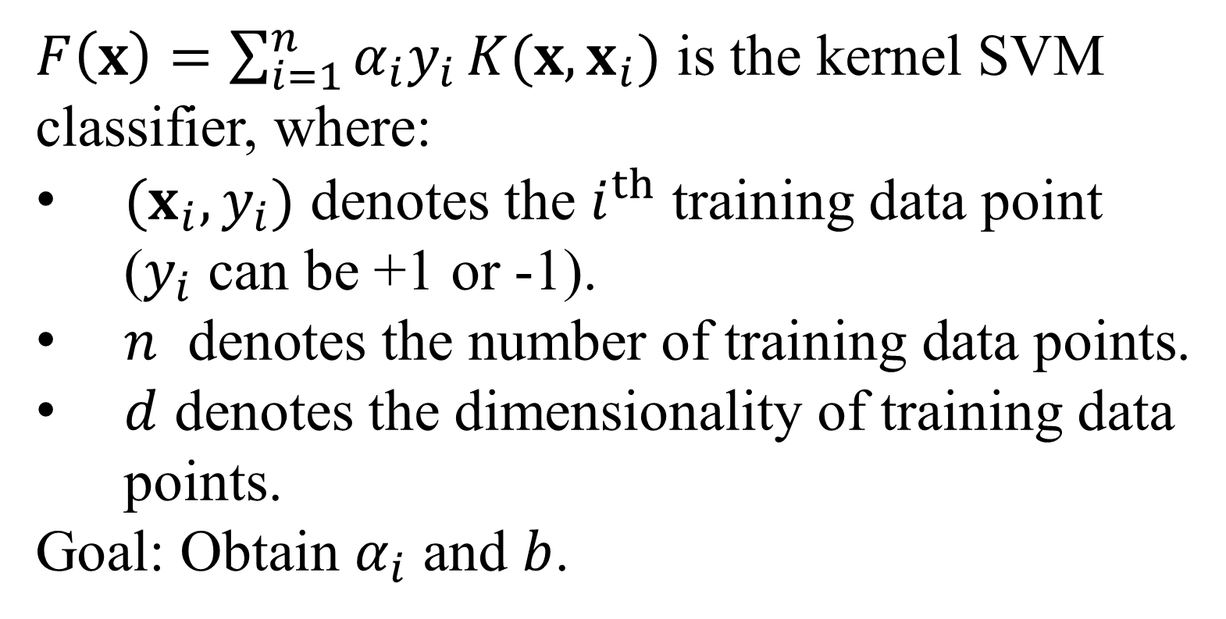
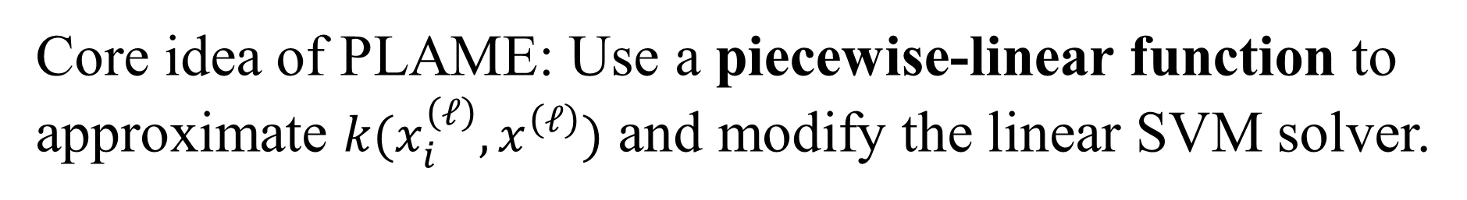

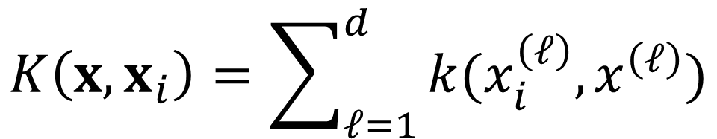
PLAME: Piecewise-Linear Approximate Measure for Additive Kernel SVM
Tsz Nam Chan
Shenzhen University
edisonchan@szu.edu.cn
Zhe Li
Alibaba Cloud
huoju.lz@alibaba-inc.com
Leong Hou U
University of Macau
ryanlhu@um.edu.mo
Reynold Cheng
The University of Hong Kong
ckcheng@cs.hku.hk
Overview of Kernel SVM
Overview of Additive Kernels
$$F\left(x\right)>b$$
$$F\left(x\right)<b$$
$$F\left(x\right)=b$$
$F\left(x\right)=\sum_{i=1}^{n}{α_{i}y_{i}}K(x,x_{i})$ is the kernel SVM classifier, where:
$(x_{i},y_{i})$ denotes the $i^{th}$ training data point ($y_{i}$ can be +1 or -1).
$n$ denotes the number of training data points.
$d$ denotes the dimensionality of training data points.
Goal: Obtain $α_{i}$ and $b$.
Additive kernels are demonstrated to be useful in many application domains, including human activity detection and pedestrian detection.
Guo et al. [a] “... we train a SVM classifier with chi-square kernel for multi-class recognition task, which is beneficial for classifying the histogram features.”
[a] Y. Guo, Y. Li, and Z. Shao. DSRF: A flexible trajectory descriptor for articulated human action recognition. Pattern Recognition, 76: 137-148, 2018.
Existing Methods of Additive Kernel SVM and PLAME
Our observation: Every additive kernel can be represented by $d$ one-dimensional additive kernel functions.
$$K\left(x,x_{i}\right)=\sum_{ℓ=1}^{d}{k(x_{i}^{\left(ℓ\right)},x^{\left(ℓ\right)})}$$
Core idea of PLAME: Use a piecewise-linear function to approximate $k(x_{i}^{\left(ℓ\right)},x^{\left(ℓ\right)})$ and modify the linear SVM solver.
Existing SVM training methods (those references in the above table can be found in our TKDE paper.) cannot simultaneously fulfill these three conditions.
Low classification error
Low memory space
Low training time
PLAME is the first approach that can achieve these three conditions.
Experimental Evaluation
Accuracy of all methods
Training time of all methods
Remark:
t.e.: more than three days for training
m.e.: more than 16 GB for training

