Slide 1


DNA: A Distribution-and-Aggregation Solution for Spatiotemporal K-function-based Analysis
(Edison) Tsz Nam Chan¹, Bojian Zhu², Dingming Wu¹,
Renchi Yang², Ruisheng Wang¹
¹Shenzhen University ²Hong Kong Baptist University

Slide 2
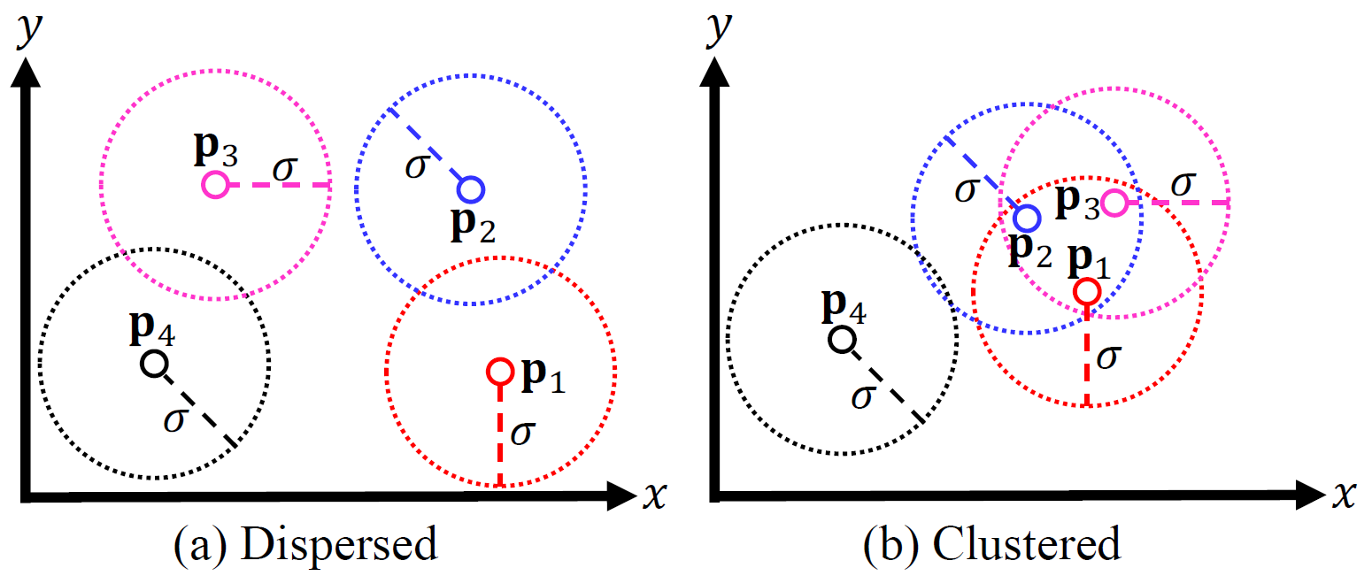

What is K-function?
Count the number of data points that are within the spatial threshold $σ$ from each data point in a dataset.
If this number is large, the dataset tends to be clustered. Otherwise, the dataset tends to be dispersed.

Slide 3
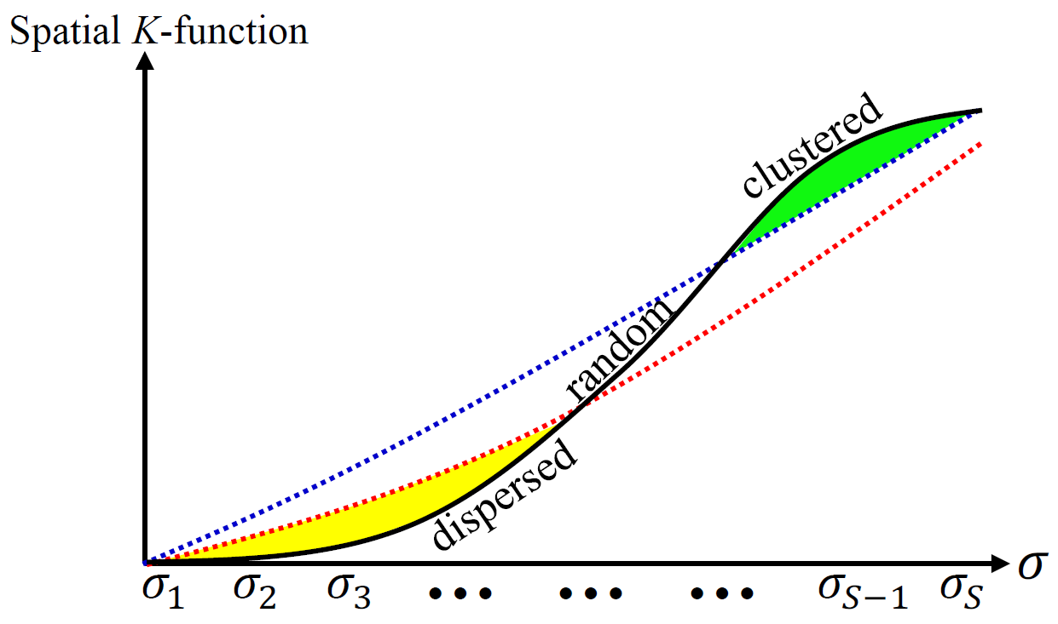
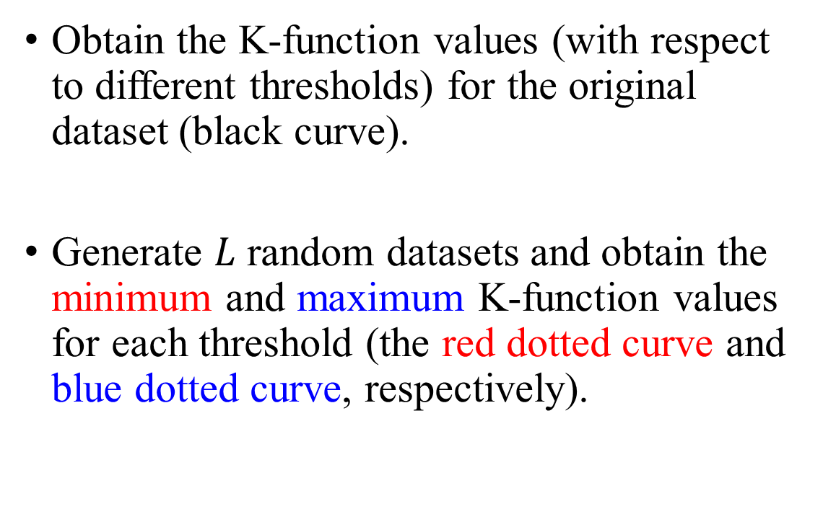
What is K-function Plot?
Obtain the K-function values (with respect to different thresholds) for the original dataset (black curve).
Generate $L$ random datasets and obtain the minimum and maximum K-function values for each threshold (the red dotted curve and blue dotted curve, respectively).

Slide 4
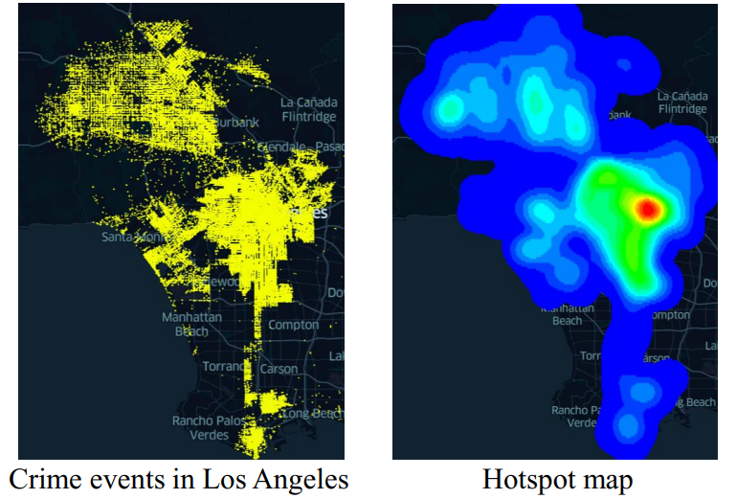
Why K-function Plot?
Check whether the hotspots/clustering results are meaningful/significant.
Select suitable parameters for some clustering/hotspot detection methods.

Slide 5
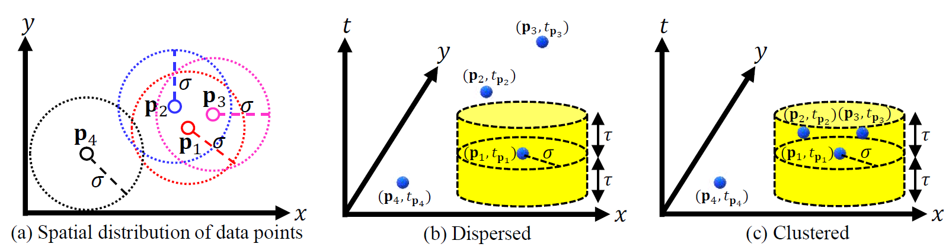
K-function Can Be Misleading!
Does not consider the temporal component of each data point. ☹

Slide 6
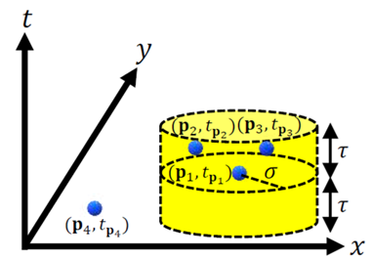
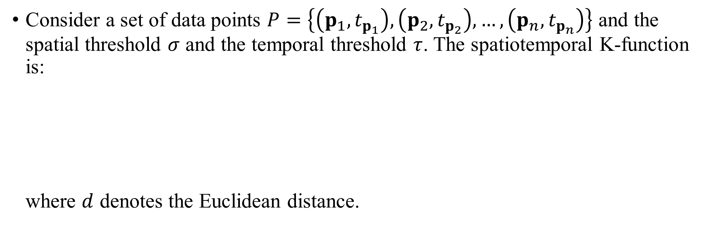
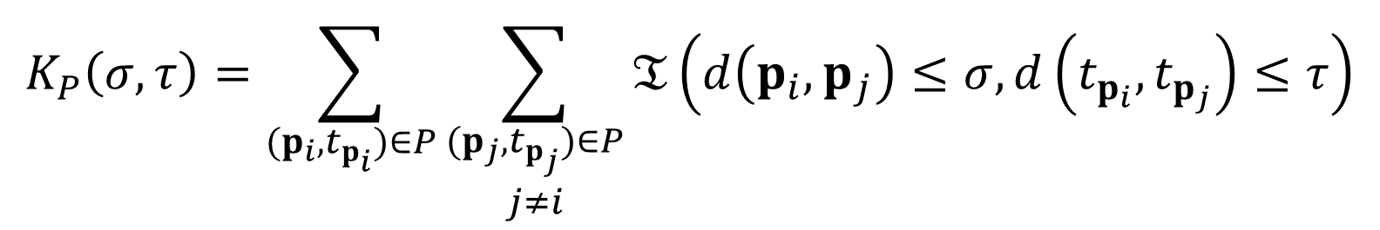
What is Spatiotemporal K-function?
Consider a set of data points $P=\left\{\left(p_{1}, t_{p_{1}}\right),\left(p_{2}, t_{p_{2}}\right),…,\left(p_{n}, t_{p_{n}}\right)\right\}$ and the spatial threshold $σ$ and the temporal threshold $τ$. The spatiotemporal K-function is: where $d$ denotes the Euclidean distance.
$$K_{P}\left(σ,τ\right)=\sum_{(p_{i},t_{p_{i}})∈P}{\sum_{\begin{matrix}(p_{j},t_{p_{j}})∈P \\ j≠i\end{matrix}}{𝔗\left(d\left(p_{i},p_{j}\right)≤σ,d\left(t_{p_{i}},t_{p_{j}}\right)≤τ\right)}}$$

Slide 7
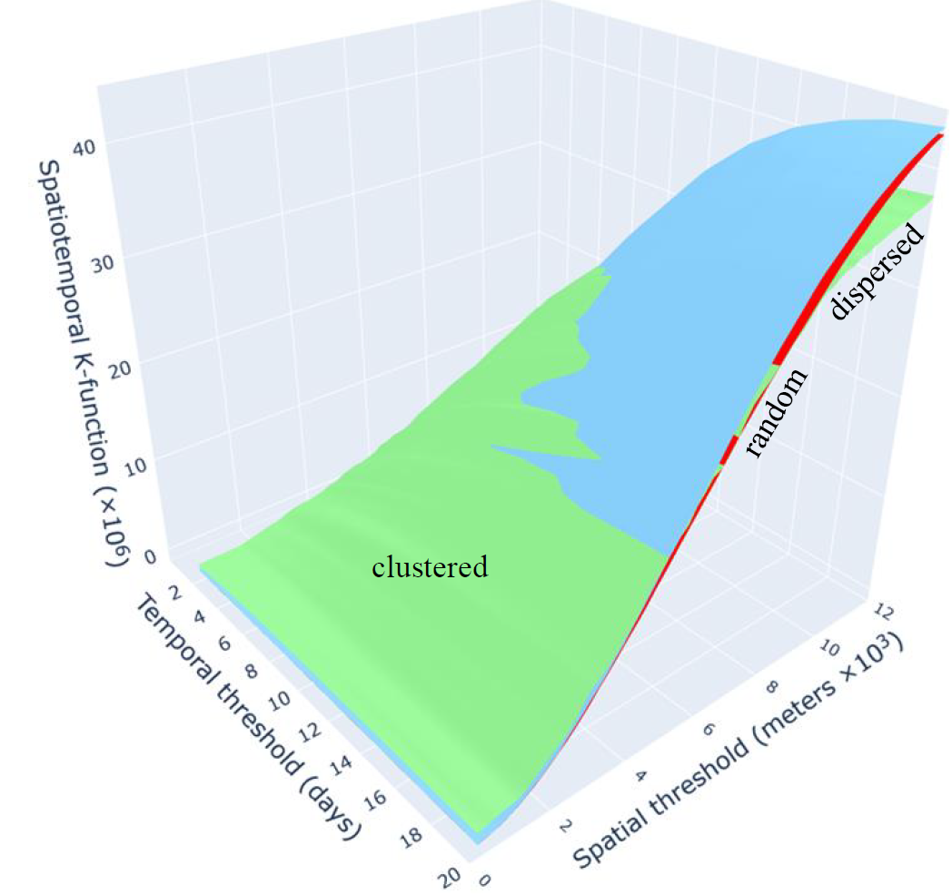
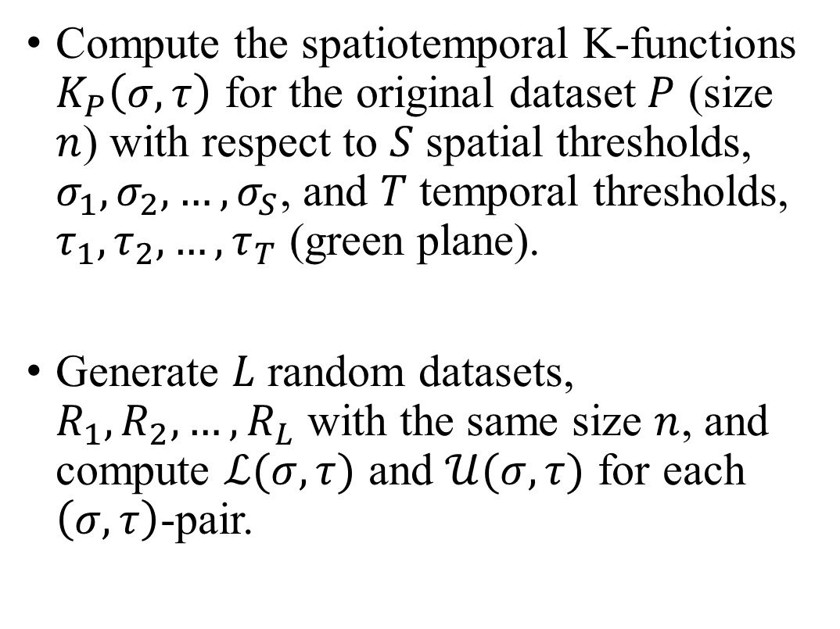
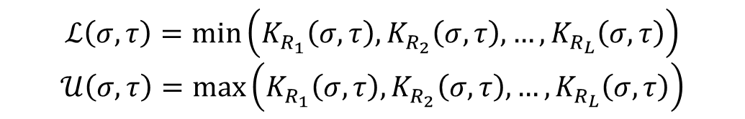
What is Spatiotemporal K-function Plot?
Compute the spatiotemporal K-functions $K_{P}\left(σ,τ\right)$ for the original dataset $P$ (size $n$) with respect to $S$ spatial thresholds, $σ_{1},σ_{2},…,σ_{S}$, and $T$ temporal thresholds, $τ_{1},τ_{2},…,τ_{T}$ (green plane).
Generate $L$ random datasets, $R_{1},R_{2},…,R_{L}$ with the same size $n$, and compute $ℒ(σ,τ)$ and $𝒰(σ,τ)$ for each $\left(σ,τ\right)$-pair.
$$ℒ\left(σ,τ\right)=\min\left(K_{R_{1}}\left(σ,τ\right),K_{R_{2}}\left(σ,τ\right),…,K_{R_{L}}\left(σ,τ\right)\right)$$
$$𝒰\left(σ,τ\right)=\max\left(K_{R_{1}}\left(σ,τ\right),K_{R_{2}}\left(σ,τ\right),…,K_{R_{L}}\left(σ,τ\right)\right)$$

Slide 8
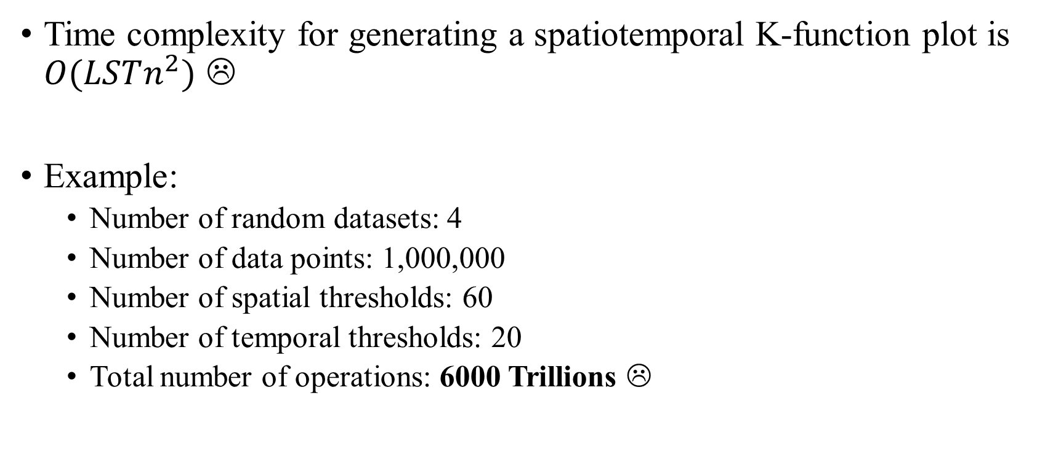
Spatiotemporal K-function Plot is Slow!
Time complexity for generating a spatiotemporal K-function plot is $O(LSTn^{2})$ ☹
Example:
Number of random datasets: 4
Number of data points: 1,000,000
Number of spatial thresholds: 60
Number of temporal thresholds: 20
Total number of operations: 6000 Trillions ☹

Slide 9
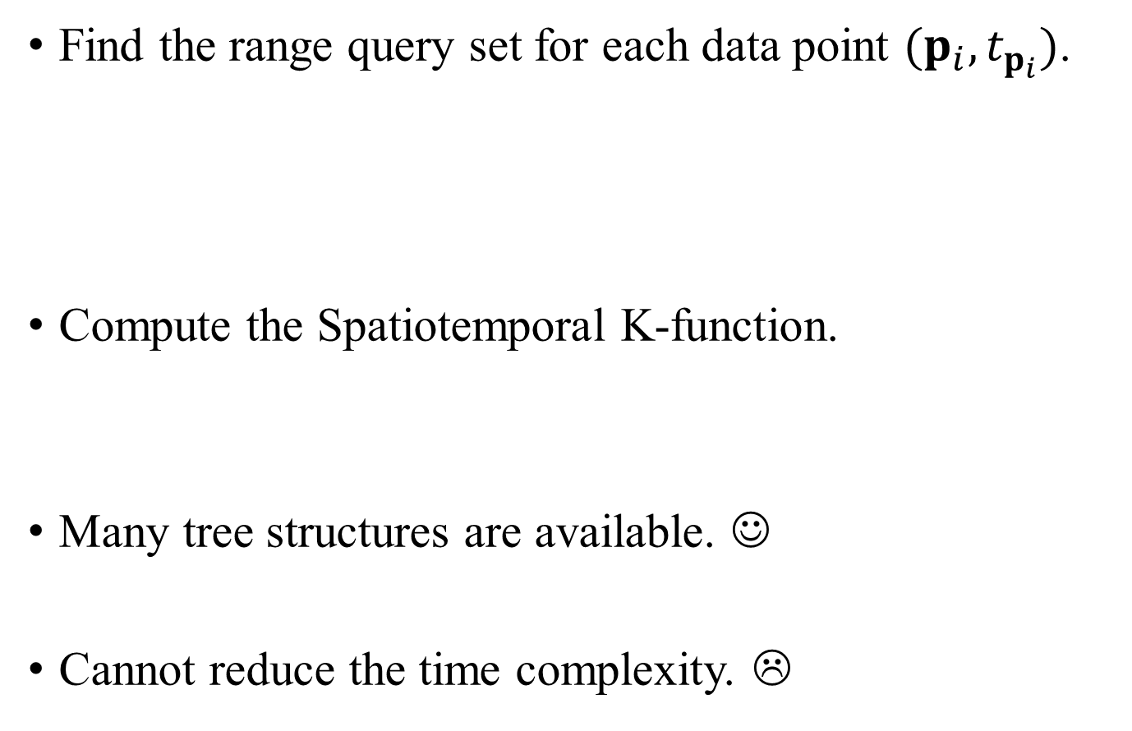
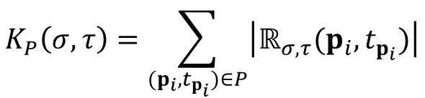
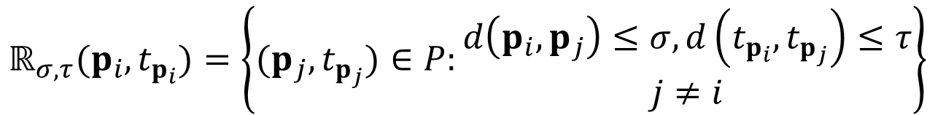
Range-Query-based Solution (RQS)
Find the range query set for each data point $(p_{i},t_{p_{i}})$.
Compute the Spatiotemporal K-function.
Many tree structures are available. ☺
Cannot reduce the time complexity. ☹
$$ℝ_{σ,τ}(p_{i},t_{p_{i}})=\left\{(p_{j},t_{p_{j}})∈P:\begin{matrix}d\left(p_{i},p_{j}\right)≤σ,d\left(t_{p_{i}},t_{p_{j}}\right)≤τ \\ j≠i\end{matrix}\right\}$$
$$K_{P}\left(σ,τ\right)=\sum_{(p_{i},t_{p_{i}})∈P}{\left|ℝ_{σ,τ}(p_{i},t_{p_{i}})\right|}$$

Slide 10
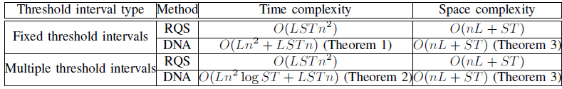
Our Contributions
Can reduce the worst-case time complexity for generating a spatiotemporal K-function plot, without increasing the space complexity. ☺
Can achieve 4.58x to 57.42x speedups compared with RQS. ☺

Slide 11
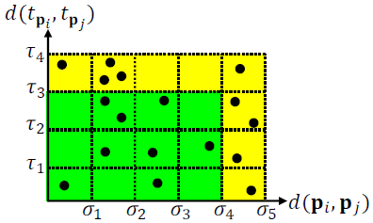
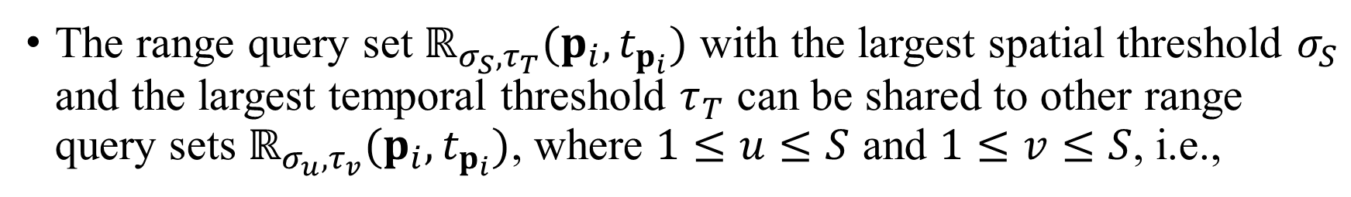
Core Idea: Coverage Property
The range query set $ℝ_{σ_{S}, τ_{T}}(p_{i},t_{p_{i}})$ with the largest spatial threshold $σ_{S}$ and the largest temporal threshold $τ_{T}$ can be shared to other range query sets $ℝ_{σ_{u}, τ_{v}}(p_{i},t_{p_{i}})$, where $1≤u≤S$ and $1≤v≤S$, i.e.,
$$ℝ_{σ_{u}, τ_{v}}(p_{i},t_{p_{i}})⊆ℝ_{σ_{S}, τ_{T}}(p_{i},t_{p_{i}})$$

Slide 12
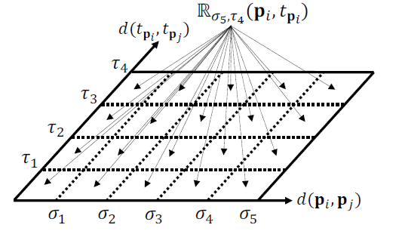
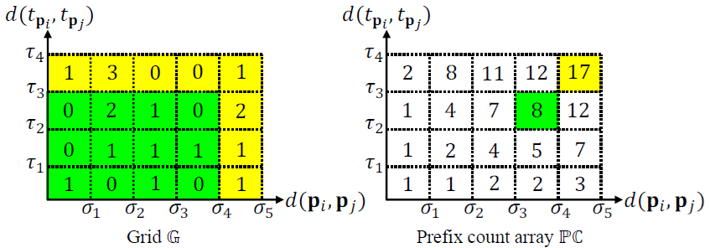
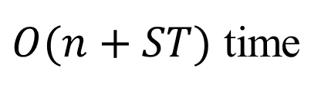
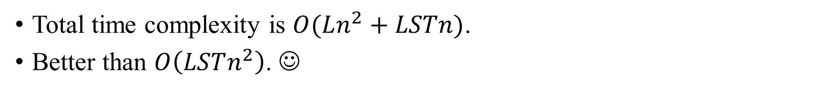
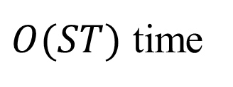
Our Solution: Distribution and Aggregation (DNA)
Distribution
Aggregation
$O(n+ST)$ time
$O(ST)$ time
Total time complexity is $O(Ln^{2}+LSTn)$.
Better than $O\left(LSTn^{2}\right)$. ☺

Slide 13
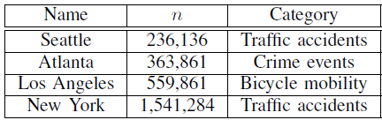
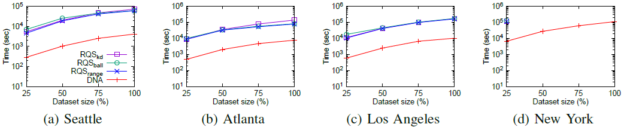
Experimental Evaluation

Slide 14
Future Work
Incorporate DNA into the QGIS/ArcGIS plugin.
Develop efficient approximate algorithms for supporting spatiotemporal K-function analysis.
Support other GIS tools, e.g., Moran’s I, Getis-Ord General G, and Kriging.
Leverage modern hardware, e.g., GPU, to further improve the performance of DNA.

Slide 15
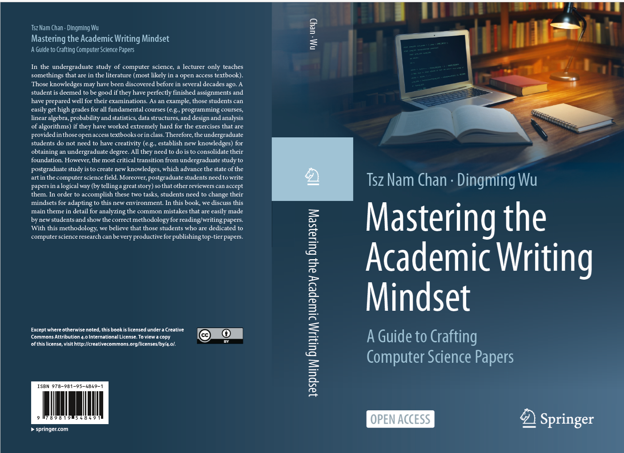
Our New Book
https://link.springer.com/book/10.1007/978-981-95-4850-7

