Slide 1





EARTH: Accelerating Spatiotemporal Network K-function-based Analytics
(Edison) Tsz Nam Chan¹, Hongwei Ye¹, Leong Hou U², Yun Peng³,
Dingming Wu¹, Jianliang Xu⁴, Christian S. Jensen⁵
¹Shenzhen University ²University of Macau ³Guangzhou University
⁴Hong Kong Baptist University ⁵Aalborg University

Slide 2
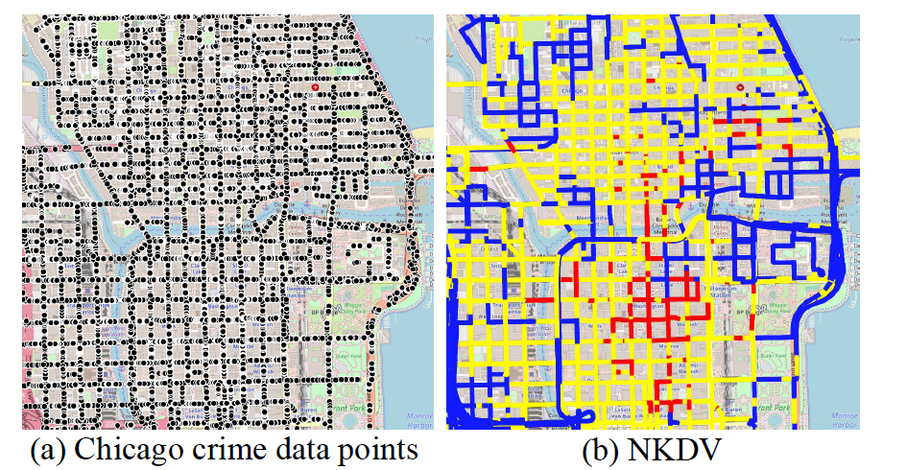
Is a Hotspot a Hotspot?
Do you think that the red part is really a hotspot?
How do you tune the parameters in some statistical/clustering models?

Slide 3
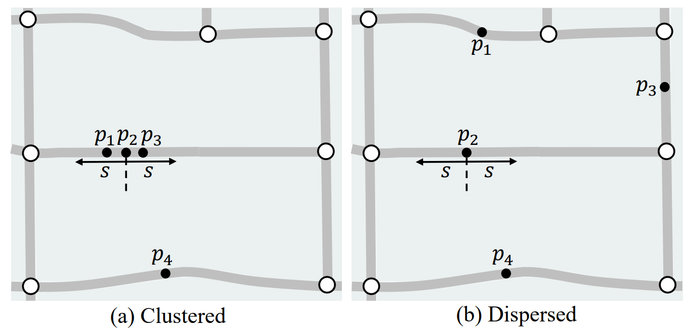

What is Network K-function?
Count the number of data points that are within the spatial threshold $s$ from each data point.

Slide 4
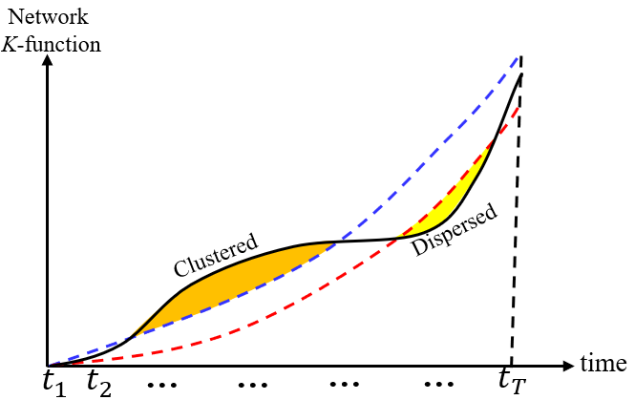


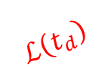
What is Network K-function Plot?
Domain experts need to determine whether the hotspots/clusters of a location dataset are meaningful.
Generate multiple random datasets with the same size as the original dataset.
Compute the network K-function values for the original dataset and random datasets with respect to multiple thresholds.
$$K_{P}\left(t_{d}\right)$$
$$U\left(t_{d}\right)$$
$$ℒ\left(t_{d}\right)$$

Slide 5
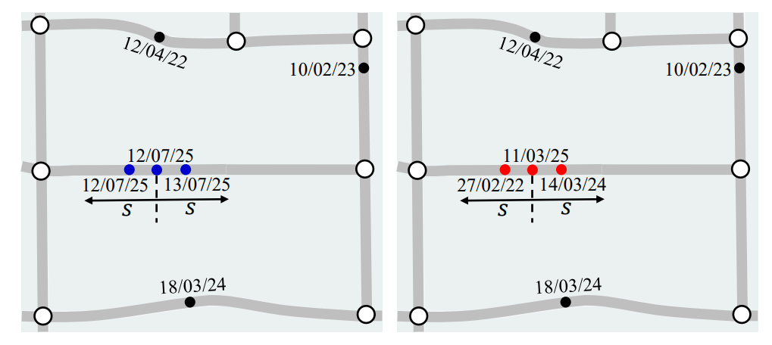
Weakness of Network K-function
Ignore the timestamp of each data point.
Many spatiotemporal events depend on time.

Slide 6

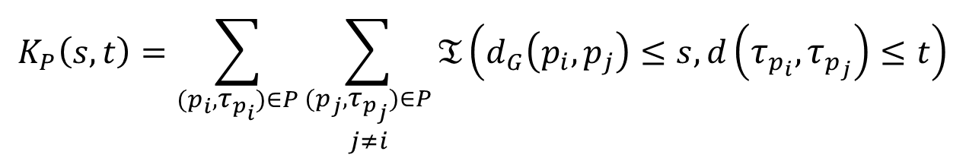
Overview of Spatiotemporal Network K-function
Given a road network $G=(V,E)$, a spatiotemporal dataset $P=\left\{\left(p_{1},τ_{p_{1}}\right),\left(p_{2},τ_{p_{2}}\right),…,\left(p_{n},τ_{p_{n}}\right)\right\}$, a spatial threshold $s$, and a temporal threshold $t$, we need to compute $K_{P}(s,t)$.
$$K_{P}\left(s,t\right)=\sum_{(p_{i},τ_{p_{i}})∈P}{\sum_{\begin{aligned}(p_{j},τ_{p_{j}})∈P \\ j≠i\end{aligned}}{𝔗\left(d_{G}\left(p_{i},p_{j}\right)≤s, d\left(τ_{p_{i}},τ_{p_{j}}\right)≤t\right)}}$$

Slide 7
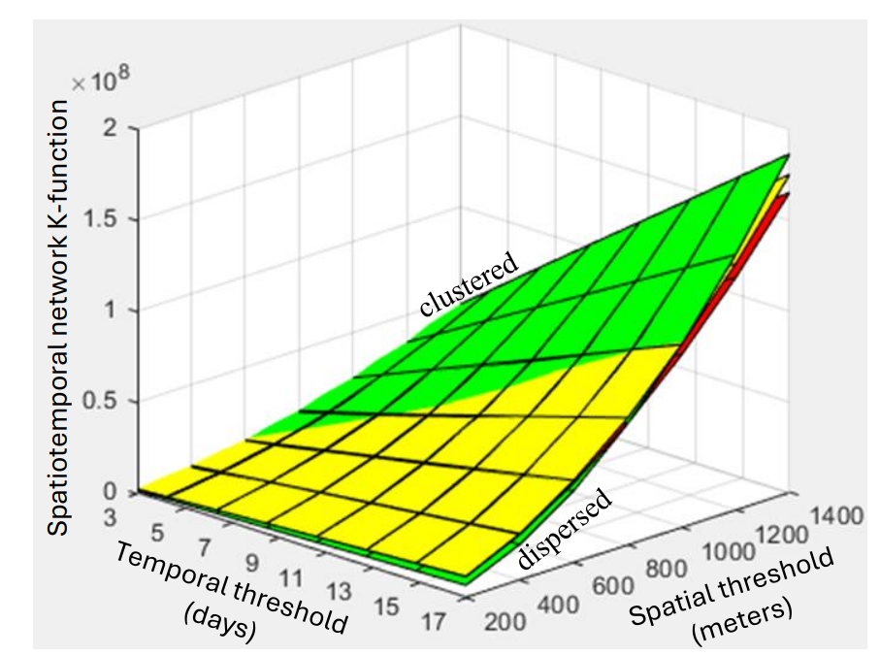
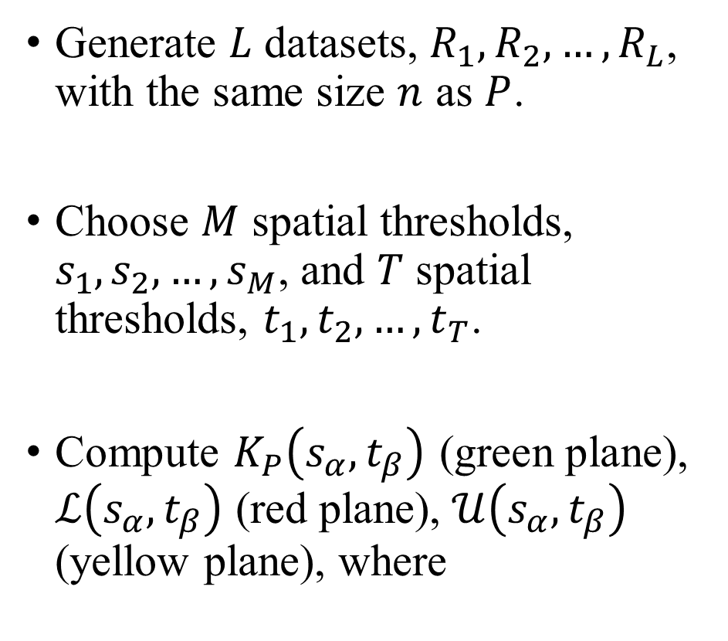

Spatiotemporal Network K-function Plot
Generate $L$ datasets, $R_{1},R_{2},…,R_{L}$, with the same size $n$ as $P$.
Choose $M$ spatial thresholds, $s_{1},s_{2},…,s_{M}$, and $T$ spatial thresholds, $t_{1},t_{2},…,t_{T}$.
Compute $K_{P}\left(s_{α}, t_{β}\right)$ (green plane), $ℒ\left(s_{α}, t_{β}\right)$ (red plane), $𝒰\left(s_{α}, t_{β}\right)$ (yellow plane), where
$$ℒ\left(s_{α}, t_{β}\right)=\min\left(K_{R_{1}}\left(s_{α}, t_{β}\right),K_{R_{2}}\left(s_{α}, t_{β}\right),…,K_{R_{1}}\left(s_{α}, t_{β}\right),K_{R_{L}}\left(s_{α}, t_{β}\right)\right)$$
$$𝒰\left(s_{α}, t_{β}\right)=\max\left(K_{R_{1}}\left(s_{α}, t_{β}\right),K_{R_{2}}\left(s_{α}, t_{β}\right),…,K_{R_{1}}\left(s_{α}, t_{β}\right),K_{R_{L}}\left(s_{α}, t_{β}\right)\right)$$

Slide 8
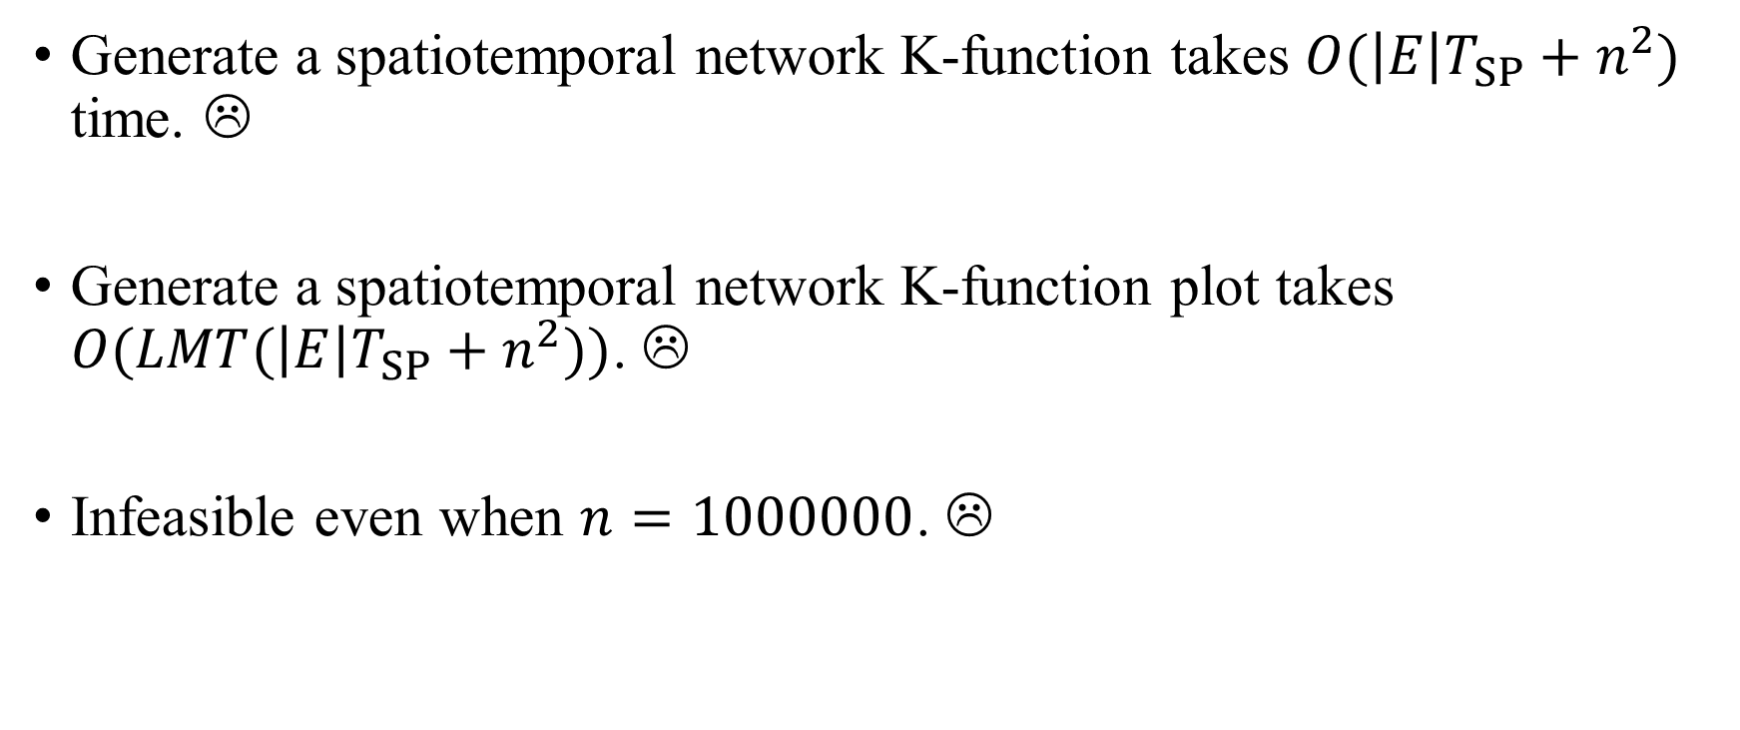
Spatiotemporal Network K-function is Slow!
Generate a spatiotemporal network K-function takes $O(\left|E\right|T_{SP}+n^{2})$ time. ☹
Generate a spatiotemporal network K-function plot takes $O(LMT(\left|E\right|T_{SP}+n^{2}))$. ☹
Infeasible even when $n=1000000$. ☹

Slide 9
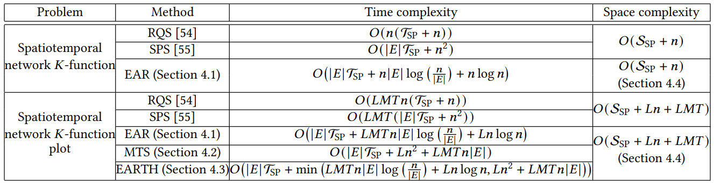
Our Contributions
Develop new methods that can theoretically reduce the time complexity with the same space complexity. ☺
Achieve up to 19.04x speedups compared with existing methods. ☺
Have integrated these methods into the python library, called FastNSA. ☺

Slide 10
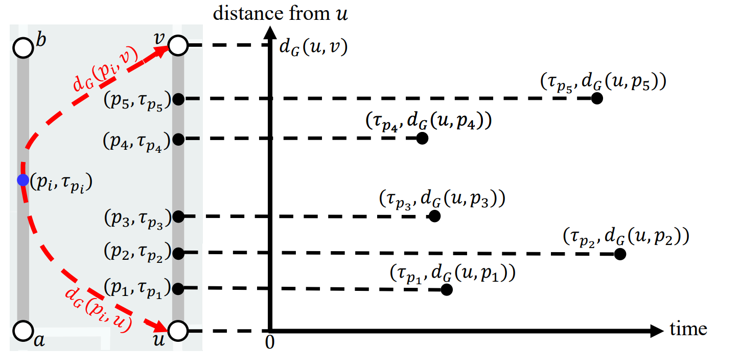
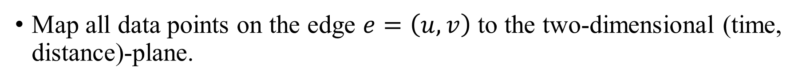
Core Idea of Our Methods: Mapping
Map all data points on the edge $e=\left(u,v\right)$ to the two-dimensional (time, distance)-plane.

Slide 11
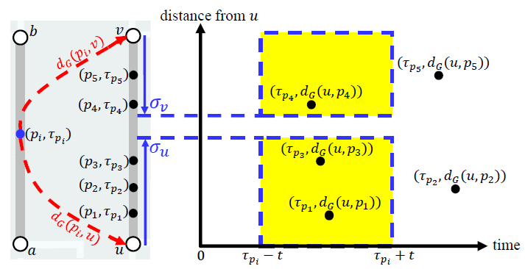
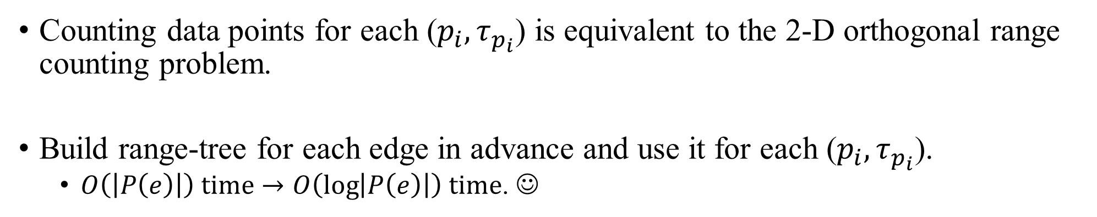
Edge Augmentation with Range-tree (EAR)
Counting data points for each ($p_{i}, τ_{p_{i}}$) is equivalent to the 2-D orthogonal range counting problem.
Build range-tree for each edge in advance and use it for each ($p_{i}, τ_{p_{i}}$).
  $O\left(\left|P\left(e\right)\right|\right) time→O\left(\log\left|P\left(e\right)\right|\right) time$. ☺

Slide 12
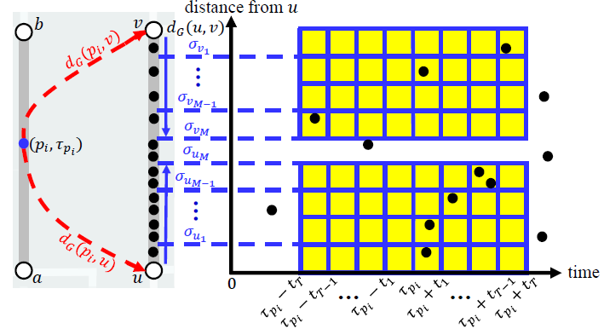
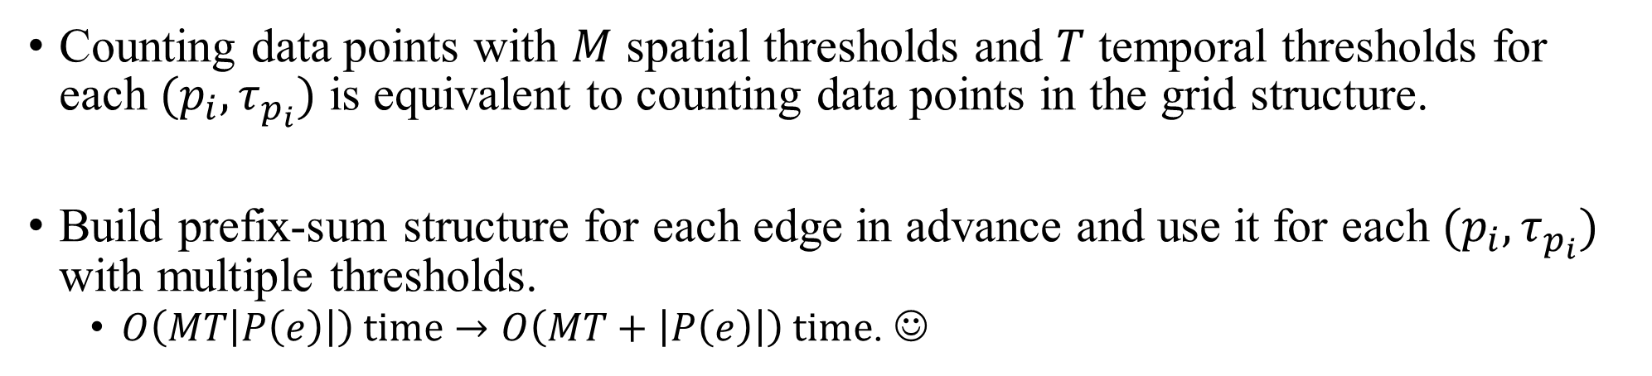
Multi-Threshold Sharing (MTS)
Counting data points with $M$ spatial thresholds and $T$ temporal thresholds for each $(p_{i}, τ_{p_{i}})$ is equivalent to counting data points in the grid structure.
Build prefix-sum structure for each edge in advance and use it for each $(p_{i}, τ_{p_{i}})$ with multiple thresholds.
  $O\left(MT\left|P\left(e\right)\right|\right) time→O\left(MT+\left|P\left(e\right)\right|\right) time$. ☺

Slide 13
EARTH
EARTH selects either EAR or MTS for each edge based on the cost function.
  EARTH = EAR + MTS
  Achieves the smallest time complexity. ☺
For details, please refer to our paper.

Slide 14
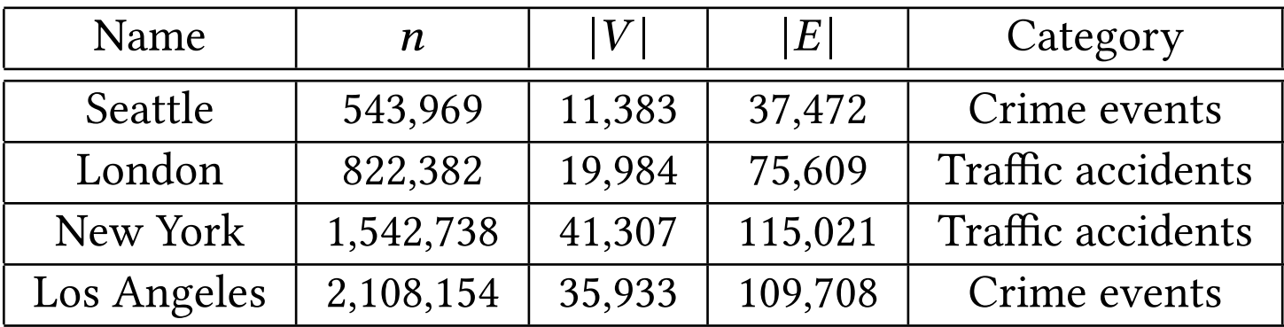
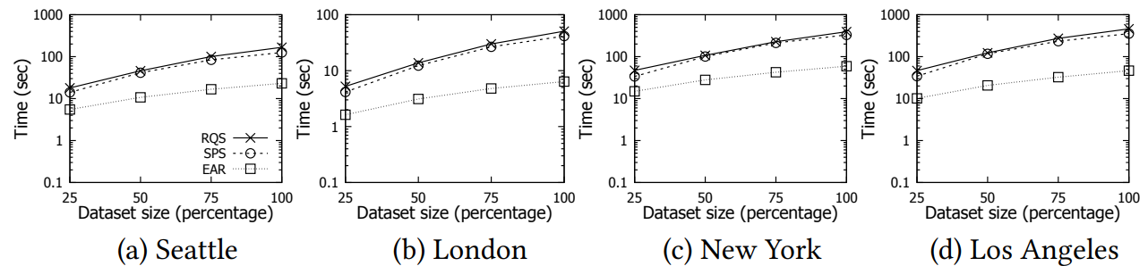
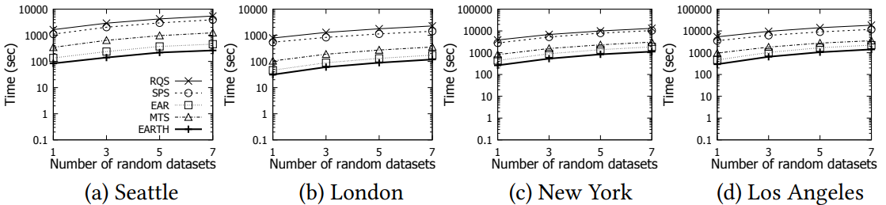
Experimental Evaluation

Slide 15
Future Work
Further reduce the time complexity of spatiotemporal network K-function with a non-trivial approximation guarantee.
Support other road network analysis tools.
  Network inverse distance weighting (Network IDW)
  Network Kriging
  Network DBSCAN
Add new functionalities in the FastNSA python library.
Develop the FastNSA QGIS plugin.

Slide 16
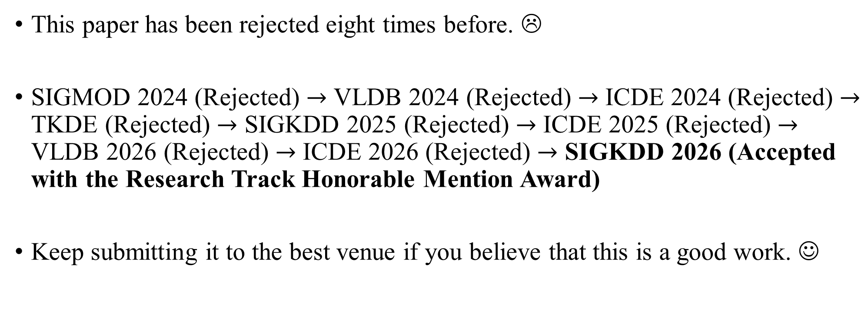
Never Give Up!
This paper has been rejected eight times before. ☹
SIGMOD 2024 (Rejected) $→$ VLDB 2024 (Rejected) $→$ ICDE 2024 (Rejected) $→$ TKDE (Rejected) $→$ SIGKDD 2025 (Rejected) $→$ ICDE 2025 (Rejected) $→$ VLDB 2026 (Rejected) $→$ ICDE 2026 (Rejected) $→$ SIGKDD 2026 (Accepted with the Research Track Honorable Mention Award)
Keep submitting it to the best venue if you believe that this is a good work. ☺

Slide 17

Our New Book
https://link.springer.com/book/10.1007/978-981-95-4850-7

