Slide 1
What Should You Think to Perfectly Present Research Papers?
Tsz Nam Chan
edisonchan@szu.edu.cn
College of Computer Science & Software Engineering

Slide 2
Steps for Presentation
Motivation of your research problem/topic
Problem description
State-of-the-art research work
Your solution
Experiment studies
Conclusion and future work

Slide 3
Motivation of Research Problem/Topic
Always ask some basic questions (may not be related to any technical details).
What are the applications for this problem?
Who are the users?
Have some software packages been developed based on this research problem/topic?
What are the challenges for this problem/topic?
(For old topic) There have been some existing research studies. Why do you need to make another solution? (Is it more accurate? Is it more efficient?)
(For new topic) No one has studied this before. Why do you need to be the first to study this topic? (Solid motivation should be provided.)
Don’t panic. Try to find out the answers.
Make sure that laymen (can be your mother or your father) can also understand what you are talking about.

Slide 4
Problem Description
Describe the problem in detail.
Use more examples.
Be careful of your notations.
Do not expect that your audience can understand everything.
Stand on their sides.
Assume that your audiences have just finished the undergraduate study in computer science or software engineering.

Slide 5
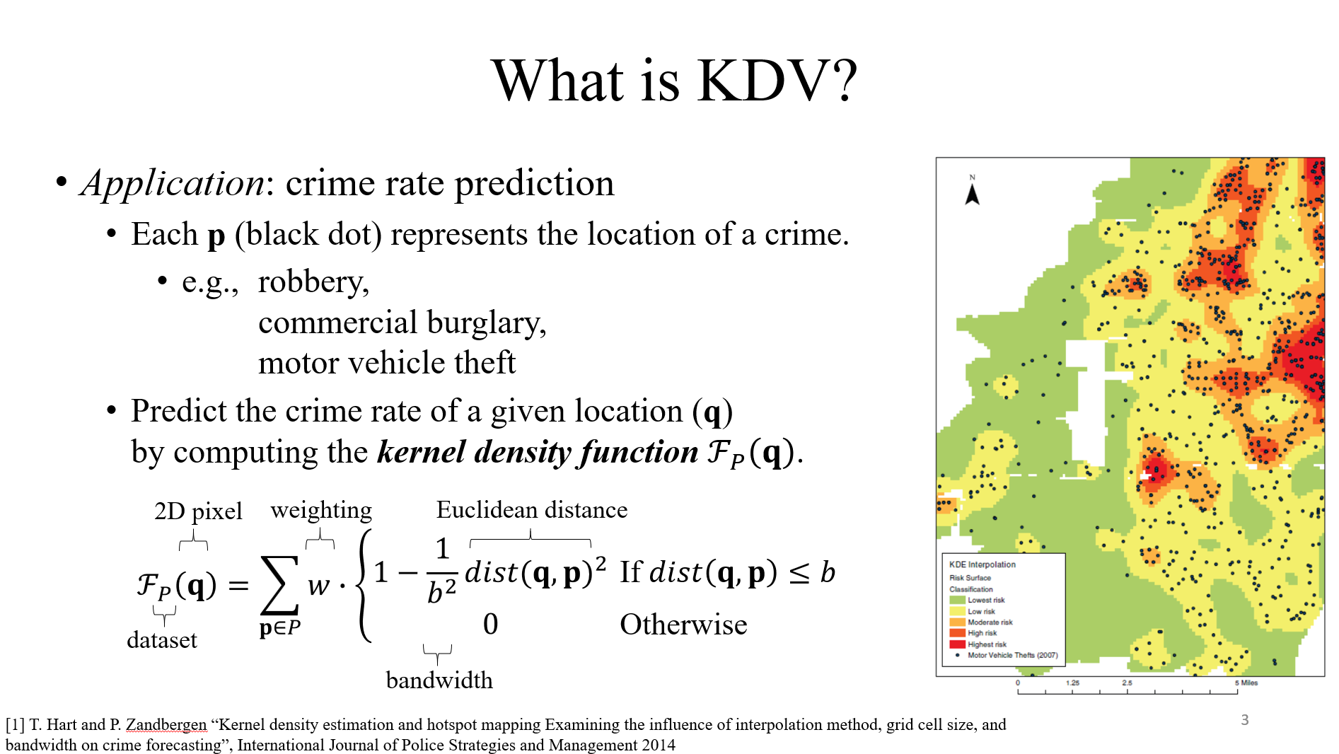
Problem Description (Example)

Slide 6
State-of-the-art Research Work
Discuss the core idea of the state-of-the-art work (opponent).
NO NEED to discuss all details.
Clearly point out the weakness of this opponent (any evidence?).
Not efficient enough
Not accurate enough
…
Further highlight the challenge.

Slide 7
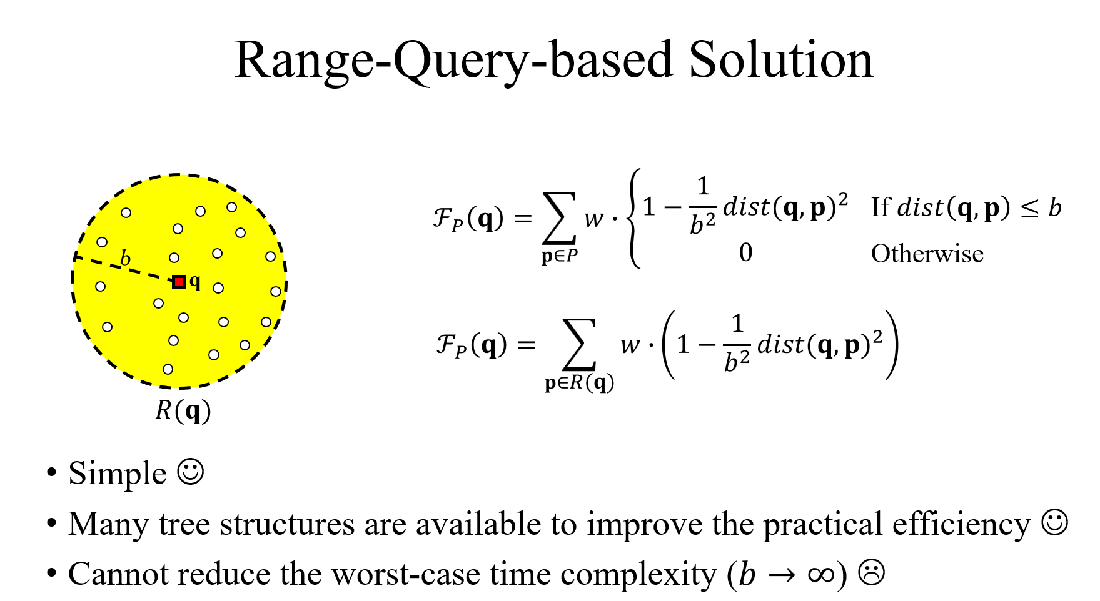
State-of-the-art Research Work (Example)

Slide 8
Your Solution
Present the core ideas.
From easy to difficult.
Make a good figure and a good example (or figure example).
No need to present all details. For example:
Pseudocode
Proof
Complicated equations
Everything that looks complicated.
Goal: Arouse their interest (Not to make them back off).

Slide 9
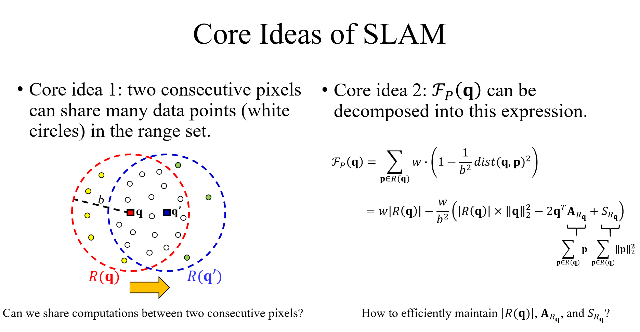
Your Solution (Example)

Slide 10
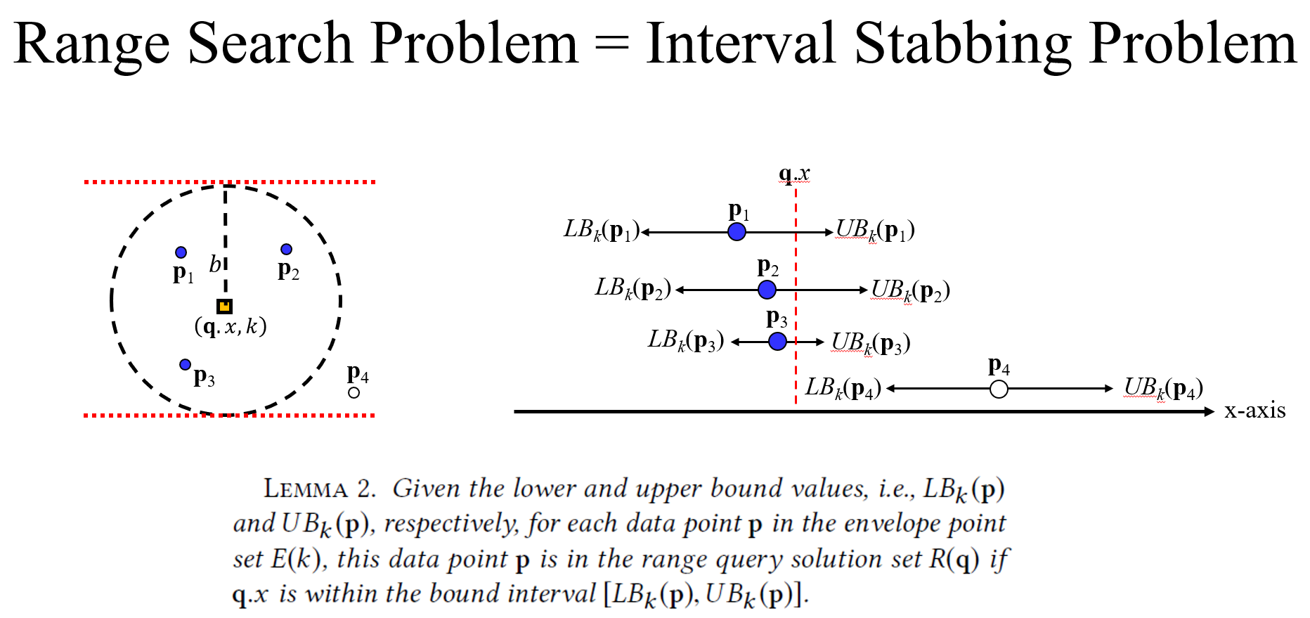
Your Solution (Example)

Slide 11
Experiment Studies
Clearly describe your datasets.
Think deeply about which experiments you should show.
Only show a few important experiments (Do not put every experiment in the slides).

Slide 12
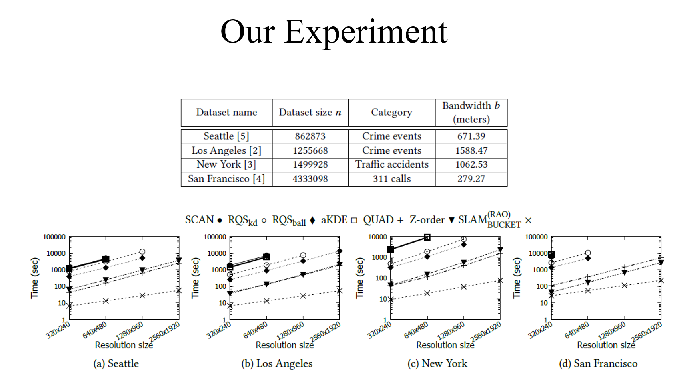
Experiment Studies (Example)

Slide 13
Conclusion and Future Work
Pretty standard. If step 1 to step 5 are perfectly done, this part can also be done perfectly.
Highlight your contribution.
State what you will do next. Think of your next work when you write your slides (or papers). (KEEP ASKING QUESTIONS)

Slide 14
Future Work with Good Quality
Can we further improve the time complexity of KDV?
…
Can we add the concept of bandwidth exploration into KDV?
Can we add the concept of time into KDV?
(9)
SLAM for KDV [i]
(8)
Bandwidth exploration for KDV [h]
Spatiotemporal Kernel Density Visualization (STKDV) [g]
…
(started on April 2021)
(started on Jan 2021)
(7)
You are here! (started on Sep 2017)
(started on Sep 2020)
(1)
Improving the prediction phase of kernel-based models [a]
Kernel Density Visualization (KDV) [b]
Can we add the concept of road network into KDV?
(2)
Can we support kernel-based visualization problems?
(started on Nov 2018)
Network Kernel Density Visualization (NKDV) [f]
…
(6)
(started on May 2020)
(3)
Improving the prediction phase of additive kernel svm [c]
Improving the training phase of additive kernel svm [d]
Can we build the exploratory system of KDV?
(4)
KDV-Explorer [e]
…
(started on June 2019)
(started on Sep 2019)
Can we handle other types of kernels?
Can we improve the efficiency of the training phase of additive kernel svm?
(5)
(started on March 2020)

Slide 15
Future Work with Good Quality
[a] Tsz Nam Chan, Man Lung Yiu, Leong Hou U: “KARL: Fast Kernel Aggregation Queries” ICDE 2019, pages 542-553.
[b] Tsz Nam Chan, Reynold Cheng, Man Lung Yiu: “QUAD: Quadratic-Bound-Based Kernel Density Visualization” SIGMOD 2020, pages 35-50.
[c] Tsz Nam Chan, Leong Hou U, Reynold Cheng, Man Lung Yiu, Shivansh Mittal: “Efficient Algorithms for Kernel Aggregation Queries” IEEE TKDE 2022 (vol 34), pages 2726-2739.
[d] Tsz Nam Chan, Zhe Li, Leong Hou U, Reynold Cheng: “PLAME: Piecewise-Linear Approximate Measure for Additive Kernel SVM” IEEE TKDE 2023 (vol. 35), pages 9985-9997.
[e] Tsz Nam Chan, Pak Lon Ip, Leong Hou U, Weng Hou Tong, Shivansh Mittal, Ye Li, Reynold Cheng: “KDV-Explorer: A Near Real-Time Kernel Density Visualization System for Spatial Analysis” PVLDB 2021 (vol 14), pages 2655-2658 (Demo track).
[f] Tsz Nam Chan, Zhe Li, Leong Hou U, Jianliang Xu, Reynold Cheng: “Fast Augmentation Algorithms for Network Kernel Density Visualization” PVLDB 2021 (vol 14), pages 1503-1516.
[g] Tsz Nam Chan, Pak Lon Ip, Leong Hou U, Byron Choi, Jianliang Xu: “SWS: A Complexity-Optimized Solution for Spatial-Temporal Kernel Density Visualization” PVLDB 2022 (vol 15), pages 814-827.
[h] Tsz Nam Chan, Pak Lon Ip, Leong Hou U, Byron Choi, Jianliang Xu: “SAFE: A Share-and-Aggregate Bandwidth Exploration Framework for Kernel Density Visualization” PVLDB 2022 (vol 15), pages 513-526.
[i] Tsz Nam Chan, Leong Hou U, Byron Choi, Jianliang Xu: “SLAM: Efficient Sweep Line Algorithms for Kernel Density Visualization” SIGMOD 2022, pages 2120-2134.
…

Slide 16
Somethings that You Should Do
Ask some basic questions and answer them for a research topic/problem.
Assume that your audience has limited background (e.g., a student who has just finished the bachelor degree).
Present the core ideas and the weakness of the state-of-the-art solutions.
Present the core ideas of your solution and the goodness of your solution.
Draw more figures and examples (or figure examples) to explain.

Slide 17
Somethings that You Should Not Do
Overcomplicate somethings.
Assume the audience can understand what you are talking about.
Present somethings that you do not fully understand.
Avoid using examples and figures.
Put everything into the slides.

Slide 18
Some Quotes
“Most people are not as knowledgeable as you think they are.”
“A presentation is like a class – if the audience does not understand it is your fault, not theirs.”
“Present only things that you understand clearly – if something still looks complex, skip it.”
“Spend a lot of time on good examples”
“Presentation is as important (if not more) than the actual work. Presentation is easier to improve.”
By Dimitris Papadias (a full professor in HKUST) https://www.cse.ust.hk/~dimitris/Instructions%20for%20PhD%20Students.pdf (Strongly suggest you to read the slides.)

Slide 19
More Suggestions: Topic-finding
Topic-finding may not be job-oriented.
Topic-finding may not be trendy.
Find the topic that you must really enjoy for.
You need to handle this topic for the future four years.
Keep asking whether you enjoy that topic.

Slide 20
More Suggestions: Writing Attitude
Write every day no matter what you feel.
Write the draft even though you have no idea.
Write introduction
Write related work
Writing helps you for concentration (for thinking ideas).
Love and believe your work.
Do not give up your idea early. (Writing can help!)
Find ways to save your ideas.

Slide 21
More Suggestions: Braveness
Be brave.
Academic freedom protects you. ☺
No one will laugh at you.
No one will blame you even if you are wrong.
If they laugh at you or blame you, you can simply say this is academic freedom (I can say whatever I say as long as they are ethical, or they do not break the law.).
Don’t be afraid if it is wrong.
“Everything you say” is only based on the best of your knowledge at that time.
You only need to say “I am sorry.” or “I learn it.” when it turns out to be wrong.

Slide 22
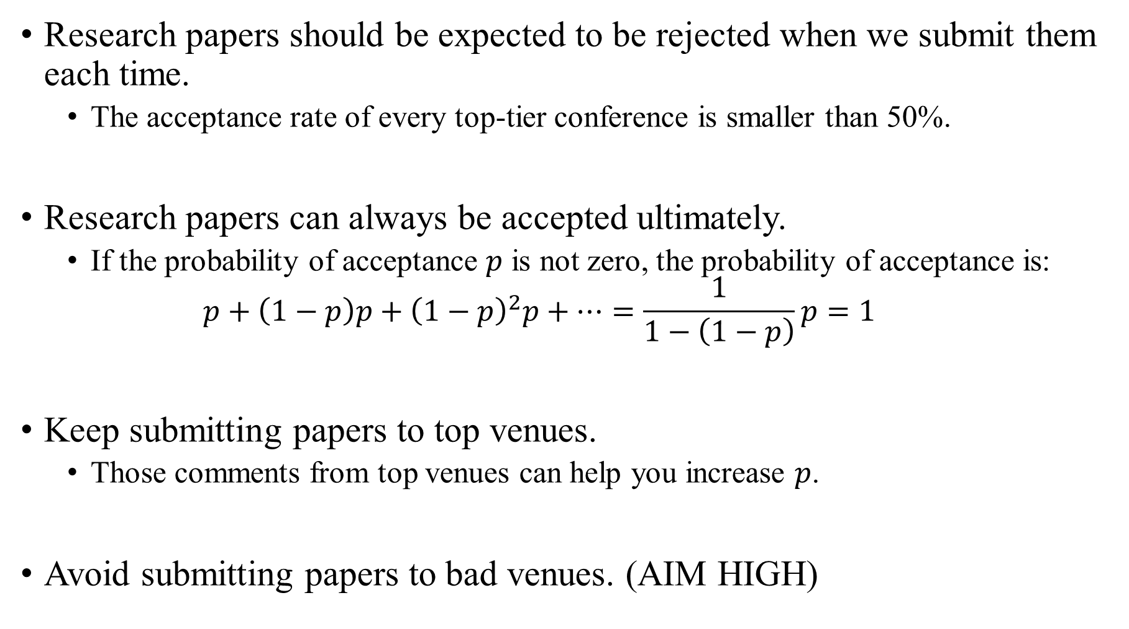
More Suggestions: Submission
Research papers should be expected to be rejected when we submit them each time.
The acceptance rate of every top-tier conference is smaller than 50%.
Research papers can always be accepted ultimately.
If the probability of acceptance $p$ is not zero, the probability of acceptance is:
$$p+\left(1−p\right)p+{\left(1−p\right)}^{2}p+…=\frac{1}{1−\left(1−p\right)}p=1$$
Keep submitting papers to top venues.
Those comments from top venues can help you increase $p$.
Avoid submitting papers to bad venues. (AIM HIGH)

Slide 23
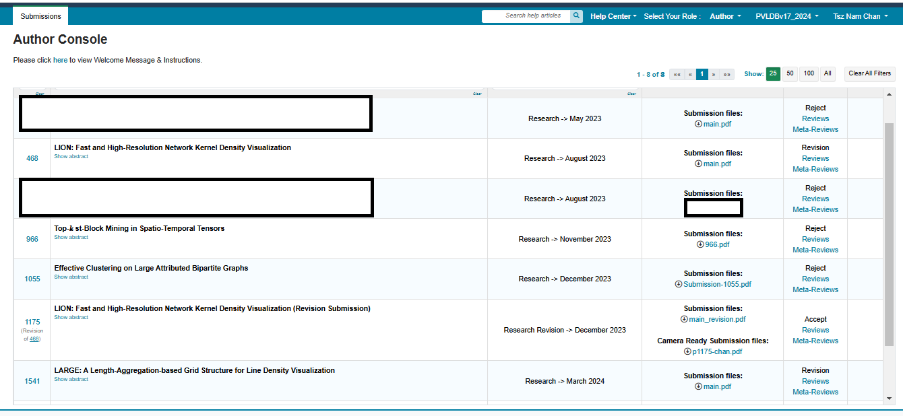
How to be Productive?
Accepted in SIGKDD 2025
Accepted in SIGKDD 2024
Accepted later

Slide 24
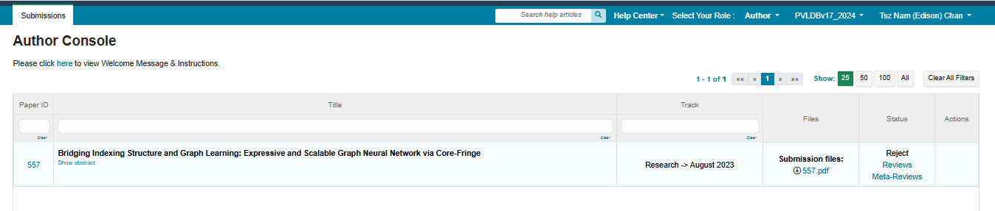
How to be Productive?
Accepted in ICDM 2024

Slide 25
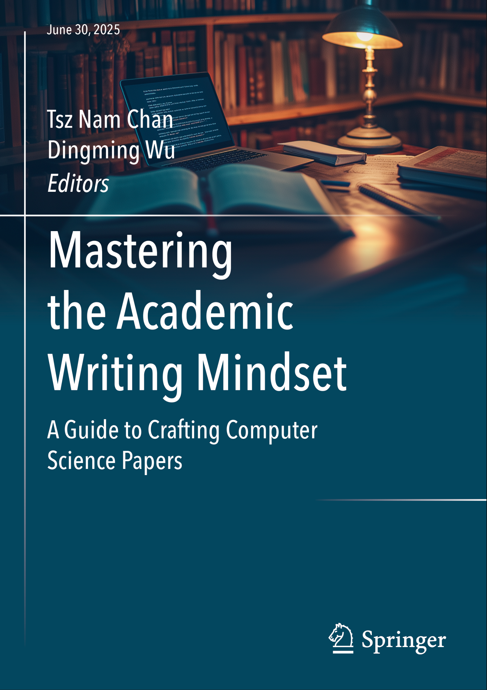
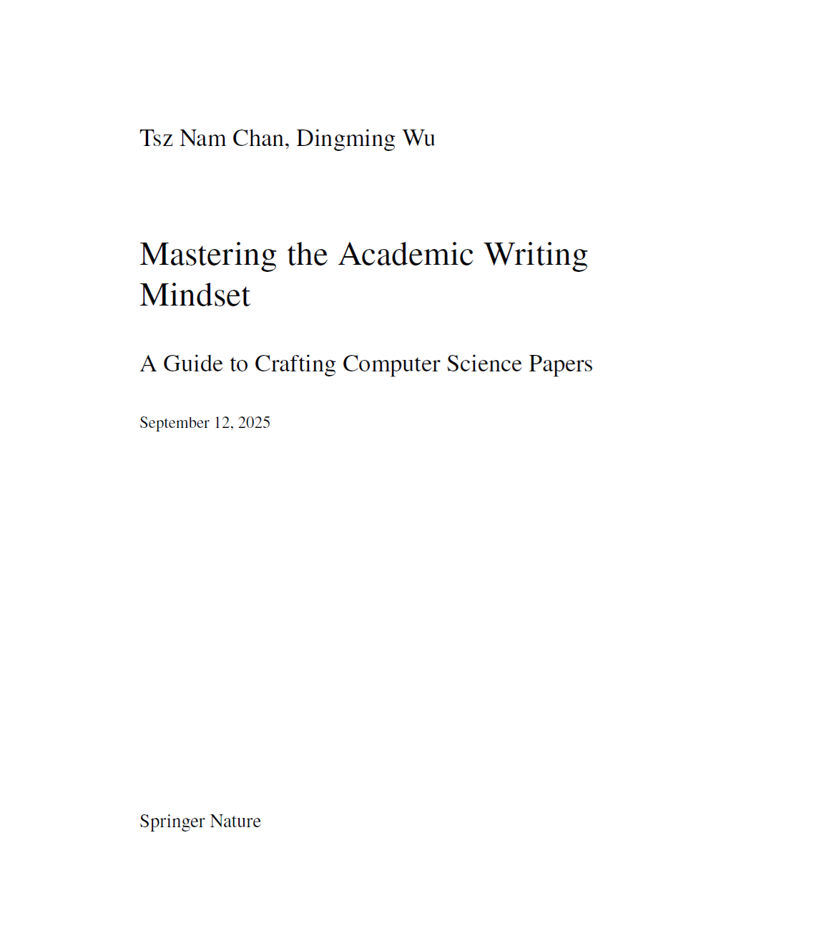
Our Book

