Slide 1


Complexity-Reduced Algorithms and Software Packages for Spatiotemporal Analysis
(Edison) Tsz Nam Chan
Shenzhen University

Slide 2
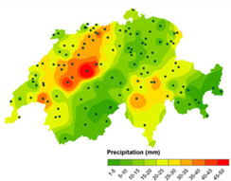
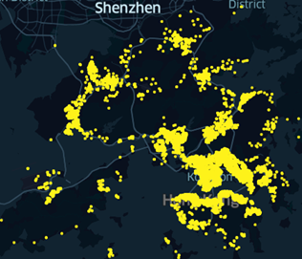
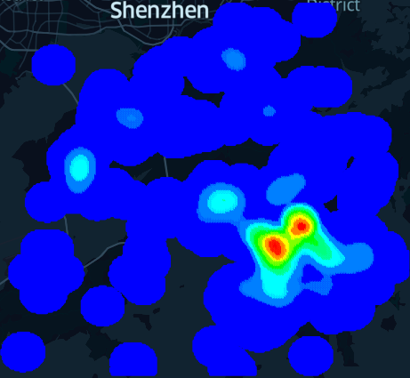
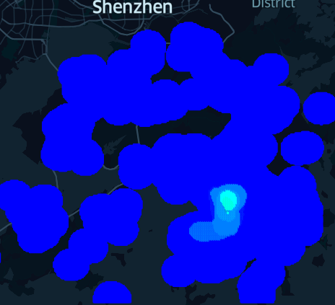
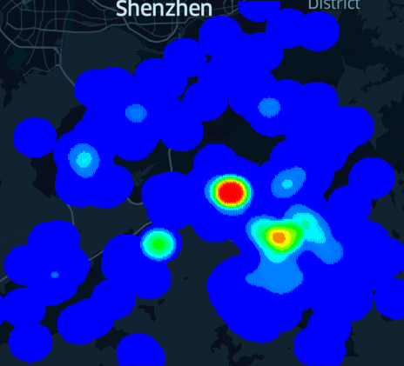
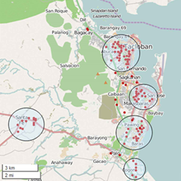
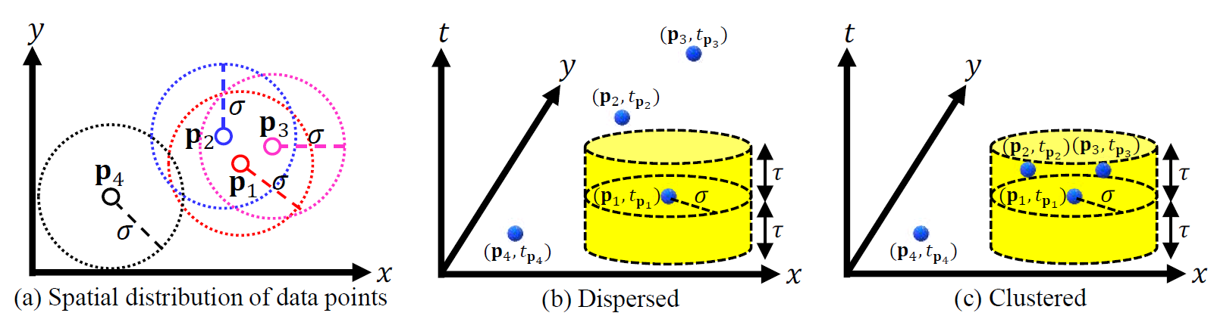
What is Spatiotemporal Analysis?
time
Spatial interpolation
Spatiotemporal hotspot detection
Point clustering
Spatiotemporal K-function

Slide 3
Why Spatiotemporal Analysis?
Discover some meaningful hidden patterns from a location dataset.
Fundamental tools for GIS domain experts/users.
Never expire in the AI age. ☺
Cannot explain the results by many deep learning models. ☹
High explainability with spatiotemporal analysis tools. ☺
This is a foundation. AI can assist for choosing the correct tools for analysis.

Slide 4
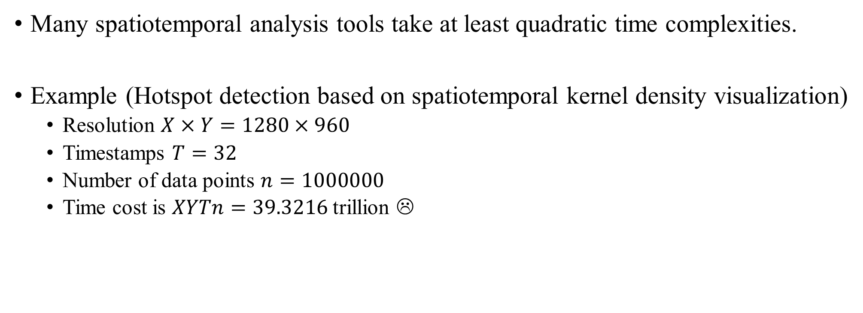
Spatiotemporal Analysis is Slow!
Many spatiotemporal analysis tools take at least quadratic time complexities.
Example (Hotspot detection based on spatiotemporal kernel density visualization)
Resolution $X×Y=1280×960$
Timestamps $T=32$
Number of data points $n=1000000$
Time cost is $XYTn=39.3216$ trillion ☹
time

Slide 5




Spatiotemporal Analysis is Slow!
Many software packages are based on naïve solutions.
Cannot be scalable to million-scale datasets.
Cannot feasibly support real-time applications (even for small-scale datasets).
Fast solution and software are needed for each spatiotemporal analysis tool.

Slide 6
How to Improve the Efficiency of Spatiotemporal Analysis Tools?
Formulate each spatiotemporal analysis tool as a query processing (computational) problem.
Understand some mathematical properties of this problem.
Design data structures and algorithms for this problem and implement them.
Establish the software plugin and the webpage function for these implementations.

Slide 7
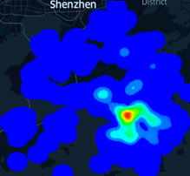
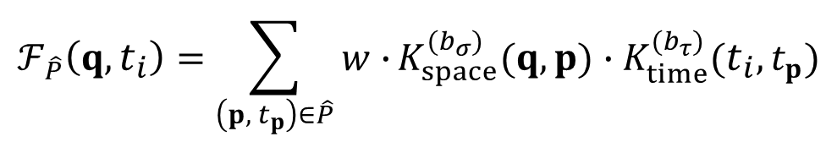
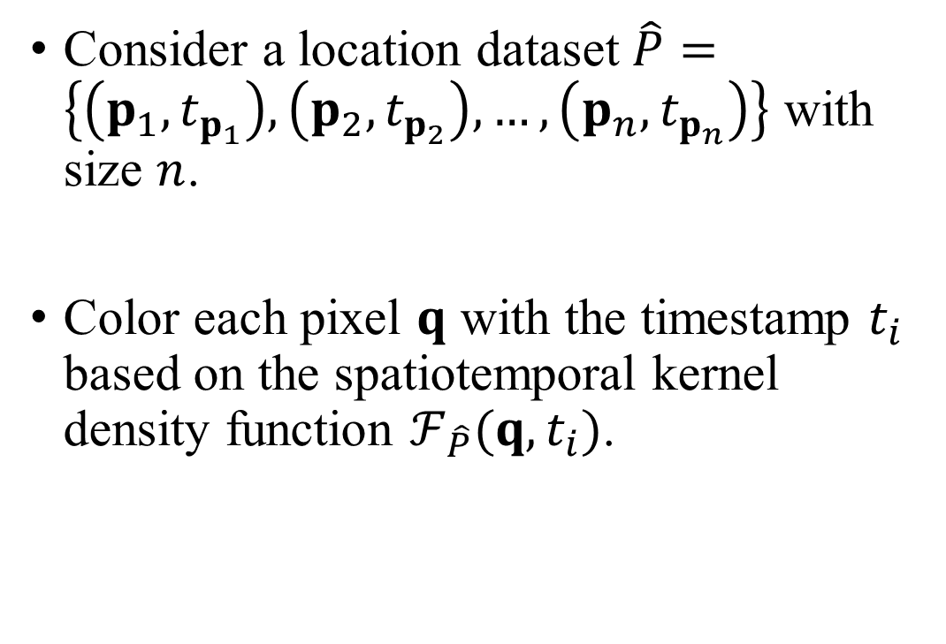
Spatiotemporal Kernel Density Visualization (STKDV)
Consider a location dataset $\hat{P}=\left\{\left(p_{1}, t_{p_{1}}\right),\left(p_{2}, t_{p_{2}}\right),…,\left(p_{n}, t_{p_{n}}\right)\right\}$ with size $n$.
Color each pixel $q$ with the timestamp $t_{i}$ based on the spatiotemporal kernel density function $ℱ_{\hat{P}}(q,t_{i})$.
2nd August 2020
6th December 2020
$$ℱ_{\hat{P}}\left(q,t_{i}\right)=\sum_{\left(p, { t}_{p}\right)∈\hat{P}}{w∙}K_{space}^{(b_{σ})}(q,p)∙K_{time}^{(b_{τ})}(t_{i},t_{p})$$
28th February 2021
28th January 2022

Slide 8
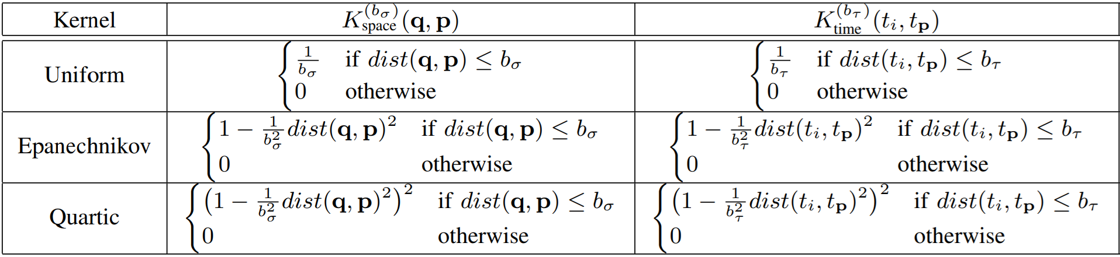
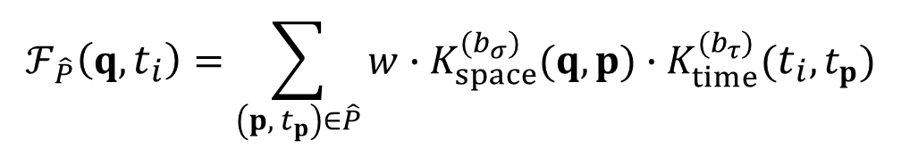

Spatiotemporal Kernel Density Visualization (STKDV)
Some representative spatial and temporal kernel functions that are used in the spatiotemporal kernel density function $ℱ_{\hat{P}}(q,t_{i})$.
$$ℱ_{\hat{P}}\left(q,t_{i}\right)=\sum_{\left(p, { t}_{p}\right)∈\hat{P}}{w∙K_{space}^{(b_{σ})}(q,p)∙K_{time}^{(b_{τ})}(t_{i},t_{p})}$$

Slide 9
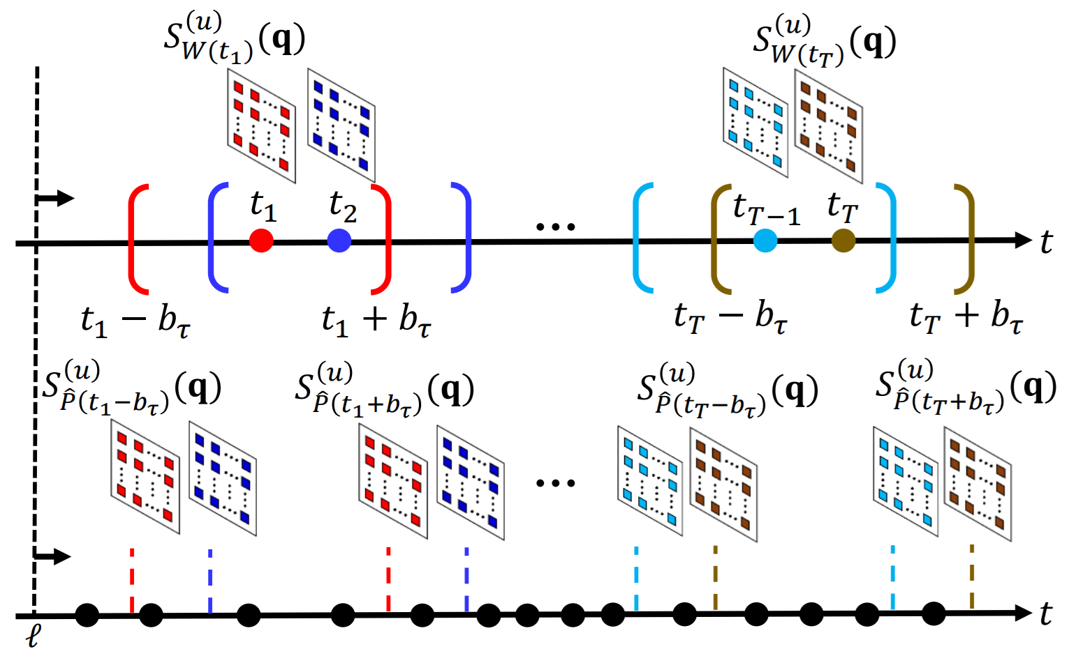
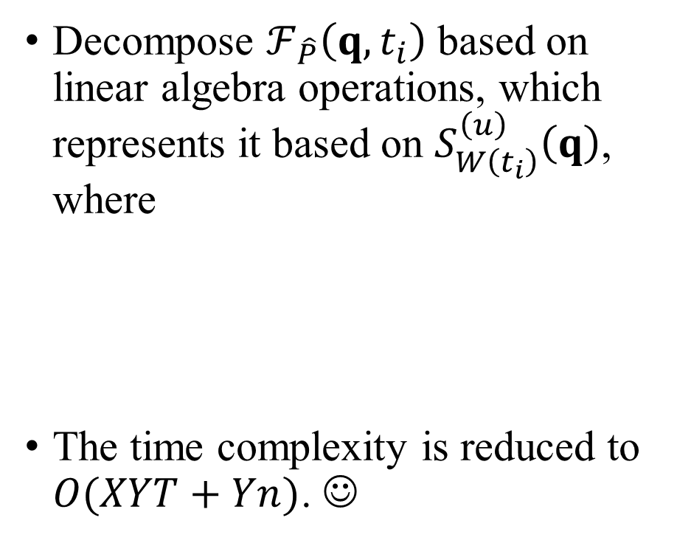
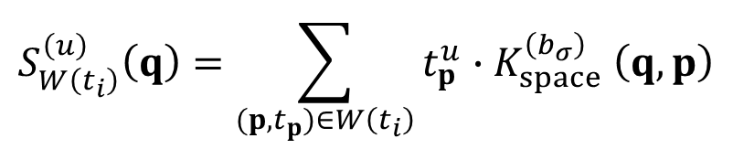
Spatiotemporal Kernel Density Visualization (STKDV)
Decompose $ℱ_{\hat{P}}\left(q,t_{i}\right)$ based on linear algebra operations, which represents it based on $S_{W\left(t_{i}\right)}^{\left(u\right)}\left(q\right)$, where
The time complexity is reduced to $O(XYT+Yn)$. ☺
$$S_{W\left(t_{i}\right)}^{\left(u\right)}\left(q\right)=\sum_{(p,t_{p})∈W\left(t_{i}\right)}{t_{p}^{u}{∙K}_{space}^{\left(b_{σ}\right)}\left(q,p\right)}$$
[a] Tsz Nam Chan, Pak Lon Ip, Bojian Zhu, Leong Hou U, Dingming Wu, Jianliang Xu, Christian S. Jensen: “Large-scale Spatiotemporal Kernel Density Visualization” ICDE 2025, pages 99-113.
[b] Yue Zhong*, Tsz Nam Chan, Leong Hou U, Dingming Wu, Wei Tu, Ruisheng Wang, Joshua Zhexue Huang: “A Fast and Accurate Block Compression Solution for Spatiotemporal Kernel Density Visualization” SIGKDD 2025, pages 4098-4109. (* represents my student.)

Slide 10
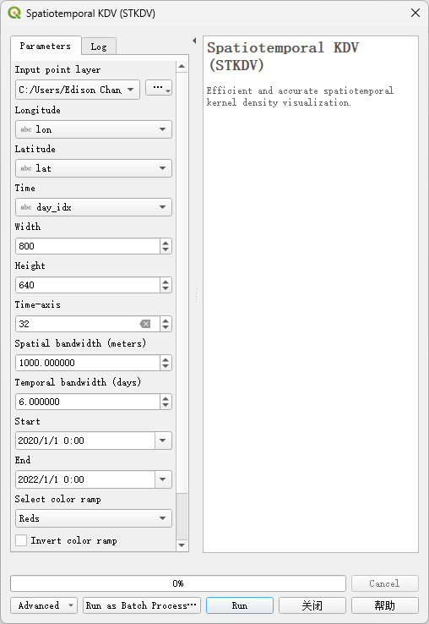
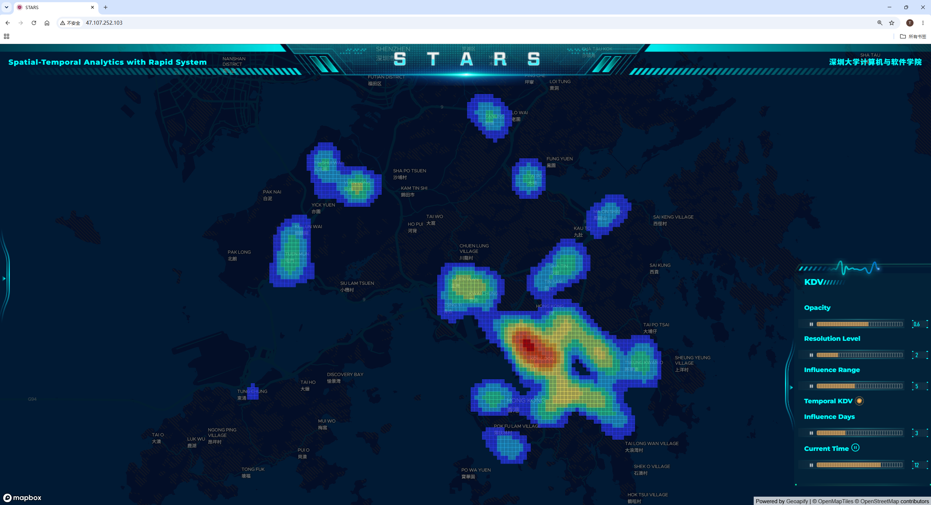
Spatiotemporal Kernel Density Visualization (STKDV)
Spatiotemporal Analysis with Rapid System (STARS)
http://47.107.252.103/
QGIS plugin: Fast Density Analysis

Slide 11
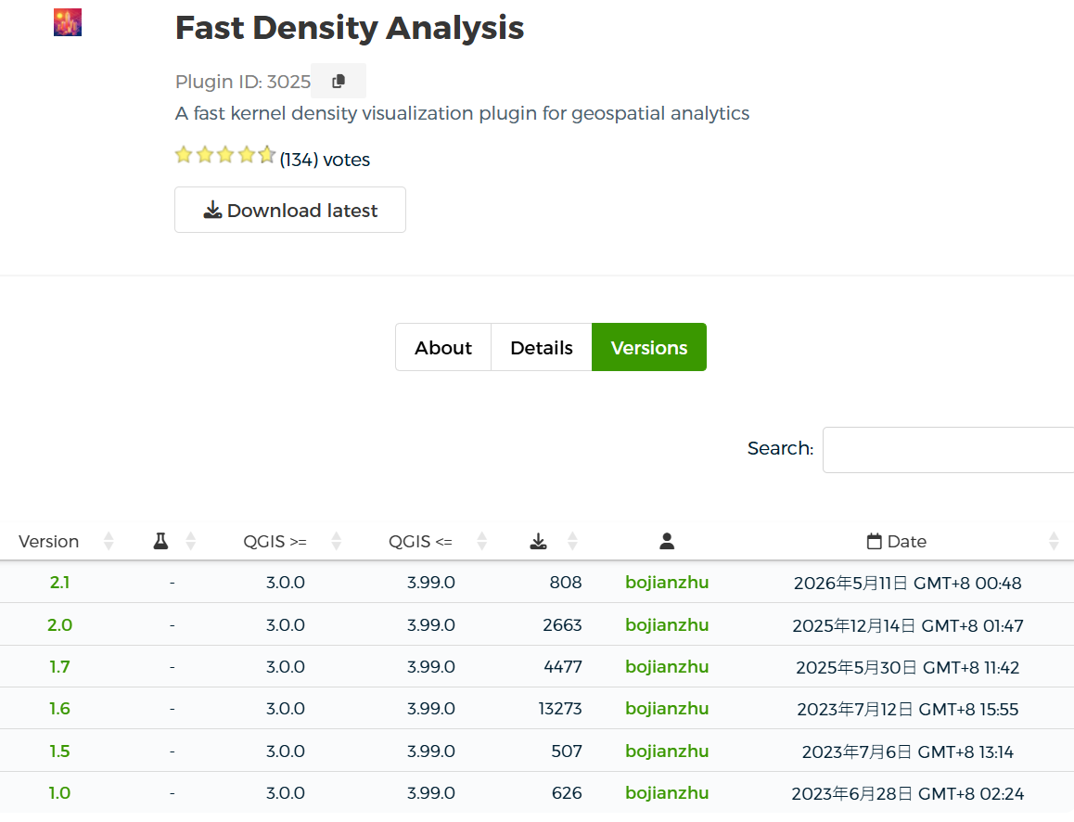
Our Software Package: Fast Density Analysis
22,354

Slide 12
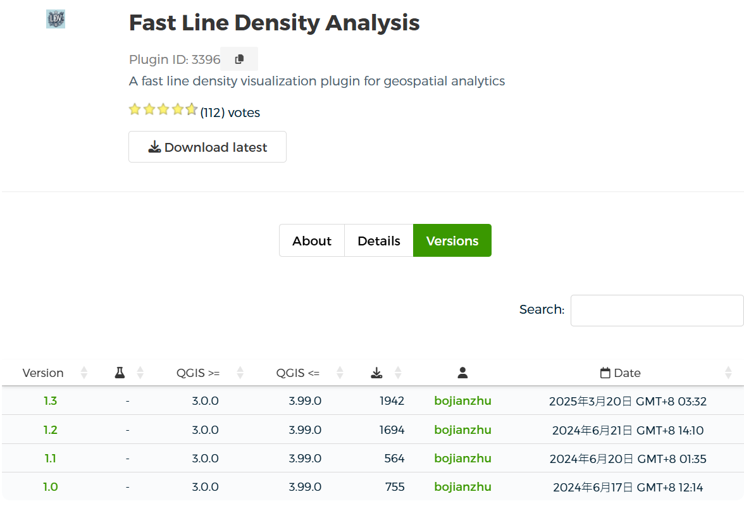
Our Software Package: Fast Line Density Analysis
4,955

Slide 13
Future Work
Develop complexity-reduced algorithms for other spatiotemporal analysis tools.
Inverse distance weighting (IDW)
Kriging
DBSCAN clustering
Integrate all these algorithms into a unified QGIS/ArcGIS plugin and the web-based system STARS.
Advertise this plugin and STARS.
Write a book (in Springer Nature) about this topic.

Slide 14

Our New Book
https://link.springer.com/book/10.1007/978-981-95-4850-7

