Slide 1

Large-scale Geospatial Analytics:
Fast Method and Software Development
(Edison) Tsz Nam Chan, Dingming Wu
Shenzhen University

Slide 2
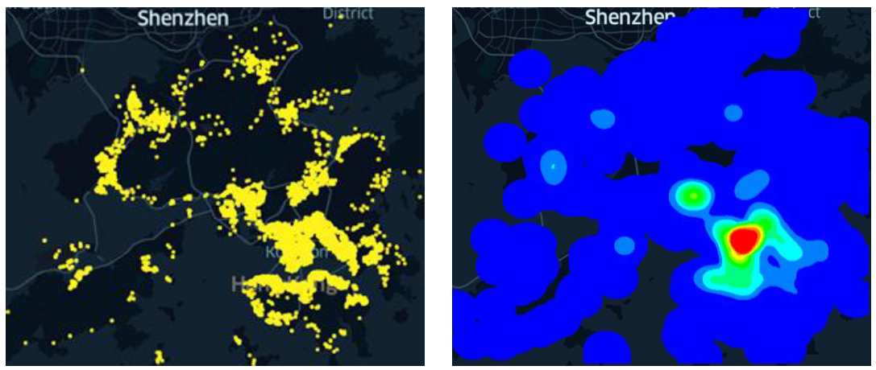
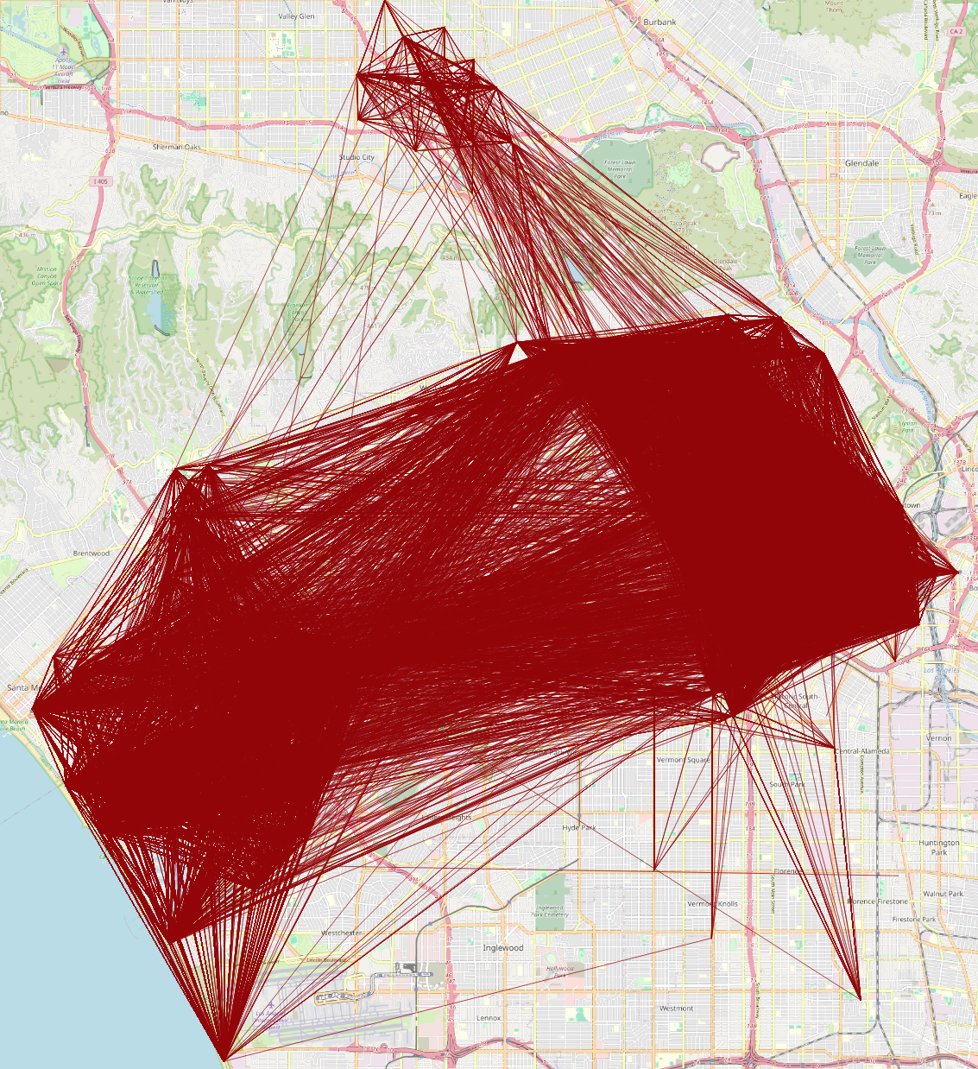
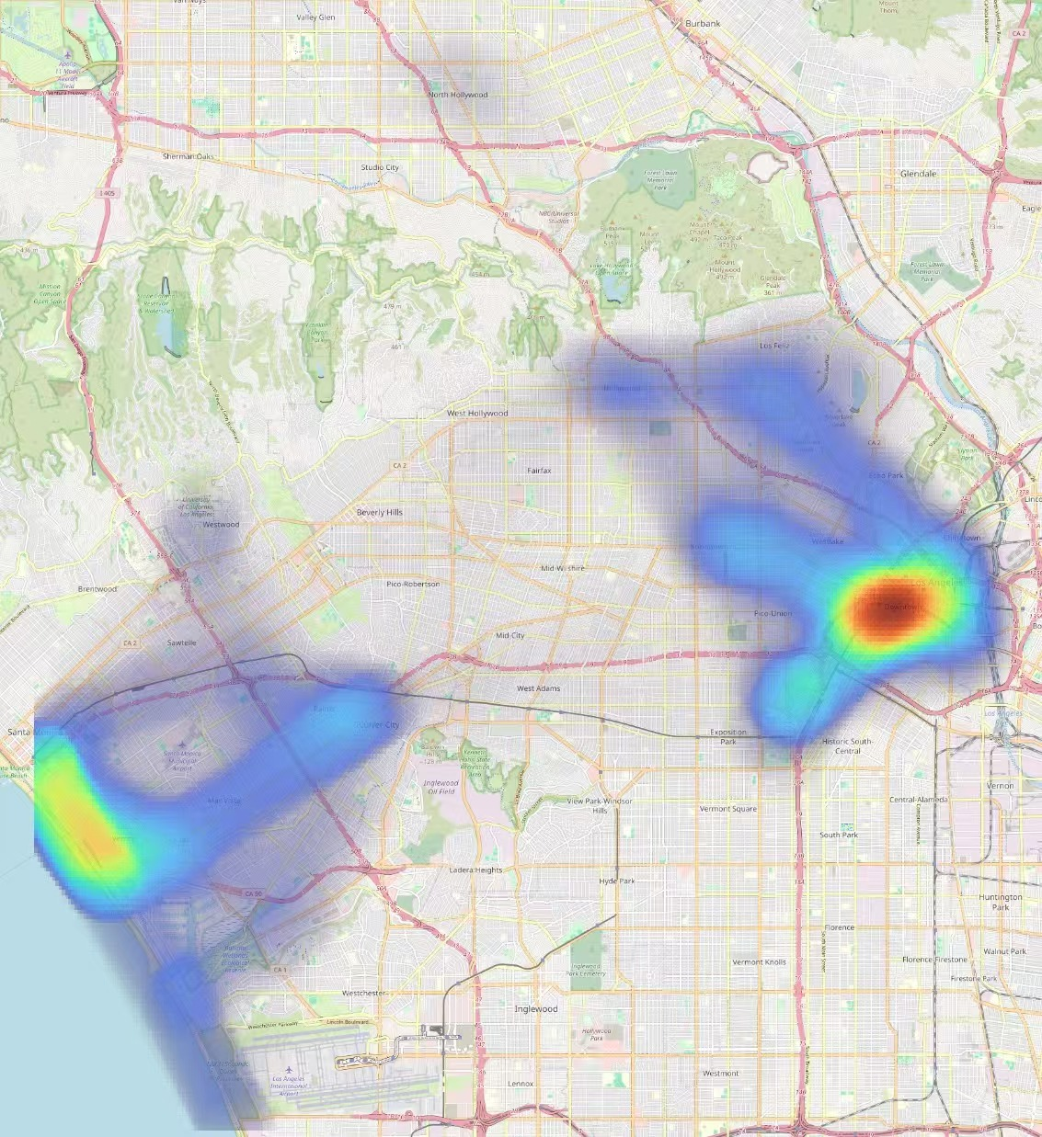
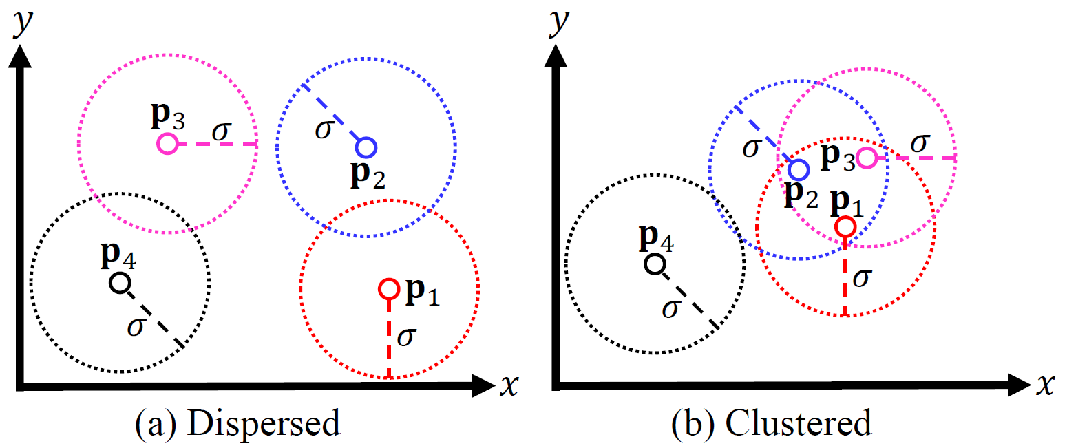
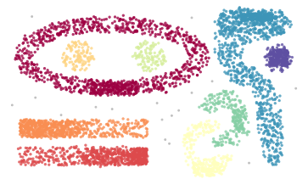

What is Geospatial Analytics?
$$p_{3}$$
Kernel density visualization
Line density visualization
K-function analysis
Point clustering

Slide 3









Contemporary GIS Software Packages

Slide 4
Weakness of Geospatial Analytics
GIS software packages are very slow. ☹
Reasons:
  High time complexity.
  No efficient algorithm development.
  No deployment.
Consequence: Cannot be scalable to large-scale datasets.

Slide 5
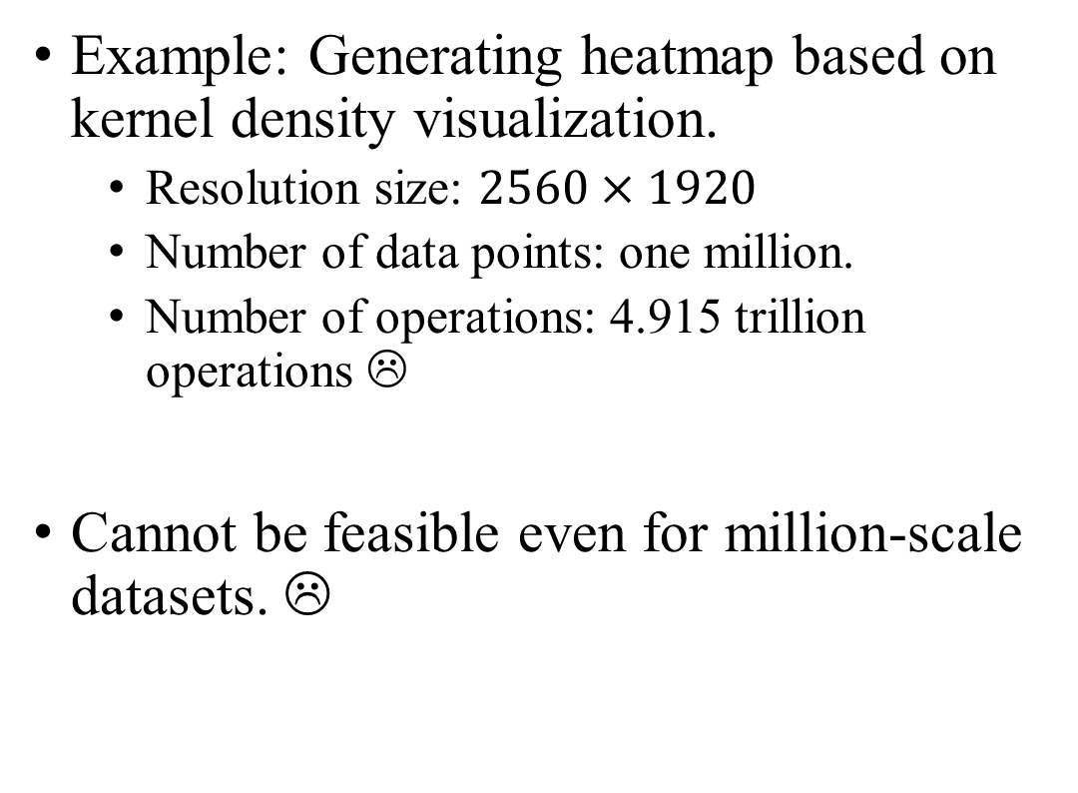

Weakness of Geospatial Analytics
Example: Generating heatmap based on kernel density visualization.
  Resolution size: $2560×1920$
  Number of data points: one million.
  Number of operations: 4.915 trillion operations ☹
Cannot be feasible even for million-scale datasets. ☹
$$p_{3}$$
Point dataset
Heatmap

Slide 6
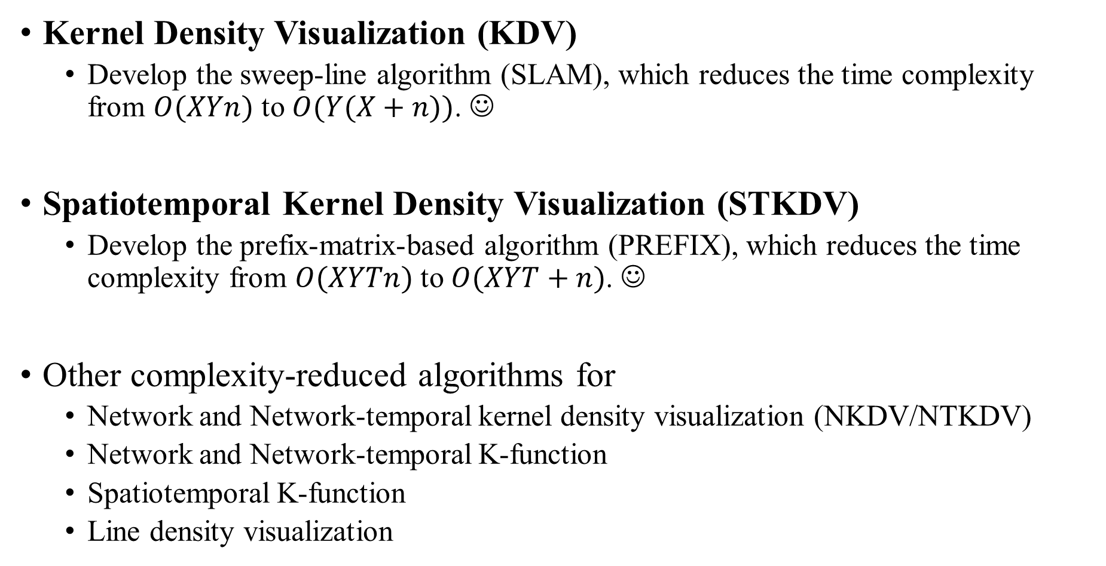
Our Solutions
Kernel Density Visualization (KDV)
  Develop the sweep-line algorithm (SLAM), which reduces the time complexity from $O(XYn)$ to $O(Y(X+n))$. ☺
Spatiotemporal Kernel Density Visualization (STKDV)
  Develop the prefix-matrix-based algorithm (PREFIX), which reduces the time complexity from $O(XYTn)$ to $O(XYT+n)$. ☺
Other complexity-reduced algorithms for
  Network and Network-temporal kernel density visualization (NKDV/NTKDV)
  Network and Network-temporal K-function
  Spatiotemporal K-function
  Line density visualization

Slide 7

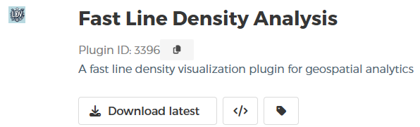
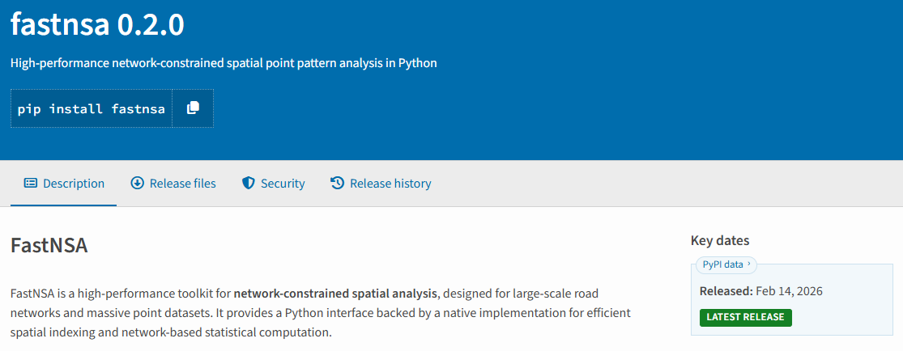
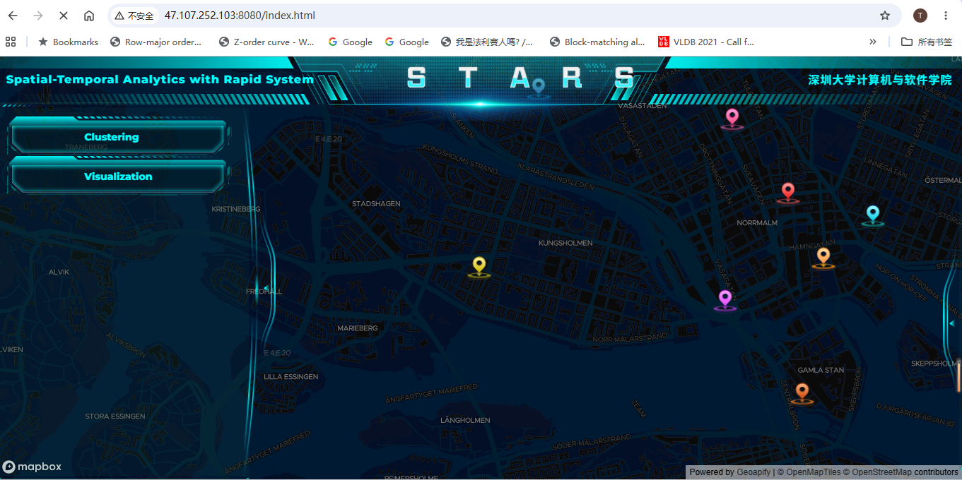
Our Software Packages
Fast Density Analysis
Fast Line Density Analysis
Fast Network Spatial Analysis (FastNSA)
Spatial-Temporal Analysis with Rapid System
(STARS)

Slide 8
Future Work
Develop efficient algorithms for other GIS tools.
  Inverse distance weighting (IDW)
  Kriging
  DBSCAN clustering
  Moran’s I
  Getis-Ord General G
Integrate these algorithms into unified QGIS and ArcGIS plugins.
Integrate these algorithms into unified python and R software packages.
Integrate these algorithms into a unified web-based system (STARS).

