Slide 1
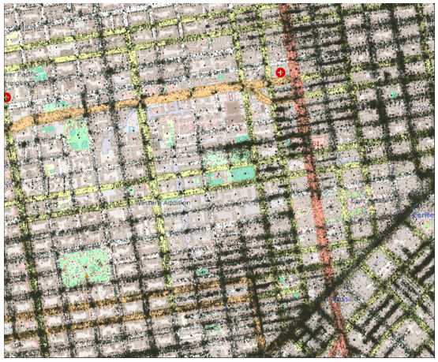
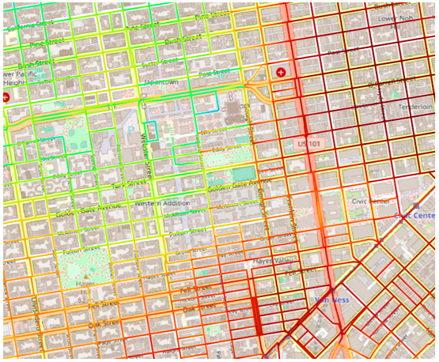
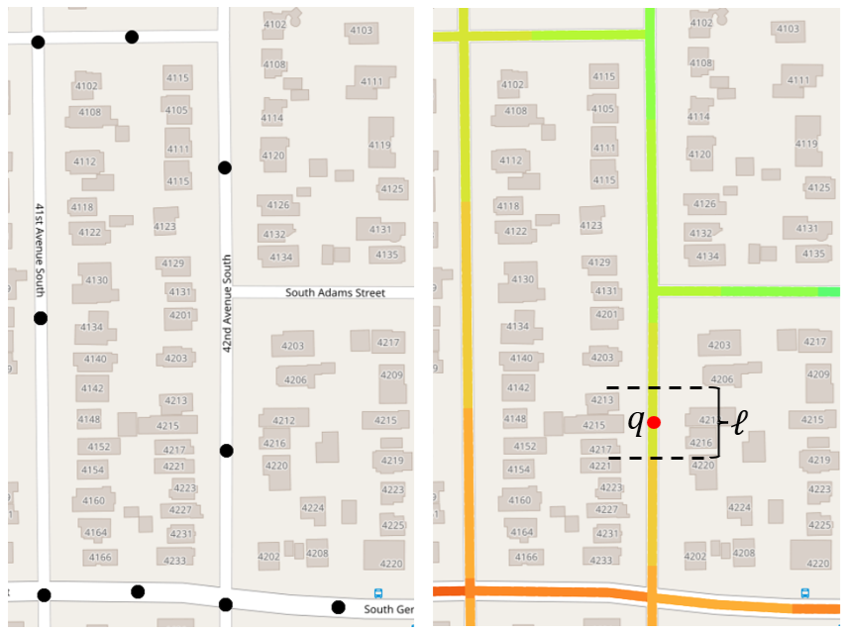
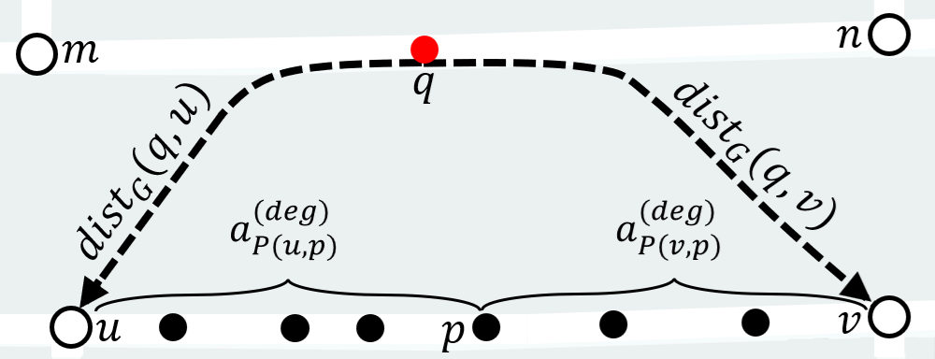
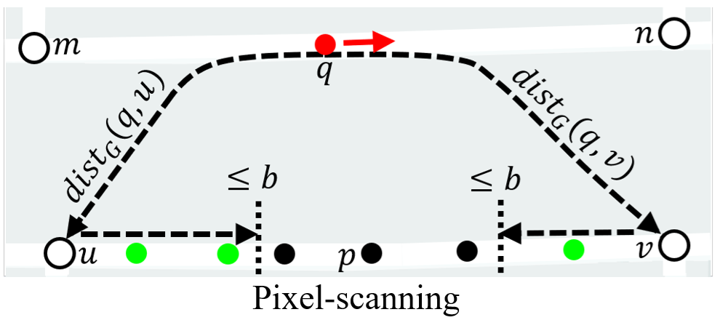
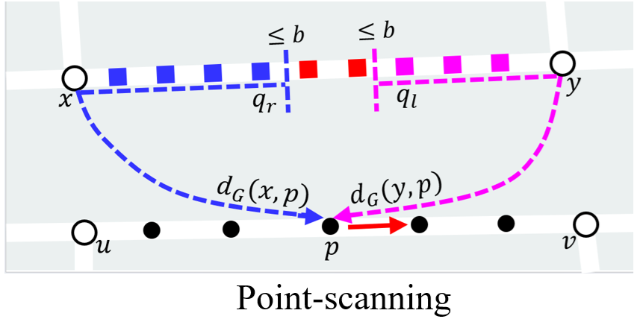
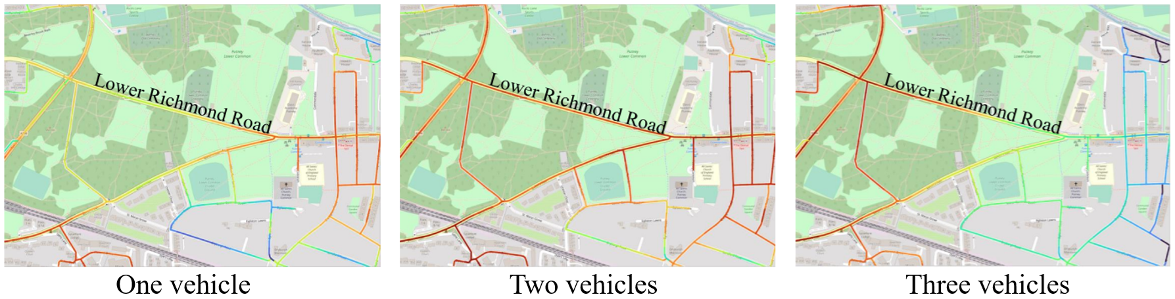
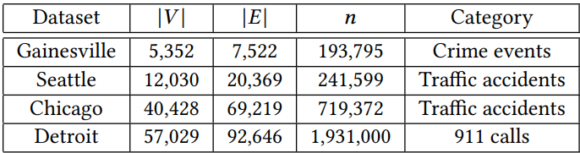
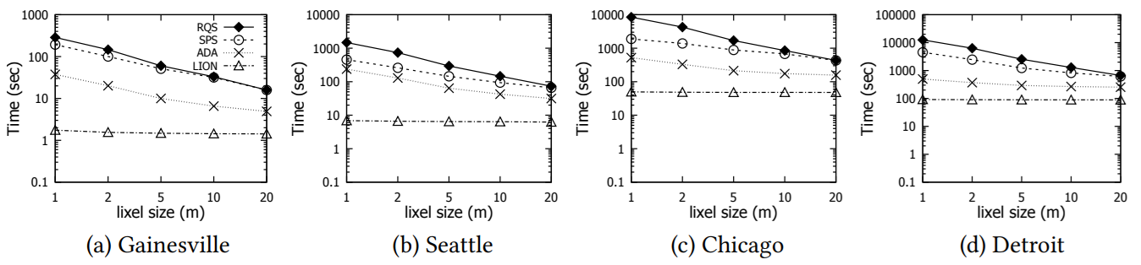
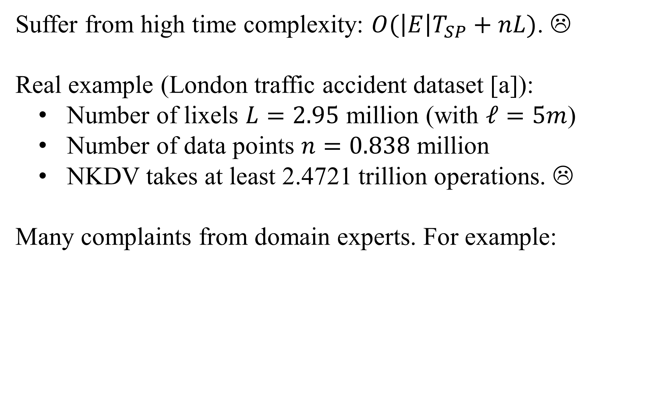
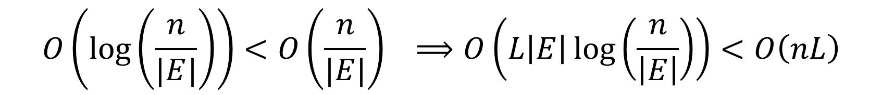
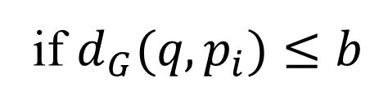
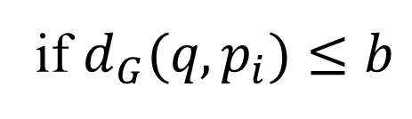
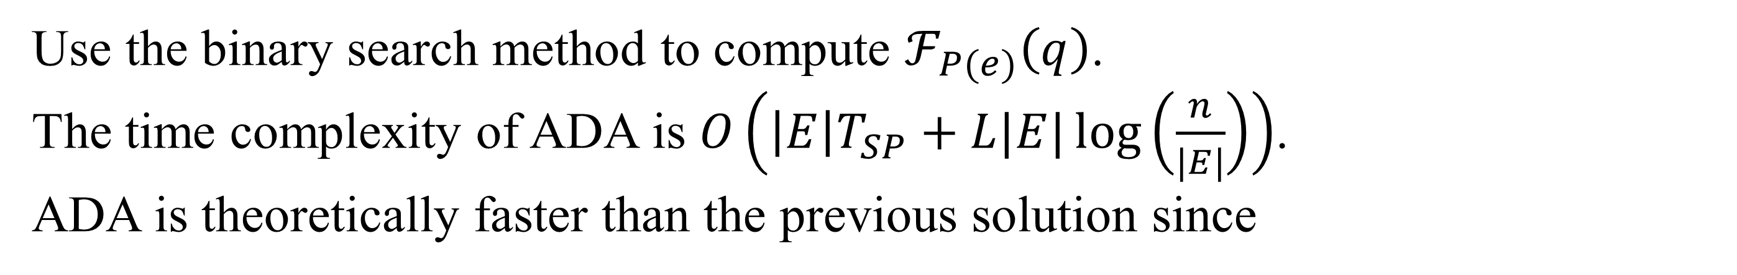
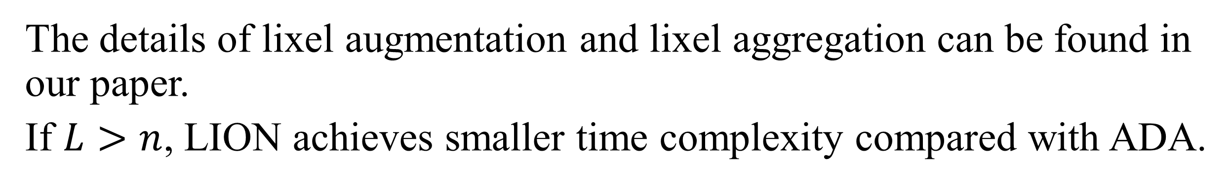
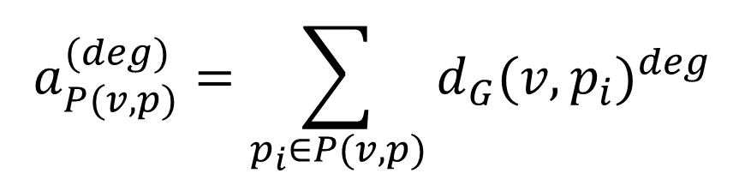
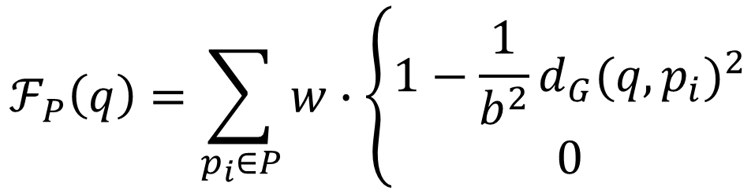
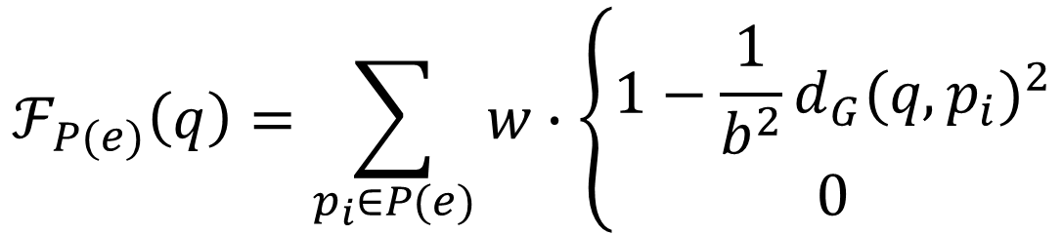

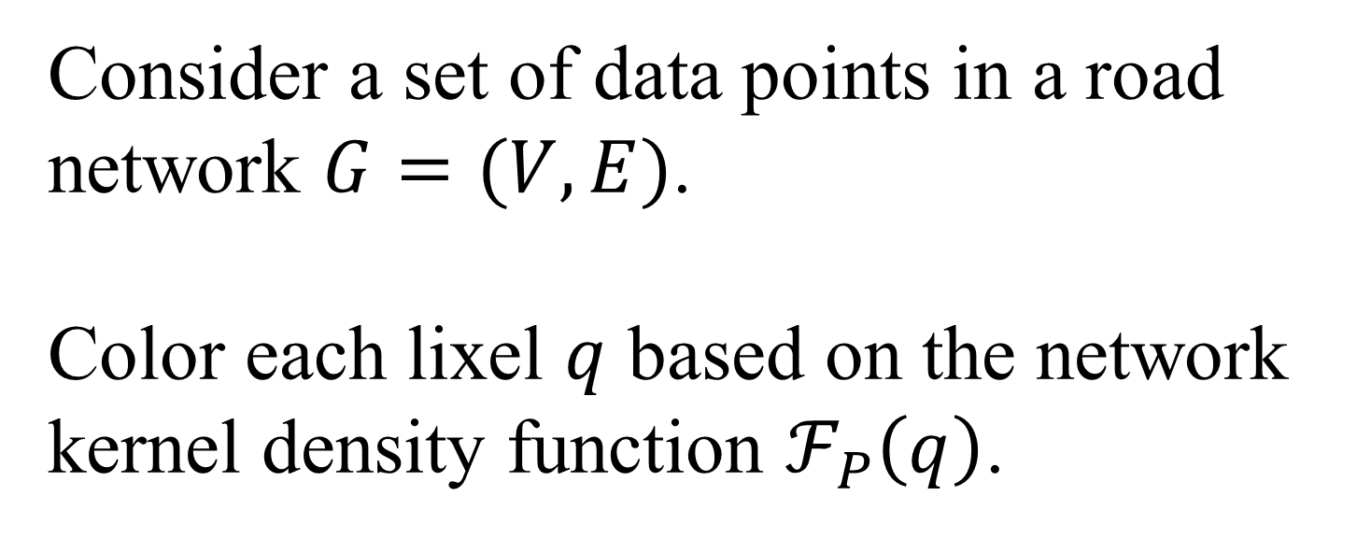
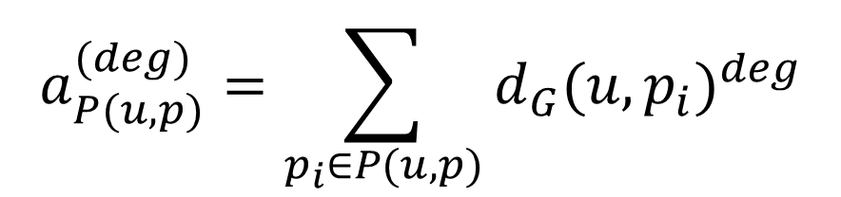
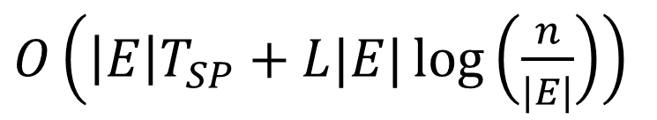
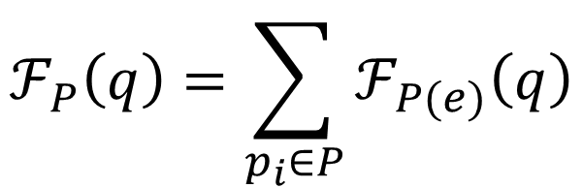
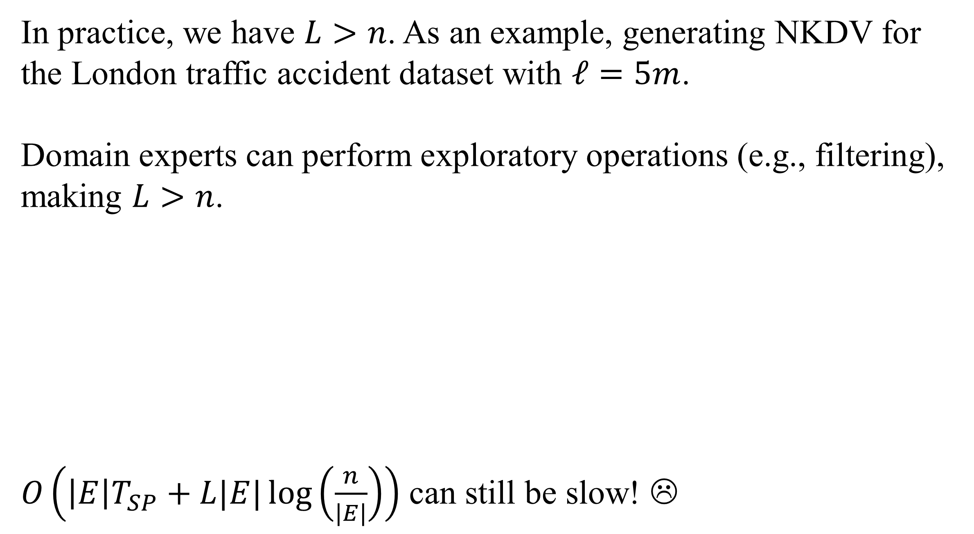
LION: Fast and High-Resolution Network Kernel Density Visualization
Tsz Nam Chan
Shenzhen University
edisonchan@szu.edu.cn
Rui Zang
Hong Kong Baptist University
19251017@life.hkbu.edu.hk
Bojian Zhu
Hong Kong Baptist University
csbjzhu@comp.hkbu.edu.hk
Leong Hou U
University of Macau
ryanlhu@um.edu.mo
Dingming Wu
Shenzhen University
dingming@szu.edu.cn
Jianliang Xu
Hong Kong Baptist University
xujl@comp.hkbu.edu.hk
Overview of Network Kernel Density Visualization (NKDV)
Consider a set of data points in a road network $G=(V, E)$.
Color each lixel $q$ based on the network kernel density function $ℱ_{P}\left(q\right)$.
lixel
weighting
shortest path distance
$$ℱ_{P}\left(q\right)=\sum_{p_{i}∈P}{w}∙\left\{\begin{matrix}1−\frac{1}{b^{2}}{d_{G}(q,p_{i})}^{2} \\ 0\end{matrix}\right.$$
if $d_{G}(q,p_{i})≤b$
311-call location data points in San Francisco
NKDV
dataset
bandwidth
otherwise
Location data points
NKDV
NKDV is Slow!
State-of-the-art Solution (ADA)
Suffer from high time complexity: $O(\left|E\right|T_{SP}+nL)$. ☹
Real example (London traffic accident dataset [a]):
Number of lixels $L=2.95$ million (with $ℓ=5m$)
Number of data points $n=0.838$ million
NKDV takes at least 2.4721 trillion operations. ☹
Many complaints from domain experts. For example:
$$ℱ_{P}\left(q\right)=\sum_{p_{i}∈P}{ℱ_{P(e)}\left(q\right)}$$
where
$$ℱ_{P(e)}\left(q\right)=\sum_{p_{i}∈P(e)}{w}∙\left\{\begin{matrix}1−\frac{1}{b^{2}}{d_{G}(q,p_{i})}^{2} \\ 0\end{matrix}\right.$$
if $d_{G}(q,p_{i})≤b$
otherwise
Augment $a_{P(u,p)}^{(deg)}$ and $a_{P(v,p)}^{(deg)}$ in each data point $p$ of the edge $e=(u,v)$.
$$a_{P(u,p)}^{(deg)}=\sum_{p_{i}∈P(u,p)}{{d_{G}(u,p_{i})}^{deg}}$$
$$a_{P(v,p)}^{(deg)}=\sum_{p_{i}∈P(v,p)}{{d_{G}(v,p_{i})}^{deg}}$$
Rakshit et al. [b] “Kernel smoothing of point events, which is simple to define and very fast to compute in two dimensions (Diggle 1985), is mathematically complicated and can be extremely time-consuming to perform on a network...”
Use the binary search method to compute $ℱ_{P(e)}\left(q\right)$.
The time complexity of ADA is $O\left(\left|E\right|T_{SP}+L|E|\log\left(\frac{n}{|E|}\right)\right)$.
ADA is theoretically faster than the previous solution since
[a] Road Safety Data. https://data.gov.uk/dataset/cb7ae6f0-4be6-4935-9277-47e5ce24a11f/road-safety-data.
[b] S. Rakshit, A. Baddeley, and G. Nair. Efficient code for second order analysis of events on a linear network. Journal of Statistical Software, Articles, 90(1):1–37, 2019.
$$O\left(\log\left(\frac{n}{|E|}\right)\right)<O\left(\frac{n}{|E|}\right) ⟹O\left(L\left|E\right|\log\left(\frac{n}{\left|E\right|}\right)\right)<O\left(nL\right)$$
Weakness of ADA
Our Solution: LION
In practice, we have $L>n$. As an example, generating NKDV for the London traffic accident dataset with $ℓ=5m$.
Domain experts can perform exploratory operations (e.g., filtering), making $L>n$.
$O\left(\left|E\right|T_{SP}+L|E|\log\left(\frac{n}{|E|}\right)\right)$ can still be slow! ☹
Core idea: Change from pixel-scanning to point-scanning.
$O\left(\left|E\right|T_{SP}+L|E|\log\left(\frac{n}{|E|}\right)\right)$
$O\left(\left|E\right|T_{SP}+n\left|E\right|+{|E|}^{2}+L\right)$
The details of lixel augmentation and lixel aggregation can be found in our paper.
If $L>n$, LION achieves smaller time complexity compared with ADA.
Experimental Evaluation
Response time for generating NKDV, varying the lixel size.

