Slide 1


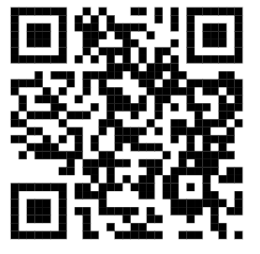
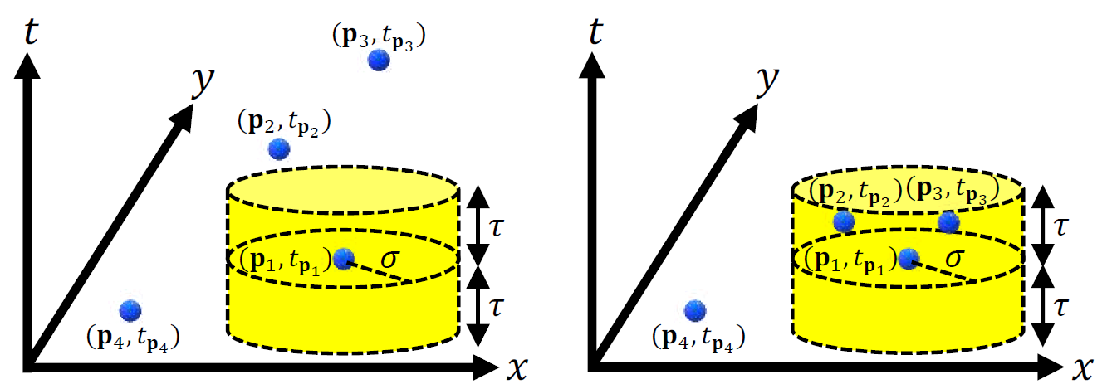
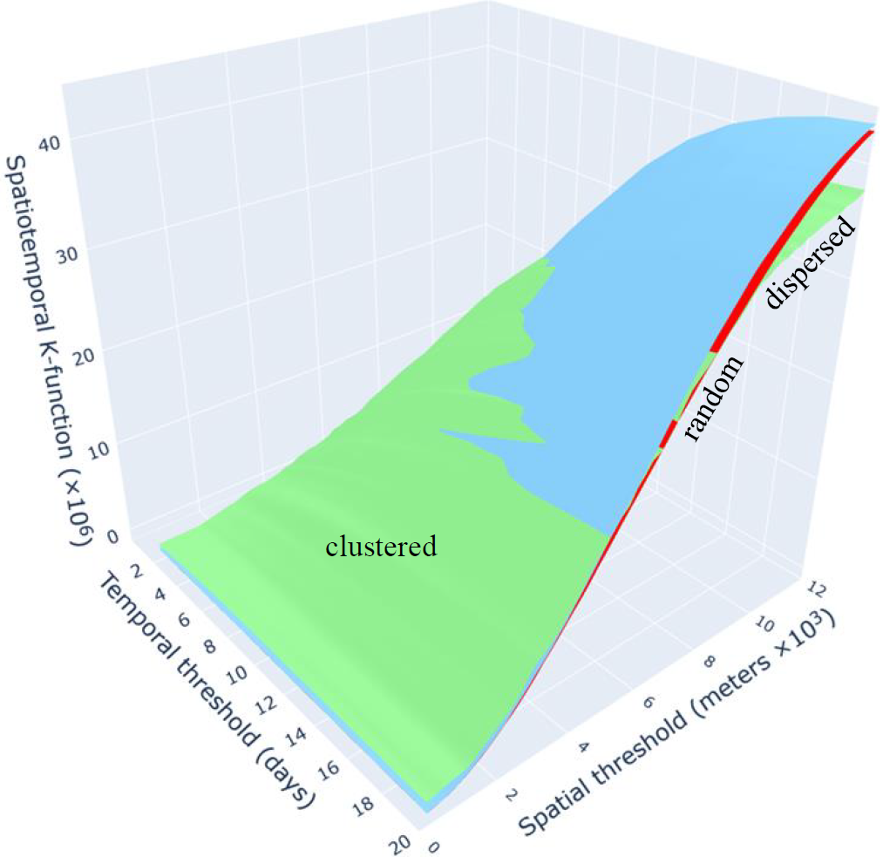
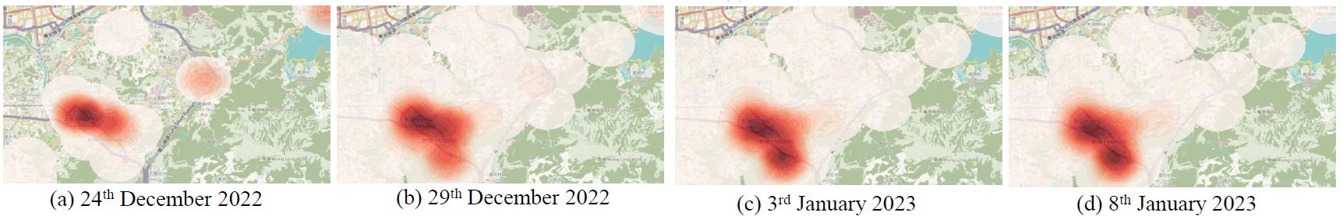
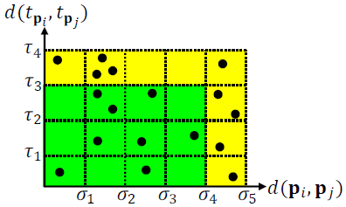
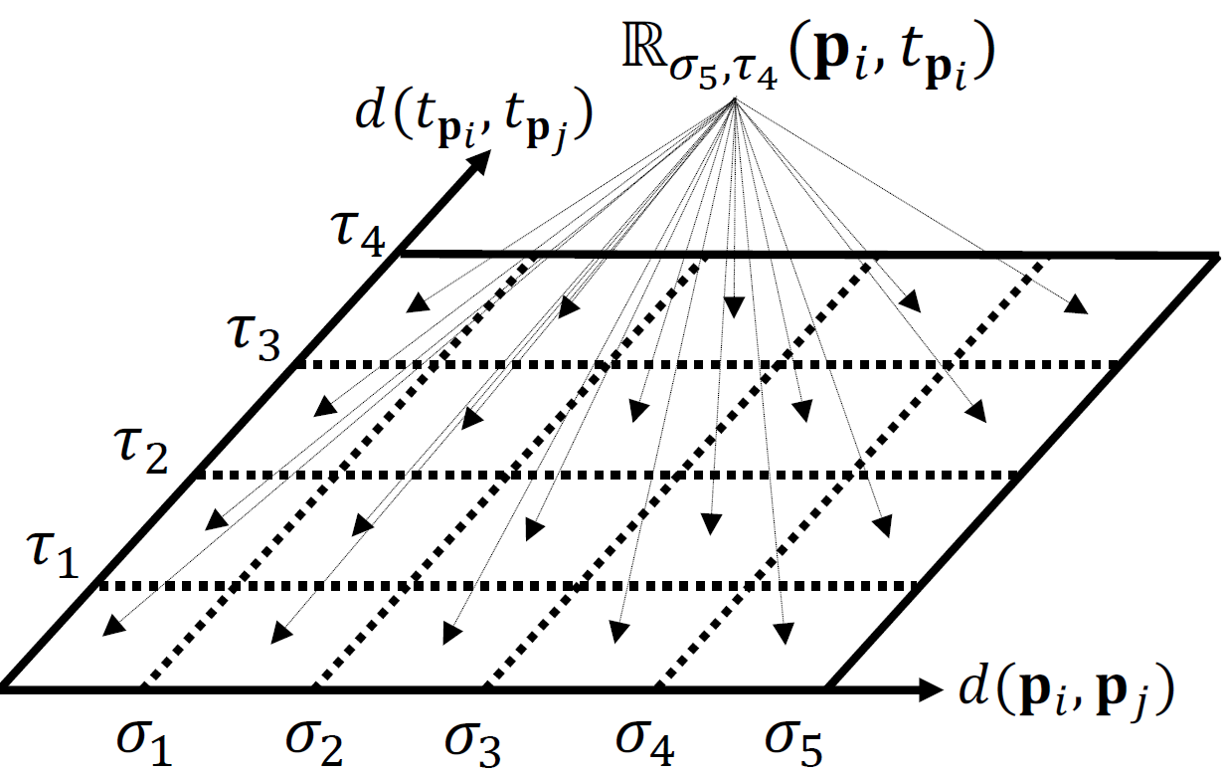
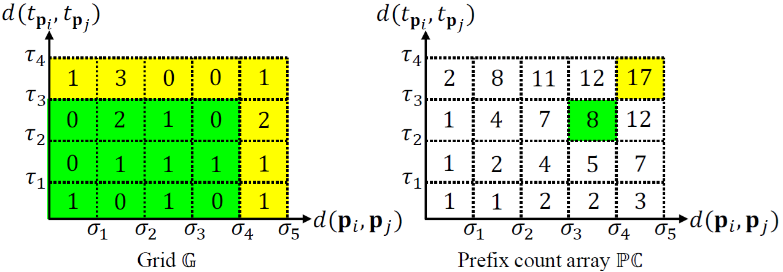
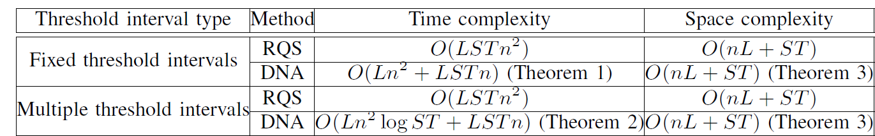
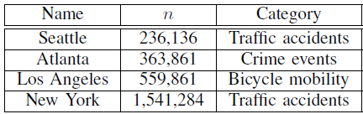
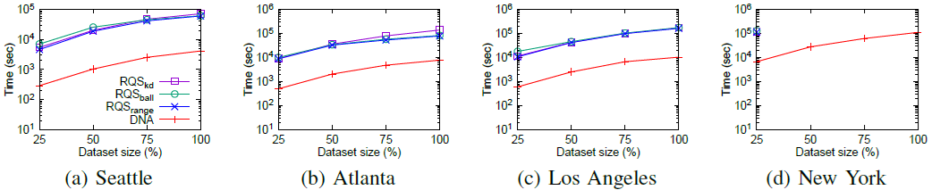
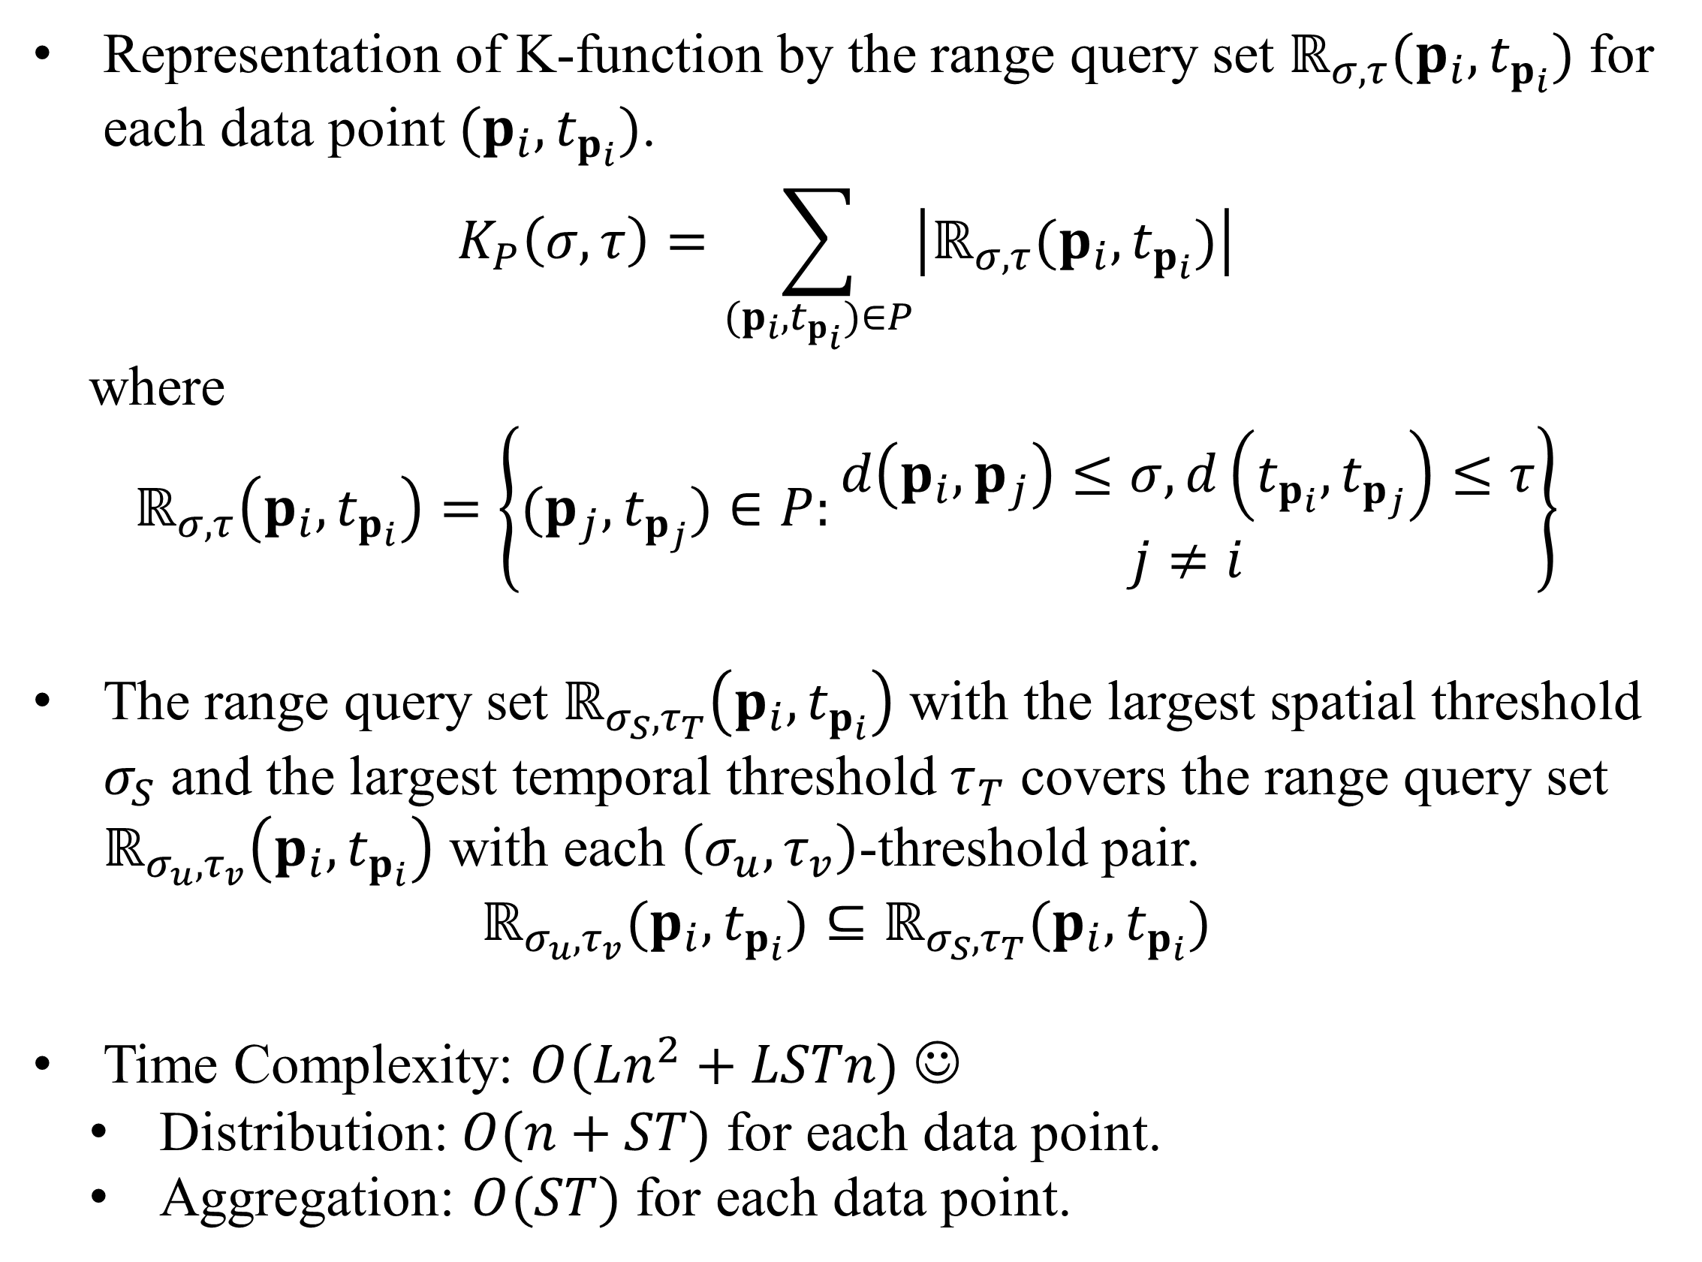
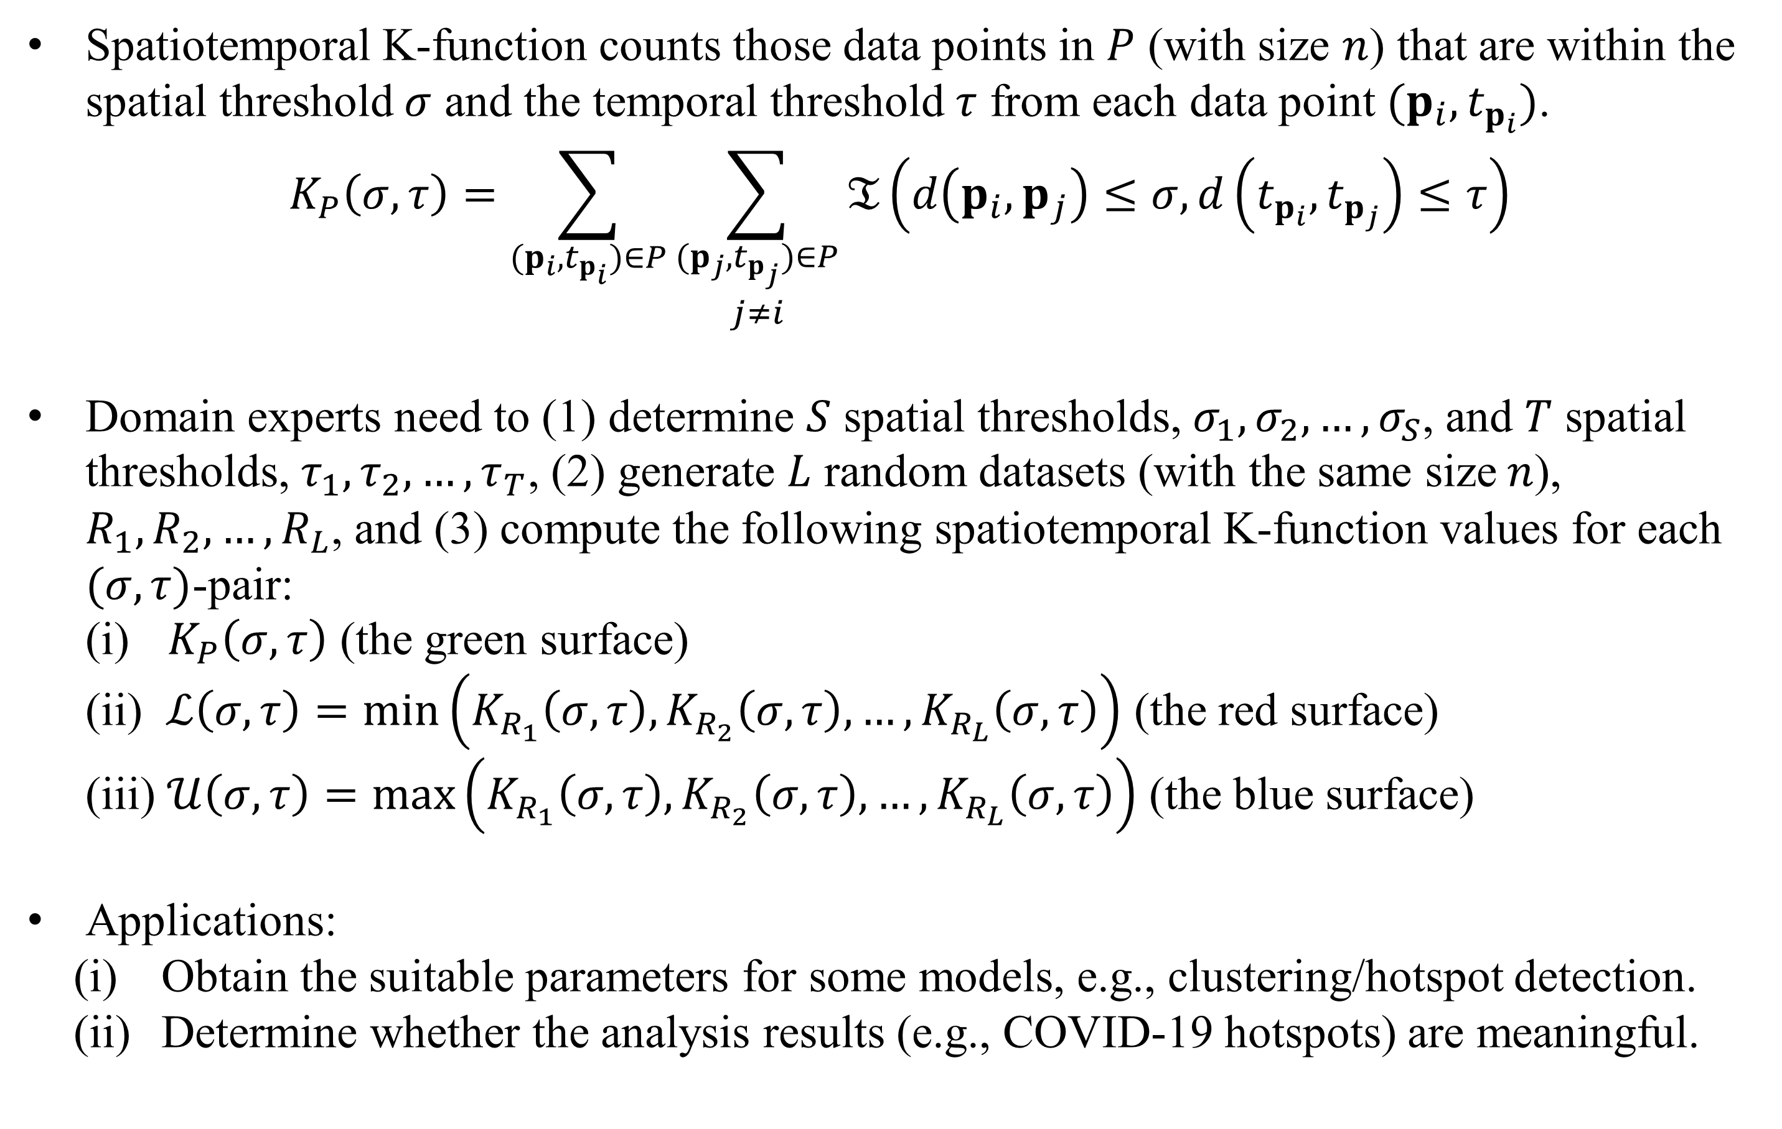
DNA: A Distribution-and-Aggregation Solution for Spatiotemporal K-function-based Analysis
Tsz Nam Chan
Shenzhen University
edisonchan@szu.edu.cn
Bojian Zhu
Hong Kong Baptist University
csbjzhu@comp.hkbu.edu.hk
Dingming Wu
Shenzhen University
dingming@szu.edu.cn
Renchi Yang
Hong Kong Baptist University
renchi@hkbu.edu.hk
Ruisheng Wang
Shenzhen University
ruiswang@szu.edu.cn
What is Spatiotemporal K-function-based Analysis?
Spatiotemporal K-function counts those data points in $P$ (with size $n$) that are within the spatial threshold $σ$ and the temporal threshold $τ$ from each data point $(p_{i}, t_{p_{i}})$.
$$K_{P}\left(σ,τ\right)=\sum_{(p_{i}, t_{p_{i}})∈P}{\sum_{\begin{matrix}(p_{j}, t_{p_{j}})∈P \\ j≠i\end{matrix}}{𝔗\left(d\left(p_{i},p_{j}\right)≤σ, d\left(t_{p_{i}},t_{p_{j}}\right)≤τ\right)}}$$
Domain experts need to (1) determine $S$ spatial thresholds, $σ_{1},σ_{2},…,σ_{S}$, and $T$ spatial thresholds, $τ_{1},τ_{2},…,τ_{T}$, (2) generate $L$ random datasets (with the same size $n$), $R_{1},R_{2},…,R_{L}$, and (3) compute the following spatiotemporal K-function values for each $(σ,τ)$-pair:
(i) $K_{P}\left(σ,τ\right)$ (the green surface)
(ii) $ℒ\left(σ,τ\right)=\min\left(K_{R_{1}}\left(σ,τ\right),K_{R_{2}}\left(σ,τ\right),…,K_{R_{L}}\left(σ,τ\right)\right)$ (the red surface)
(iii) $𝒰\left(σ,τ\right)=\max\left(K_{R_{1}}\left(σ,τ\right),K_{R_{2}}\left(σ,τ\right),…,K_{R_{L}}\left(σ,τ\right)\right)$ (the blue surface)
Applications:
Obtain the suitable parameters for some models, e.g., clustering/hotspot detection.
Determine whether the analysis results (e.g., COVID-19 hotspots) are meaningful.
Dispersed
Clustered
Spatiotemporal K-function plot (Hong Kong COVID-19 cases)
Spatiotemporal Kernel Density Visualization (Hong Kong COVID-19 cases)
A Distribution and Aggregation Solution (DNA)
Representation of K-function by the range query set $ℝ_{σ,τ}(p_{i},t_{p_{i}})$ for each data point $(p_{i},t_{p_{i}})$.
$$K_{P}\left(σ,τ\right)=\sum_{(p_{i},t_{p_{i}})∈P}{\left|ℝ_{σ,τ}(p_{i},t_{p_{i}})\right|}$$
where
$$ℝ_{σ,τ}\left(p_{i},t_{p_{i}}\right)=\left\{(p_{j},t_{p_{j}})∈P:\begin{matrix}d\left(p_{i},p_{j}\right)≤σ,d\left(t_{p_{i}},t_{p_{j}}\right)≤τ \\ j≠i\end{matrix}\right\}$$
The range query set $ℝ_{σ_{S},τ_{T}}\left(p_{i},t_{p_{i}}\right)$ with the largest spatial threshold $σ_{S}$ and the largest temporal threshold $τ_{T}$ covers the range query set $ℝ_{σ_{u},τ_{v}}\left(p_{i},t_{p_{i}}\right)$ with each $\left(σ_{u},τ_{v}\right)$-threshold pair.
$$ℝ_{σ_{u}, τ_{v}}(p_{i},t_{p_{i}})⊆ℝ_{σ_{S}, τ_{T}}(p_{i},t_{p_{i}})$$
Time Complexity: $O(Ln^{2}+LSTn)$ ☺
Distribution: $O(n+ST)$ for each data point.
Aggregation: $O(ST)$ for each data point.
Core idea
Distribution
Aggregation
Theoretical and Experimental Results

