Slide 1



PLAN: Fast and Approximate Gaussian Kernel Density Visualization in Road Networks
(Edison) Tsz Nam Chan¹, Hongwei Ye¹, Bojian Zhu², Leong Hou U³,
Dingming Wu¹, Ruisheng Wang¹, Joshua Zhexue Huang¹
¹Shenzhen University ²Hong Kong Baptist University ³University of Macau

Slide 2
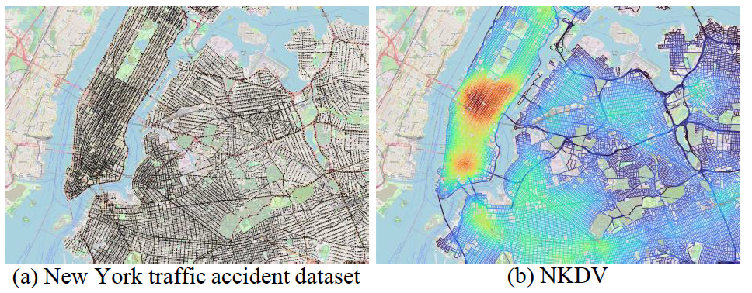
Why Network Kernel Density Visualization (NKDV) ?
Some representative applications:
Traffic/Traffic accident hotspot detection
Crime hotspot detection
Urban planning

Slide 3
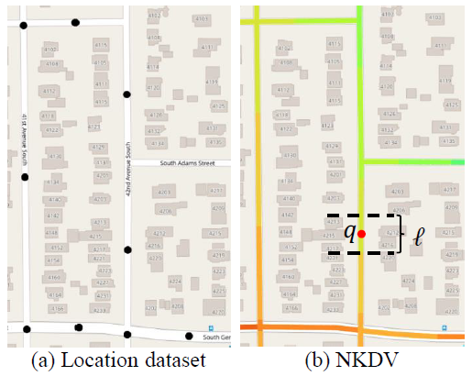

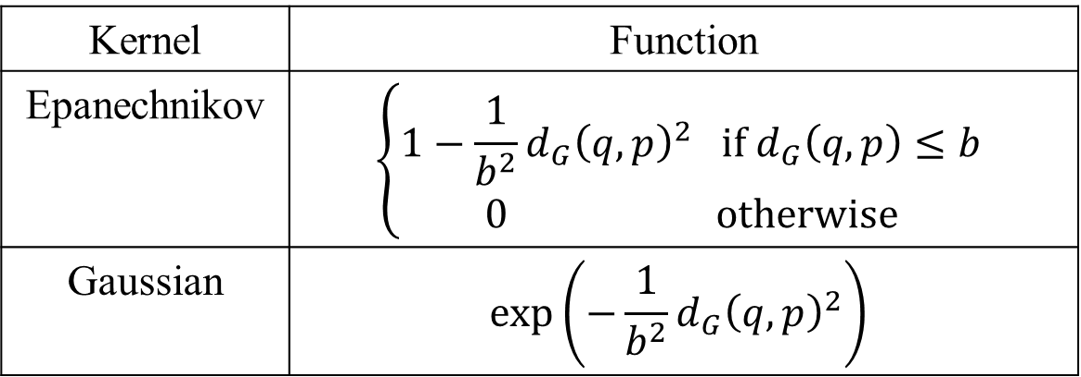
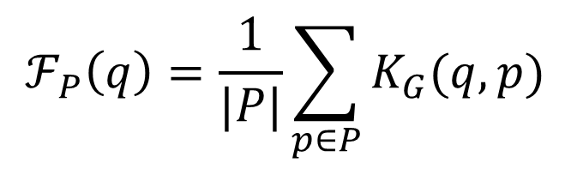
What is NKDV?
Given a location dataset $P=\{p_{1},p_{2},…,p_{n}\}$ and a road network $G=(V,E)$, we need to color each lixel $q$ based on the network kernel density function $ℱ_{P}(q)$.
$$ℱ_{P}\left(q\right)=\frac{1}{|P|}\sum_{p∈P}{K_{G}(q,p)}$$
Kernel | Function
Epanechnikov | $$\left\{\begin{matrix}1−\frac{1}{b^{2}}{d_{G}\left(q,p\right)}^{2} if d_{G}\left(q,p\right)≤b \\ 0 otherwise\end{matrix}\right.$$
Gaussian | $$exp⁡\left(−\frac{1}{b^{2}}{d_{G}\left(q,p\right)}^{2}\right)$$

Slide 4
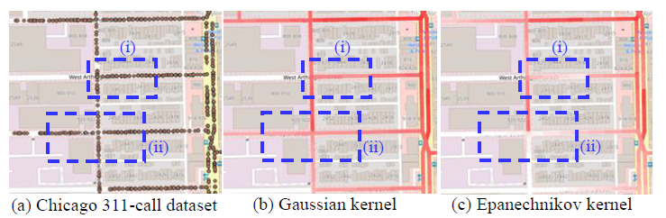
NKDV: Epanechnikov v.s. Gaussian
Gaussian kernel can provide smoother visualization. ☺
Gaussian kernel is the default one in many software packages. ☺

Slide 5
Weakness of Gaussian-based NKDV
Gaussian-based KDV is computationally expensive. ☹
Example (Chicago 311-call dataset):
Number of data points: 10.893 million
Number of lixels (with 10m): 0.67 million
Number of operations: > 7.298 trillion
Not feasible to generate multiple NKDVs. ☹

Slide 6
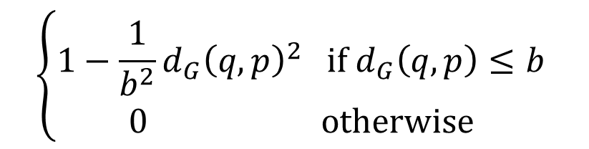
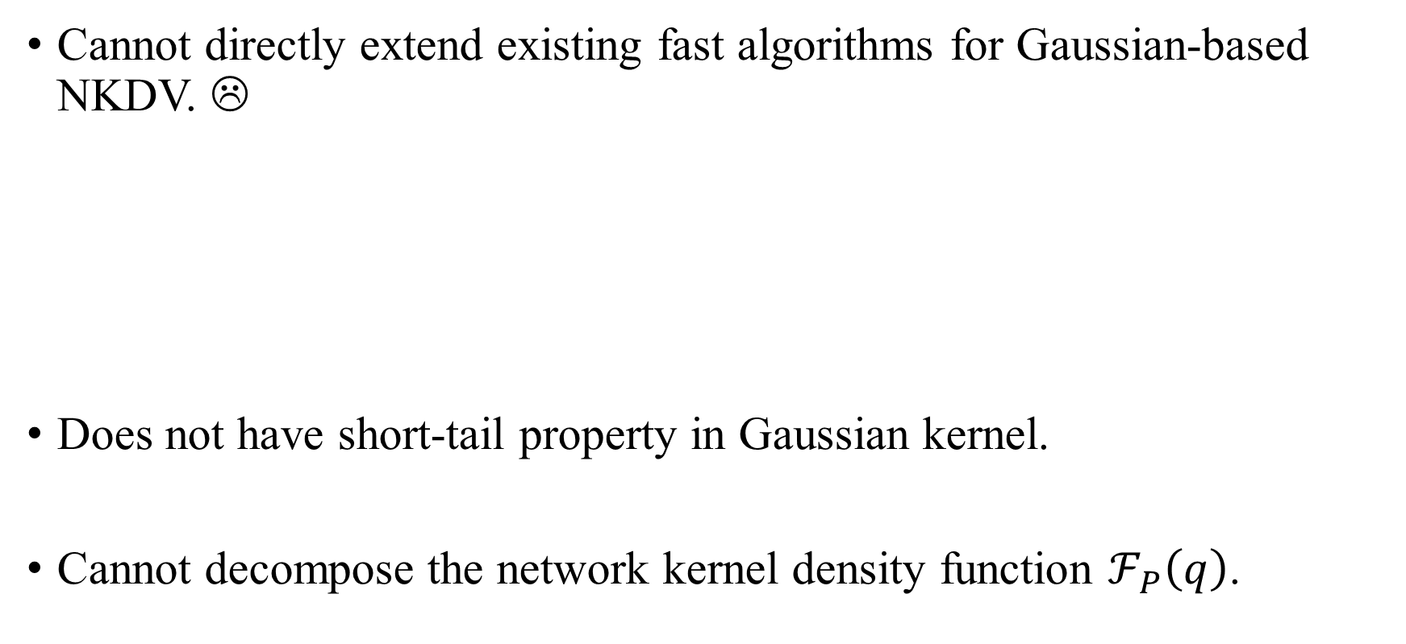
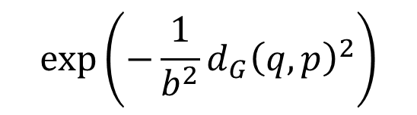
Weakness of Gaussian-based NKDV
Cannot directly extend existing fast algorithms for Gaussian-based NKDV. ☹
Does not have short-tail property in Gaussian kernel.
Cannot decompose the network kernel density function $ℱ_{P}\left(q\right)$.
$$\left\{\begin{matrix}1−\frac{1}{b^{2}}{d_{G}\left(q,p\right)}^{2} if d_{G}\left(q,p\right)≤b \\ 0 otherwise\end{matrix}\right.$$
$$exp⁡\left(−\frac{1}{b^{2}}{d_{G}\left(q,p\right)}^{2}\right)$$
v.s.

Slide 7
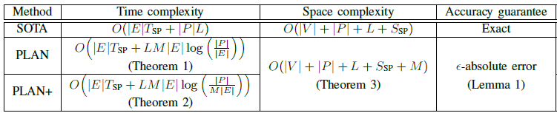
Our Contributions
Reduce the time complexity for generating NKDV with (1) a non-trivial approximation guarantee and (2) a slight overhead in terms of space complexity. ☺
Achieve 32.47x to 2936.88x speedups compared with SOTA.

Slide 8
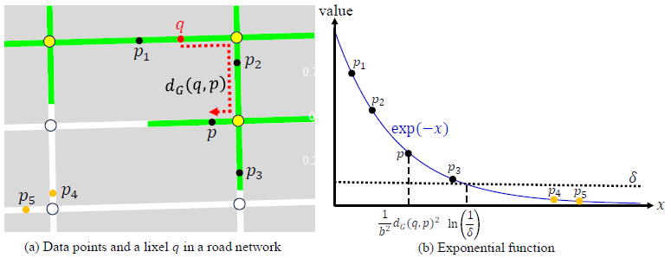
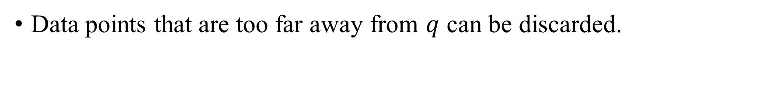
Core Idea 1: Enable the Short Tail Property
Data points that are too far away from $q$ can be discarded.

Slide 9
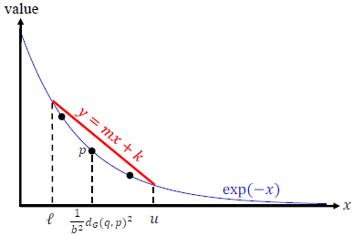

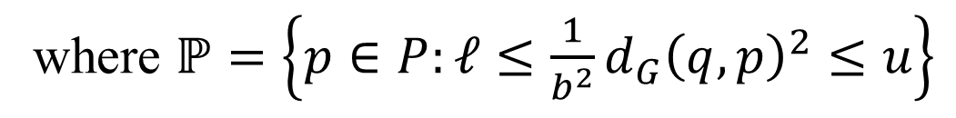

Core Idea 2: Function Approximation
This upper bound function can approximate $ℱ_{ℙ}\left(q\right)$.
$$ℱ_{ℙ}\left(q\right)=\frac{1}{|ℙ|}\sum_{p∈ℙ}{\exp\left(−\frac{1}{b^{2}}{d_{G}(q,p)}^{2}\right)} \\ ≤\frac{1}{|ℙ|}\sum_{p∈ℙ}{\left(\frac{m}{b^{2}}{d_{G}(q,p)}^{2}+k\right)}$$
where $ℙ=\left\{p∈P:ℓ≤\frac{1}{b^{2}}{d_{G}\left(q,p\right)}^{2}≤u\right\}$

Slide 10
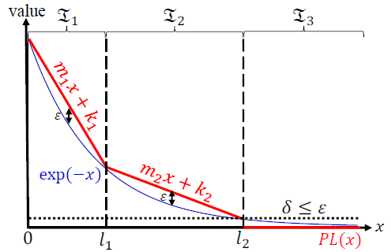
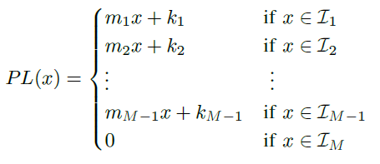

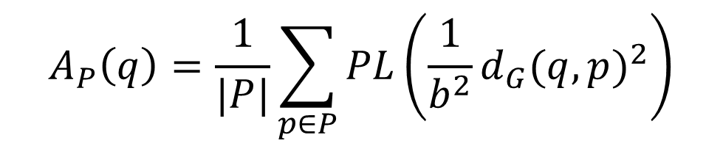
PLAN: Approximate the Network Kernel Density Function
Use $A_{P}(q)$ to approximate $ℱ_{P}\left(q\right)$.
Can achieve $ε$-absolute error guarantee. ☺
$$A_{P}\left(q\right)=\frac{1}{|P|}\sum_{p∈P}{PL\left(\frac{1}{b^{2}}{d_{G}(q,p)}^{2}\right)}$$
where

Slide 11
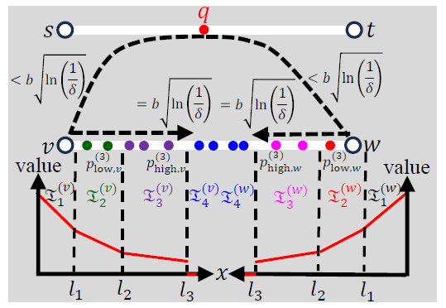
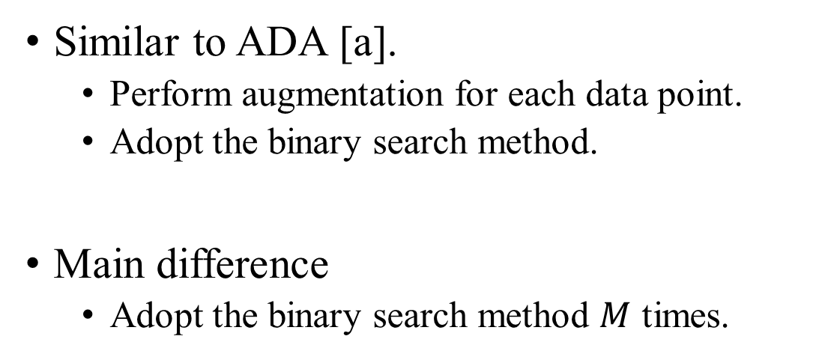
PLAN: Efficient Computation
Similar to ADA [a].
Perform augmentation for each data point.
Adopt the binary search method.
Main difference
Adopt the binary search method $M$ times.
Refer to our paper for details.
[a] T. N. Chan, Z. Li, L. H. U, J. Xu, and R. Cheng, “Fast augmentation algorithms for network kernel density visualization,” Proc. VLDB Endow., vol. 14, no. 9, pp. 1503–1516, 2021.

Slide 12
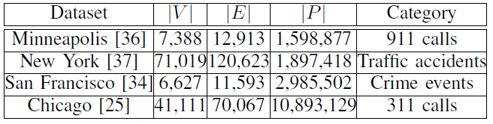
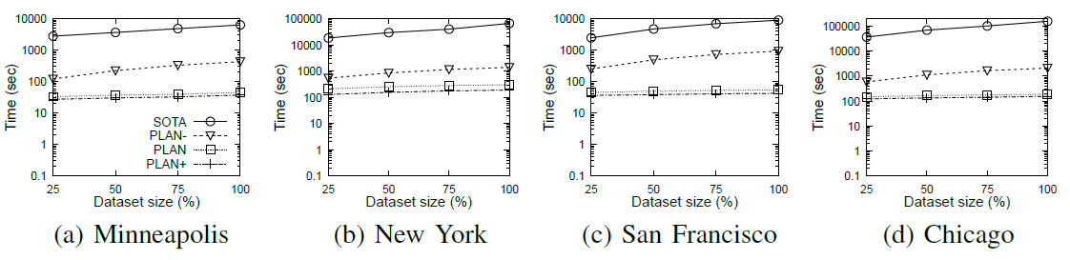
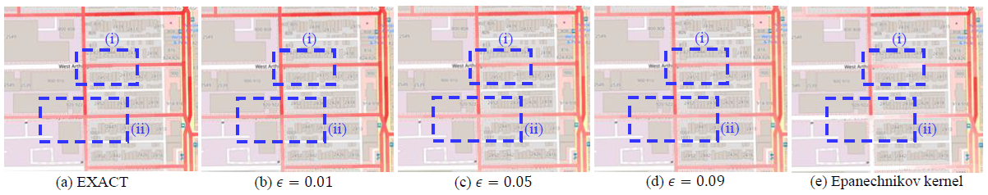
Experimental Evaluation

Slide 13
Future Opportunities
Incorporate PLAN into the QGIS plugin, called Fast Density Analysis.
Support NKDV with adaptive bandwidth.
Adopt parallel/distributed/hardware-based approaches to improve the efficiency of NKDV.
Support other inefficient road network analysis tasks, e.g., network Moran’s I, network K-function, and network DBSCAN.

Slide 14

Our New Book
https://link.springer.com/book/10.1007/978-981-95-4850-7

