Slide 1


QUAD: Quadratic-Bound-Based Kernel Density Visualization
(Edison) Tsz Nam Chan¹, Reynold Cheng¹, Man Lung Yiu²
¹University of Hong Kong ²Hong Kong Polytechnic University
[1] T. N. Chan, R. Cheng and M. L. Yiu “QUAD: Quadratic-Bound-Based Kernel Density Visualization” Under submission to SIGMOD2020

Slide 2
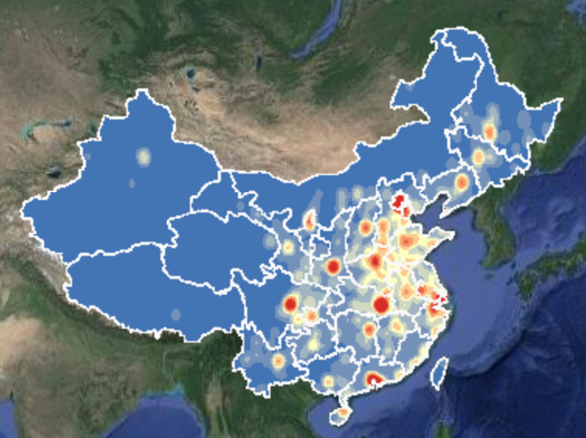
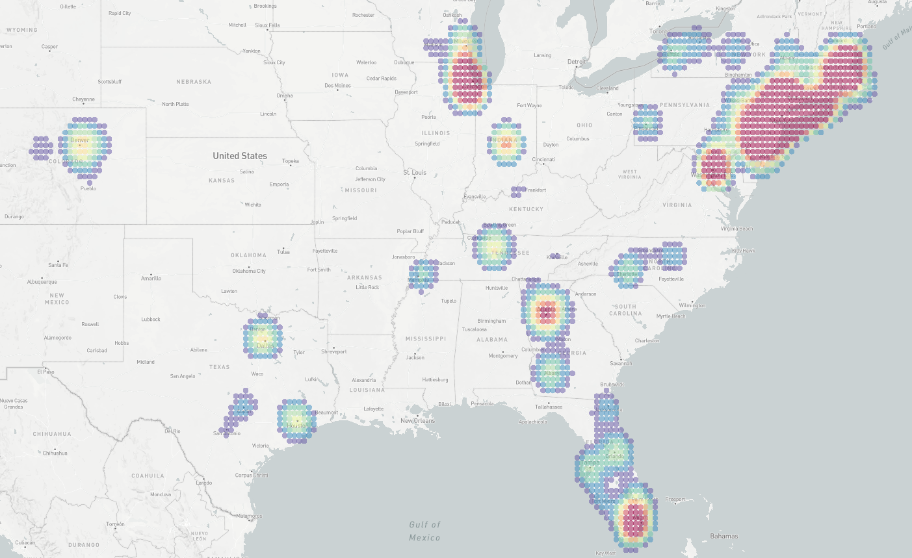
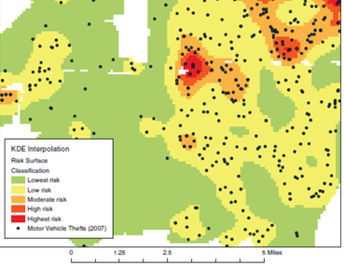
Why Kernel Density Visualization (KDV)?
(a) Visualization of COVID-19 cases
(b) Visualization of crime events
[1] http://drr.ikcest.org/knowledge_service/ncp.html
[2] T. N. Chan, P. L. Ip, L. H. U, W. H. Tong, S. Mittal, Y. Li and R. Cheng. “IKDV-SYS: A System for Near Real-Time Interactive Kernel Density Visualization” Under submission to VLDB, 2020.
Project link of [2]: https://edisonchan2013928.github.io/My-homepage/system/IKDV-SYS.html
Video link of [2]: https://www.youtube.com/watch?v=2xN9fbl61Sw
[3] T. Hart and P. Zandbergen “Kernel density estimation and hotspot mapping Examining the influence of interpolation method, grid cell size, and bandwidth on crime forecasting”, International Journal of Police Strategies and Management 2014

Slide 3
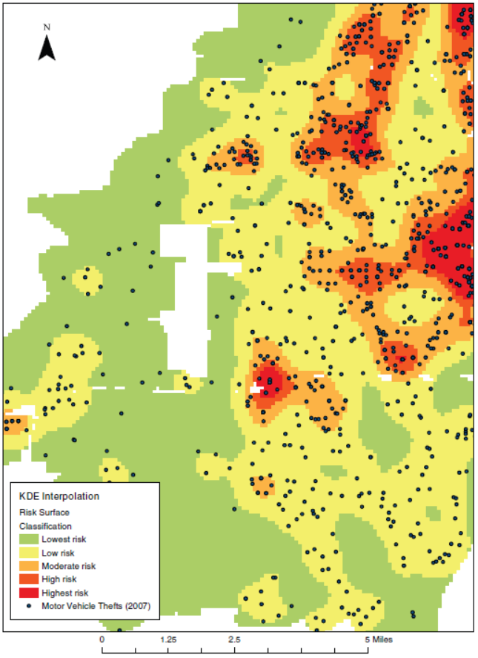
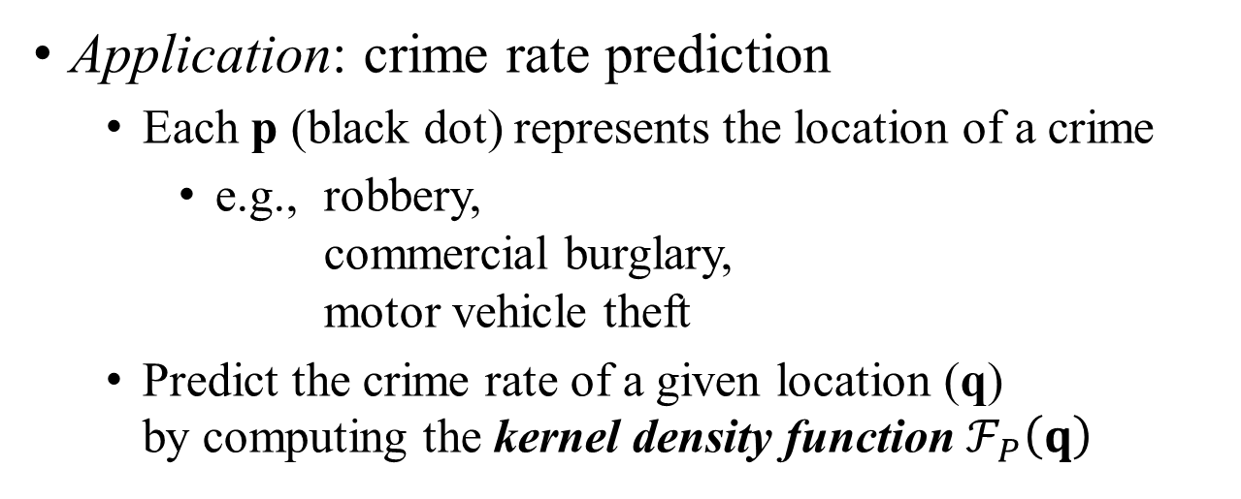
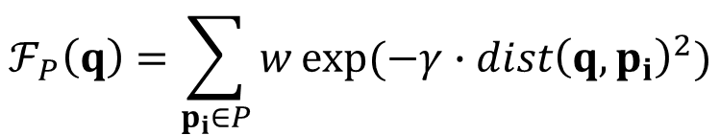
What is KDV?
Application: crime rate prediction
Each p (black dot) represents the location of a crime
e.g., robbery, commercial burglary, motor vehicle theft
Predict the crime rate of a given location (q) by computing the kernel density function $ℱ_{P}\left(q\right)$
2D pixel
weighting
Euclidean distance
$$ℱ_{P}\left(q\right)=\sum_{p_{i}∈P}{w}exp⁡(−γ∙{dist\left(q,p_{i}\right)}^{2})$$
dataset
constant
[1] T. Hart and P. Zandbergen “Kernel density estimation and hotspot mapping Examining the influence of interpolation method, grid cell size, and bandwidth on crime forecasting”, International Journal of Police Strategies and Management 2014

Slide 4
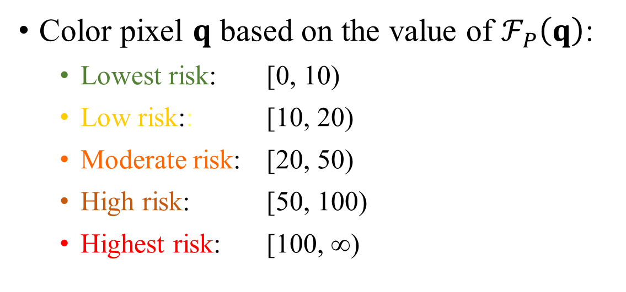
What is KDV?
Color pixel $q$ based on the value of $ℱ_{P}\left(q\right)$:
Lowest risk: [0, 10)
Low risk:: [10, 20)
Moderate risk: [20, 50)
High risk: [50, 100)
Highest risk: [100, ∞)
T. Hart and P. Zandbergen “Kernel density estimation and hotspot mapping Examining the influence of interpolation method, grid cell size, and bandwidth on crime forecasting”, International Journal of Police Strategies and Management 2014

Slide 5
Evaluating Exact KDV is expensive!
Perrot et al. [1]: “…computing the exact density function of 1 million points on a 2 mega pixels screen (1920x1080) requires 2 trillion operations.”
[1] A. Perrot, R. Bourqui, N. Hanusse, F. Lalanne, and D. Auber. Large interactive visualization of density functions on big data infrastructure. In LDAV, pages 99–106, 2015.

Slide 6
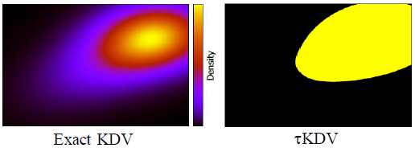
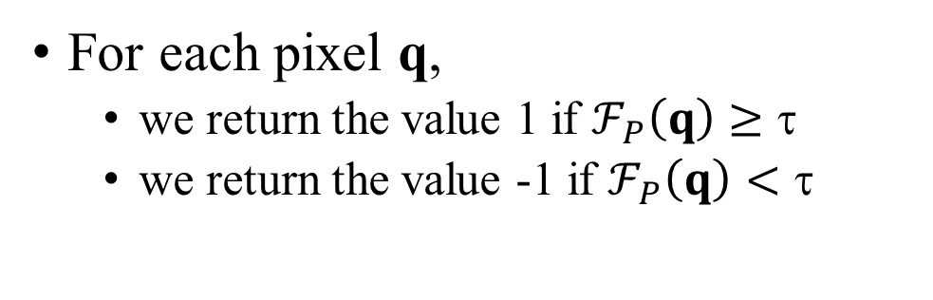
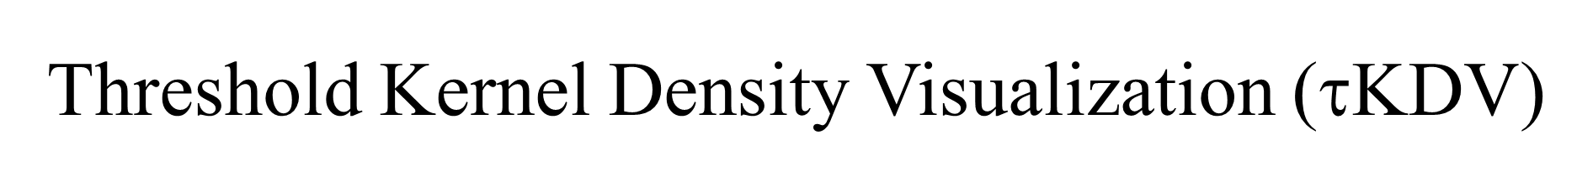
Threshold Kernel Density Visualization ($\text{}$KDV)
For each pixel q,
we return the value 1 if $ℱ_{P}\left(q\right)≥\text{τ}$
we return the value -1 if $ℱ_{P}\left(q\right)<\text{τ}$

Slide 7
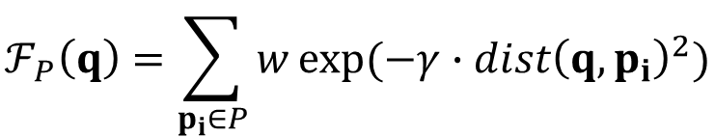




How to speed up?
$$ℱ_{P}\left(q\right)=\sum_{p_{i}∈P}{w}exp⁡(−γ∙{dist\left(q,p_{i}\right)}^{2})$$
Cases to avoid computing exact $ℱ_{P}\left(q\right)$:
Case 1 ($ℱ_{P}\left(q\right)≥\text{τ}$):
Case 2 ($ℱ_{P}\left(q\right)<\text{τ}$):
UB(q)
τ
$$LB\left(q\right)≤ℱ_{P}\left(q\right)≤UB(q)$$
UB(q)
LB(q)
τ
LB(q)
Requirements:
Fast to compute
As tight as possible
[1] E. Gan and P. Bailis. “Scalable kernel density classification via threshold based pruning” SIGMOD2017
[2] T. N. Chan, M. L. Yiu and L. H. U “KARL: Fast Kernel Aggregation Queries” ICDE2019

Slide 8
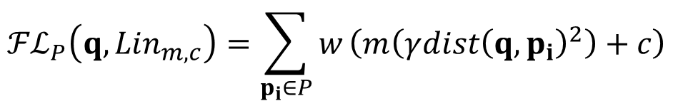

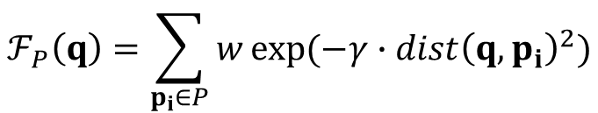
The State-of-the-art Bound functions (KARL)
$$ℱ_{P}\left(q\right)=\sum_{p_{i}∈P}{w}exp⁡(−γ{∙dist\left(q,p_{i}\right)}^{2})$$
x_{i}
Time complexity: O(|P|×d)-time
x₁
Tangent Bound:
x₂
x₃
$${ℱℒ}_{P}\left(q,{Lin}_{m,c}\right)=\sum_{p_{i}∈P}{w}\left(m\left(γ{dist\left(q,p_{i}\right)}^{2}\right)+c\right)$$
function
exp(–x)
x_{i}
optimized tangent line (at t):
E^{L}(x)=mx + c
Time complexity: O(d)-time
$\left|P\right|=3$ in this example
[1] T. N. Chan, M. L. Yiu and L. H. U “KARL: Fast Kernel Aggregation Queries” ICDE2019

Slide 9

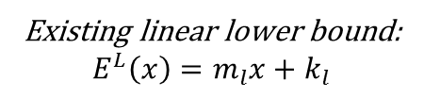
Weakness of KARL
function value
function: $exp⁡(−x)$
x₁
Gap
x₂
x₃
Existing linear lower bound:
$$E^{L}\left(x\right)=m_{l}x+k_{l}$$
The larger the value of x₃ – x₁, the larger the gap → Loose lower bound for $ℱ_{P}\left(q\right)$
How to reduce the gap?
☹

Slide 10

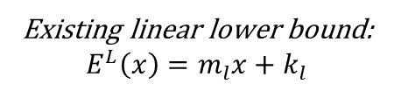
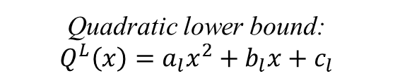
Our proposal: QUAD
function value
function: $exp⁡(−x)$
(t, exp(-t))
Quadratic lower bound: $$Q^{L}\left(x\right)=a_{l}x^{2}+b_{l}x+c_{l}$$
Existing linear lower bound:
$$E^{L}\left(x\right)=m_{l}x+k_{l}$$
What is the time complexity of QUAD?

Slide 11
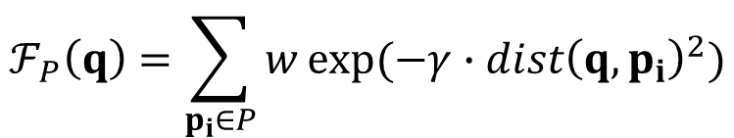
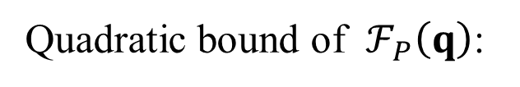
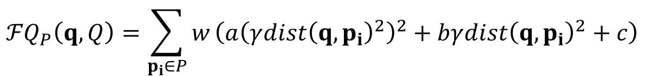
O(d²)-time Tighter Quadratic Bound
$$ℱ_{P}\left(q\right)=\sum_{p_{i}∈P}{w}exp⁡(−γ{∙dist\left(q,p_{i}\right)}^{2})$$
Tightness
Exact
x_{i}
Quadratic bound of $ℱ_{P}\left(q\right)$:
QUAD
$${ℱQ}_{P}\left(q,Q\right)=\sum_{p_{i}∈P}{w}\left(a{\left(γ{dist\left(q,p_{i}\right)}^{2}\right)}^{2}+bγ{dist\left(q,p_{i}\right)}^{2}+c\right)$$
KARL
x_{i}
x_{i}
Time complexity: O(d²)-time
Time
O(d)
O(d²)
O(|P|×d)
O(d²) is nothing for KDV-based applications:
Human can only visualize at most 3 dimensions, the dimensionality d of the dataset is at most 3.

Slide 12
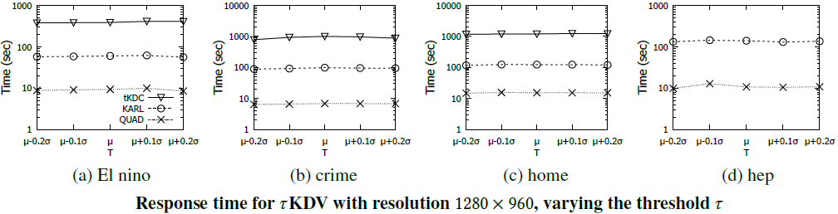

Experimental Results for τKDV
We only report the results with the running time <7200sec.
tKDC: E. Gan and P. Bailis. "Scalable kernel density classification via threshold based pruning" SIGMOD2017
KARL: T. N. Chan, M. L. Yiu and L. H. U “KARL: Fast Kernel Aggregation Queries” ICDE2019

Slide 13
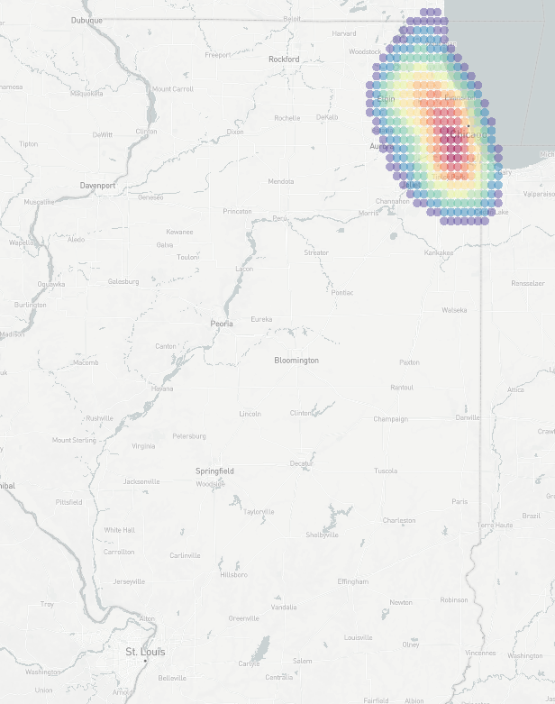
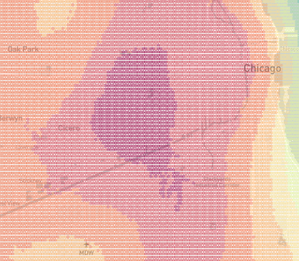
Our Near Real-Time System: IKDV-SYS (based on QUAD)
zoom in
zoom in
City level (Chicago)
Country level
Province level (Illinois)
[1] T. N. Chan, P. L. Ip, L. H. U, W. H. Tong, S. Mittal, Y. Li and R. Cheng. “IKDV-SYS: A System for Near Real-Time Interactive Kernel Density Visualization” Under submission to VLDB, 2020.
Project link of [1]: https://edisonchan2013928.github.io/My-homepage/system/IKDV-SYS.html
Video link of [1]: https://www.youtube.com/watch?v=2xN9fbl61Sw

Slide 14
Conclusion and Future Work
Conclusion:
Theoretically tighter bounds (QUAD) compared with KARL
Achieve at least one-order-of-magnitude speedup, compared with state-of-the-art solutions
Future Work:
Can we support some important and timely applications, using QUAD? (done, [1])
Can we support other types of feature-based kernel functions? (done, [2])
Can we extend our methods to training phase of kernel methods? (ongoing)
Can we support other types of kernel-based models (e.g., kernel clustering)? (ongoing)
Can we support the prediction phase of graph-based kernel methods? (not start yet)
[1] T. N. Chan, P. L. Ip, L. H. U, W. H. Tong, S. Mittal, Y. Li and R. Cheng. “IKDV-SYS: A System for Near Real-Time Interactive Kernel Density Visualization” Under submission to VLDB, 2020.
Project link of [1]: https://edisonchan2013928.github.io/My-homepage/system/IKDV-SYS.html
Video link of [1]: https://www.youtube.com/watch?v=2xN9fbl61Sw
[2] T. N. Chan, L. H. U, R. Cheng, M. L. Yiu, S. Mittal. “Efficient Algorithms for Kernel Aggregation Queries” TKDE, Minor Revision

