Slide 1


QUAD: Quadratic-Bound-Based Kernel Density Visualization
(Edison) Tsz Nam Chan¹, Reynold Cheng¹, Man Lung Yiu²
¹University of Hong Kong ²Hong Kong Polytechnic University
[1] T. N. Chan, R. Cheng and M. L. Yiu “QUAD: Quadratic-Bound-Based Kernel Density Visualization” Under submission to SIGMOD2020

Slide 2
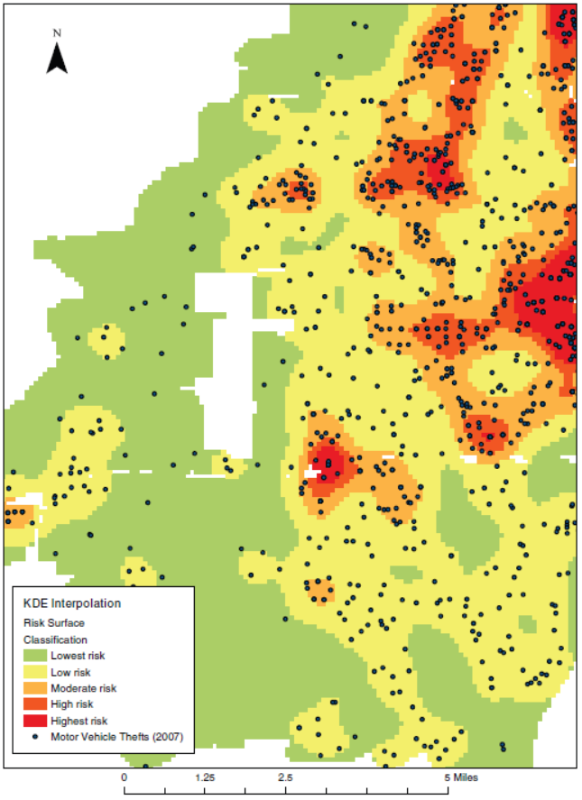
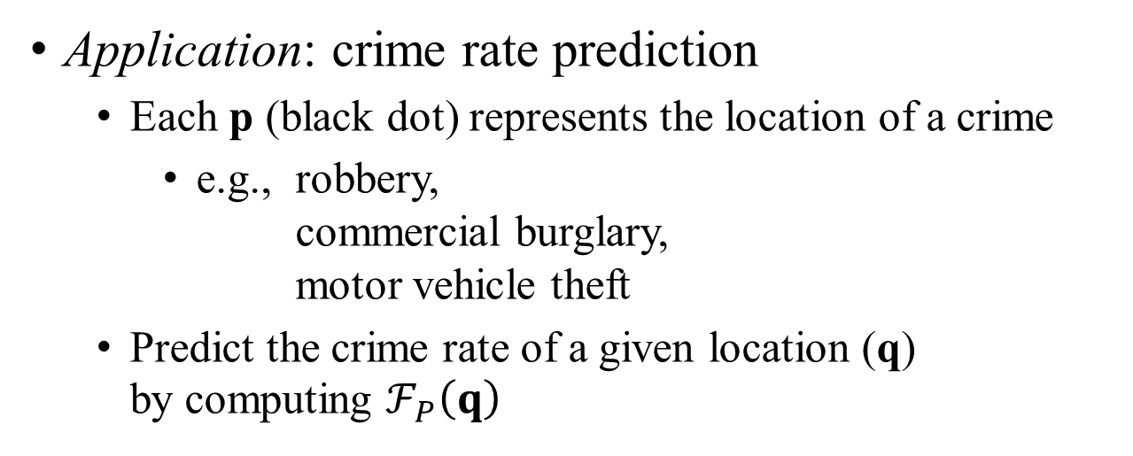
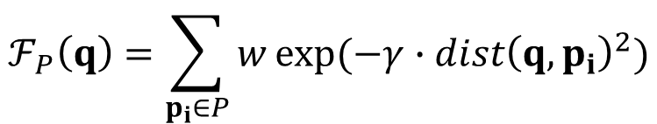
What is Kernel Density Visualization?
2D pixel
weighting
Euclidean distance
Compute the function:
$$ℱ_{P}\left(q\right)=\sum_{p_{i}∈P}{w}exp⁡(−γ∙{dist\left(q,p_{i}\right)}^{2})$$
dataset
constant
Application: crime rate prediction
Each p (black dot) represents the location of a crime
e.g., robbery, commercial burglary, motor vehicle theft
Predict the crime rate of a given location (q) by computing $ℱ_{P}\left(q\right)$
[1] T. Hart and P. Zandbergen “Kernel density estimation and hotspot mapping Examining the influence of interpolation method, grid cell size, and bandwidth on crime forecasting”, International Journal of Police Strategies and Management 2014

Slide 3
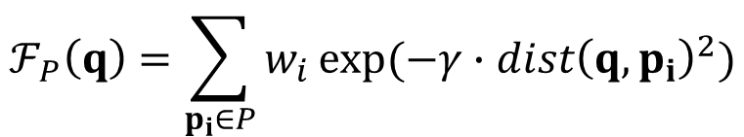
Evaluating KDV is expensive!
Perrot et al. [1]: “…computing the exact density function of 1 million points on a 2 mega pixels screen (1920x1080) requires 2 trillion operations.”
$$ℱ_{P}\left(q\right)=\sum_{p_{i}∈P}{w_{i}}exp⁡(−γ{∙dist\left(q,p_{i}\right)}^{2})$$
O(|P| × d) time
[1] A. Perrot, R. Bourqui, N. Hanusse, F. Lalanne, and D. Auber. Large interactive visualization of density functions on big data infrastructure. In LDAV, pages 99–106, 2015.

Slide 4
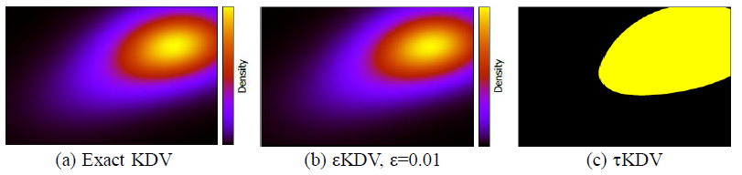
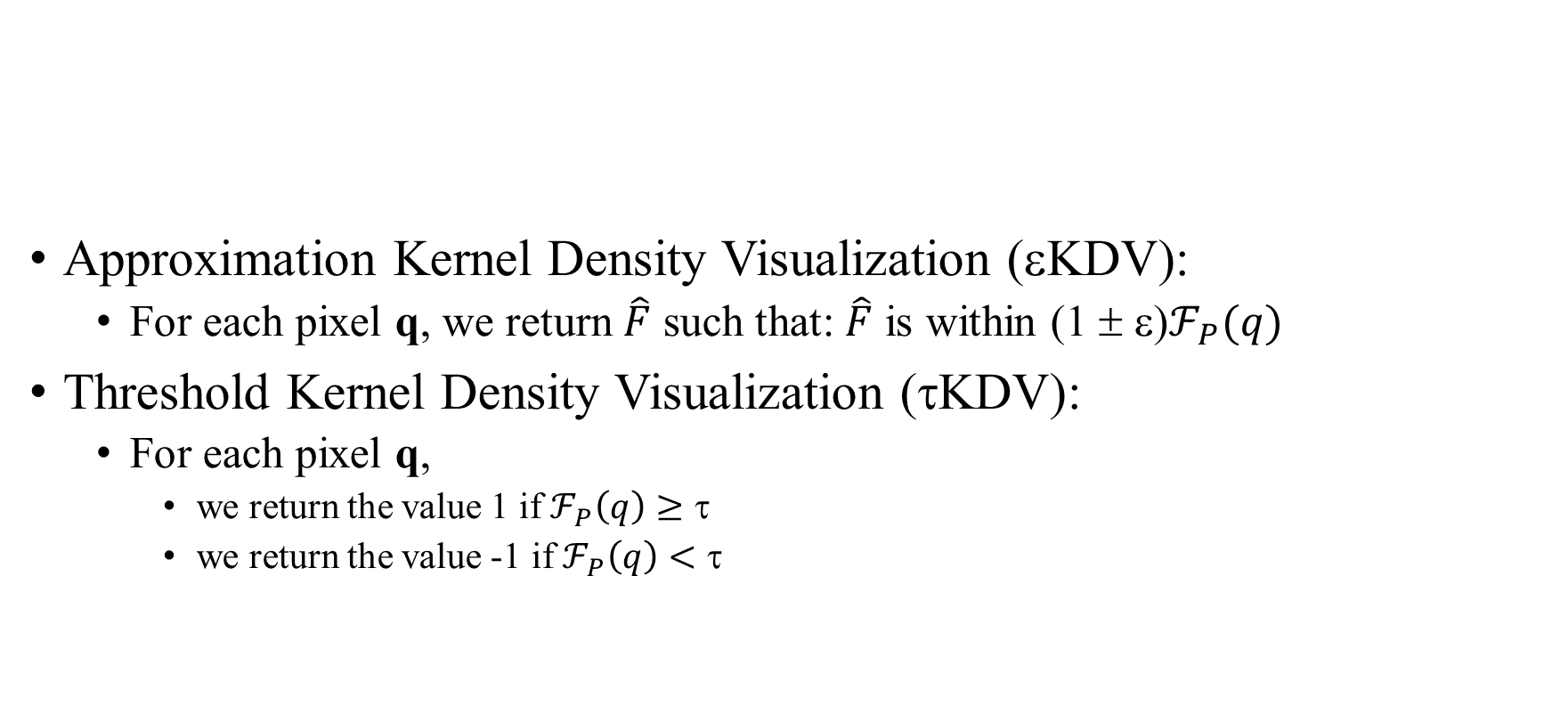
Two types of queries
Approximation Kernel Density Visualization (εKDV):
For each pixel q, we return $\hat{F}$ such that: $\hat{F}$ is within (1 ± ε)$ℱ_{P}(q)$
Threshold Kernel Density Visualization (τKDV):
For each pixel q,
we return the value 1 if $ℱ_{P}\left(q\right)≥\text{τ}$
we return the value -1 if $ℱ_{P}\left(q\right)<\text{τ}$

Slide 5
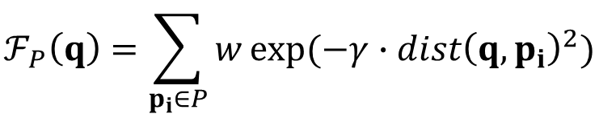




How to speed up?
$$ℱ_{P}\left(q\right)=\sum_{p_{i}∈P}{w}exp⁡(−γ∙{dist\left(q,p_{i}\right)}^{2})$$
Cases to avoid computing exact $ℱ_{P}\left(q\right)$:
Case 1 ($ℱ_{P}\left(q\right)≥\text{τ}$):
Case 2 ($ℱ_{P}\left(q\right)<\text{τ}$):
UB(q)
τ
$$LB\left(q\right)≤ℱ_{P}\left(q\right)≤UB(q)$$
UB(q)
LB(q)
τ
LB(q)
Requirements:
Fast to compute
As tight as possible
[1] E. Gan and P. Bailis. “Scalable kernel density classification via threshold based pruning” SIGMOD2017
[2] T. N. Chan, M. L. Yiu and L. H. U “KARL: Fast Kernel Aggregation Queries” ICDE2019

Slide 6
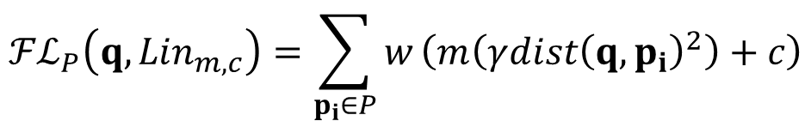
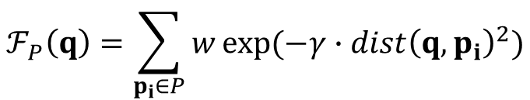
The State-of-the-art Bound functions (KARL)
$$ℱ_{P}\left(q\right)=\sum_{p_{i}∈P}{w}exp⁡(−γ{∙dist\left(q,p_{i}\right)}^{2})$$
x_{i}
x_{min}
Tangent Bound:
x₁
$${ℱℒ}_{P}\left(q,{Lin}_{m,c}\right)=\sum_{p_{i}∈P}{w}\left(m\left(γ{dist\left(q,p_{i}\right)}^{2}\right)+c\right)$$
x₂
x_{i}
x₃
x_{max}
function
exp(–x)
optimized tangent line (at t):
E^{L}(x)=mx + c
[1] T. N. Chan, M. L. Yiu and L. H. U “KARL: Fast Kernel Aggregation Queries” ICDE2019

Slide 7
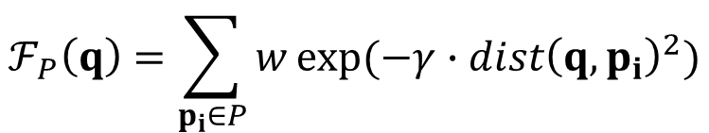
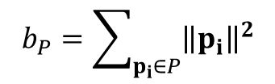
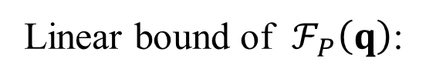
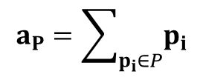
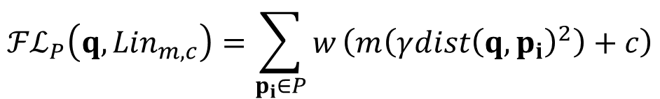
O(d)-time Linear Bound
$$ℱ_{P}\left(q\right)=\sum_{p_{i}∈P}{w}exp⁡(−γ{∙dist\left(q,p_{i}\right)}^{2})$$
x_{i}
Linear bound of $ℱ_{P}\left(q\right)$:
$${ℱℒ}_{P}\left(q,{Lin}_{m,c}\right)=\sum_{p_{i}∈P}{w}\left(m\left(γ{dist\left(q,p_{i}\right)}^{2}\right)+c\right)$$
x_{i}
$${ℱℒ}_{P}\left(q,{Lin}_{m,c}\right)=wmγ\left(\left|P\right|{\left\|q\right\|}^{2}−2q∙a_{P}+b_{P}\right)+wc|P|$$
O(d)
O(d)
where
$$a_{P}=\sum_{p_{i}∈P}{p_{i}}$$
and
$$b_{P}=\sum_{p_{i}∈P}{{\left\|p_{i}\right\|}^{2}}$$

Slide 8

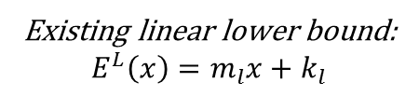
Weakness of KARL
function value
x_{min}
x_{max}
function: $exp⁡(−x)$
Gap
(t, exp(-t))
Existing linear lower bound:
$$E^{L}\left(x\right)=m_{l}x+k_{l}$$
The larger the value of x_{max} – x_{min}, the larger the gap → Loose lower bound
How to reduce the gap?

Slide 9

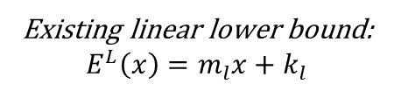
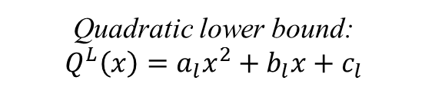
Our proposal: QUAD
function value
x_{min}
x_{max}
function: $exp⁡(−x)$
(t, exp(-t))
Quadratic lower bound: $$Q^{L}\left(x\right)=a_{l}x^{2}+b_{l}x+c_{l}$$
Existing linear lower bound:
$$E^{L}\left(x\right)=m_{l}x+k_{l}$$
What is the time complexity of QUAD?

Slide 10
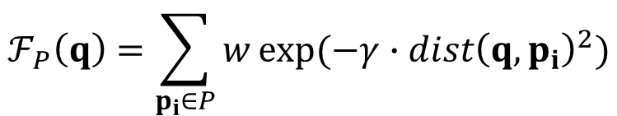
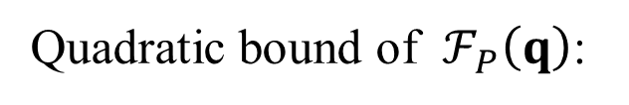
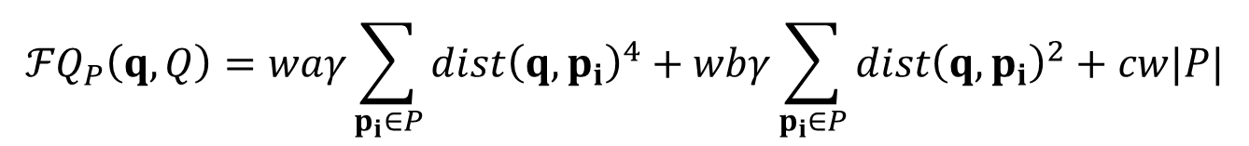
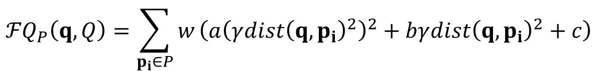
O(d²)-time Tighter Quadratic Bound
$$ℱ_{P}\left(q\right)=\sum_{p_{i}∈P}{w}exp⁡(−γ{∙dist\left(q,p_{i}\right)}^{2})$$
Tightness
Exact
x_{i}
Quadratic bound of $ℱ_{P}\left(q\right)$:
QUAD
$${ℱQ}_{P}\left(q,Q\right)=\sum_{p_{i}∈P}{w}\left(a{\left(γ{dist\left(q,p_{i}\right)}^{2}\right)}^{2}+bγ{dist\left(q,p_{i}\right)}^{2}+c\right)$$
KARL
x_{i}
x_{i}
$${ℱQ}_{P}\left(q,Q\right)=waγ\sum_{p_{i}∈P}{{dist\left(q,p_{i}\right)}^{4}}+wbγ\sum_{p_{i}∈P}{{dist\left(q,p_{i}\right)}^{2}+cw|P|}$$
Time
O(d)
O(d²)
O(|P|d)
O(d²)
O(d)
O(d²) is nothing for KDV-based applications:
Human can only visualize at most 3 dimensions, the dimensionality d of the dataset is at most 3.

Slide 11
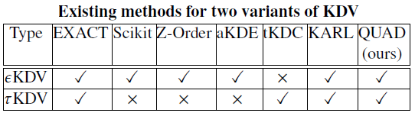
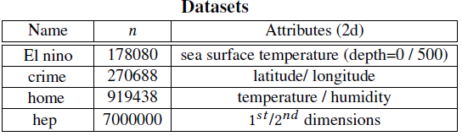
Experimental Setting
EXACT: Baseline
Scikit: F. Pedregosa et al. “Scikit-learn: Machine learning in python” Journal of Machine Learning Research 2011
Z-Order: Y. Zheng, J. Jestes, J. M. Phillips, and F. Li. “Quality and efficiency for kernel density estimates in large data” SIGMOD2013
aKDE: A. G. Gray and A. W. Moore. “Nonparametric density estimation: Toward computational tractability” SDM2003
tKDC: E. Gan and P. Bailis. "Scalable kernel density classification via threshold based pruning" SIGMOD2017
KARL: T. N. Chan, M. L. Yiu and L. H. U “KARL: Fast Kernel Aggregation Queries” ICDE2019

Slide 12
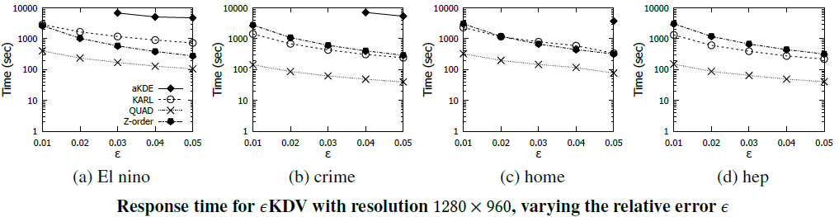
Experimental Results for εKDV
We only report the points with the running time <7200sec.

Slide 13
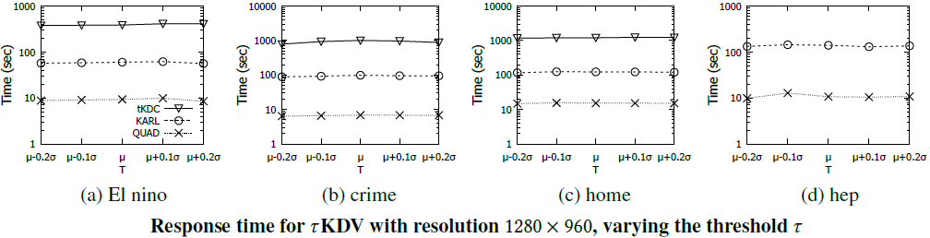

Experimental Results for τKDV
We only report the points with the running time <7200sec.

Slide 14
Future Work
Can we extend our methods to training phase of kernel methods?
Ongoing
Can we support other types of feature-based kernel functions?
Ongoing
Can we support other types of kernel-based models (e.g., kernel clustering)?
Ongoing
Can we support the prediction phase of graph-based kernel methods?
Not start yet

Slide 15
Advertisement of our research work
Kernel Methods for Machine Learning
T. N. Chan, M. L. Yiu and L. H. U “KARL: Fast Kernel Aggregation Queries” ICDE2019
T. N. Chan, R. Cheng and M. L. Yiu “QUAD: Quadratic-Bound-Based Kernel Density Visualization” Under submission to SIGMOD2020
T. N. Chan, L. H. U, R. Cheng, M. L. Yiu and M. Shivansh “Efficient Algorithms for Kernel Aggregation Queries” Under submission to TKDE
Similarity Measures
T. N. Chan, M. L. Yiu and L. H. U “The Power of Bounds: Answering Approximate Earth Mover's Distance with Parametric Bounds” TKDE (To appear)
T. N. Chan, M. L. Yiu and K. A. Hua “Efficient Sub-Windows Nearest Neighbor Search on Matrix” TKDE2017
T. N. Chan, M. L. Yiu and K. A. Hua “A Progressive Approach for Similarity Search on Matrix” SSTD2015
Please visit my homepage: https://edisonchan2013928.github.io/My-homepage/

